Slide 1
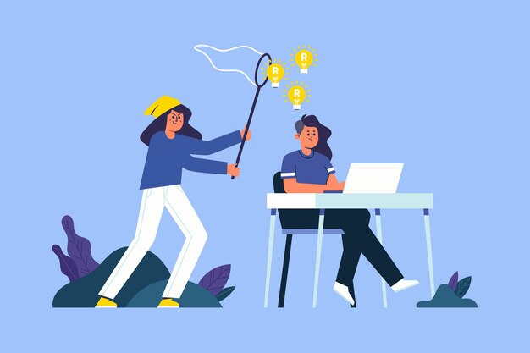
Course 3: Plagiarism and Copyright

Slide 2
Copyright
Definition:
Copyright is a set of legal rights that protect original works of the mind, such as books, films, music, artworks, and software. These rights aim to protect the interests of creators by allowing them to control the use of their works and benefit from their exploitation.

Slide 3
Copyright
Main Components of Copyright:
1. Right of Reproduction: The creator has the exclusive right to reproduce their work, whether in physical form (like a book) or digital form (like an audio file).
2. Right of Distribution: This right allows the creator to control the distribution of their work to the public, whether through sale, rental, or other means.
3. Right of Modification: The creator can decide whether their work can be adapted, modified, or transformed.

Slide 4
Copyright
4. Right of Public Performance: This includes the right to present or perform the work publicly, as in the case of shows or screenings.
5. Moral Rights: In addition to economic rights, copyright includes moral rights, such as the right of attribution (to recognize the author) and the right to integrity (to protect the work from derogatory modifications).

Slide 5
Plagiarism
Definition:
Plagiarism is the act of copying or using the ideas, words, or creations of another person without properly attributing the source. This constitutes a form of intellectual fraud and is considered unethical in academic, artistic, and professional settings.

Slide 6
Types of Plagiarism
1. Direct Plagiarism: Copying passages from a work verbatim without quotation marks or citation.
2. Paraphrased Plagiarism: Rephrasing another person's ideas without appropriate citation, even if the words have been changed.
3. Source Plagiarism: Failing to cite the source of an idea, image, data, or work, even if the idea has been rephrased.
4. Self-Plagiarism: Reusing previously submitted work for other projects without informing teachers or publishers.

Slide 7
Consequences of Plagiarism
Plagiarism can have serious consequences, including:
1. Academic: Students who plagiarize may face disciplinary actions, ranging from failing a course to expulsion.
2. Professional: In the workplace, plagiarism can lead to loss of reputation, termination, or legal action.
3. Legal: Plagiarism often violates copyright laws, which can result in lawsuits from rights holders.

Slide 8
How to Avoid Plagiarism
To avoid plagiarism, it is essential to:
1. Cite Properly: Use appropriate citation styles (such as APA, MLA, Chicago) to give credit to sources.
2. Use Detection Tools: Software like Turnitin or Grammarly can help identify potentially plagiarized passages.

Slide 9
How to Avoid Plagiarism
3. Paraphrase Carefully: When rephrasing, ensure that you express the idea in your own words while citing the source.
4. Take Accurate Notes: While researching, keep track of the sources used and note complete references.

Slide 10
Digital plagiarism
Digital plagiarism refers to the unauthorized use of content from online sources, such as articles, images, or videos, without proper attribution.
This phenomenon is common due to the increasing accessibility of information on the internet, and it can have serious consequences, including academic, professional, and legal repercussions.

Slide 11
How to Avoid Digital Plagiarism
To prevent digital plagiarism, several strategies can be implemented:
1. Proper Citations: Learn and use appropriate citation systems (such as APA, MLA, or Chicago) for all digital sources.
2. Use of Detection Tools: Plagiarism detection software, such as Turnitin or Grammarly, can help identify potentially plagiarized passages before submitting work.

Slide 12
How to Avoid Digital Plagiarism
3. Permission for Visual Content: Always seek permission before using images or videos from others, and give credit when required.
4. Education and Awareness: Academic and professional institutions should raise awareness among students and employees about the issues related to digital plagiarism, including the consequences and how to avoid it.

Slide 13
How to Avoid Digital Plagiarism
5. Taking Accurate Notes: When conducting research, it is crucial to take clear and precise notes of the sources used, including URLs and access dates.

Slide 14
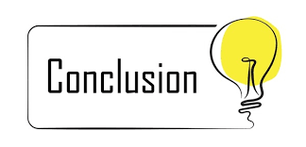

Slide 15
Conclusion
Plagiarism and copyright are critical issues in today’s information-driven society. Plagiarism undermines the integrity of academic and professional work, while copyright laws protect the rights of creators and their intellectual property.
Understanding and respecting these concepts is essential for fostering a culture of originality and creativity. By properly citing sources and adhering to copyright guidelines, individuals can contribute to an ethical environment that values and supports the contributions of all creators.

