Slide 1
Chapter V:
Sampling in natural environments (spontaneous vegetation)

Slide 3
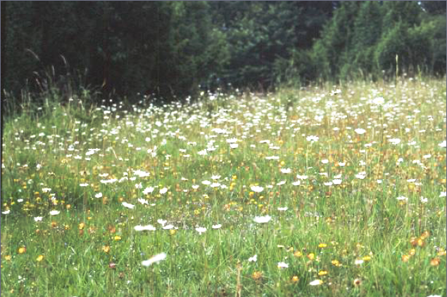

Slide 4
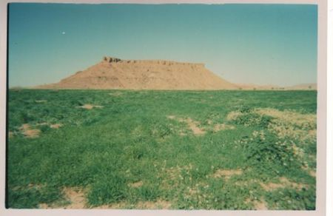

Slide 5
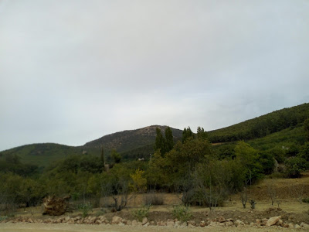

Slide 6
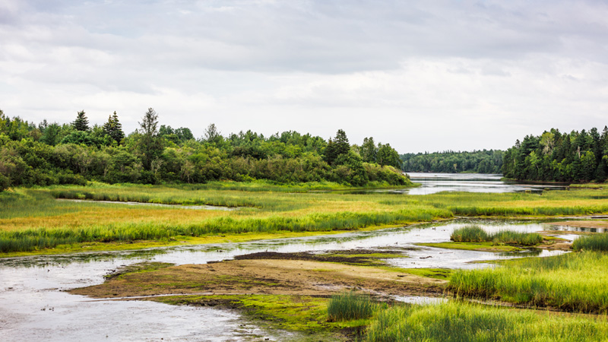

Slide 7
Sampling in natural environments
In the biotic part:
Biocenosis (living beings)
In the abiotic part:
Biotope (Water, Area, and Soil)
Plants
Insects
Animals
Microorganisms

Slide 8
1. Plant sampling
Quadrat method:
The quadrat is a square or rectangle, or four-sided shape. It is made of either metal, wood or plastic, and is used in ecology and geography to isolate a sample of usually about 1 m² or 0.25 m².
This method is suitable for sampling plants, slow-moving animals, insects, and some aquatic organisms.

Slide 9
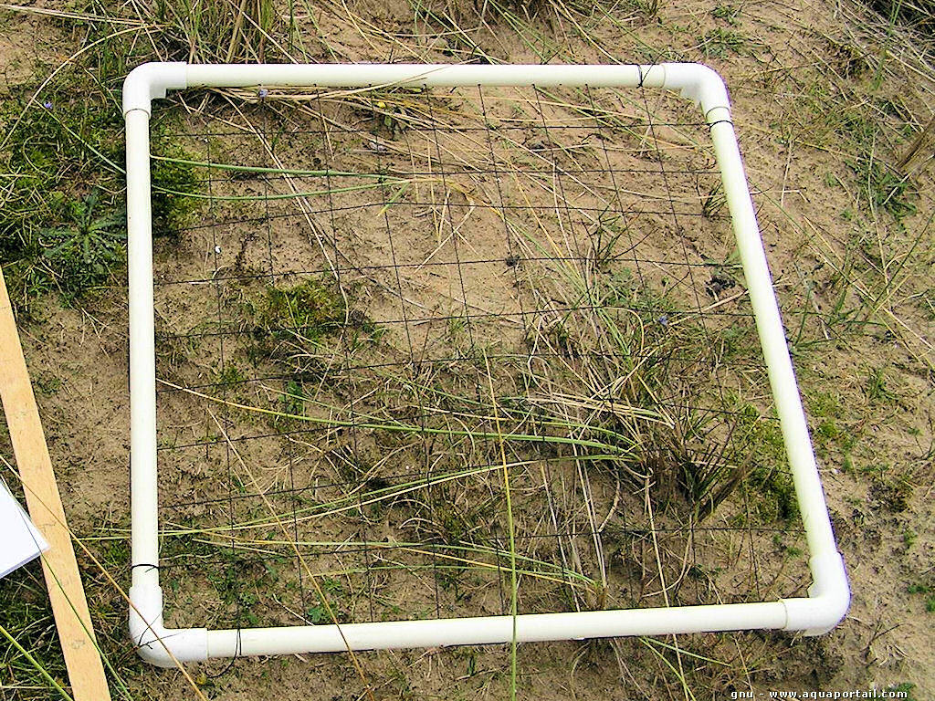

Slide 10
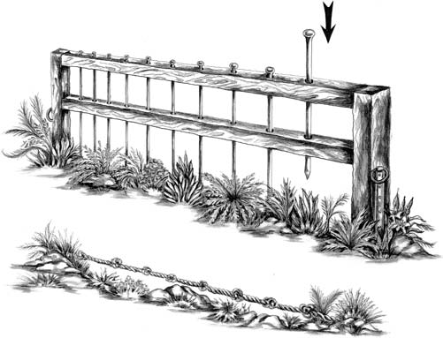
Line Interception Methods
To measure the vegetation cover: pin frame (above) and a graduated rope (below)

Slide 11
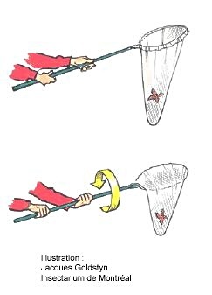
2. Insect sampling
Net
Allows "on-sight" captures
- Indicates only whether or not a given species is present at a given location.
- Does not provide much information on abundance or diversity (no numerical results).

Slide 12
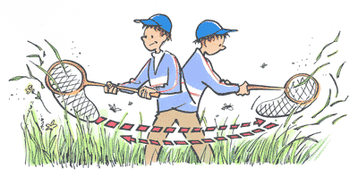
Sweep net
- Technique consisting of advancing a certain distance by mowing the grass with the net.
Highly selective method: some species are much more likely than others to be caught.
- Number of individuals captured of a given species following 20 net strokes over a distance of x meters.

Slide 13
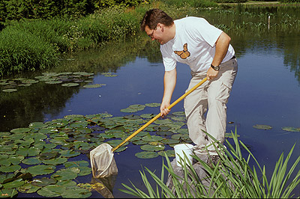
Troubled net
- Several species of insects spend part of their lives in water.

Slide 14
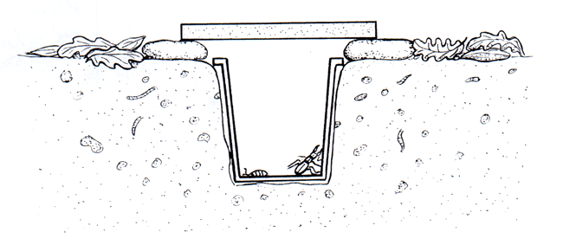
Pit trap (or Barber's trap)
Allows you to obtain indices of abundance of certain species living on the ground.
The diameter of the trap has an effect on the size of the trap (e.g. a trap with a larger diameter catches proportionally more large prey than a smaller one).
- A preservative liquid can be added to the bottom: Alcohol, detergent

Slide 15
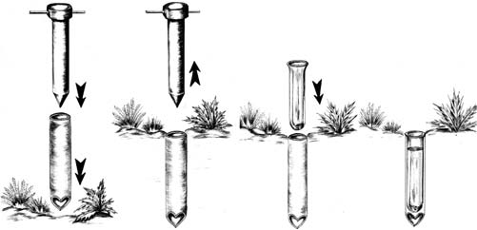
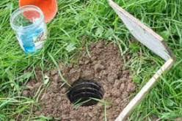
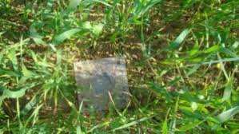
Pit trap (or Barber's trap)

Slide 16
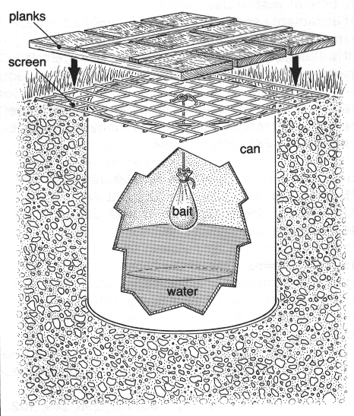
Pit trap (or Barber's trap)
Can be made more effective and especially selective by adding cooked meat or overripe fruit
Wire mesh to prevent bait from being stolen by small mammals

Slide 17
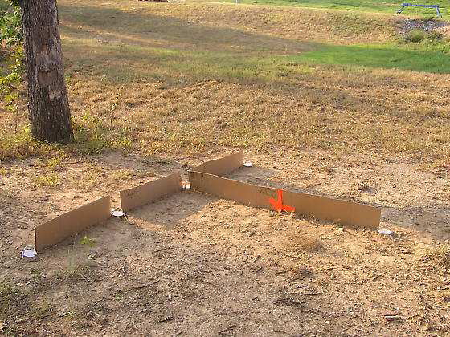
"Barriers" driven into the ground
0,5 m

Slide 18
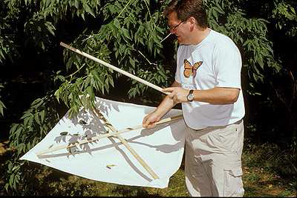
Japanese umbrella (batting tablecloth)
- For harvesting arthropods living on the foliage of trees and shrubs.
- The umbrella is a square of white fabric stretched over a wooden cross that is placed under the beaten branches.

Slide 19
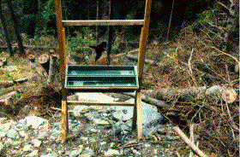
In-Flight Interception Trap (Impact Trap)
- Flying insects hit the transparent surface and fall into a preservative liquid.
- Highly variable yield depending on weather conditions or where the trap is placed.

Slide 20
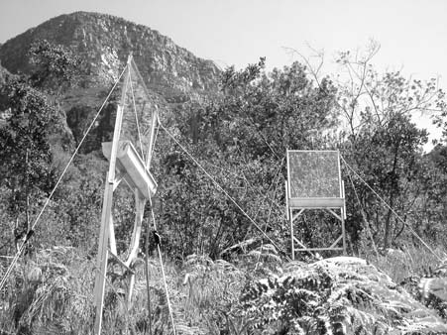

Slide 21
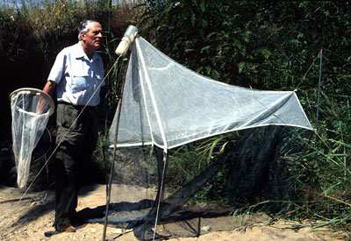
In-flight interception trap (Malaise trap)
Based on the tendency of insects to climb when they encounter an obstacle. Effective especially for Diptera, Hymenoptera and Lepidoptera.
These species are attracted to dark shapes (note the dark color of the interior "walls").

Slide 22
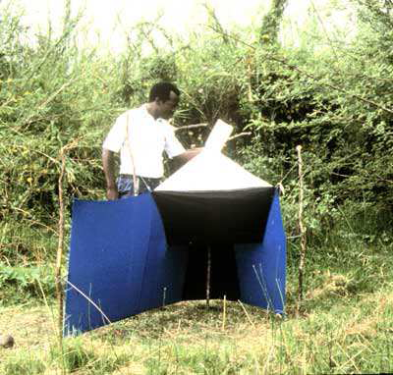
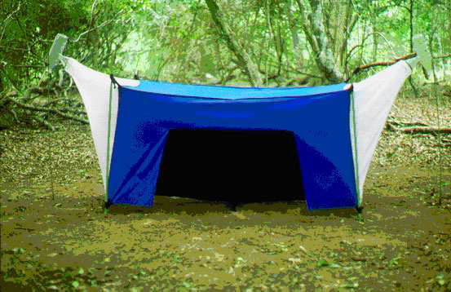
Ngu Trap
H Trap

Slide 23
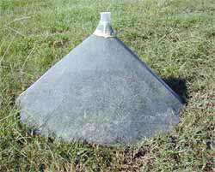
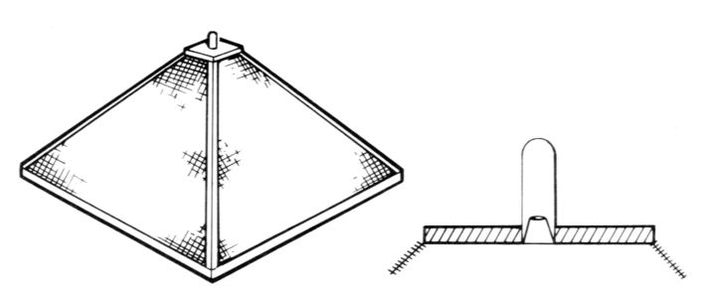
Emergence cages
Harvests all flying plants that emerge from the ground or water. Deliver excellent results.

Slide 24
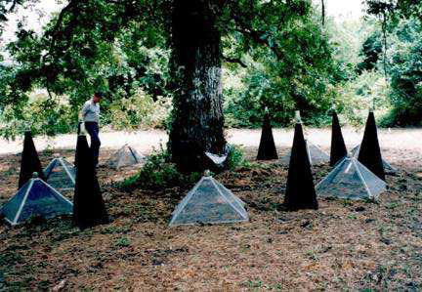
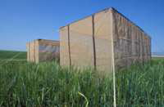
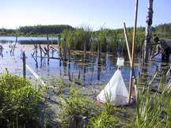
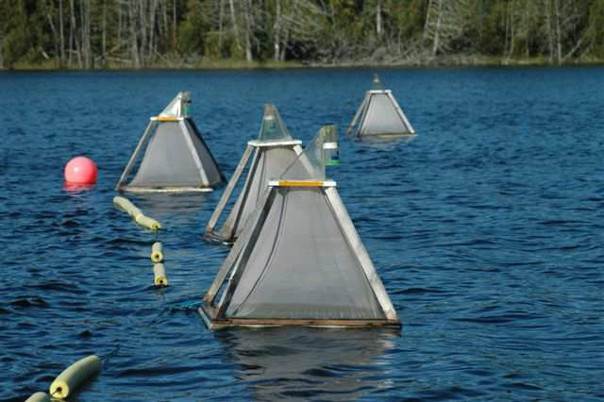
Emergence cages

Slide 25
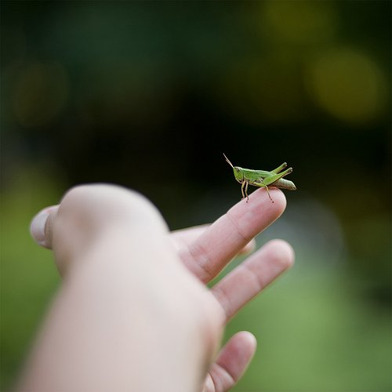
Hand Collecting
- Often the simplest and fastest method to sample insects that live on the surface of plants, under stones...
- Be careful, however, some may grind or inflict painful stings.

Slide 26
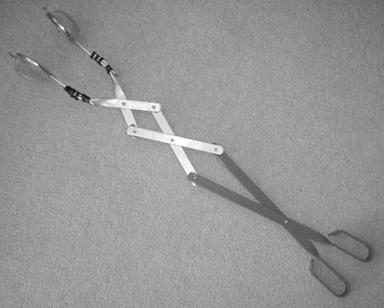
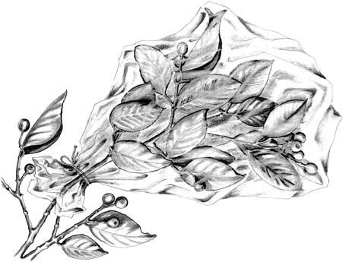
Other techniques

Slide 27
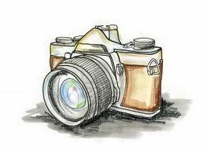
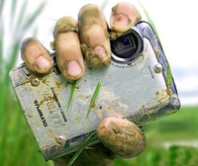
The camera

Slide 28
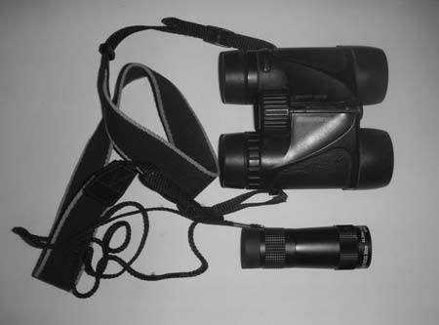

Slide 29
3. Animal sampling
Reptiles
We were able to capture a few species of reptiles manually, but in most cases, we were content to observe them with the naked eye and sometimes to photograph them and observe their behavior in their natural environment.
We also captured some species of small reptiles in the invertebrate pit traps mentioned above.

Slide 30
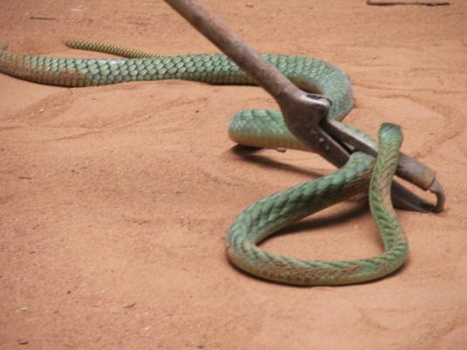
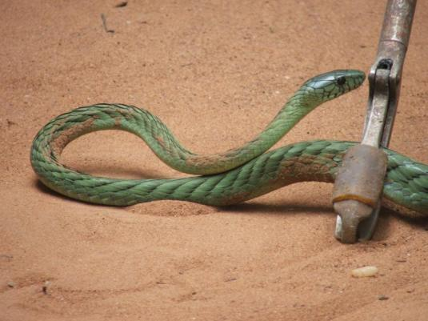
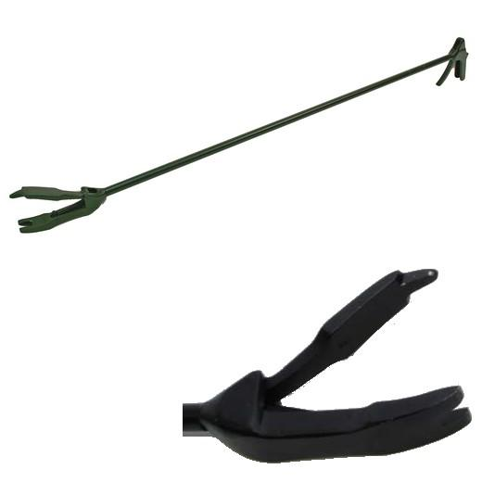

Slide 31
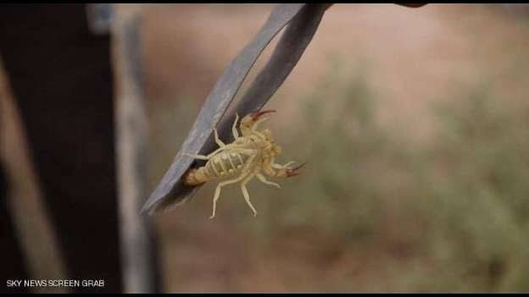
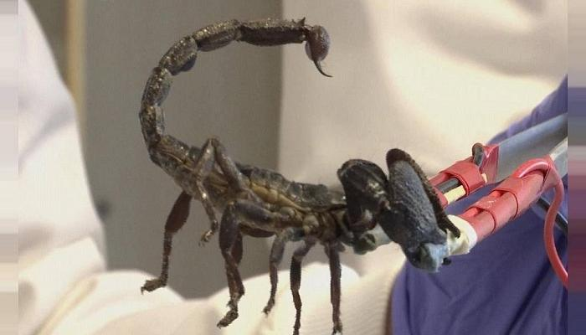
Scorpions

Slide 32
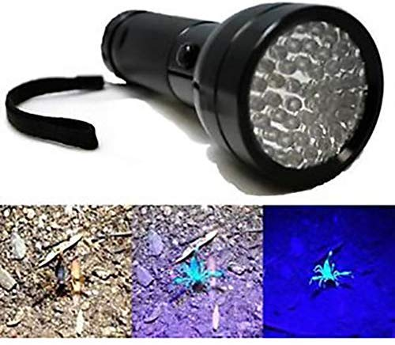
Scorpions

Slide 33
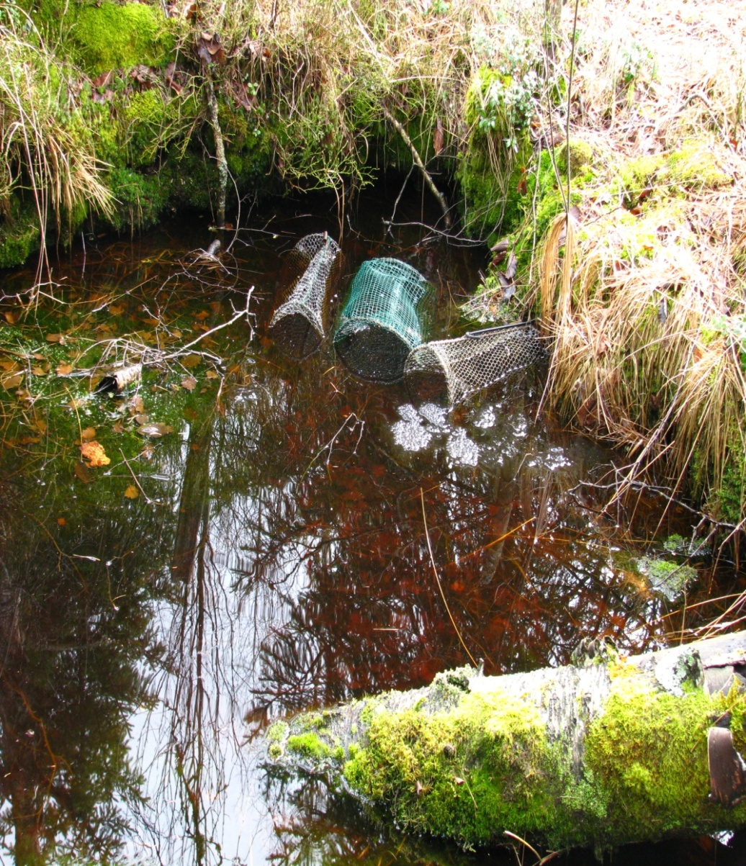
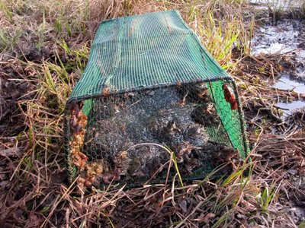
Frogs

Slide 34
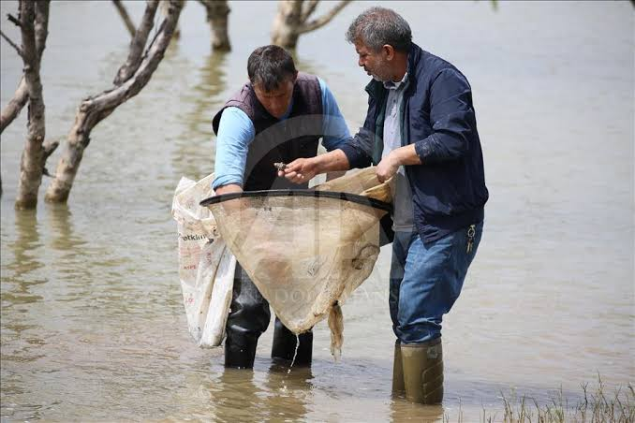
Frogs

Slide 35
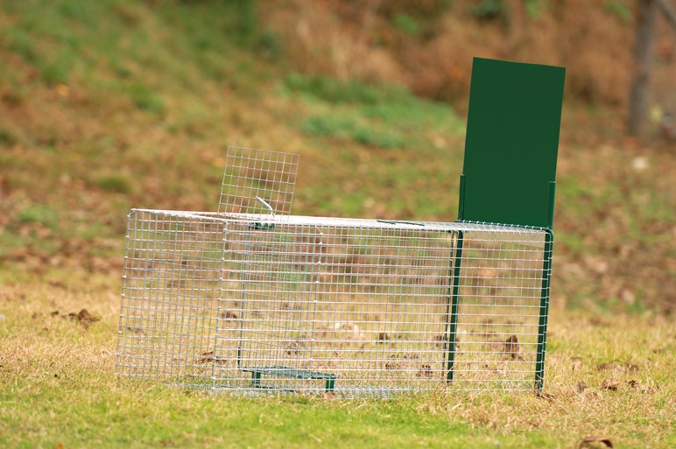
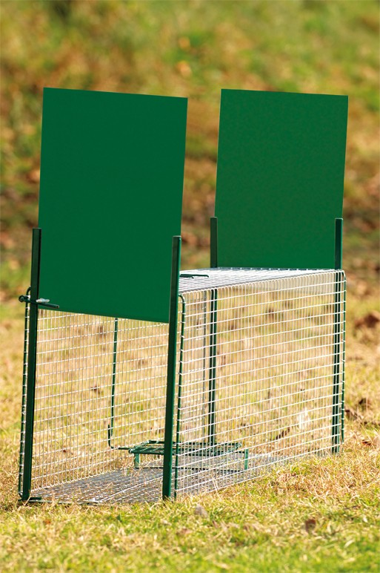
Rats

Slide 36
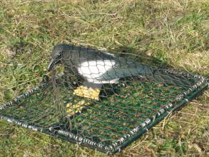
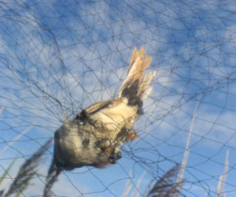
Birds
For their study, we used traces and signs of presence (feathers, nests,...) which are important elements in the identification of certain species.

Slide 37
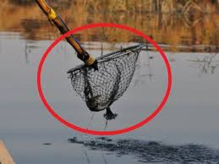
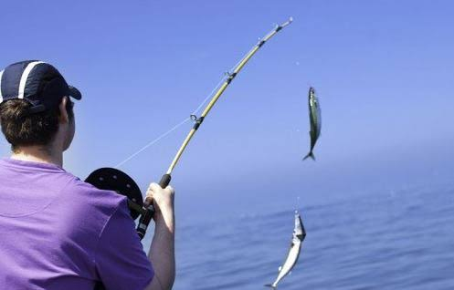
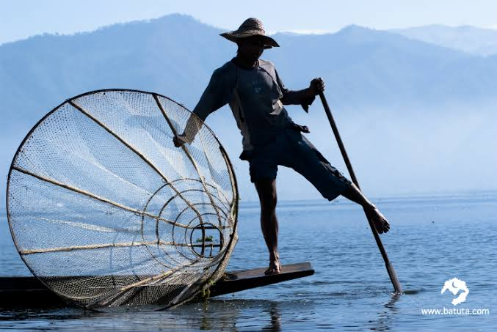
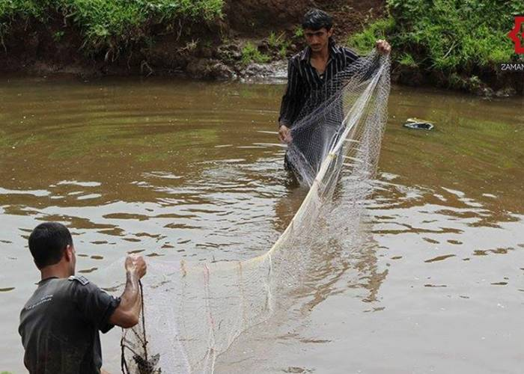
Fish

Slide 38


4. Microorganism sampling
On the ground
Auger

Slide 39

4. Microorganism sampling
Substrate separation: Cradle apparatus and sieve

Slide 40


4. Microorganism sampling
In water
The taking of a water sample is a delicate operation that must be homogeneous, representative and obtained without modifying the physical-chemical and bacteriological characteristics of the water according to the standard in force.

Slide 41


