Slide 1
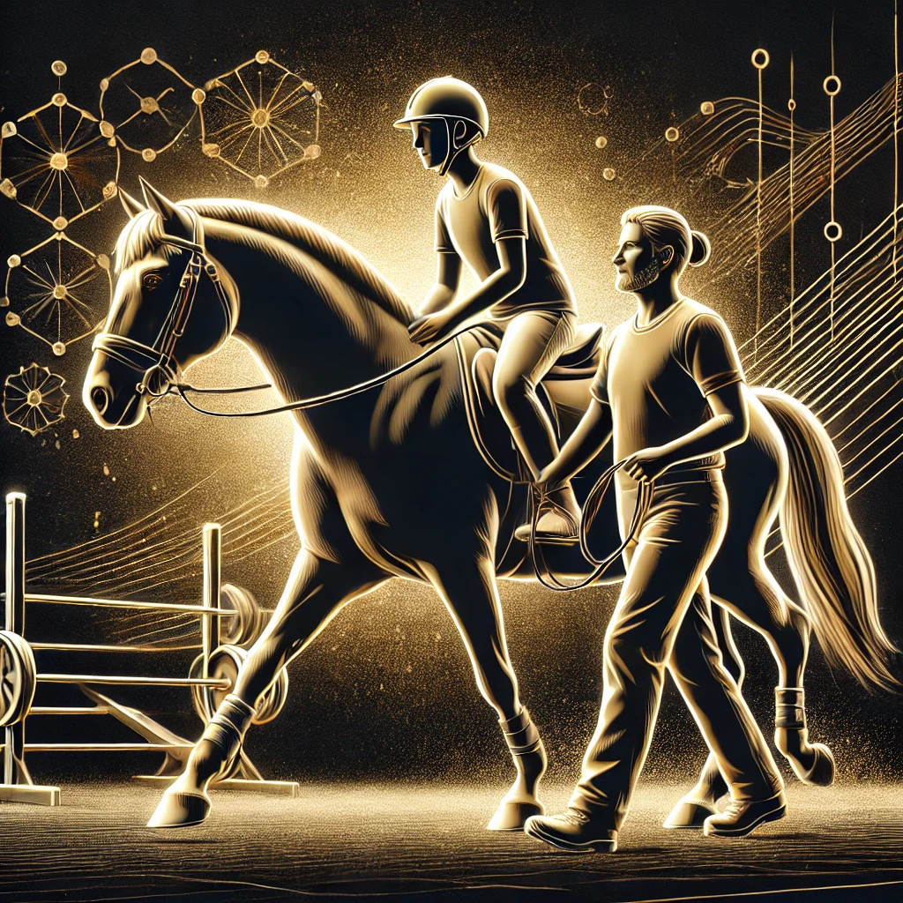
Equine Therapy
Sefsaf Nadjah
Sebaa Rayane
Sebaa Islam
Group: 04

Slide 2
Research plan
Introduction
Defining Equine Therapy
The origins of equine therapy
Steps of Equine Therapy
Target Audience for Equine Therapy
Mental & Emotional Benefits & Physical Benefits
Conclusion

Slide 3

Introduction
Equine therapy is an integrative treatment approach that utilizes horses to help individuals improve their physical, mental, and emotional abilities. This type of therapy relies on human-horse interaction to enhance balance, motor coordination, and social communication skills.

Slide 4


Defining Equine Therapy
Equine therapy is a type of treatment aimed at training body muscles through exercises performed on the horse. The horse’s movements are used as a therapeutic strategy in horseback riding therapy. One of the key reasons for using horses in therapy is that their rhythmic movements closely resemble human movements.

Slide 5

The origins of equine therapy
The origins of equine therapy, or therapeutic horseback riding, date back to ancient civilizations. The Greeks documented the benefits of horseback riding for rehabilitation as early as 600 BCE. In the 20th century, equine therapy gained recognition, particularly after Danish dressage rider Lis Hartel, who had polio, demonstrated its rehabilitative effects in the 1950s. This led to the formalization of therapeutic riding programs, especially in Europe and North America, where it is now widely used for physical, emotional, and cognitive therapy.

Slide 6





Steps of Equine Therapy
Assessment
Therapist evaluates patient's needs and goals.
Goal Setting
Define specific, measurable objectives.
Horse Selection
Select a suitable horse for the patient based
on their needs and characteristics.
Regular Riding
Conduct riding sessions regularly to achieve the set goals,

Slide 7




Target Audience for Equine Therapy
Individuals with mental health challenges.
Individuals with physical disabilities.
Individuals with developmental disabilities.

Slide 8

Mental & Emotional Benefits
Emotional Regulation
Horses mirror emotions, promoting self-awareness.
Self-Esteem and Confidence
Mastering new skills with horses increases self-worth.
Communication Skills
Interacting with horses and therapy team helps.
Reduced Anxiety and Stress
The presence of horses has a calming effect.

Slide 9



Physical Benefits
2
Muscle Strength
1
Balance and Coordination
Motor Skills
3

Slide 10

Conclusion
Equine therapy offers a unique pathway to healing and growth. It encompasses different types with varied benefits and drawbacks.

