Slide 1
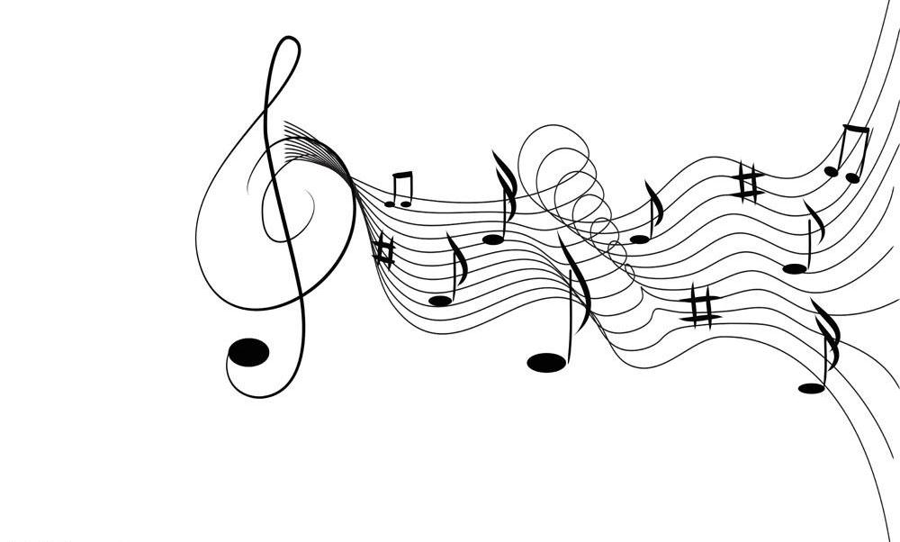
Music therapy
Prepared by(grp 04):
Supervised by
Tertag ines
HANSALI meriama
HADEF Iman

Slide 2
CONTENTS
Introduction
01
02
Historical Overview
Definition
03
04
Types of Therapies
Method of Music Therapy
05
06
Conclusion

Slide 3

01
Introduction
Music therapy is a therapeutic approach that uses music systematically to address individuals' physical, emotional, psychological, and social needs.
It serves as an effective tool to treat various mental and
physical issues, such as anxiety, depression, and stress.
Through interaction with music, individuals can achieve emotional balance, relieve tension, and enhance social abilities. Music therapy is not just a recreational activity but a
well-researched treatment method that contributes to improving the overall health and well-being of patients in various settings

Slide 4
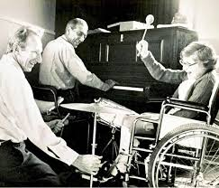
02
Historical Overview
The origins of music therapy date back to ancient civilizations, where music was used for spiritual healing. In the 20th century, music therapy began to gain recognition as a formal treatment. One of the pioneers in this field was E. Thayer Gaston, an American professor who is often referred to as the
"father of music therapy." He played a significant role in establishing music therapy as a professional discipline in the mid-1900s. Another notable figure is Juliet Alvin, a British music therapist who contributed to the development of music therapy practices in Europe. During World War II, music was used to help soldiers recover from psychological trauma. In the 1970s, music therapy was officially recognized as a profession, and associations like the American Music Therapy Association (AMTA) were founded to support research and training in this field

Slide 5


03
Definition of Music Therapy
Music therapy is the use of music in a structured and purposeful manner to fulfill a person's psychological, emotional, physical, and social needs. The music therapist selects specific forms of music or musical activities, such as listening, singing, or playing instruments, with the goal of improving the individual’s health and enhancing their well-being.

Slide 6

04
Types of Therapies
The types of music therapy are based on active interventions where the patients make music with the therapist by singing a song or playing a musical instrument and receptive interventions where they interact with the music passively, such as by listening. The types of music therapy are listed below.

Slide 7
Definition of Music Therapy
Receptive Music Therapy
Re-creational Music Therapy
This type involves the patient listening to live or recorded music. The response can be verbal, physical (like movement), or simply passive listening.
Purpose: To promote relaxation, improve mood, and stimulate memory.
Example: The Bonny Method of Guided Imagery and Music (GIM), which uses classical music and guided visualization.
The patient sings or plays familiar/new music to improve social skills and build confidence.
Purpose: Enhancing social skills and building self-confidence through active musical participation
01
02
Compositional Music Therapy
The patient composes original music with the therapist to express emotions and support mental well-being.
Purpose: Emotional release, creative development, and psychological support.
Techniques: Songwriting, rewriting lyrics, composing new music, or creating music collages.
Improvisational Music Therapy:
03
04
The patient creates music spontaneously to express emotions and uncover hidden psychological issues
Purpose: Self-expression and revealing unconscious emotional conflicts.
Example: The Nordoff-Robbins approach and Analytically Oriented Music Therapy (AOM)..

Slide 8
05
Method of Music Therapy
The method of music therapy relies on using music as a therapeutic tool aimed at achieving specific psychological, social, and behavioral goals. The music therapist begins with a comprehensive assessment of the patient’s condition to understand their individual needs, then develops a treatment plan based on those needs. Music therapy techniques vary according to the nature of the case and include receptive methods, where the patient’s role is limited to listening, as well as interactive or creative approaches, where the patient participates through playing instruments, singing, or composing music. The type of music used is carefully selected to match the patient’s emotional and psychological state; for instance, calm music may be used to promote relaxation, while faster-paced pieces can improve mood or boost energy. Sessions are conducted individually or in groups, and the therapist continuously monitors the patient’s responses to evaluate the effectiveness of the therapy and adjust the treatment plan if necessary. This type of therapy contributes to enhancing the quality of life, especially for individuals suffering from anxiety, depression, or developmental and cognitive disorders

Slide 9
07
Music therapy is considered one of the modern therapeutic approaches that has proven effective in enhancing both mental and physical health. Through its various techniques—whether receptive, interactive, or compositional—patients can express their emotions, reduce stress, and achieve inner balance in a non-traditional way. This form of therapy highlights the importance of integrating art and medicine in supporting individuals to overcome psychological challenges and improve their quality of life. With ongoing research in this field, its applications are expected to expand and become even more effective across a wider range of cases. Music is not merely an art form; it is a powerful therapeutic tool that deserves attention and support
conclusion

Slide 10
Thank you

