Slide 1
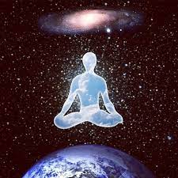
Meditation therapy
Group: 04
Hadil brahimi
Asma sekkai
Donia Touaoua

Slide 2
Introduction
Definition of Meditation Therapy
Historical Overview
How to Apply Meditation Therapy
Types of Meditation Therapy
Importance of Meditation Therapy

Slide 3
Introduction
Meditation is an ancient practice that aims to calm the mind and achieve inner peace. It is used as a therapeutic tool for a variety of conditions, including anxiety, stress, depression, and chronic pain

Slide 4

Definition of Meditation Therapy
Meditation is a practice that involves focusing or clearing the mind using a combination of mental and physical techniques. Depending on the type of meditation you choose, you can meditate to relax, reduce anxiety, stress, and more.

Slide 5
Historical Overview
Meditation has been around for over five thousand years in India and was used by the ancient Egyptians and Babylonians. It was associated with religious rituals and practices. That is, it existed even before the advent of psychology. The origin of the word is Meditari, which means thinking, and the word Mederi, which means treatment, is derived from it. For over fifty years, the use of meditation has developed in Western countries as a complementary therapeutic technique for many psychological problems, and scientific studies have shown its benefits for mental and physical health.

Slide 6
How to Apply Meditation Therapy
Position
Sit in a comfortable position,
Intention
Set your intention for meditation, whether it is to reduce stress, improve concentration, or other.
Find a quiet place free from distractions.
Choose the place and time
Choose a suitable time when you are not tired or busy.
Keep your back and head straight,
You can close your eyes or keep them partially open.
Preparation and setup

Slide 7
Focus your attention on your breath, notice the inhalation and exhalation.
Notice the thoughts and feelings that appear in your mind, without judging them or trying to suppress them,
Body awareness
Draw your attention to physical sensations, for example, notice any tension in your muscles and try to relax them
Focus on breathing
Notice thoughts and feelings
meditation practice

Slide 8
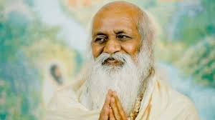
Types of Meditation Therapy
Transient Meditation
This type appeared in the sixties with the yoga practitioner Maharishi Mahesh, where he developed this technique in order to eliminate stress, anxiety and negative feelings.

Slide 9

He believes that the mind is attracted to happiness and can find it through silence and rest for the mind through this meditation and the meaning of the transit is a state in which the mind is in deep calm and without effort and where the body is comfortable. This type allows the individual to access his latent unused abilities such as intelligence, creativity, happiness and energy.
The individual sits with his eyes closed and repeats sounds or words several times for 15 to 20 minutes. These chants work to make all attention with them and thus prevent and eliminate confusing thoughts.

Slide 10
Breathing-based meditation
Attention is on the breath.
Color meditation
Mentally imagine a color or several colors
Zan meditation
Sitting in the lotus position where the back is straight, and breathing Through the abdomen, and letting the thoughts go without effort
Mindfulness meditation
paying attention to what is happening in the present moment, whether in oneself or in the environment, without judgment or reactions.

Slide 11
Importance of Meditation Therapy
Benefits of Meditation
Reducing stress and anxiety.
Improving mood.
Improving focus and attention.
Improving sleep quality.
Reducing chronic pain.

