Slide 1
University Of Mohammed Khider -Biskra -
Faculty of Economic Sciences, Commercial Sciences and Management Sciences
Department of Management
Lecture n°10:
READING CHARTS AND GRAPHS
-Understanding Data at a Glance-
Dr. ABDAOUI Nawal
nawal.abdaoui@univ-biskra.dz
Academic Year
2024-2025

Slide 2
Why Graphs Matter
- Visualize data quickly
- Crucial for decisions in science, business and daily life
- Spot trends and outliers

Slide 3
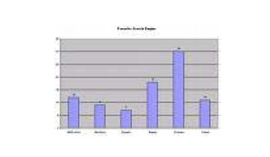
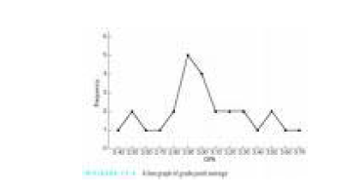
Common Types of Graphs
Bar Graphs
Compare quantities
Line Graphs
Trends over time

Slide 4
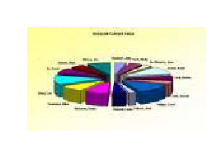
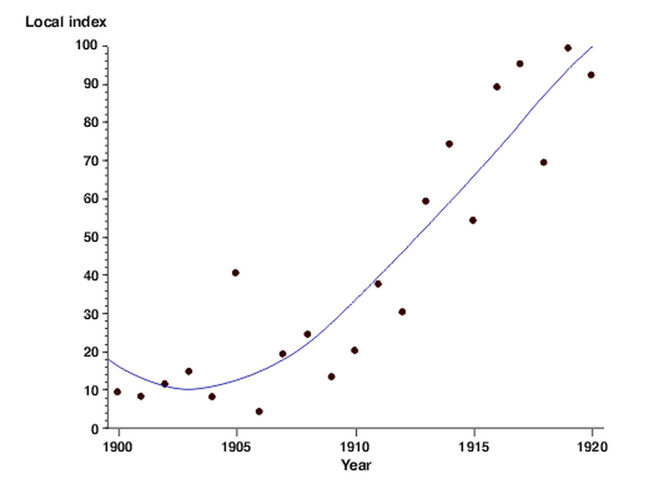
Common Types of Graphs
Pie Charts
Parts of a whole
Scatter Plots
Relationships

Slide 5
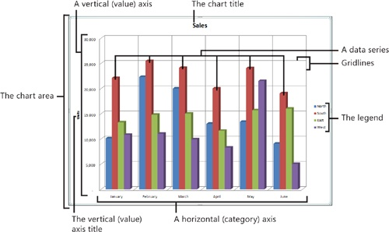
Anatomy of a Graph
- Title
- Axes (X and Y)
- Legend (if needed)
- Data points or bars

Slide 6
How to Read a Graph
Describing graphs requires several vocabularies to present the data given in a pie/ bar/ line graph or to desribe a process. This vocabulary section aims to help you gathering and learning all the vocabulary, phrases and words you need to know and use. Each part has a specific format and therefore being equipped with the necessary vocabulary

Slide 7
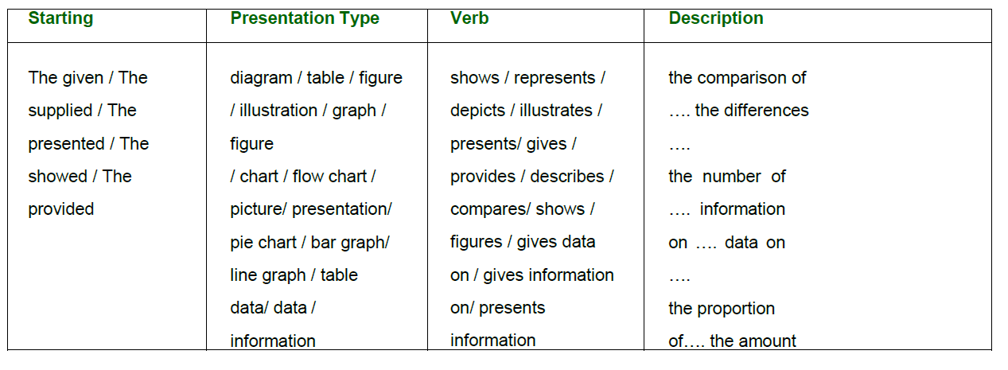
1- Vocabulary For The Introduction
The provided diagram shows data on employment categories in energy producing sectors in Europe starting from 1925 to 1985.

Slide 8
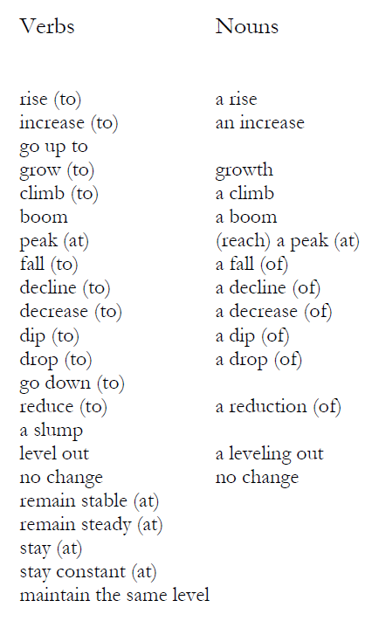
2- Vocabulary to show change

Slide 9
3- Vocabulary to show change

Slide 10
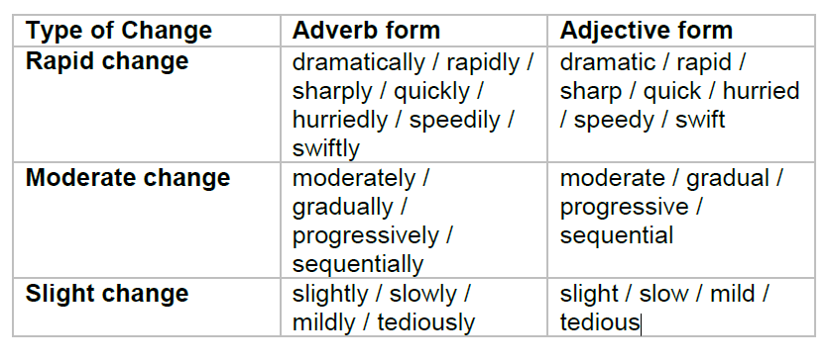
Example:
1. The economic inflation of the country increased sharply by 20% in 2008.
2. There was a sharp drop in the industrial production in the year 2009.
3. The demand for new houses dramatically increased in 2002.

Slide 11
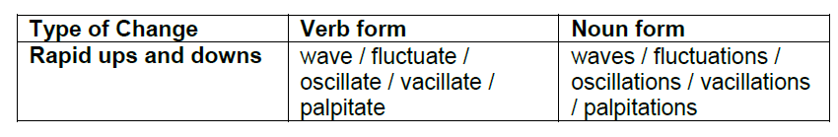
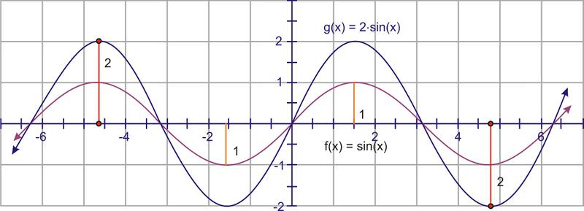
4- Vocabulary to represent frequent changes in graphs:
1. The price of the raw materials fluctuated for the first three months.
2. The graph shows the oscillations of the price of fuel from 1998 to 2002.

Slide 12


