Slide 1
University Of Mohammed Khider -Biskra -
Faculty of Economic Sciences, Commercial Sciences and Management Sciences
Department of Management
Lecture n°9:
CORPORATE SOCIAL RESPONSIBILITY
-Creating Value Beyond Profit-
Dr. ABDAOUI Nawal
nawal.abdaoui@univ-biskra.dz
Academic Year
2024-2025

Slide 2

What is CRS
A company’s commitment to manage the social, environmental, and economic effects of its operations responsibly.
- CRS beyonds legal obligations
- CRS Grows societal expectations

Slide 3
The Pillars of CSR
Environmental Responsibility
Sustainable resource use, reducing carbon footprint
Social Responsibility
Fair labor, community engagement
Economic Responsibility
Ethical sourcing, economic growth

Slide 4
Why CSR Matters
- Builds brand reputation and trust
- Enhances employee satisfaction
- Reduces regulatory intervention
- Improves customer loyalty
- Attracts investors

Slide 5

Types of CSR Activities
- Donations and charity work
- Employee volunteer programs
- Ethical labor practices
- Environmental sustainability
- Transparent governance

Slide 6
Challenges in Implementing CSR
1
Balancing profit and responsibility
2
Greenwashing
3
4
Measuring impact
Stakeholder skepticism

Slide 7
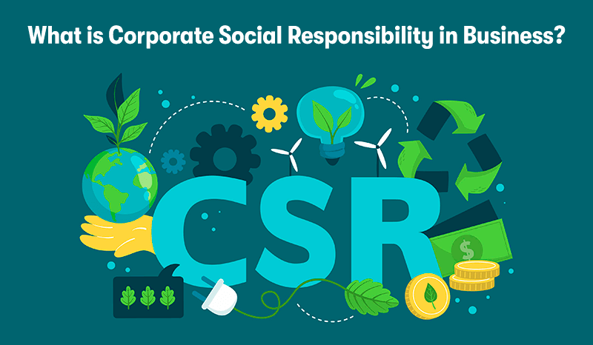
Future of CSR
- ESG investing
- Transparency and accountability
- Strategy integration
- Purpose-driven brands

Slide 8


Slide 9


