Slide 1
University Of Mohammed Khider -Biskra -
Faculty of Economic Sciences, Commercial Sciences and Management Sciences
Department of Management
Lecture n°8:
STARTING AND FINISHING AN EMAIL
Dr. ABDAOUI Nawal
nawal.abdaoui@univ-biskra.dz
Academic Year
2024-2025

Slide 2
Here are some important points to consider when starting and finishing an email.
1- Formal or informal?
We write a formal email when we want to be polite, or when we do not know the reader very well. A lot of work emails are formal. We write informal emails when we want to be friendly, or when we know the reader well. A lot of social emails are informal. Here are some examples of formal and informal messages
Before you start writing an email, decide if you want to write a formal email or an informal one.
Formal | Informal
An email to a customer A job application An email to your manager A complaint to a shop An email from one company to another company | A birthday greeting to a colleague An email to a colleague who is also a good friend A social invitation to a friend at your workplace An email with a link to a funny YouTube clip A message to a friend on a social networking site

Slide 3
2- Layout and punctuation:
a- Starting an email: We normally write a comma after the opening phrase. We start a new line after the name of the person we’re writing to.
b- Finishing an email: We normally write a comma after the closing phrase. We start a new line to write our name at the end
Formal | Informal
Dear Mr Piper, I am writing to thank you for all your help. I look forward to seeing you next week. With best wishes, John Smith | Hi Tim, Many thanks for your help. See you next week. John

Slide 4
3- Phrases for starting and finishing:
Here are some phrases which we use for starting and finishing emails. We use these in formal and informal emails:
Phrases | Formal | Informal
Starting phrases | Dear Mr Piper, Dear Sir or Madam, | Hi Tim, Hi there Tim, Morning/Afternoon/Evening Tim, Hello again Tim,
Ending phrases | Yours sincerely, Yours faithfully, Yours truly, | Regards, Bye for now, See you soon,

Slide 5
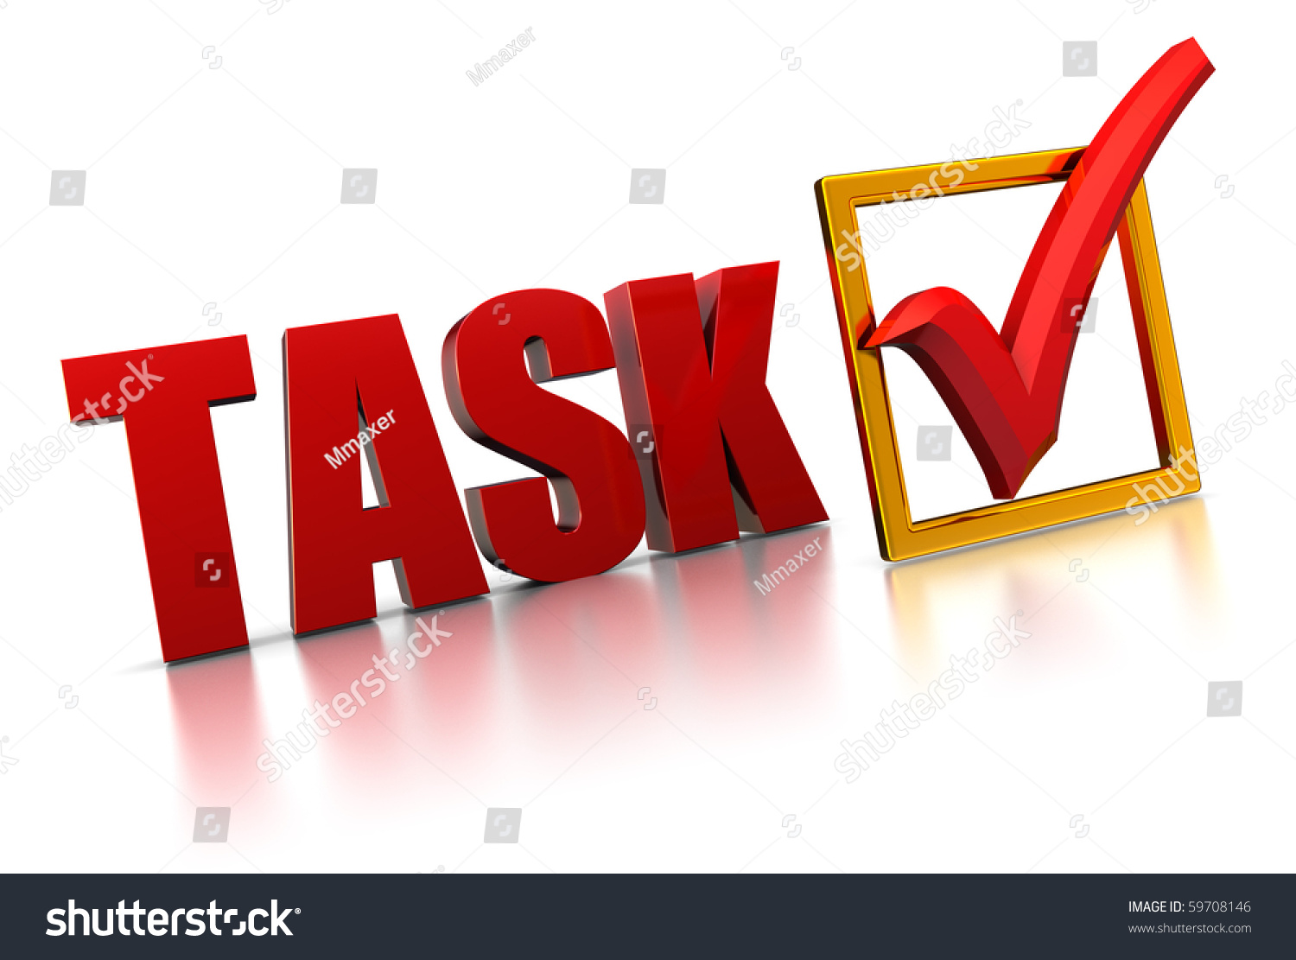

Slide 6
Omar, a maths teacher, has written four emails this morning. Read the opening lines of the emails and then match them to the descriptions of the emails below:
1- Morning everyone, just thought you might be interested to know that…
a- OMAR emailed all the maths teachers at his school about some training
2- Hi there Rahim, Hope you’re well. Might be a bit late on Saturday
b- OMAR wrote to his friend about their plans to play football at the weekend.
3- Dear Mr Bakr, Iam writing to you because i am worried that…
c- OMAR sent an email asking for more information about a conference. He did not know the name of the person who will read his email.
4- Dear Sir or Madame, could you please send me…
d- OMAR emailed a man called Bakr, the father of a pupil at the school. He wanted to know why Mr Bakr’s son was absent from school.

Slide 7


