Slide 1
University Of Mohammed Khider -Biskra -
Faculty of Economic Sciences, Commercial Sciences and Management Sciences
Department of Management
Lecture n°7:
CONFLICT MANAGEMENT
Dr. ABDAOUI Nawal
nawal.abdaoui@univ-biskra.dz
Academic Year
2024-2025

Slide 2
Introduction
Conflict, like change, will always occur given the dynamics of human interactions.
It will occur between family members, workers, colleagues, supervisors, boards of management in our work or play environments, between organizations and within organizations.
Why this? Because we all have different interests, goals, perceptions, viewpoints, values and experiences.

Slide 3
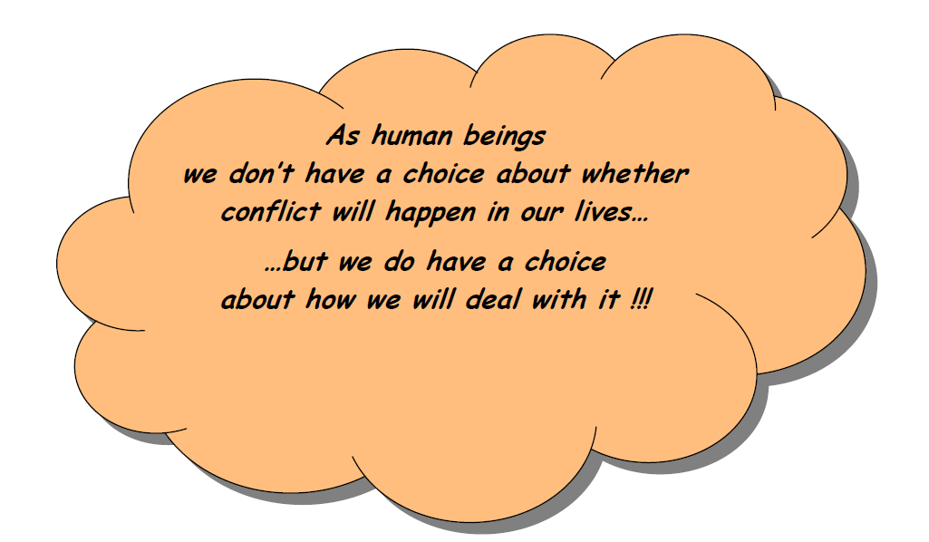

Slide 4

What is conflict
An issue between two or more parties who have (or think they have) incompatible goals or ideas. Conflicts may involve deep-rooted moral or value differences, or can be about who dominates whom.
The paradox of conflict is that it is both the force that can tear relationships apart and the force that binds them together, meaning that they can be either healthy (constructive) or unhealthy (destructive).

Slide 5
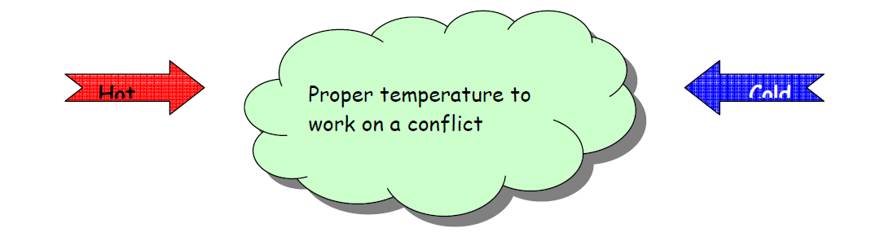
Burning and frozen conflicts
It’s hardly possible to constructively work towards the resolution of a conflict, when conflecting parties are either screaming at each other or not talking at all. In the first case, the conflict is too ”hot” and in the second is too “cold”.

Slide 6
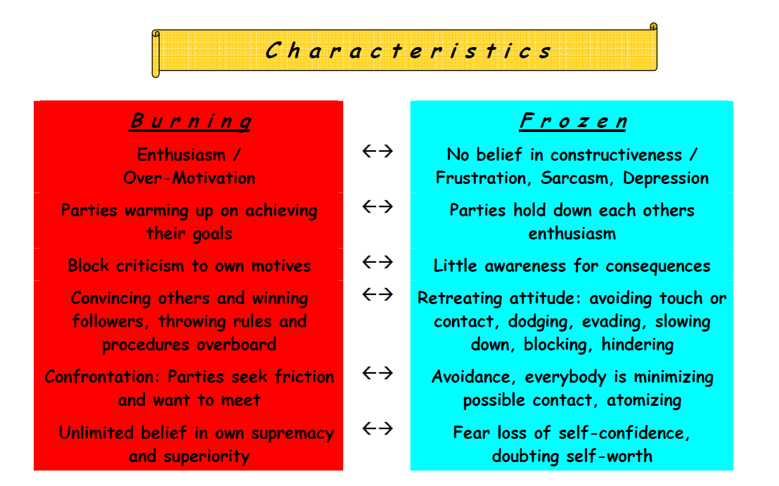

Slide 7
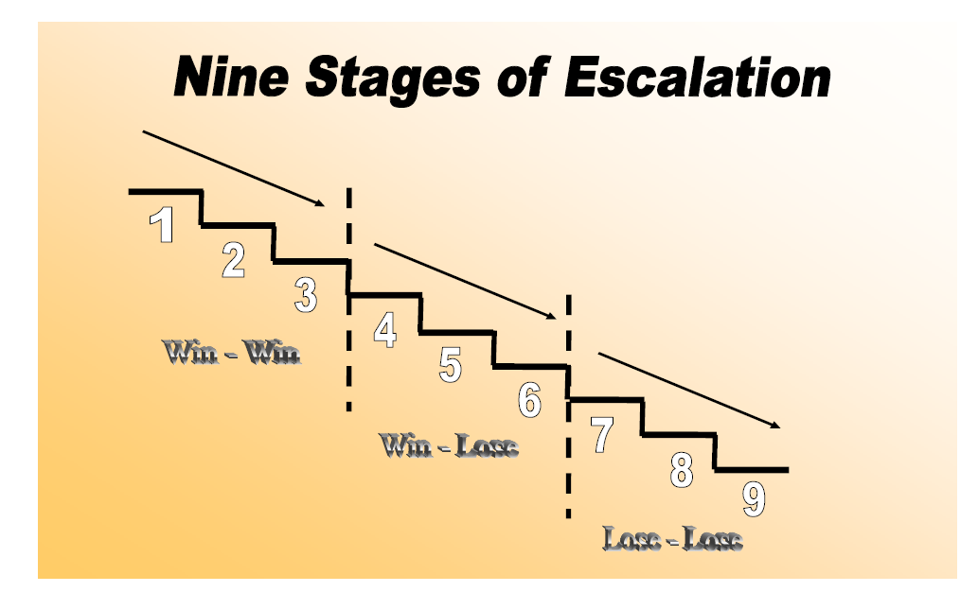
Escalation of conflict
The nine stages of conflict escalation were developed in the 1980s by Australian professor Friedrick Glasl. The uninterrupted escalation of a conflict can pull us down as into quicksand, and if there is no turning point, we will end in the abyss.
At every stage, the dynamic of a conflict can escalate further when there is no conscious causing or moment of awareness and reflection

Slide 8
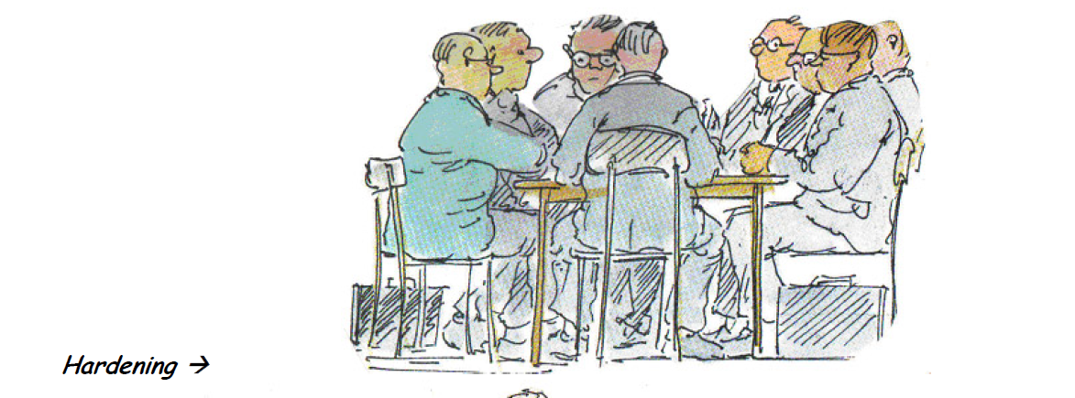
1- Hardening of Positions
Tensions and clashes
Cooperation is bigger than rivalry

Slide 9
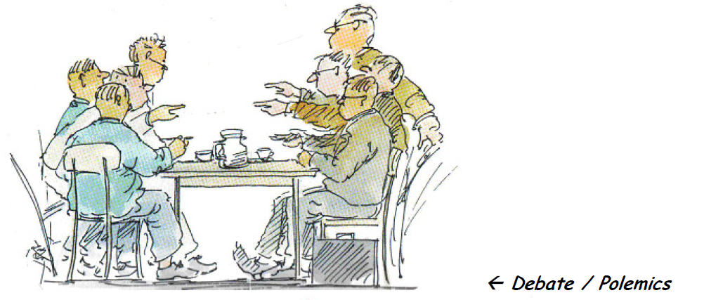
2- Debates and Polemics
Polarisation in feeling, thinking
and acting
Willing to dominate

Slide 10
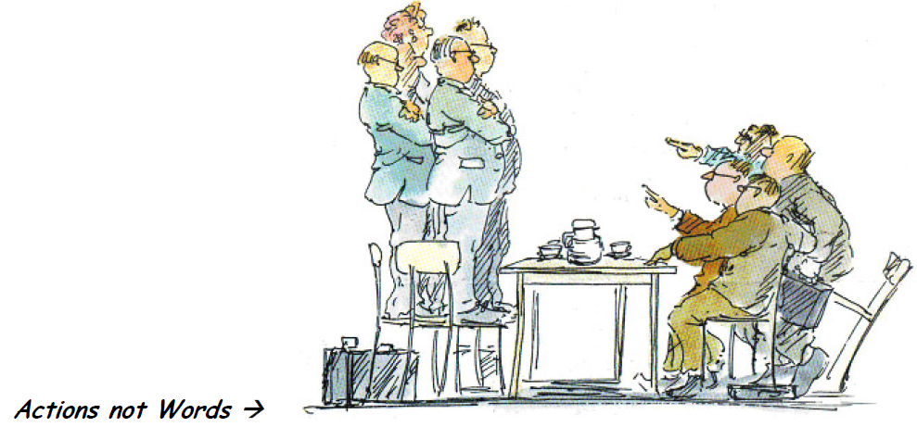
3- No more words but action
Loss of empathy
Rivalry is bigger than cooperation

Slide 11
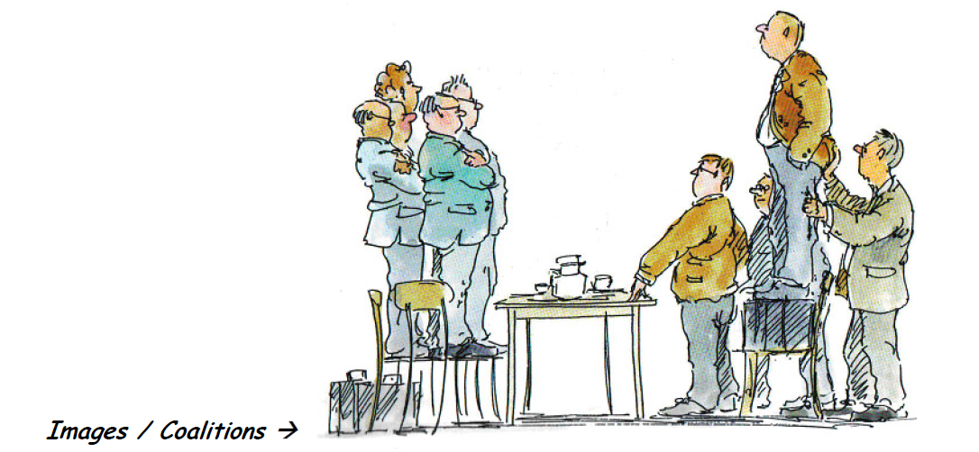
4- Images and group building
coalition
Remarkable prejudices

Slide 12
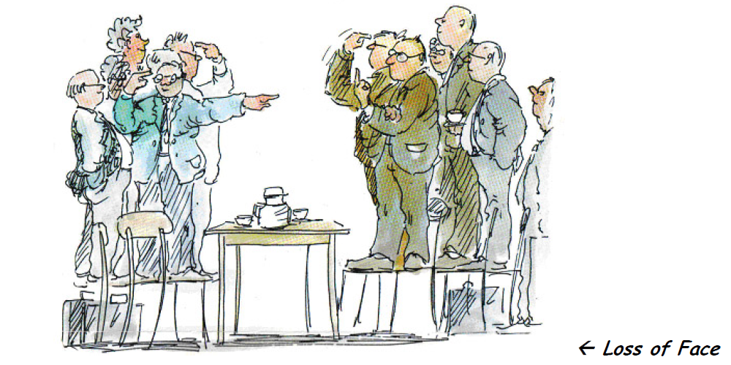
5- loss of face
Unmasking the other direct and
public attacks
Disgust and banning

Slide 13
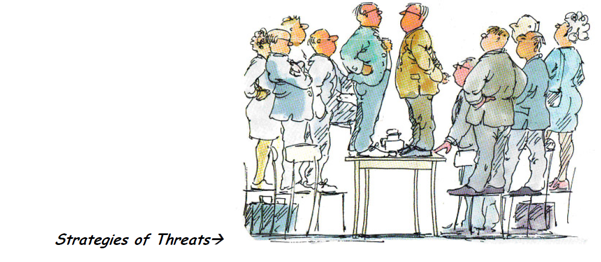
6- Strategy of threatening
Spiral of threats and counter-threats
acceleration

Slide 14
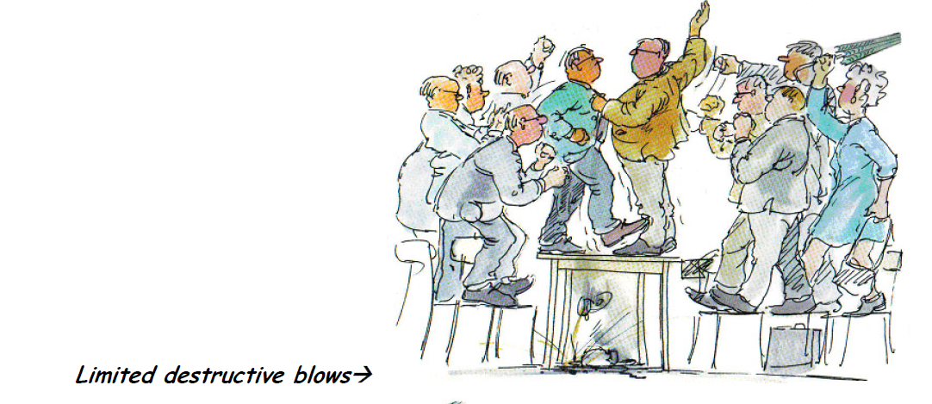
7- limited destruction
Human being are becoming things
Morals are becoming upside down

Slide 15
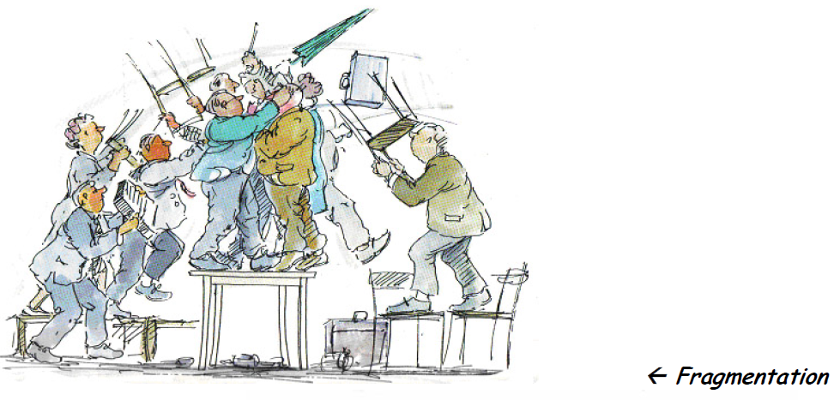
8- Fragmentation
Complete destrucion: physical, mental,
spiritual, social and economical

Slide 16
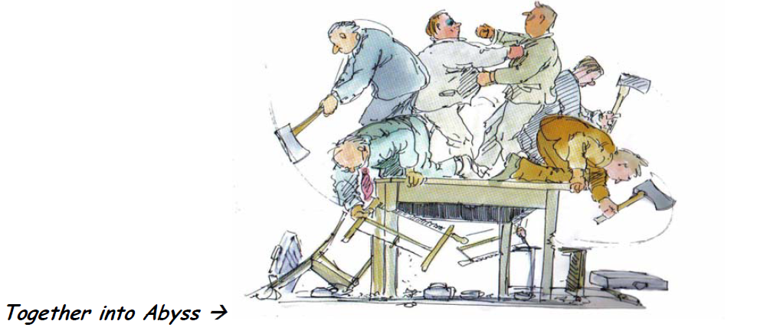
9- Together into the abyss
Total confrontation
No way back
Destruction is out of control

Slide 17


