Slide 1
University Of Mohammed Khider -Biskra -
Faculty of Economic Sciences, Commercial Sciences and Management Sciences
Department of Management
Lecture n°6:
TEAM BUILDING
Dr. ABDAOUI Nawal
nawal.abdaoui@univ-biskra.dz
Academic Year
2024-2025

Slide 2
a group of people united by a common purpose
the process of enhancing the effectiveness of team. This process is known also as team development
the skills developed while working with a group of people who are not a team back at work
Team
Team
Building
Team
Working
skills

Slide 3

Why team work
Distribution of work: a bringing-together of skills;
Problem-solving/ decision making;
Information and idea collection;
Co-ordinating between individuals and groups and between groups;
Management and control of work.

Slide 4

Think of a team you work in or have worked in that was successful and where things went well; jot down some comments consider:
People,
Feelings,
Activities performed,
your role

Slide 5
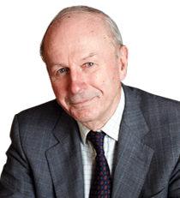
Task achievement in team (The John Adair Model)
John Adair is acknowledged as a leading expert in “teams” and it was he who first brought this model to people’s attention
He states that there are three areas of need present in working groups:
To achieve the common task;
To be held together or to maintain themselves as cohesive unities;
The needs which individuals bring to the group

Slide 6
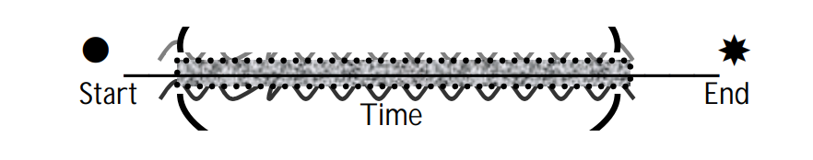
Distinguishing between Task, People and Process Interaction
1- The task: the task itself often needs clarifying to discover the true start, end and time allocation. Often first few meetings of the group will be to define and re-define the task itself- to really understand what is required of the group.
The prime task if often involved and the timescales in which it is to be achieved.

Slide 7
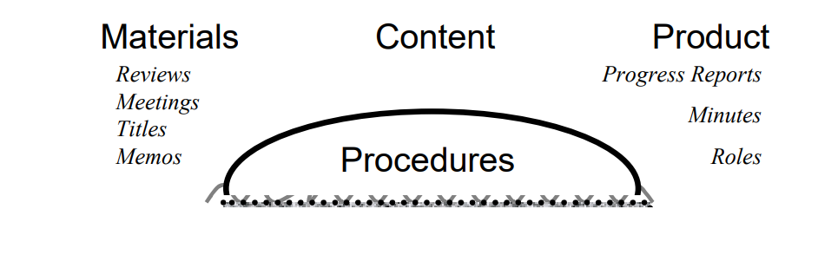
2- The process: this is the way in which the job is done:
- What information is needed?
- How should we organize ourselves?
What about roles-chair? Note-taker? Facilitators?
Frequency of meetings?
Recording information and decisions…

Slide 8
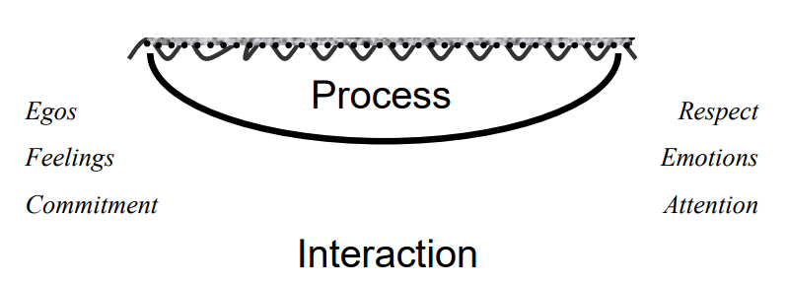
3- People: when people get together to work things become different and often difficult. As interactions take place:
Some people lead, some follow/ some become dominant, some people only listen to certain others/ some get energy, upset, confused/ some are committed/some have other things on their mind/ some have a hidden agenda
People

Slide 9
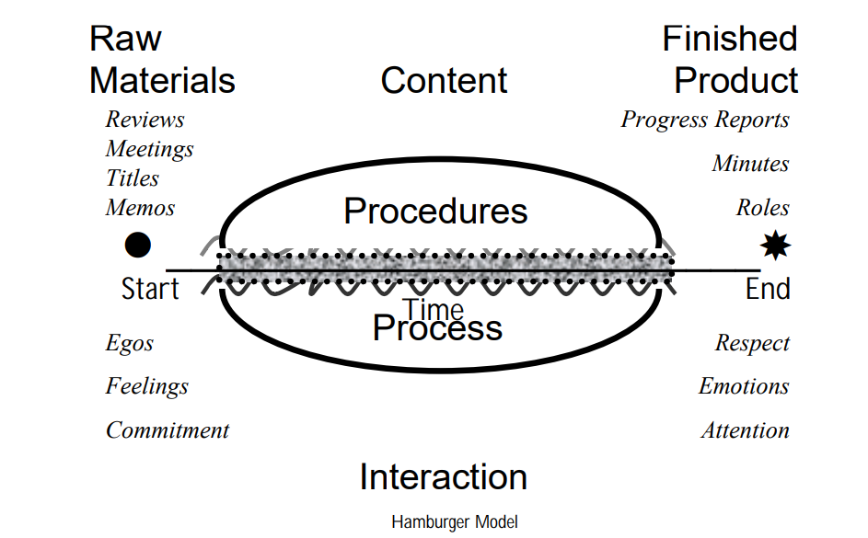
This often called the “HAMBURGER MODEL”
People

Slide 10
As with a real hamburger all three need to be present:
A team needs a task (a hamburger without a filling is just a bread roll);
A team needs rules and procedures of operating ( a hamburger without a top is an open sandwich -and the ketchup makes a mess of your face-)
A team needs to consider the emotions of the individuals in the teem (a hamburger without a bottom bun is a very messy experience indeed)

Slide 11
Go back to your answers for exercise one; fit them into task, procedures and emotions.

Slide 12


