Slide 1

LOGISTICS
Dr.DJOUDI Hanane
Faculty of ECMS/ University of Biskra
April, 2025
REF: Business Vocabulary in Use-Advanced

Slide 2
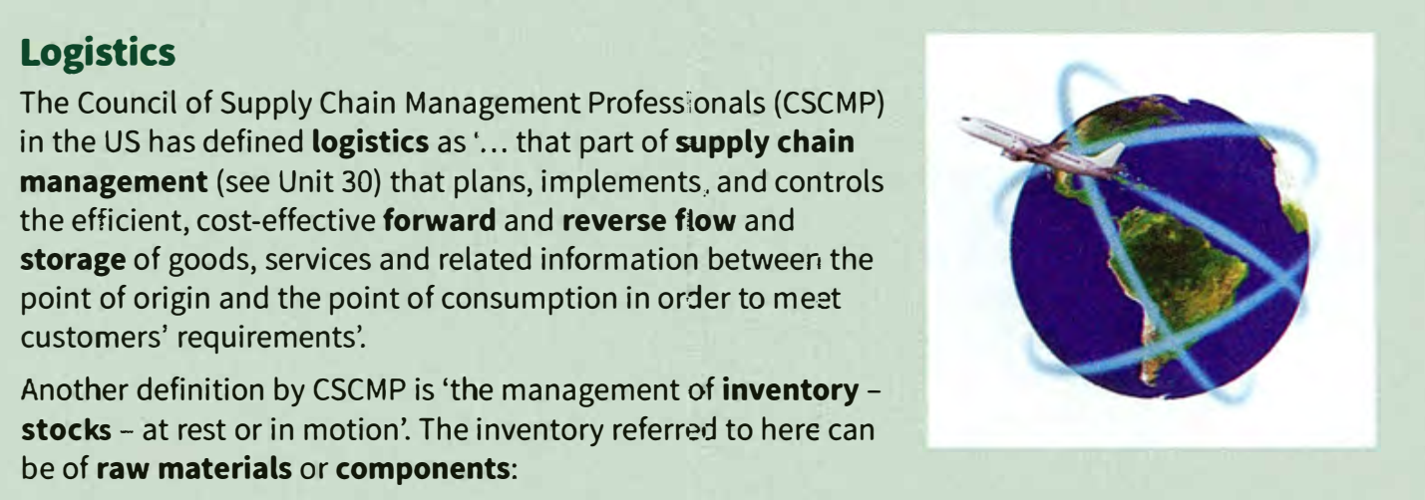
A

Slide 3
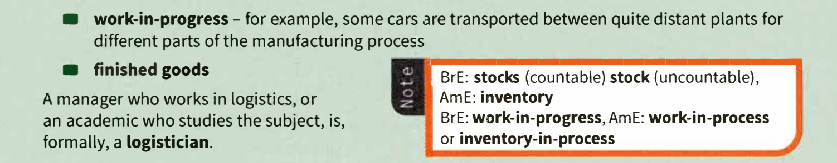
A

Slide 4
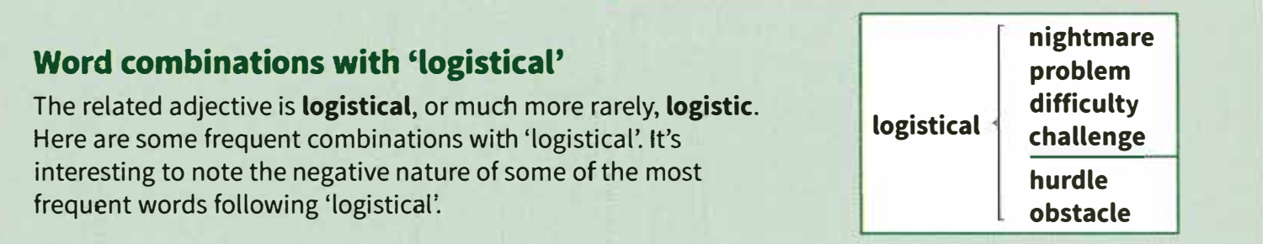
B

Slide 5
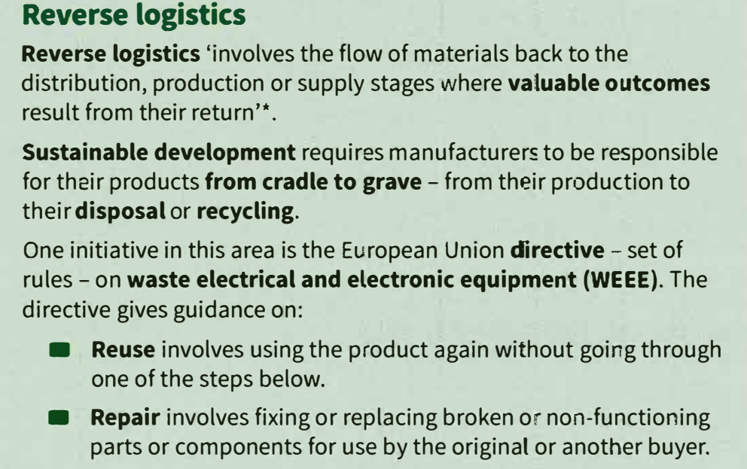
c

Slide 6
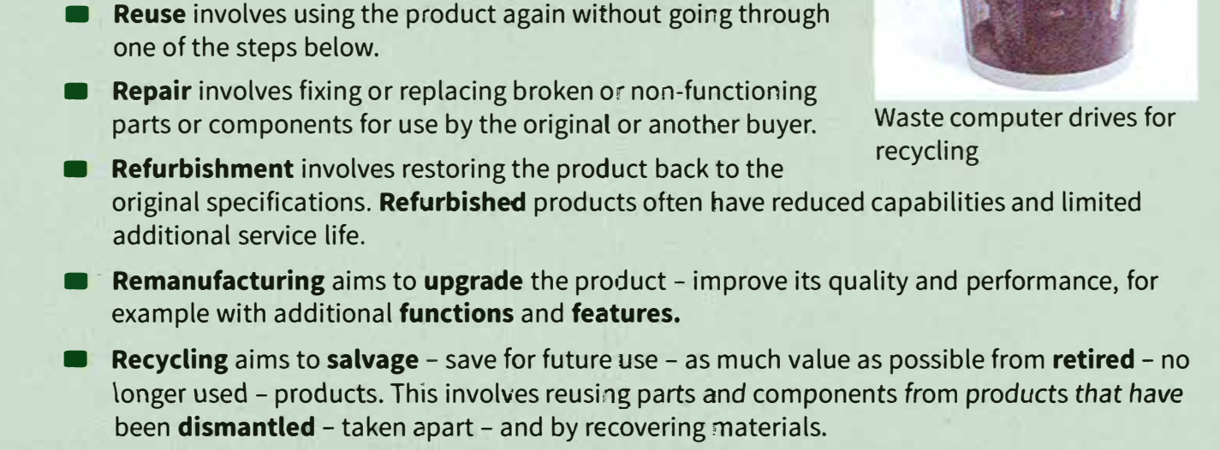
c

Slide 7
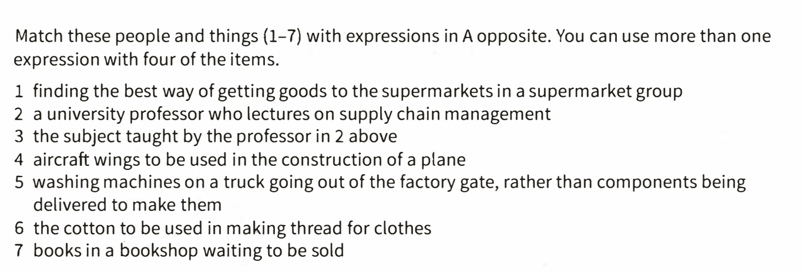
EX 1

Slide 8
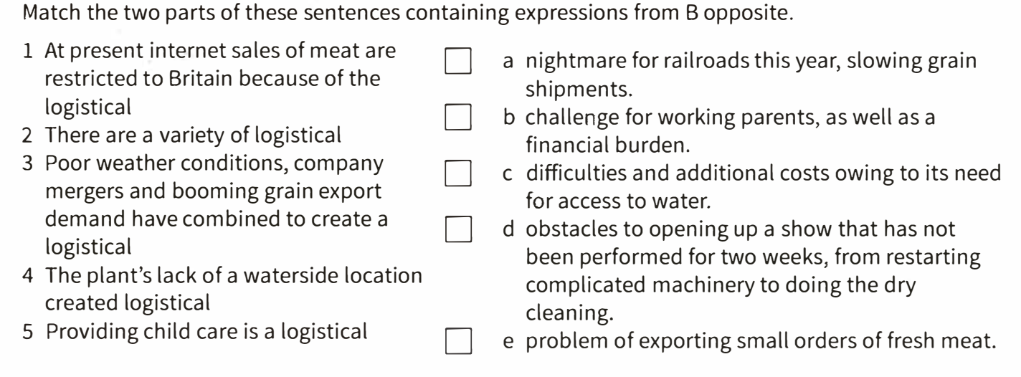
EX 2

Slide 9
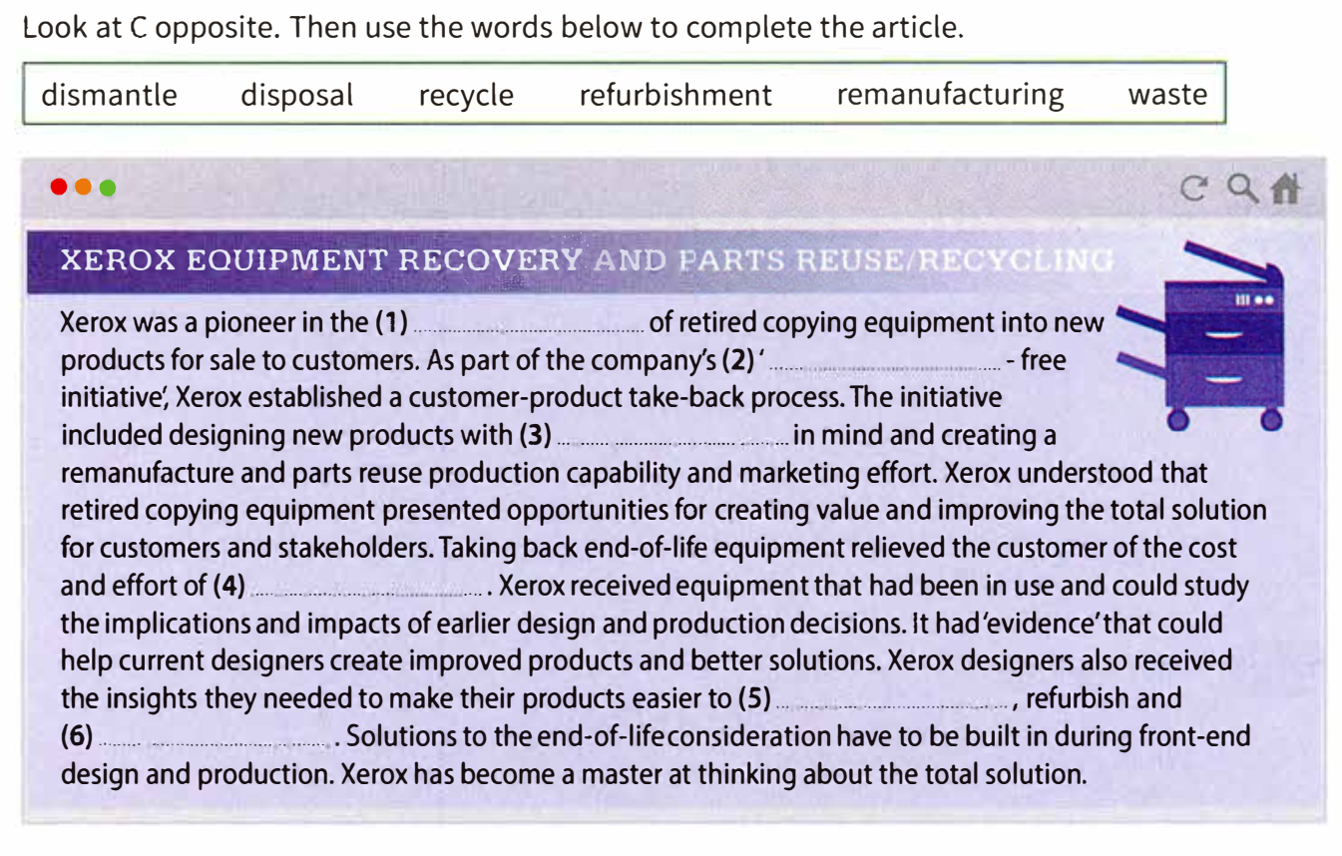
EX 3

Slide 10
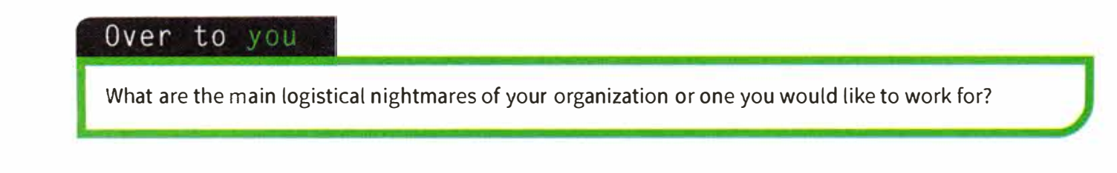
OVER
TO YOU

Slide 11
Thanks

