Slide 1
استراتيجيات سلسلة الامداد
محاضرات مقدمة لللسنة الثالثة ادارة أعمال
طاهري فاطمة الزهراء

Slide 2
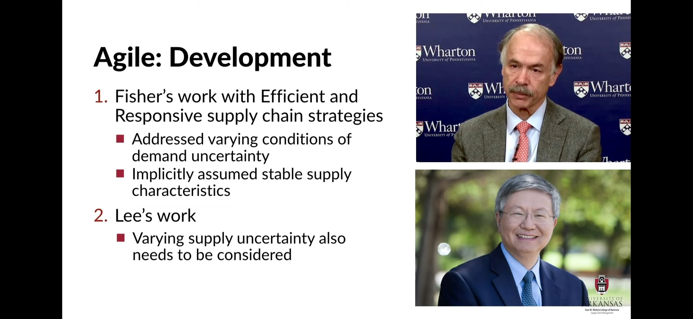

Slide 3
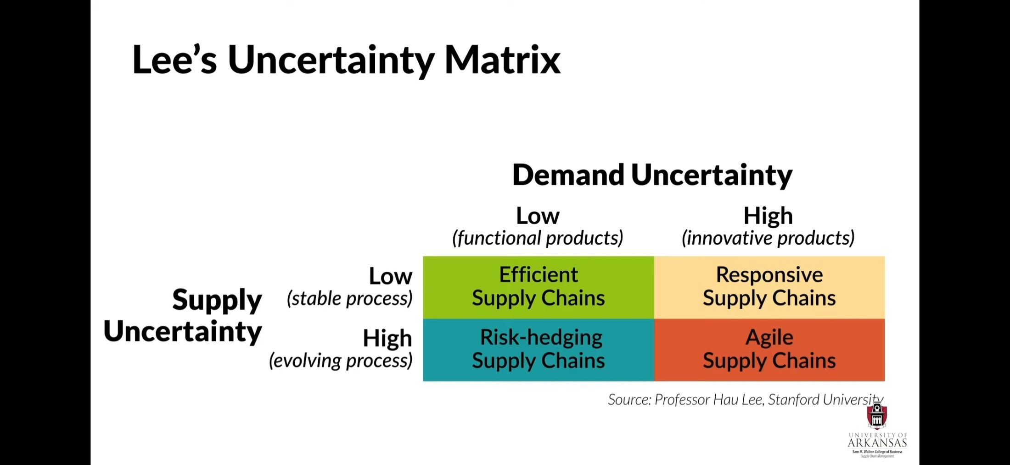

Slide 4
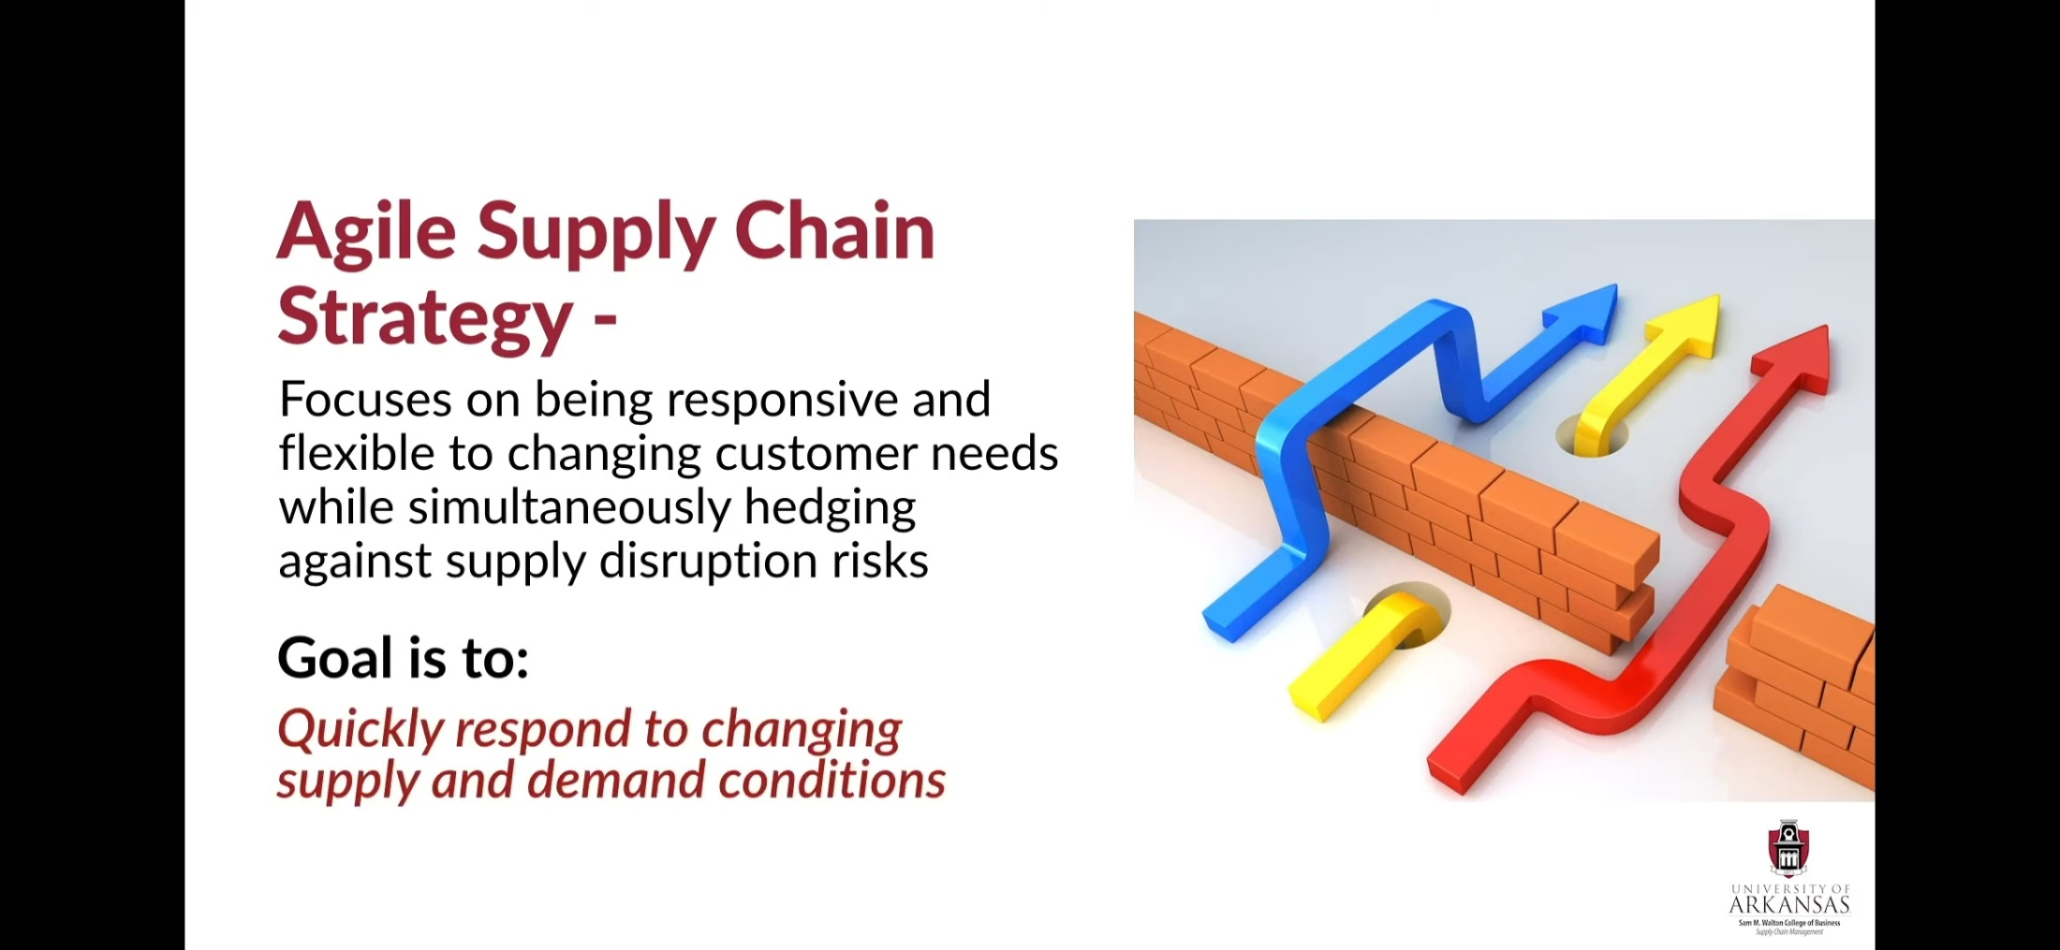

Slide 5
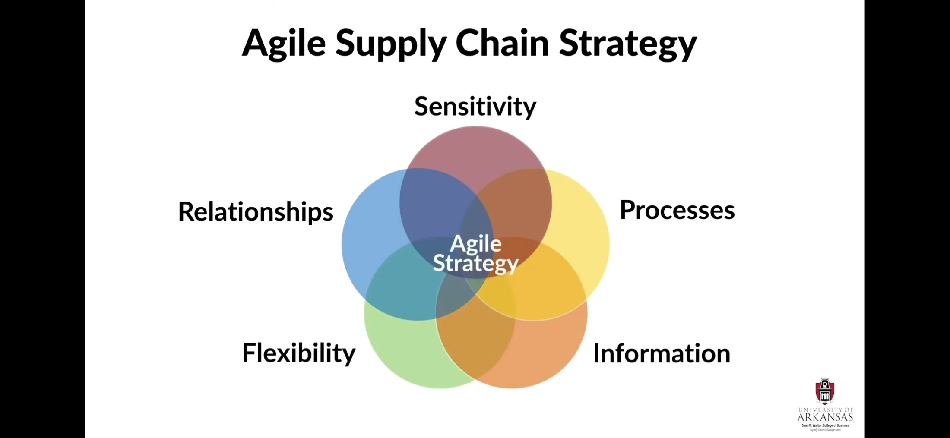

Slide 6
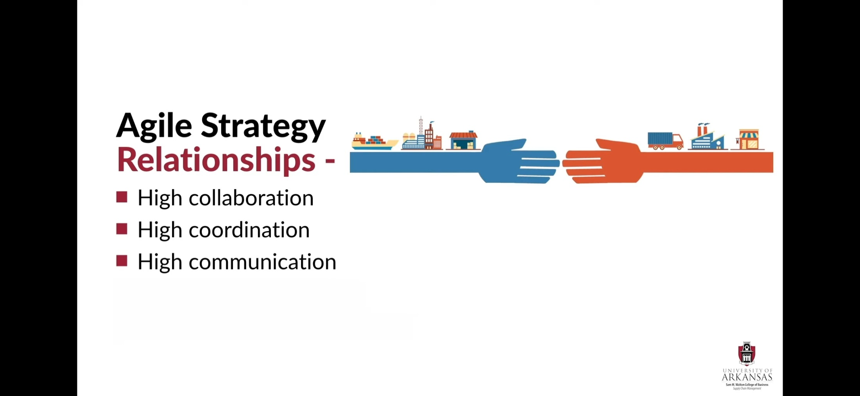

Slide 7
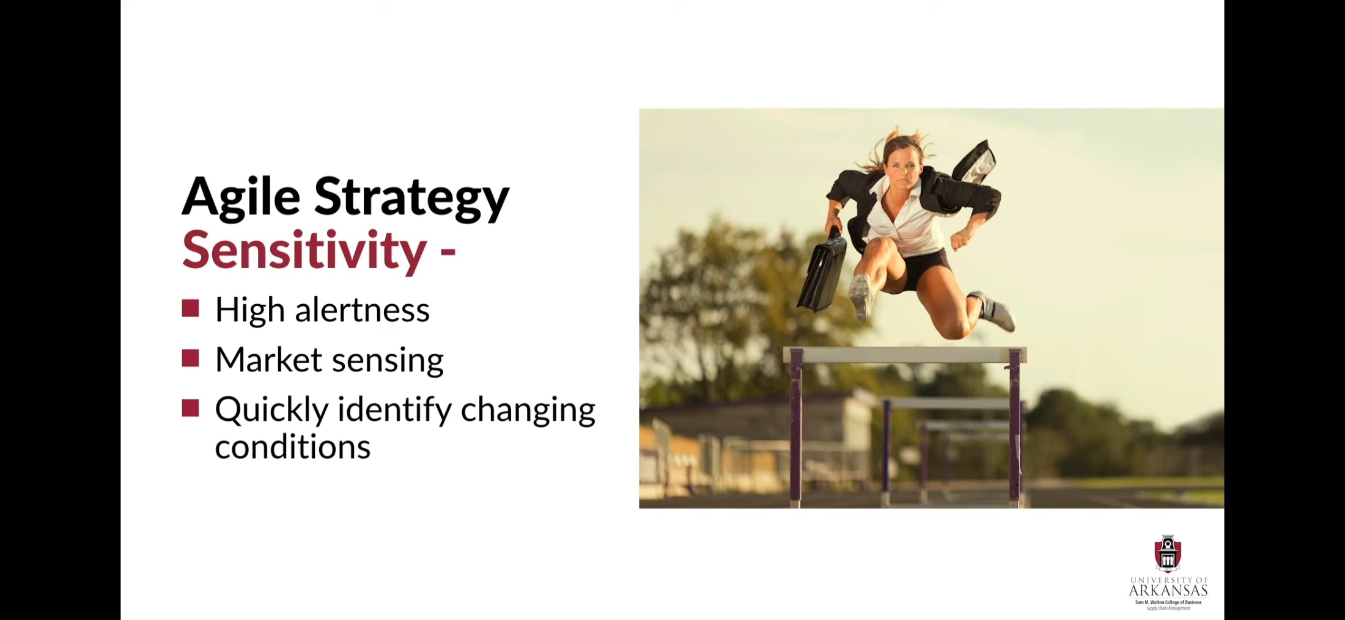

Slide 8
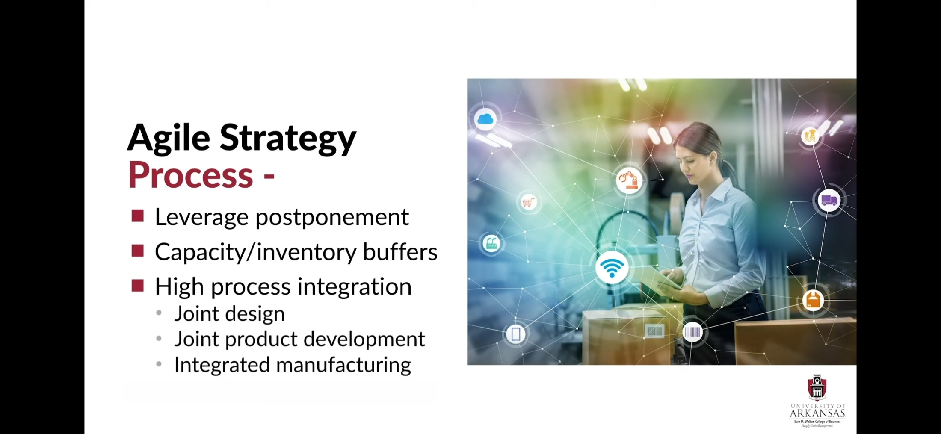

Slide 9
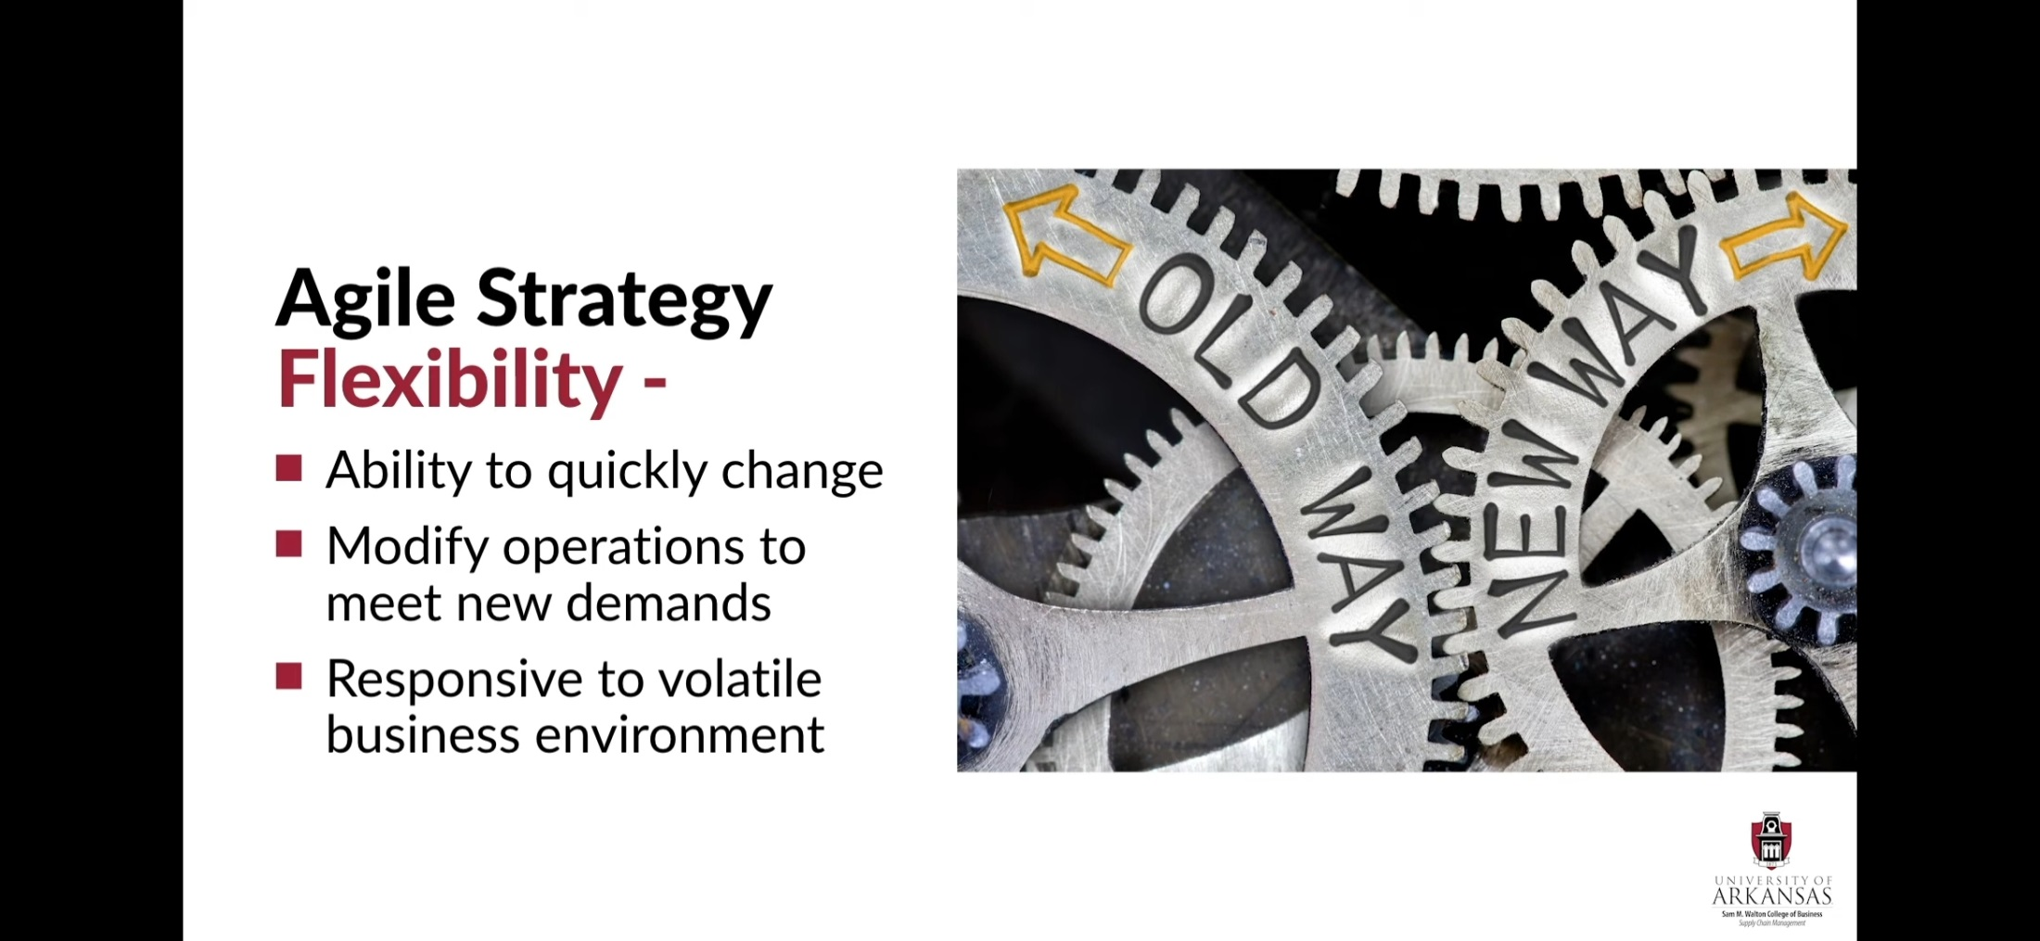

Slide 10
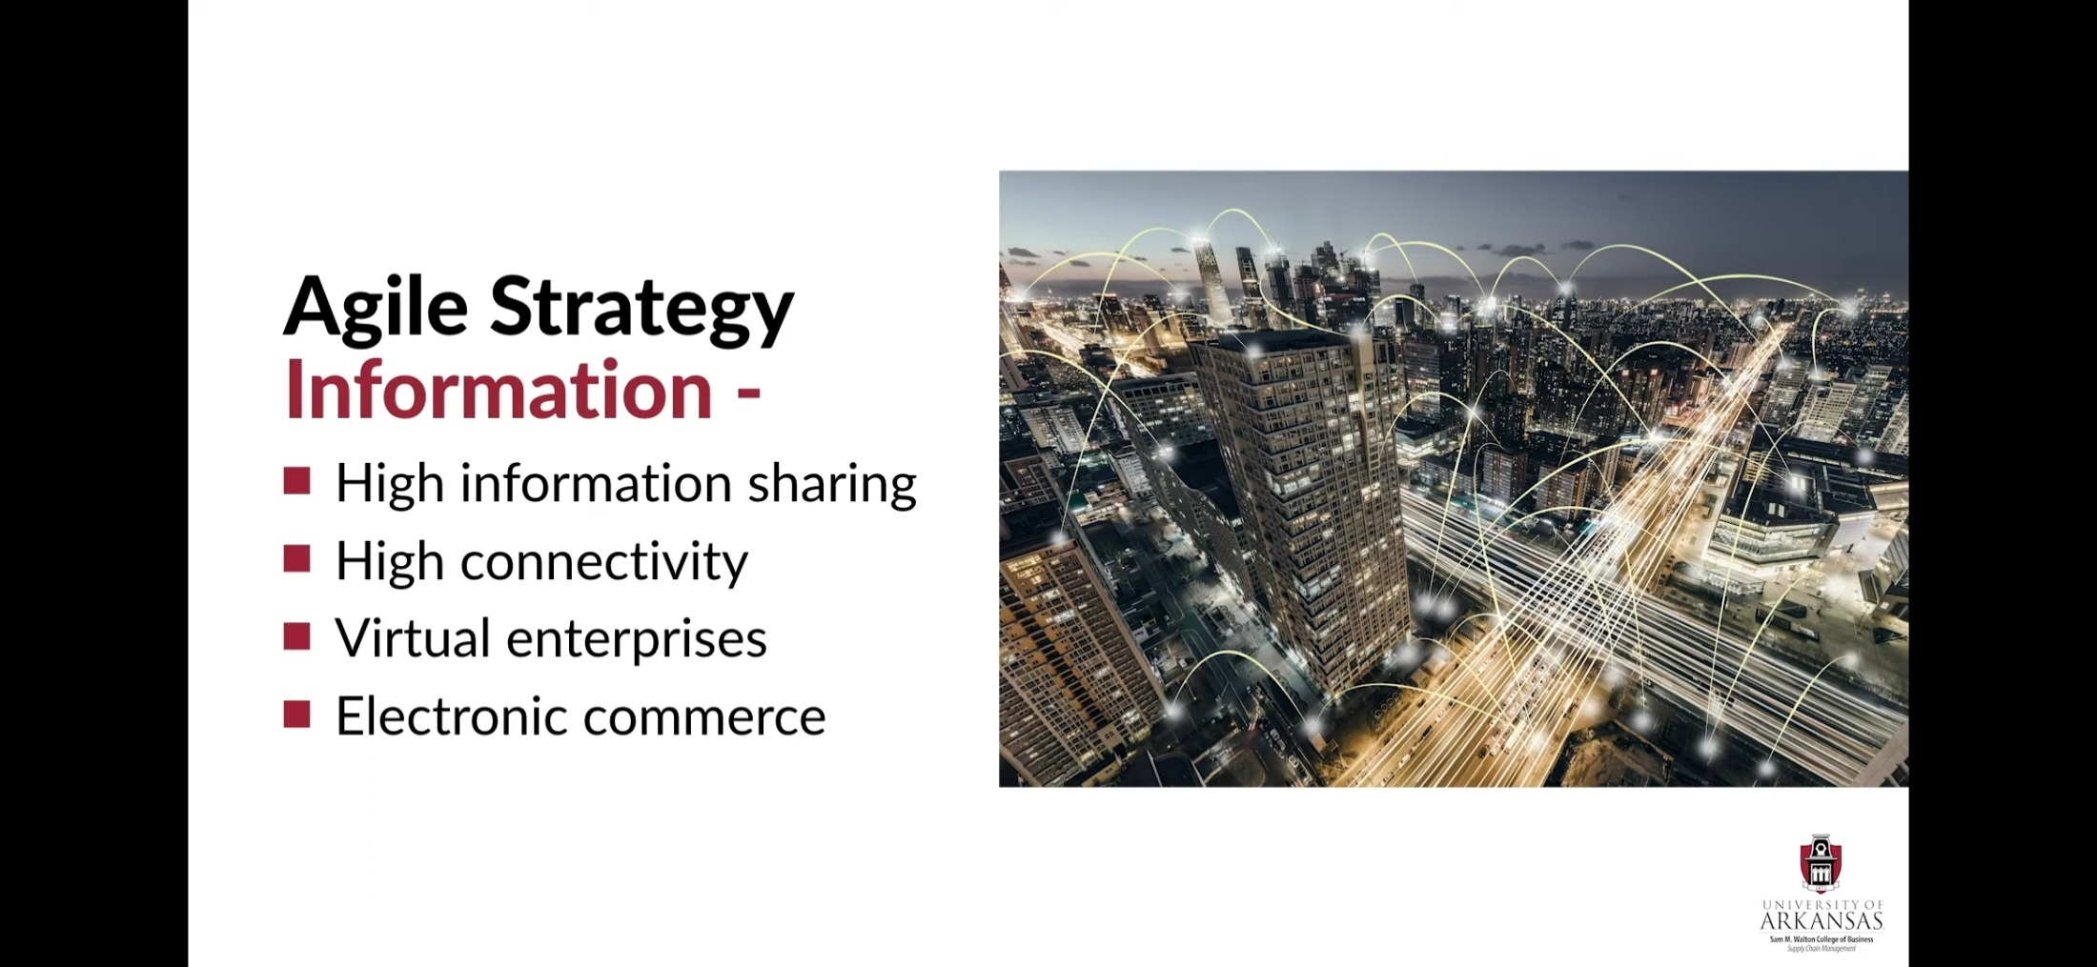

Slide 11
risk hedging supply chain strategy
A risk hedging supply chain strategy is focused on dealing with supply chain disruptions and has two goals:
Share and pool resources
Collectively share and minimize supply chain disruption risks

Slide 12
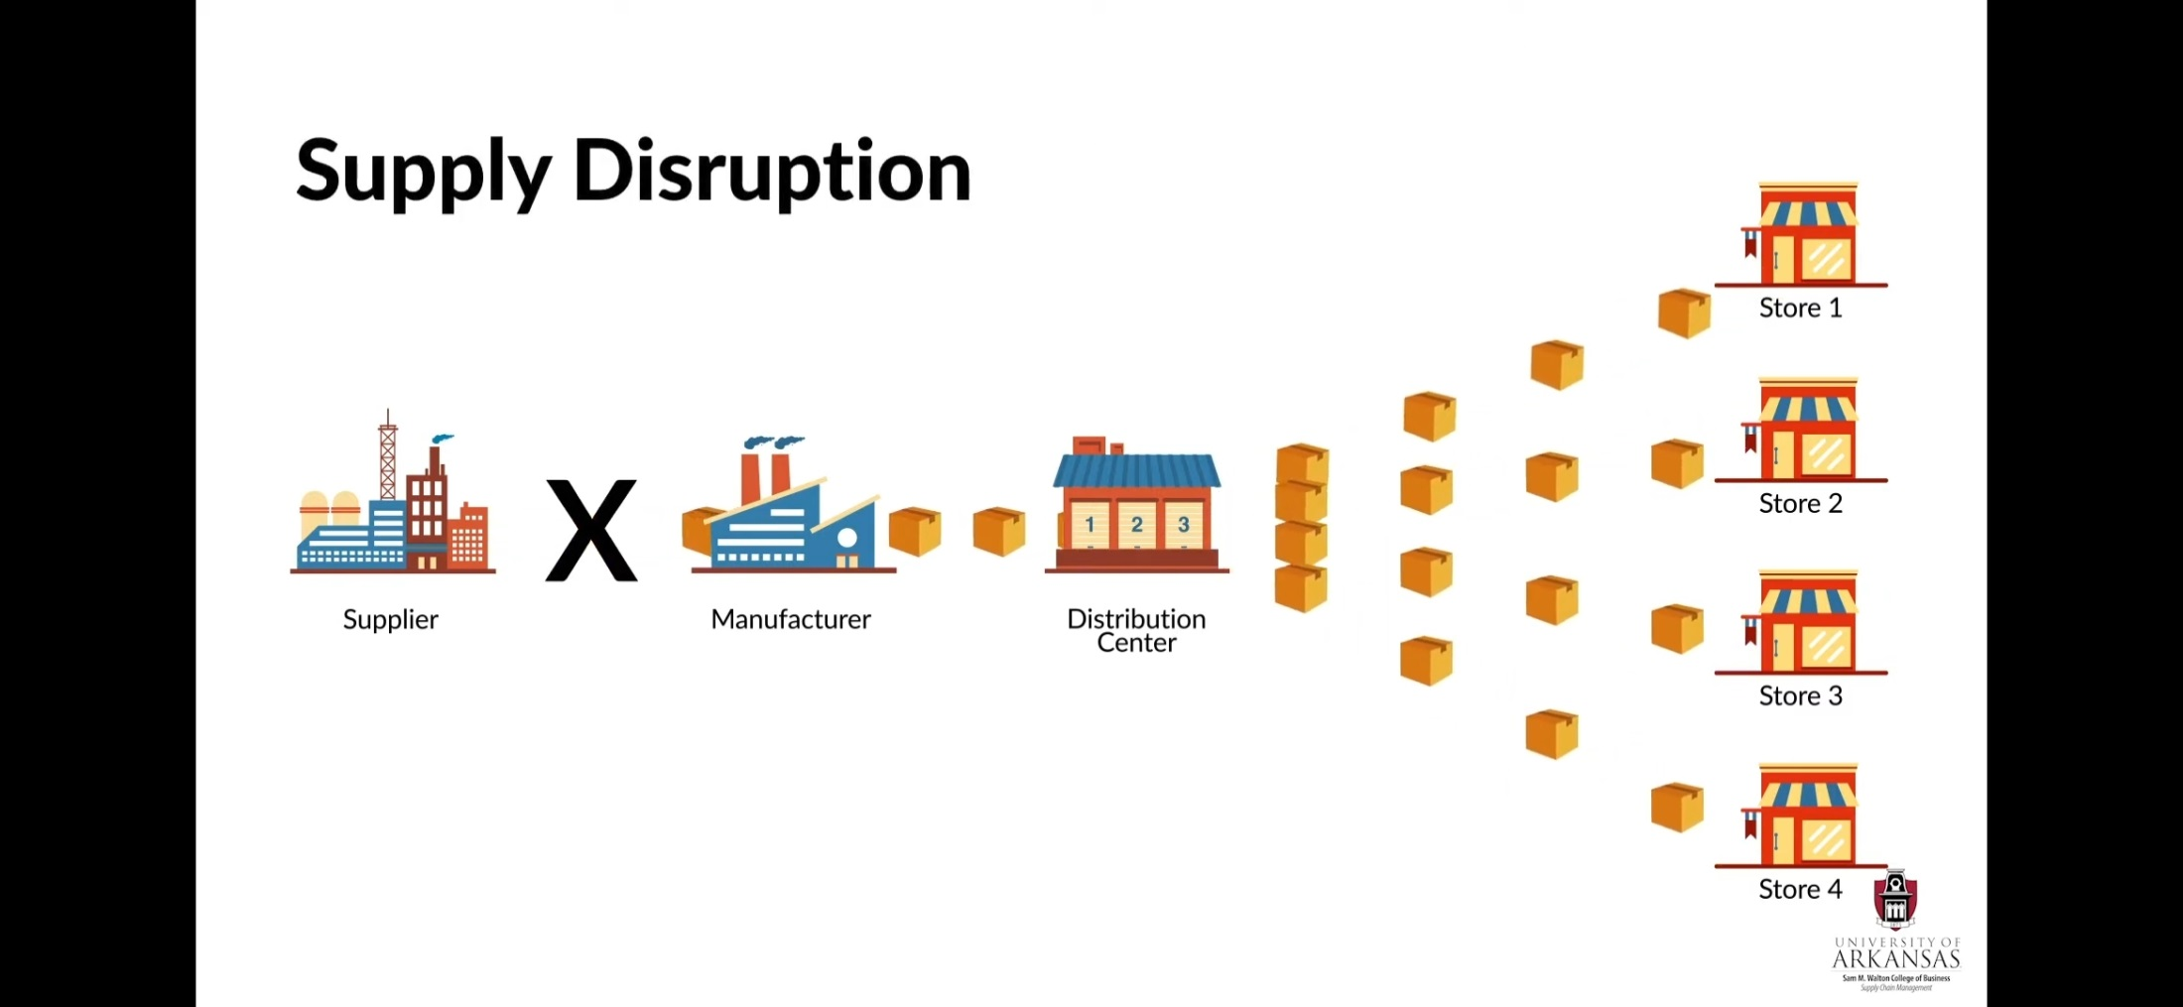

Slide 13
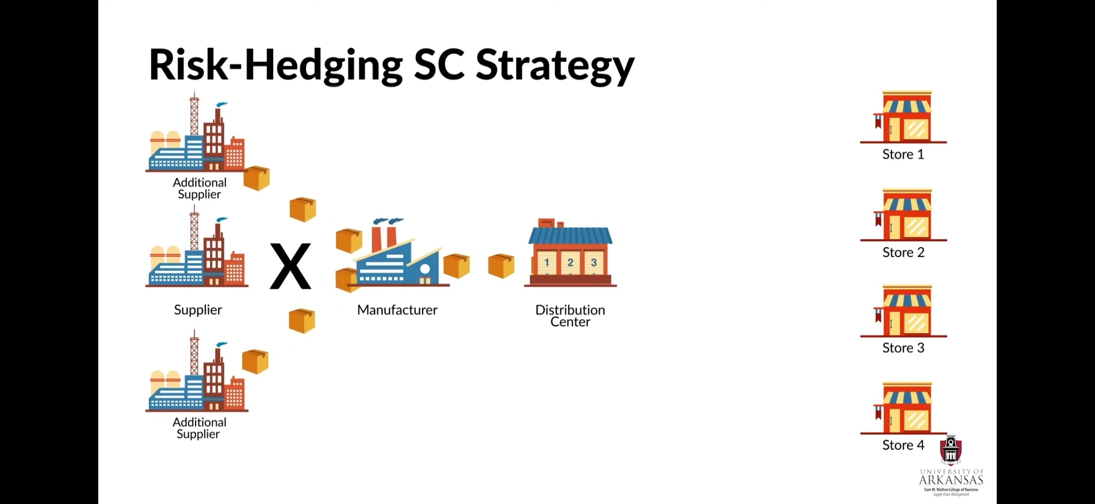

Slide 14
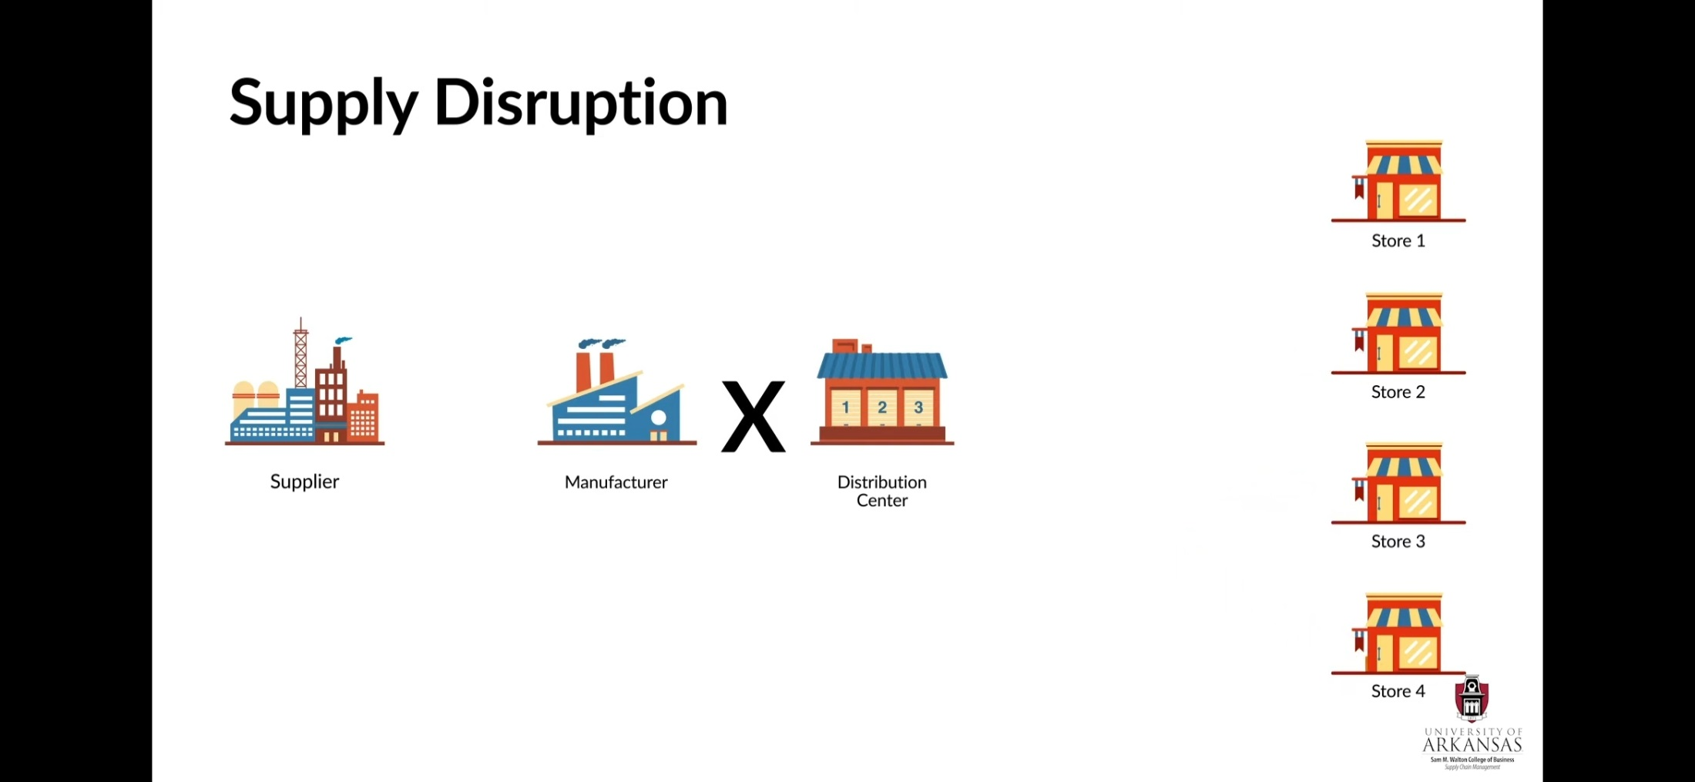

Slide 15
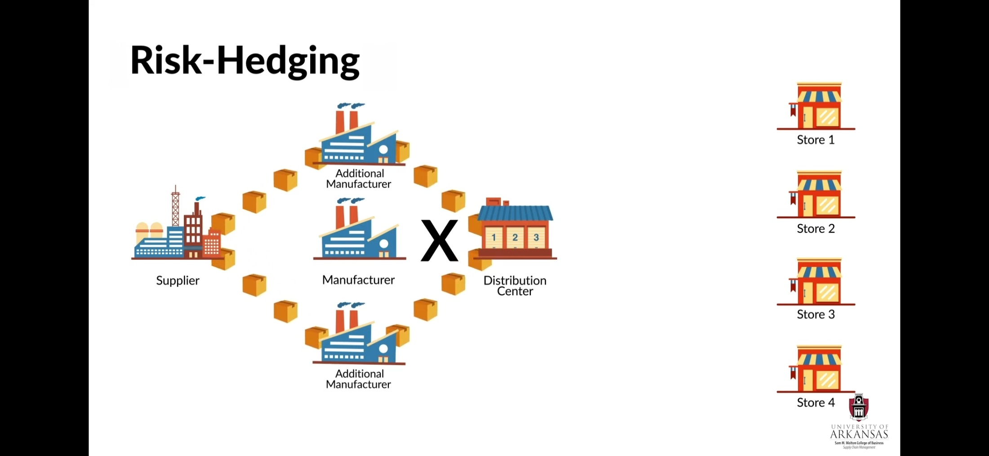

Slide 16
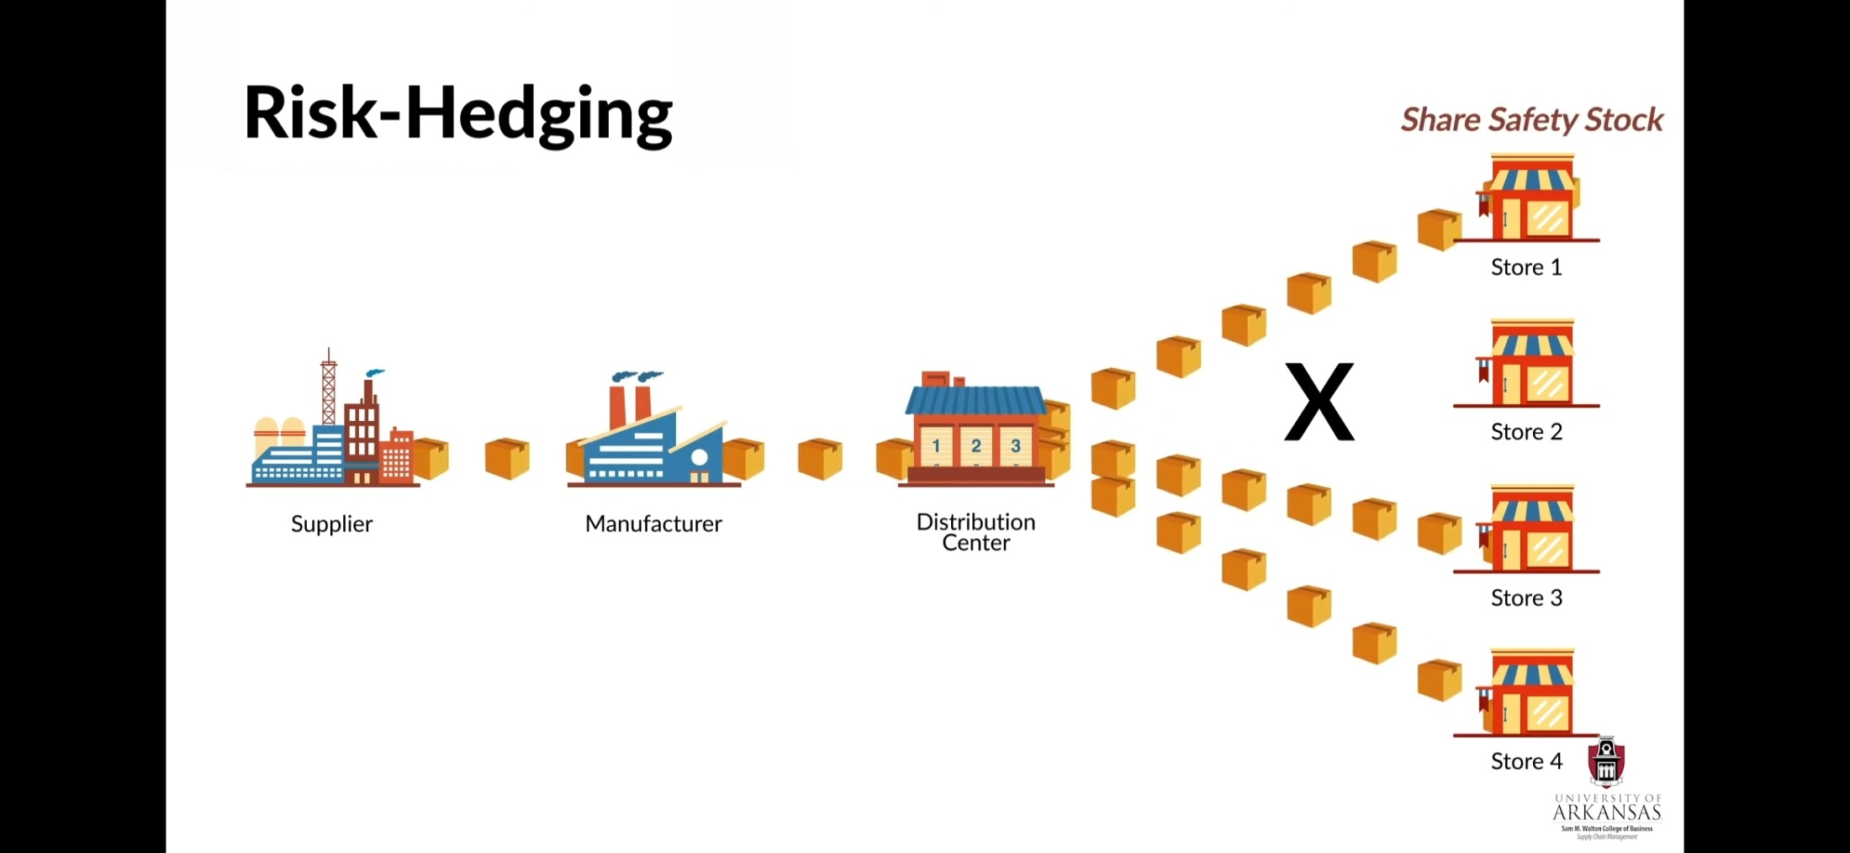

Slide 17
