Slide 1
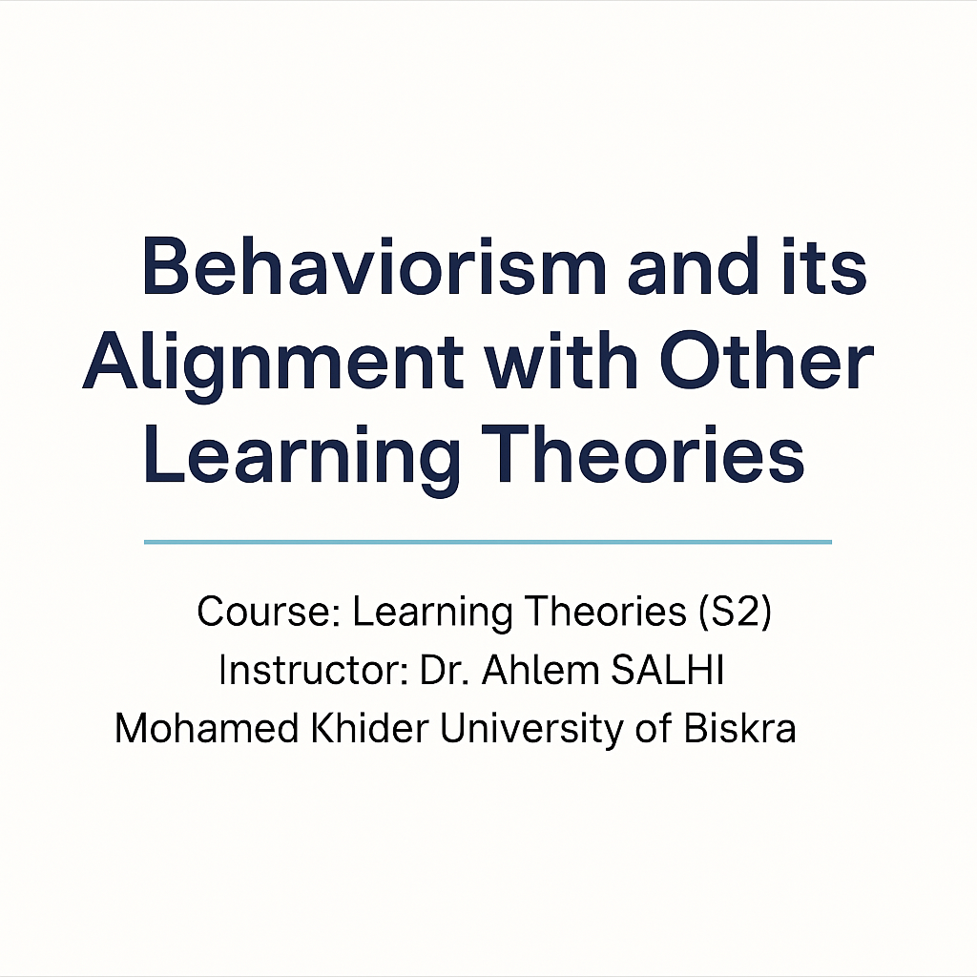

Slide 2
Alignment of Learning Theories
Behaviorism and Its Interaction with Other Theories

Slide 3
Introduction to Alignment
Alignment in educational theories refers to how different theories complement or contrast with each other.
By understanding these alignments, educators can create more effective learning environments.

Slide 4
Behaviorism Overview
Behaviorism focuses on observable behavior, which is shaped by external stimuli.
Key principles: stimulus-response, reinforcement, conditioning.
Key theorists: Skinner, Pavlov, Thorndike.

Slide 5
Behaviorism and Cognitivism Alignment
Both theories track learning, but Behaviorism focuses on observable behaviors while Cognitivism focuses on mental processes.
Behaviorism: Reinforcement of correct responses.
Cognitivism: Information processing and memory retention.
Example: Using rewards in Behaviorism and cognitive strategies in Cognitivism.

Slide 6
Behaviorism and Constructivism Alignment
Behaviorism and Constructivism both value active participation in learning, but in different ways.
Behaviorism: Focuses on external stimuli and reinforcement.
Constructivism: Emphasizes learner autonomy and cognitive processes.
Example: Reinforcement in Behaviorism vs. Inquiry-based learning in Constructivism.

Slide 7
Behaviorism and Social Learning Theory Alignment
Both theories highlight the role of the environment and social context in learning.
Behaviorism: External reinforcement and behavior shaping.
Social Learning Theory: Learning through observation of others.
Example: Reinforcement of behaviors in social settings.

Slide 8
Behaviorism and Humanism Alignment
Behaviorism and Humanism differ in approach: Behaviorism focuses on external factors, while Humanism emphasizes emotional and personal growth.
Behaviorism: Reinforcement and external control.
Humanism: Self-actualization and personal development.
Example: Positive reinforcement vs. learner-centered emotional engagement.

Slide 9
Key Insights of Alignment
Understanding the alignments between theories helps educators choose the best approach for their learners.
Each theory provides unique perspectives on behavior, cognition, and learning, which can be integrated in diverse teaching strategies.

Slide 10
Conclusion
Aligning learning theories can create more holistic, adaptable, and effective learning environments.
Educators can combine elements from each theory to cater to different learning needs and contexts.

