Slide 1

PREPARING FOR THE FUTURE
Dr.DJOUDI Hanane
Faculty of ECMS/ University of Biskra
March, 2025
REF: Business Vocabulary in Use-Advanced

Slide 2
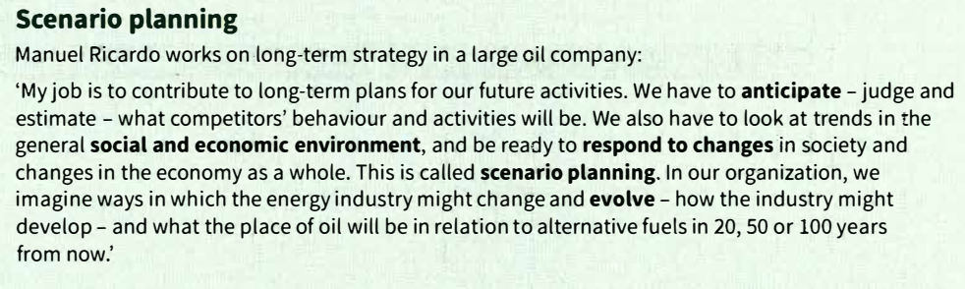
A

Slide 3
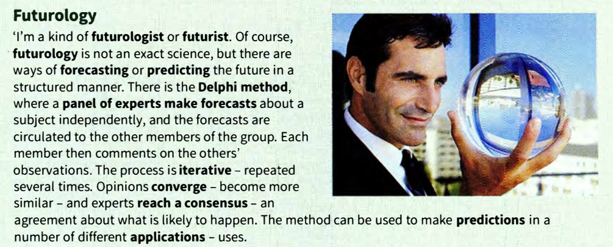
B

Slide 4
B

Slide 5
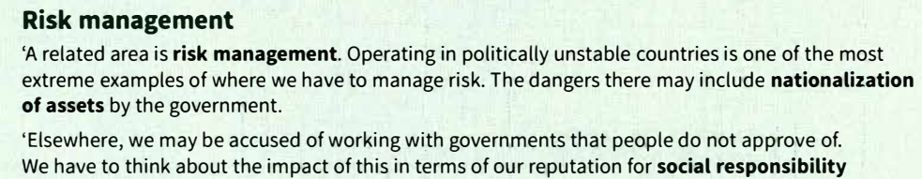
c

Slide 6

c

Slide 7
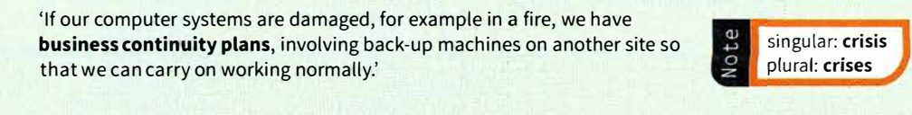
c

Slide 8
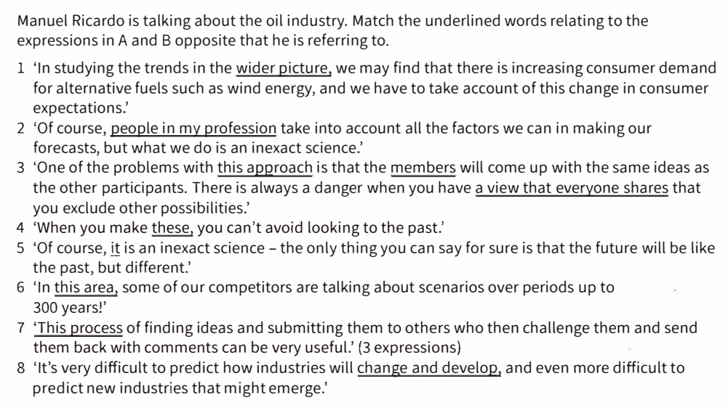
EX 1

Slide 9
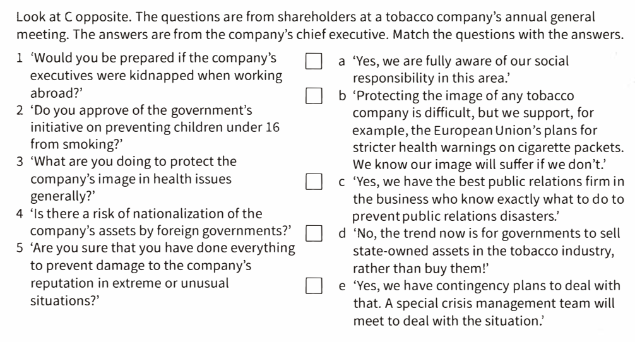
EX 2

Slide 10

OVER TO
YOU

Slide 11
Thanks

