Slide 1
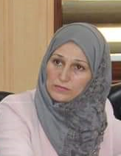
ENTREPRENEURIAL ECOSYSTEM
Virtous Vs Vicious cycles
Dr.DJOUDI Hanane
Faculty of ECMS/ University of Biskra
MARCH, 2025
REF: Growing and sustaining entrepreneurial ecosystems, SEAANZ Ltd 2014

Slide 2
Virtous Vs Vicious cycles
Venkataraman (2004) highlighted the need for a ‘virtuous’ rather than a ‘vicious’ cycle to emerge within a region if technologically based enterprises were to emerge.
النظام البيئي لريادة الأعمال Entrepreneurship ecosystem

Slide 3
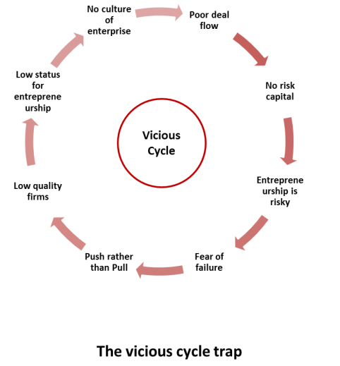
النظام البيئي لريادة الأعمال Entrepreneurship ecosystem

Slide 4
The vicious cycle
sees a culture that is not supportive of enterprise and has a flow of only a few entrepreneurial businesses that are insufficient to attract risk capital, thereby creating a more risky environment. This can increase a fear of failure with a need to push or assist firms to grow rather than having them pulled into growth by market forces. The end result is low quality firms and the overall status of entrepreneurship is low leading to a poor culture in the region in relation to enterprise.
النظام البيئي لريادة الأعمال Entrepreneurship ecosystem

Slide 5
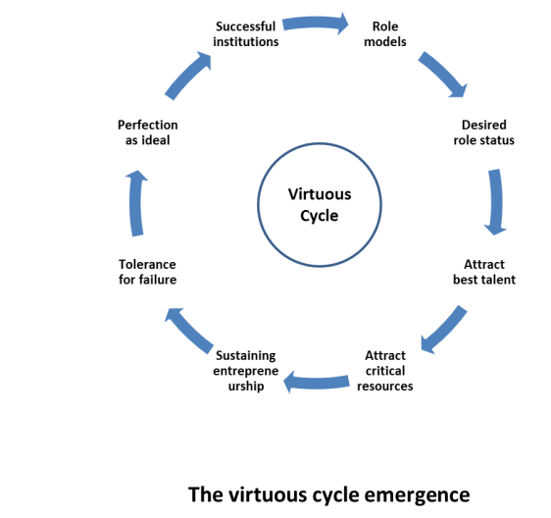
النظام البيئي لريادة الأعمال Entrepreneurship ecosystem

Slide 6
The virtuous cycle
involves the building on successful enterprises that serve as role models, and then serves to
attract into the region the kind of people who will seek to emulate these role models. There is
also a tolerance of failure and an inflow of critical resources such as human capital, money and
infrastructure.
النظام البيئي لريادة الأعمال Entrepreneurship ecosystem

Slide 7
Virtous Vs Vicious cycles
Venkataraman (2004) suggested the need for ‘seven intangibles’ ,which reflect the conditions that should exist before a vicious cycle can be converted into a virtuous cycle.
النظام البيئي لريادة الأعمال Entrepreneurship ecosystem

Slide 8
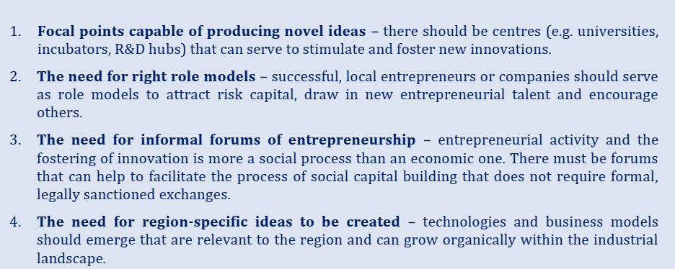
النظام البيئي لريادة الأعمال Entrepreneurship ecosystem

Slide 9
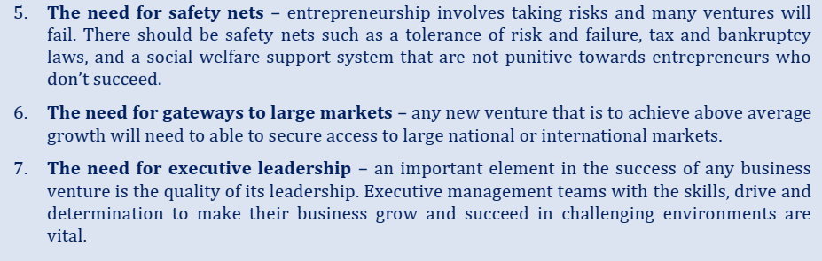
النظام البيئي لريادة الأعمال Entrepreneurship ecosystem

