Slide 1
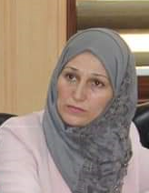
THE RIGHT SKILLS
Dr.DJOUDI Hanane
Faculty of ECMS/ University of Biskra
March, 2025
REF: Business Vocabulary in Use-Advanced

Slide 2
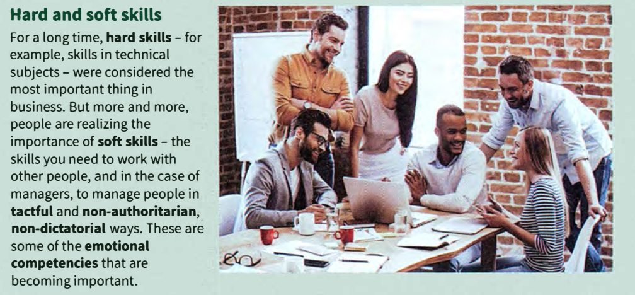
A

Slide 3
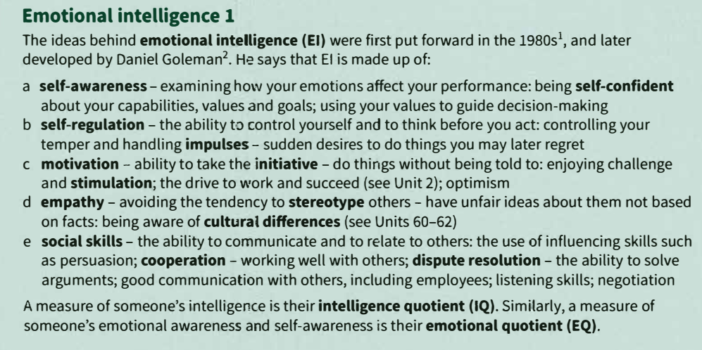
B

Slide 4
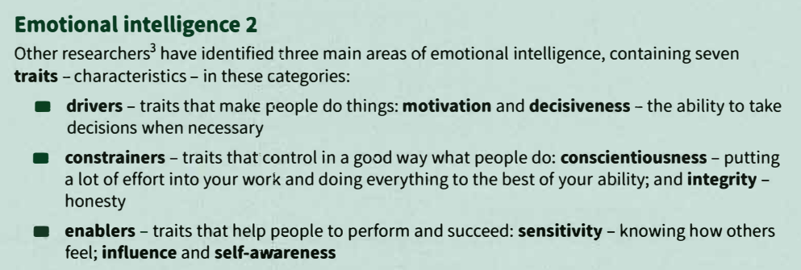
c

Slide 5
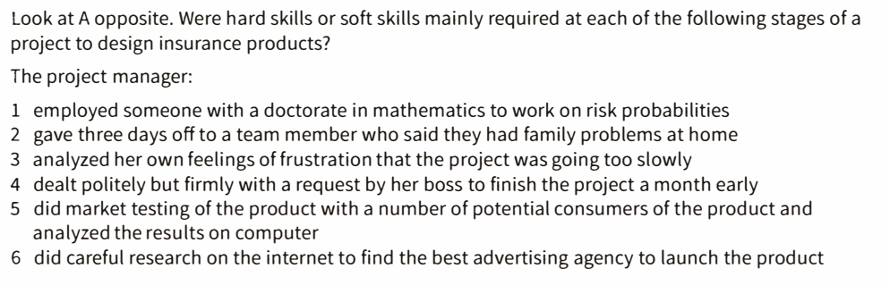
EX 1

Slide 6
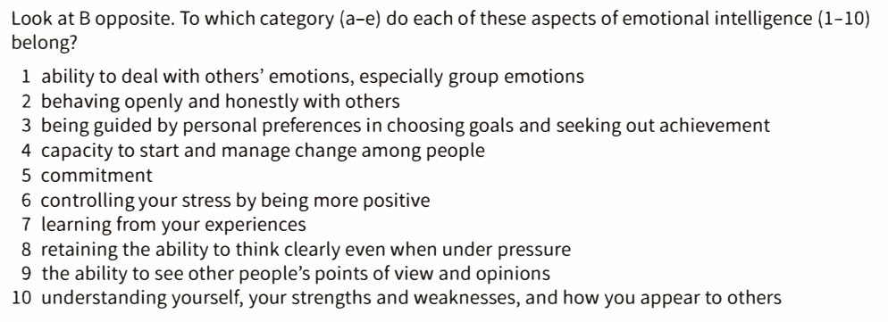
EX 2

Slide 7
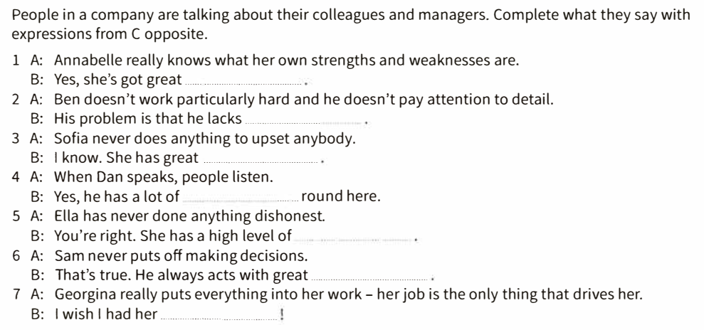
EX 3

Slide 8
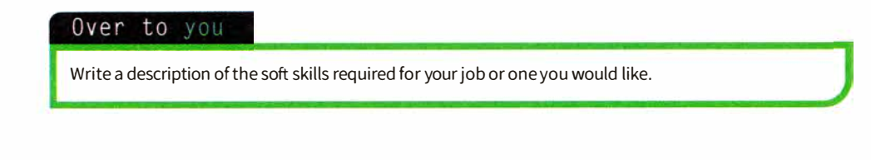
OVER TO
YOU

Slide 9
Thanks

