Slide 1
University Of Mohammed Khider -Biskra -
Faculty of Economic Sciences, Commercial Sciences and Management Sciences
Department of Management
Lecture n°5:
LEADERSHIP STYLES
Dr. ABDAOUI Nawal
nawal.abdaoui@univ-biskra.dz
Academic Year
2024-2025

Slide 2

INTRODUCTION
Leadership refers to the process of influencing and guiding others towards the achievement of a common goal or vision. Simply put, leadership is the ability to inspire, motivate, and empower individuals or groups to work collaboratively and effectively. leadership encompasses a wide range of skills, traits, and behaviors, including: decision-making, communication, strategic thinking, and vision setting – which are quite key for every leader.

Slide 3
DEFINITION OF LEADERSHIP STYLE
Leaders usually exhibit a style of leadership as they motivate and inspire their followers. Leadership style therefore, refers to the manner in which a leader chooses to lead and interact with their followers. It reflects the leader's behaviors, attitudes, and actions in influencing and directing others. Leadership style has a huge influence on how a leader makes decisions, communicates expectations, motivates followers, and creates a work environment.
Leadership style is an expression of the leader's leadership approach. It reflects the leader's preferences, values, and beliefs about how to effectively lead and influence others.
There are several leaderships styles and these different leadership styles can impact the dynamics, productivity, and culture within an organization or group in several different ways.

Slide 4
autocratic
transactional
transformational

Slide 5
Transformational leadership is a leadership style in which the leader inspires and motivates his/her followers to achieve exceptional performance by creating a vision, setting high expectations, and challenging the followers to exceed their own self-interests for the benefit of the organization or society at large. Transformational leaders focus on transforming individuals and organizations by encouraging creativity and promoting personal growth.
The main characteristics of transformational leadership are:
Visionary: Transformational leaders have a clear vision of what they want to achieve.
Effective communicators: Transformational leaders are good communicators who articulate their vision effectively to their followers.
Inspirational and motivational: Transformational leaders inspire and motivate others by providing a compelling future direction. They also create a positive and motivating environment.
Forster change: Transformational leaders are change leaders or drivers.
Empathetic: Transformational leaders are empathetic and understand their followers’ needs and concerns.
TRANSFORMATIONAL

Slide 6
TRANSFORMATIONAL | ADVANTAGES | DISADVANTAGES
 | - Transformational leaders inspire their followers to go above and beyond, resulting in higher levels of motivation and commitment. - By setting high expectations and encouraging innovation, transformational leaders can drive their teams or organizations to achieve outstanding results. - Transformational leaders create a positive and supportive work environment that promotes collaboration, creativity, and a sense of purpose. Transformational leaders are change leaders, they lead and drive change in organizations or societies. | - Transformational leadership relies heavily on the leader's influence, and if the leader is absent or fails to provide proper guidance, it can negatively impact the followers. - Followers often become over-reliant on the leader’s guidance and decision-making. - Transformational leaders may set extremely high expectations, leading to increased stress and burnout among their followers. - The leaders too, face burnout as they invest too much time and energy in supporting and developing their followers. - Since some individuals naturally resist change, they may resist the transformational leader's vision or find it difficult to adapt to the constant changes and challenges.

Slide 7
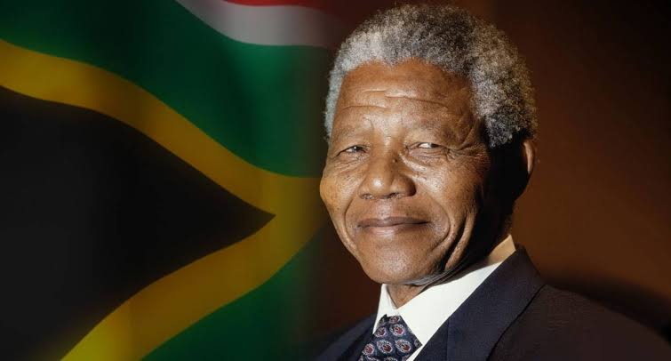
Nelson Mandela
The former President of South Africa, exemplified transformational leadership through his vision of a democratic and all-inclusive South Africa. He demonstrated transformational leadership when he inspired and united millions of South Africans during the anti-apartheid movement, and his emphasis on reconciliation and forgiveness.

Slide 8
Transactional leadership is an approach that focuses on the exchange relationship between leaders and followers . In this leadership style, the leader maintains stability and achieves goals through a system of rewards and punishment. For any good performance, the leader provides rewards (such as bonuses, improved salaries, promotions,…) while poor performance receives punishments (like demotions, warning letters, reprimands, salary cuts and terminations).
the features and characteristics of transactional leadership as:
Clearly defined expectations: Transactional leaders establish clear expectations and ensure that everyone understands these expectations.
Defined contingent rewards: In line with the expectations, transactional leaders also provide well defined rewards and pusnishments to their followers based on meeting the set performance targets.
Exchange relationship: This leadership style is based on an exchange relationship - a reward for good performance and punishment for poor performance.
Monitoring performance: Transactional leaders closely monitor the performance of their teams and intervene when deviations occur to ensure compliance with established standards.
Goal oriented: This type of leadership is focused on achieving goals.
TRANSACTIONAL

Slide 9
TRANSACTIONAL | ADVANTAGES | DISADVANTAGES
 | Clear expectations: Transactional leaders set specific goals and performance standards, providing clarity to their followers about what is expected of them. - This leadership approach promotes efficiency and productivity by emphasizing adherence to established procedures and standards. - Goal achievement: This leadership style is focused on achieving goals. - Quick decision-making: Transactional leaders make decisions efficiently, relying on established protocols and systems. | - Limited creativity and innovation: Transactional leadership discourages creativity and innovation as the focus is primarily on meeting predetermined goals and targets. - Lack of long-term motivation: The rewards and punishments provided by transactional leaders may primarily focus on short-term goals, potentially leading to a lack of sustained motivation among followers in the long term. - Inflexibility and limited adaptability to change: Transactional leaders may struggle to adapt to rapidly changing environments and circumstances or unexpected challenges due to their reliance on established rules and procedures.

Slide 10

Bill Gates
the co-founder of the software giant Microsoft, exhibited transactional leadership by setting well defined goals, and rewarding the achievement of these goals.

Slide 11
Autocratic leadership, also known as authoritarian leadership, is a leadership system in which the leader holds absolute power and makes decisions without any input from followers. The leader exercises full control over the decision-making process and typically expects strict compliance from the subordinates.
The features and characteristics of autocratic leaders as :
Centralized decision-making: Autocratic leaders make all the decisions independently, without any input or feedback from their followers.
Direct supervision: Such leaders closely monitor and control their subordinates' work, often providing detailed instructions and closely overseeing their subordinates’ tasks.
Limited individual autonomy: Autocratic leaders expect strict adherence to rules and procedures, leaving little or no room for individual initiative or independent decision-making.
Auoritarian Control: The leader has absolute control over the team and expects team members to follow instructions without question.
Autocratic

Slide 12
AUTOCRATIV | ADVANTAGES | DISADVANTAGES
 | - Clear direction: With autocratic leadership, there is a clear chain of command and well-defined roles and responsibilities, providing clarity to followers. - Suitable in crisis situations: This style can be effective in crisis situations where decisive action is necessary, and there is limited time for consultation. | - Lack of creativity and innovation: Autocratic leadership stifles creativity and innovation since the focus is primarily on following instructions and procedures. - Reduced employee morale and motivation: The lack of involvement and participation in decision-making can lead to decreased employee morale, job desatisfaction, and demotivation. - Dependency on the leader: In autocratic leadership, the leader holds most of the power and knowledge, creating a dependency on their presence and decision-making abilities.

Slide 13
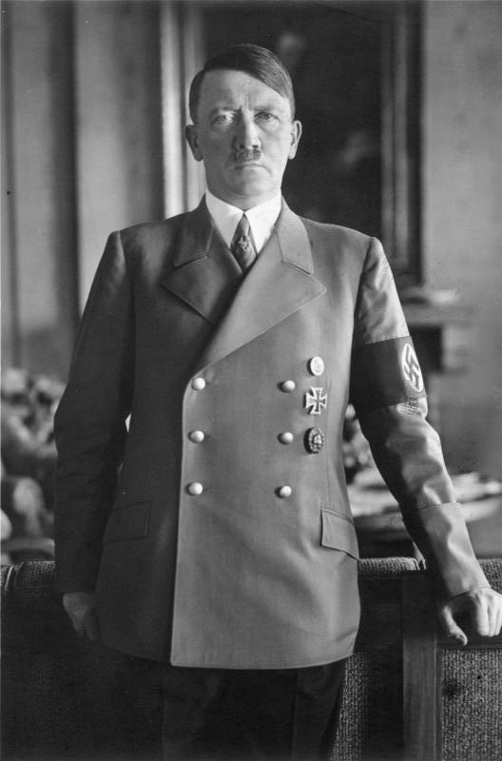
Adolf Hitler
Hitler's leadership during the Nazi regime exemplified autocratic leadership, with him holding absolute power, making decisions unilaterally, and demanding unquestioning obedience from his subordinates.

Slide 14


