Slide 1
University Of Mohammed Khider -Biskra -
Faculty of Economic Sciences, Commercial Sciences and Management Sciences
Department of Management
Lecture n°4:
Organizational structure
Dr. ABDAOUI Nawal
nawal.abdaoui@univ-biskra.dz
Academic Year
2024-2025

Slide 2


Slide 3

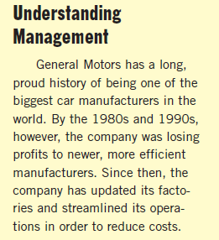
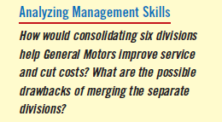

Slide 4



Slide 5
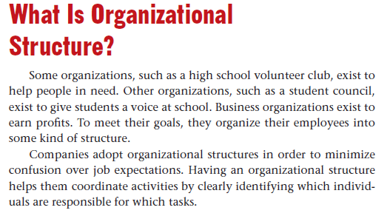

Slide 6


Slide 7

Functional structure
U- Form
Divisional structure
M- Form
Matrix structure
Network structure

Slide 8
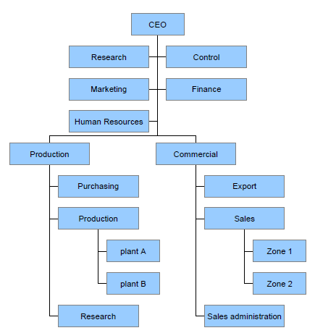
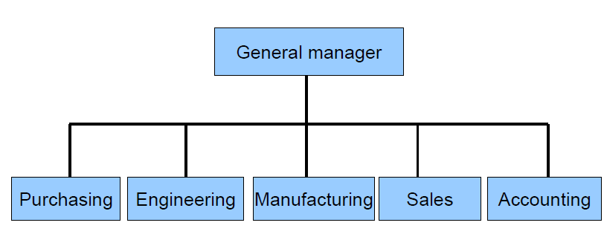
Functional structure
U- Form

Slide 9
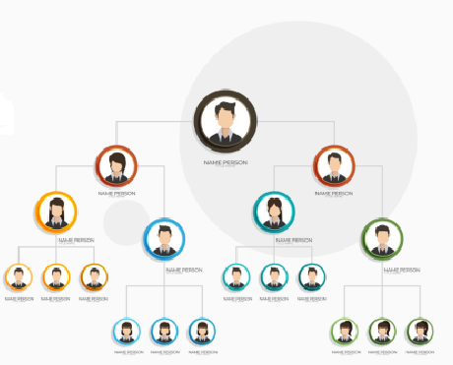
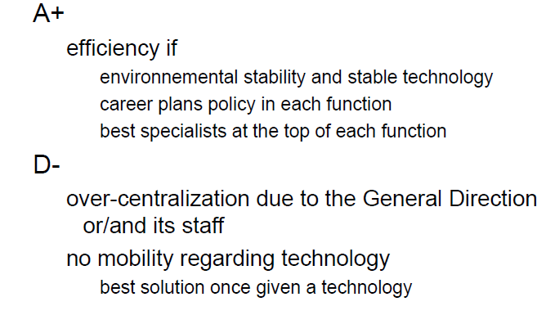

Slide 10
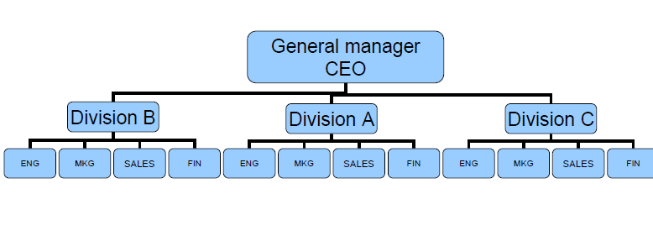
Divisional structure
M- Form

Slide 11
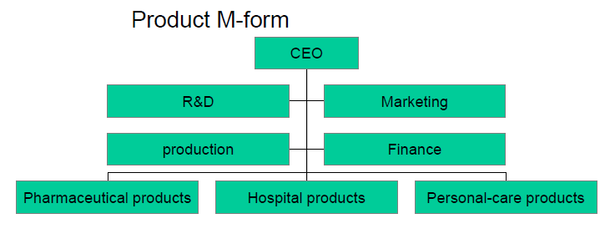
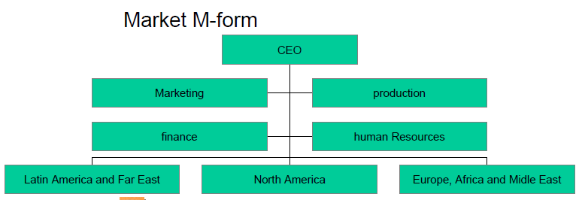

Slide 12
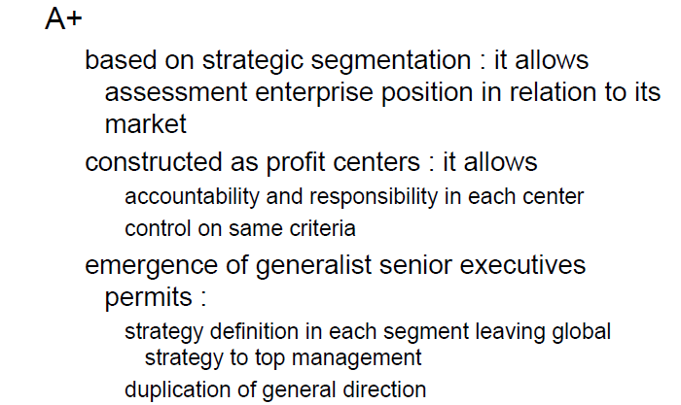
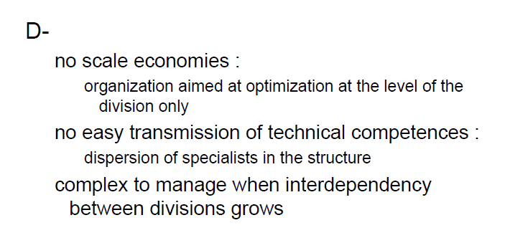

Slide 13
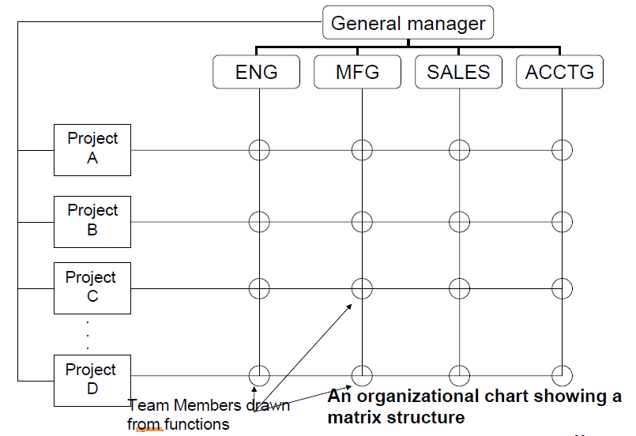
Matrix structure

Slide 14
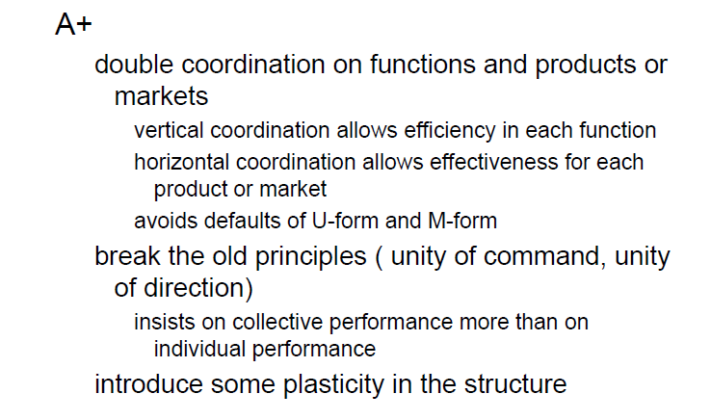


Slide 15
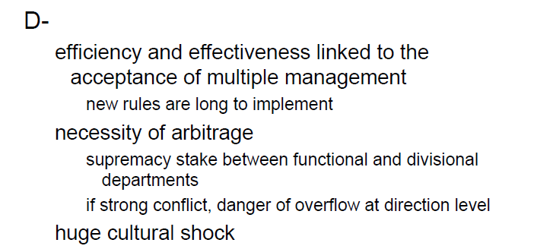

Slide 16
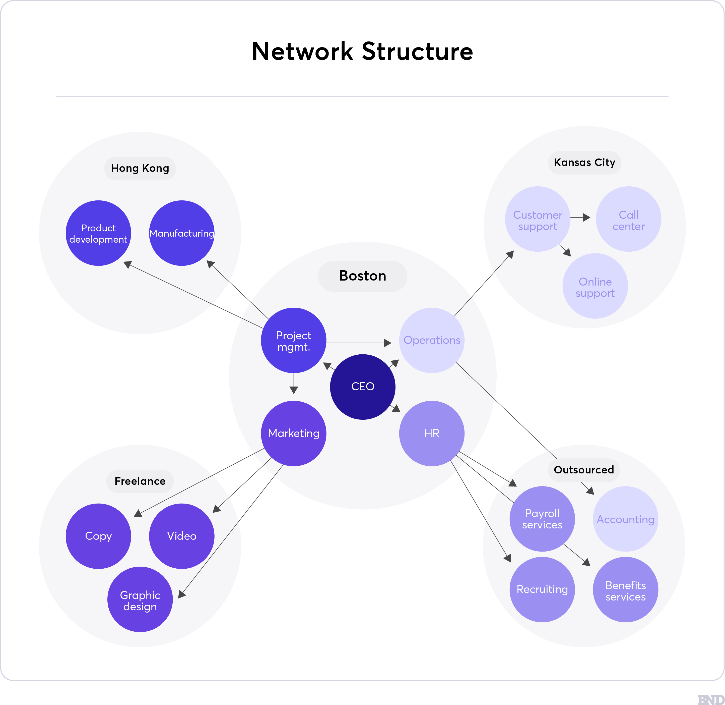
Network structure

Slide 17
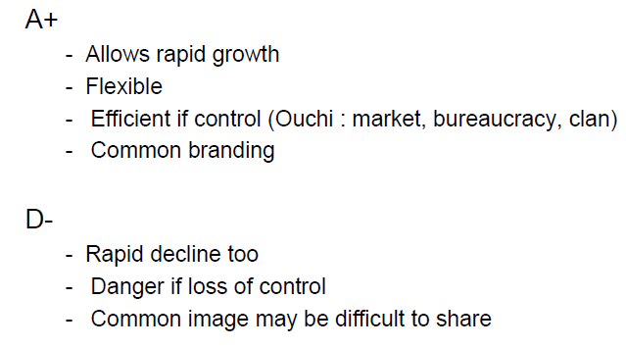

Slide 18
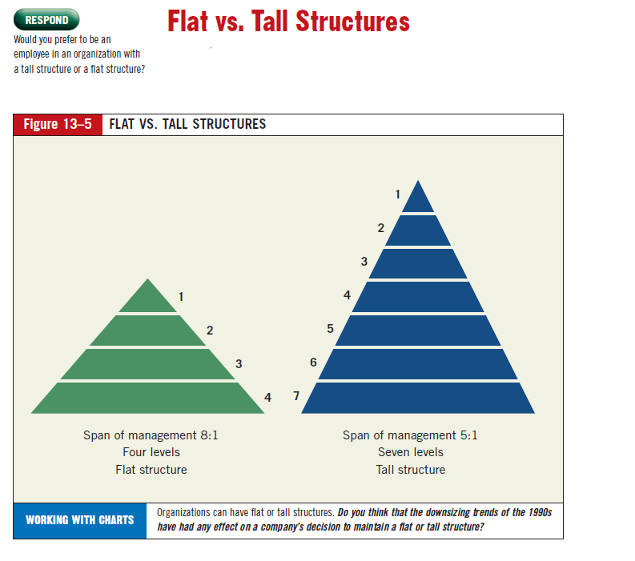

Slide 19
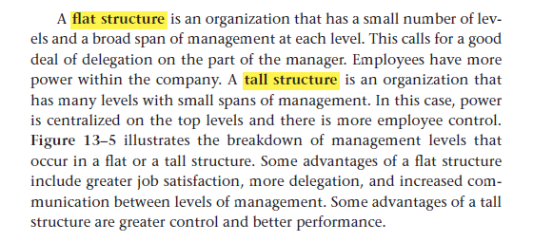

Slide 20


