Slide 1
University Of Mohammed Khider -Biskra -
Faculty of Economic Sciences, Commercial Sciences and Management Sciences
Department of Management
Lecture n°2:
Entrepreneurship
Dr. ABDAOUI Nawal
nawal.abdaoui@univ-biskra.dz
Academic Year
2024-2025

Slide 2
HOW DO YOU RATE AS ENTREPRENEURS?
1. Are you a self starter?
a. I only make an effort when I want to.
b. If someone explains what to do, then I can continue from there.
c. I make my own decisions. I don’t need anyone to tell me what to do.
2. How do you get on with other people?
a. I get on with almost everybody.
b. I have my own friends and I don’t really need anyone else.
c. I don’t really feel at home with other people.
3. Can you lead and motivate others?
a. Once something is moving I’ll join in.
b. I’m good at giving orders when I know what to do.
c. I can persuade most people to follow me when I start something.

Slide 3
4. Can you take responsibility?
a. I like to take charge and to obtain results.
b. I’ll take charge if I have to; but I prefer someone else to be responsible.
c. Someone always wants to be the leader and I’m happy to let them do the job.
5. Are you a good organizer?
a. I tend to get confused when unexpected problems arise.
b. I like to plan exactly what I’m going to do.
c. I just like to let things happen.
6. How good a worker are you?
a. I’m willing to work hard for something I really want.
b. I find my home environment more stimulating than work.
c. Regular work suits me but I don’t like it to interfere with my private life.

Slide 4
7. Can you make decisions?
a. I am quite happy to execute other people’s decisions.
b. I often make very quick decisions which usually work but sometimes don’t.
c. Before making a decision, I need time to think it over.
8. Do you enjoy taking risks?
a. I always evaluate the exact dangers of any situation.
b. I like the excitement of taking big risks.
c. For me safety is the most important thing.
9. Can you stay the course?
a. The biggest challenge for me is getting a project started.
b. If I decide to do something, nothing will stop me.
c. If something doesn’t go right first time, I tend to lose interest.

Slide 5
10. Are you motivated by money?
a. For me, job satisfaction cannot be measured in money terms.
b. Although money is important to me, I value other things just as much.
c. Making money is my main motivation.
11. How do you react to criticism?
a. I dislike any form of criticism.
b. If people criticize me, I always listen and may or may not reject what they have to say.
c. When people criticize me there is usually some truth in what they say.
12. Can people believe what you say?
a. I try to be honest, but it is sometimes difficult or too complicated to explain things to other people.
b. I don’t say things I don’t mean.
c. When I think I’m right, I don’t care what anyone else thinks.

Slide 6
13. Do you delegate?
a. I prefer to delegate what I consider to be the least important tasks.
b. When I have a job to do I like to do everything myself.
c. Delegating is an important part of any job.
14. Can you cope with stress?
a. Stress is something I can live with.
b. Stress can be a stimulating element in a business.
c. I try to avoid situations which lead to stress.
15. How do you view your chances of success?
a. I believe that my success will depend to a large degree on factors outside my control.
b. I know that everything depends on me and my abilities.
c. It is difficult to foresee what will happen in the future.

Slide 7
16. If the business was not making a profit after five years, what would you do?
a. give up easily.
b. give up reluctantly.
c. carry on.

Slide 8
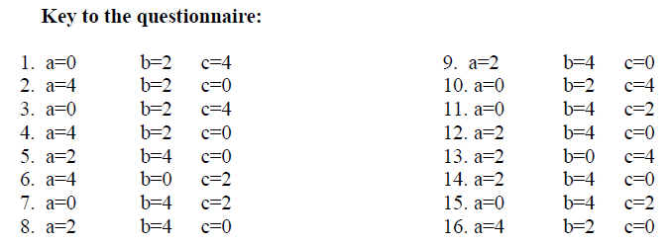

Slide 9
44 or above
You definitely have the necessary qualities to become the director of a successful business. You have a strong sense of leadership; you can both organize and motivate and you know exactly where you and your team are going.

Slide 10
Between 44 and 22
You may need to think more carefully before setting up your own business. Although you do have some of the essential skills for running business, you will, probably, not be able to deal with the pressures and strains that are a part of the job. You should perhaps consider taking some professional training or finding an associate who can compensate for some of your weaknesses.

Slide 11
Below 22
Managing your own business is not for you. You are better suited to an environment where you are not responsible for making decisions and taking risks. To operate successfully you need to follow well defined instructions and you prefer work that is both regular and predictable.

Slide 12


