Slide 1

STRATEGIC THINKING
Dr.DJOUDI Hanane
Faculty of ECMS/ University of Biskra
February, 2025
REF: Business Vocabulary in Use-Advanced

Slide 2
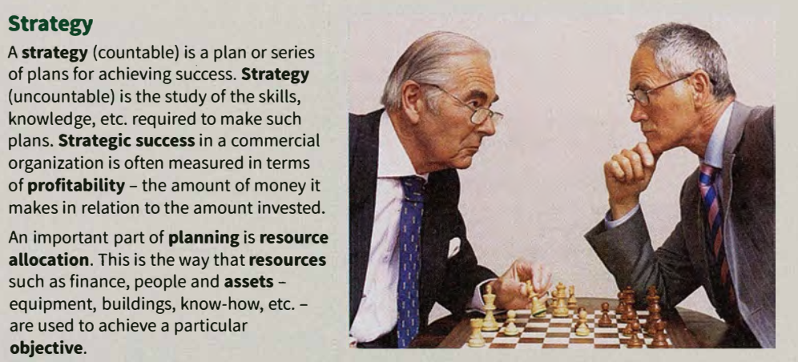
A

Slide 3
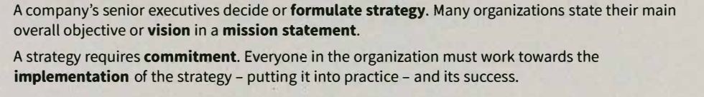
A

Slide 4
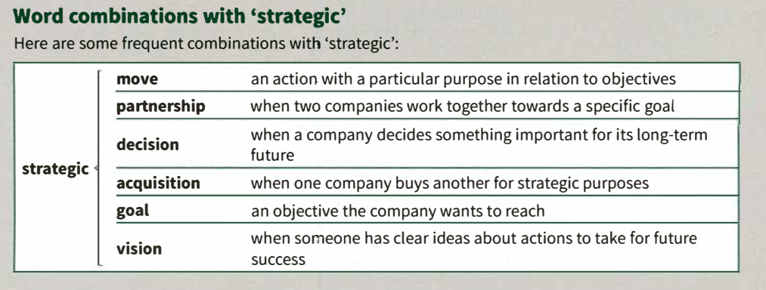
B

Slide 5
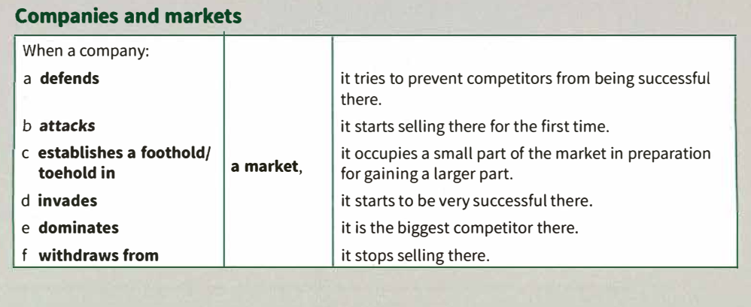
c

Slide 6
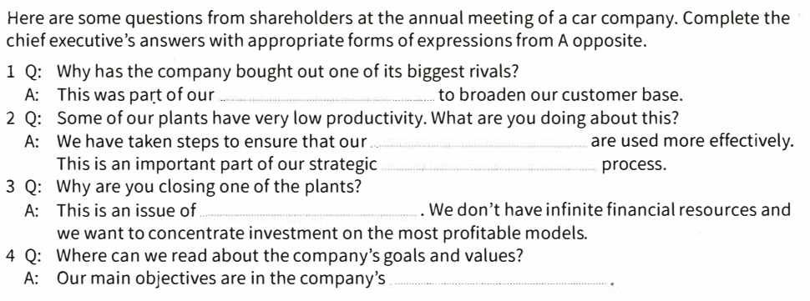
EX 1

Slide 7
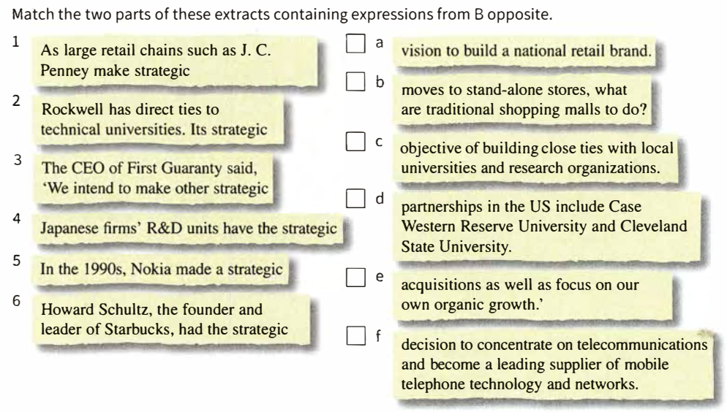
EX 2

Slide 8
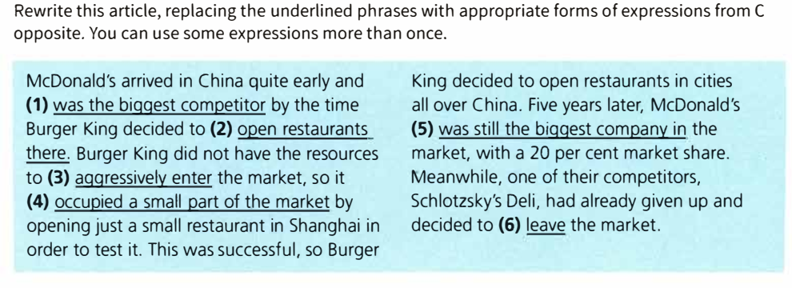
EX 3

Slide 9
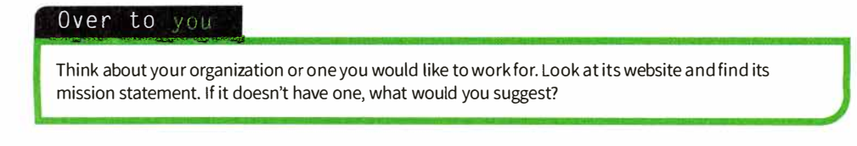
OVER TO
YOU

Slide 10
Thanks

