Slide 1
بسم الله الرحمان الرحيم
( قَالَ رَبِّ اشْرَحْ لِي صَدْرِي (25) وَيَسِّرْ لِي أَمْرِي (26) وَاحْلُلْ عُقْدَةً مِنْ لِسَانِي (27) يَفْقَهُوا قَوْلِي (28) ) صدق الله العظيم
سورة طه

Slide 2


University: Med Kheider- Biskra-
Faculty of Economics and Management
Level: Level: 3rd Year. Option: Management
Lecture 6:
Strategic Management
Dr: Reguia Abdelhamid Cherroun
Associate professsor
Notes:
Notre travail de recherche s’intitule : les différents mécanismes de contrôle et l’ impact du phénomène de l’enracinement des dirigeants sur la performance des firmes : cas Français

Slide 3
Management
Stephen P. Robbins Mary Coulter
Chapter
3
Strategic Management
Notes:
(En outre, La propriété des investisseurs institutionnels a aussi constitué une caractéristique actionnariale affectant la possibilité d’avoir une stratégie d’enracinement).

Slide 4
Types of Organizational Strategies
Corporate-Level Strategies
  Top management’s overall plan for the entire organization and its strategic business units
Types of Corporate Strategies
  Growth: expansion into new products and markets
  Stability: maintenance of the status quo
  Renewal: redirection of the firm into new markets

Slide 5
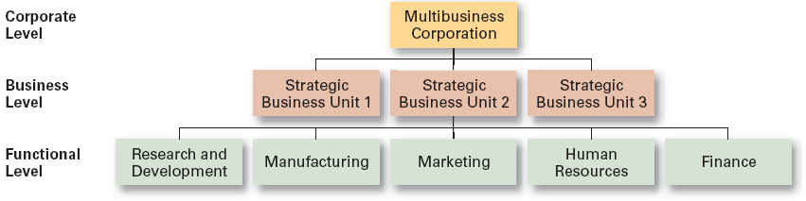
Levels of Organizational Strategy

Slide 6
Corporate-Level Strategies
Growth Strategy
  Seeking to increase the organization’s business by expansion into new products and markets.
Types of Growth Strategies
  Concentration
  Vertical integration
  Horizontal integration
  Diversification

Slide 7
Growth Strategies
Concentration
  Focusing on a primary line of business and increasing the number of products offered or markets served.
Vertical Integration
  Backward vertical integration: attempting to gain control of inputs (become a self-supplier).
  Forward vertical integration: attempting to gain control of output through control of the distribution channel and/or provide customer service activities (eliminating intermediaries).

Slide 8
Growth Strategies (cont’d)
Horizontal Integration
  Combining operations with another competitor in the same industry to increase competitive strengths and lower competition among industry rivals.
Related Diversification
  Expanding by merging with or acquiring firms in different, but related industries that are “strategic fits”.
Unrelated Diversification
  Growing by merging with or acquiring firms in unrelated industries where higher financial returns are possible.

Slide 9
Growth Strategies (cont’d)
Stability Strategy
  A strategy that seeks to maintain the status quo to deal with the uncertainty of a dynamic environment, when the industry is experiencing slow- or no-growth conditions, or if the owners of the firm elect not to grow for personal reasons.

Slide 10
Growth Strategies (cont’d)
Renewal Strategies
  Developing strategies to counter organization weaknesses that are leading to performance declines.
    Retrenchment: focusing of eliminating non-critical weaknesses and restoring strengths to overcome current performance problems.
    Turnaround: addressing critical long-term performance problems through the use of strong cost elimination measures and large-scale organizational restructuring solutions.

Slide 11
Corporate Portfolio Analysis
BCG Matrix
  Developed by the Boston Consulting Group
  Considers market share and industry growth rate
  Classifies firms as:
    Cash cows: low growth rate, high market share
    Stars: high growth rate, high market share
    Question marks: high growth rate, low market share
    Dogs: low growth rate, low market share

Slide 12
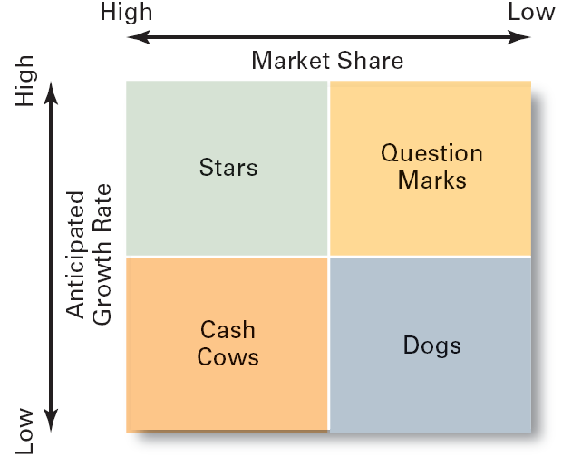
The BCG Matrix
Exhibit 8.5

Slide 13
Business-Level Strategy
Business-Level Strategy
  A strategy that seeks to determine how an organization should compete in each of its SBUs (strategic business units).

Slide 14
The Role of Competitive Advantage
Competitive Advantage
  An organization’s distinctive competitive edge that is sourced and sustained in its core competencies.
Quality as a Competitive Advantage
  Differentiates the firm from its competitors.
  Can create a sustainable competitive advantage.
  Represents the company’s focus on quality management to achieve continuous improvement and meet customers’ demand for quality.

Slide 15
The Role of Competitive Advantage (cont’d)
Sustainable Competitive Advantage
  Continuing over time to effectively exploit resources and develop core competencies that enable an organization to keep its edge over its industry competitors.

Slide 16
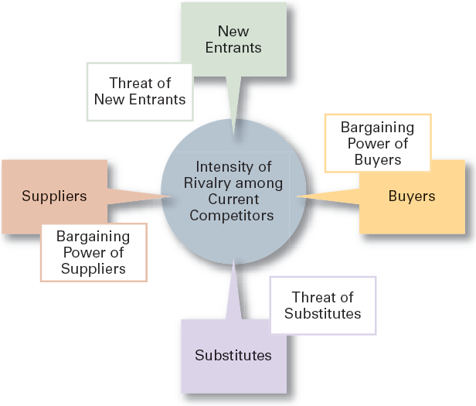
Forces in the Industry
Analysis
Source: Based on M.E. Porter, Competitive Strategy: Techniques for Analyzing Industries and Competitors (New York: The Free Press, 1980).
Exhibit 8.6

Slide 17
Five Competitive Forces
Threat of New Entrants
  The ease or difficulty with which new competitors can enter an industry.
Threat of Substitutes
  The extent to which switching costs and brand loyalty affect the likelihood of customers adopting substitutes products and services.
Bargaining Power of Buyers
  The degree to which buyers have the market strength to hold sway over and influence competitors in an industry.

Slide 18
Five Competitive Forces
Bargaining Power of Suppliers
  The relative number of buyers to suppliers and threats from substitutes and new entrants affect the buyer-supplier relationship.
Current Rivalry
  Intensity among rivals increases when industry growth rates slow, demand falls, and product prices descend.

Slide 19
Competitive Strategies
Cost Leadership Strategy
  Seeking to attain the lowest total overall costs relative to other industry competitors.
Differentiation Strategy
  Attempting to create a unique and distinctive product or service for which customers will pay a premium.
Focus Strategy
  Using a cost or differentiation advantage to exploit a particular market segment rather a larger market.

Slide 20
Strategic Management Today
The Rule of Three
  The competitive forces in an industry, if unfettered, will inevitably create a situation where three companies (full-line generalists) will dominate any given market
  Some firms in the same market become super niche players and while others end up as “stuck-in-the-ditch” bottom dwellers.

Slide 21
Strategies for Applying e-Business Techniques
Cost Leadership
  On-line activities: bidding, order processing, inventory control, recruitment and hiring
Differentiation
  Internet-based knowledge systems, on-line ordering and customer support
Focus
  Chat rooms and discussion boards, targeted web sites

Slide 22
Customer Service Strategies
Giving the customers what they want.
Communicating effectively with them.
Providing employees with customer service training.

Slide 23
Innovation Strategies
Possible Events
  Radical breakthroughs in products.
  Application of existing technology to new uses.
Strategic Decisions about Innovation
  Basic research
  Product development
  Process innovation
First Mover
  An organization that brings a product innovation to market or use a new process innovations

Slide 24
First-Mover Advantages–Disadvantages
Advantages
  Reputation for being innovative and industry leader
  Cost and learning benefits
  Control over scarce resources and keeping competitors from having access to them
  Opportunity to begin building customer relationships and customer loyalty
Disadvantages
  Uncertainty over exact direction technology and market will go
  Risk of competitors imitating innovations
  Financial and strategic risks
  High development costs
Exhibit 8.8

Slide 25
شكرا
Thank you

