Slide 1



Mohamed Khider University of Biskra
Faculty of Science and Technology
Common Core of Science and Technology
Matter : Careers in Science and Technology 2
Mechanical Engineering Career Opportunities:
Exploring the Future of Mechanical Engineering
First year ST _ LMD
Academic year : 2024-2025
Dr. Soraya Zehani
Soraya.zehani@univ-biskra.dz
Notes:
http://meet.google.com/skj-hycu-ijy

Slide 2
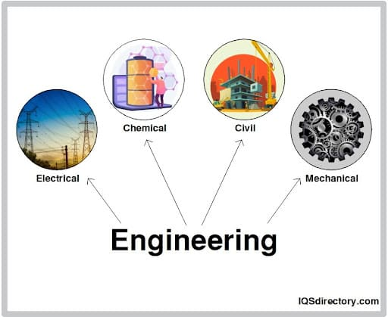
Careers in Science and Technology: Engineering

Slide 3


1. What is Mechanical Engineering?
Mechanical engineering is a broad and versatile field of engineering that applies principles of physics, mathematics, and material science to design, analyze, manufacture, and maintain mechanical systems. It is one of the oldest and most fundamental engineering disciplines, playing a crucial role in industries such as automotive, aerospace, energy, manufacturing, robotics, and biomedical engineering, and so on…
Notes:
The importance of mechanical engineering.
Mechanical engineering is one of the oldest and broadest engineering fields.

Slide 4


2. Career Opportunities in Mechanical Engineering
A degree in mechanical engineering opens the door to various industries and career paths, including:
Automotive Industry (Vehicle design, engine development, aerodynamics)
Aerospace Industry (Aircraft, satellites, propulsion systems)
Manufacturing & Production (Industrial machinery, automation, robotics)
Energy Sector (Renewable energy, power plants, HVAC systems)
Biomedical Engineering (Medical devices, prosthetics, biomechanics)
Robotics & AI (Design of robotic arms, autonomous systems)
Research & Development (Material science, nanotechnology, AI-driven engineering)

Slide 5


Core Subjects in a Mechanical Engineering Course
A mechanical engineering degree typically covers the following foundational subjects:
A. Mathematics & Physics
Calculus, Differential Equations, Linear Algebra
Engineering Physics (Mechanics, Thermodynamics, Electricity & Magnetism)
B. Mechanics & Materials
Engineering Mechanics (Statics & Dynamics)
Strength of Materials (Stress, Strain, Failure Analysis)
Fluid Mechanics (Fluid Dynamics, Hydraulics, Aerodynamics)
Materials Science (Metals, Polymers, Composites, Nanomaterials)

Slide 6
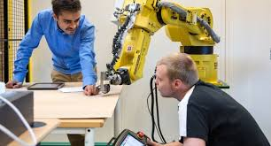

Core Subjects in a Mechanical Engineering Course
A mechanical engineering degree typically covers the following foundational subjects:
C. Thermodynamics & Heat Transfer
Laws of Thermodynamics (Energy Conservation, Entropy)
Heat Transfer (Conduction, Convection, Radiation)
HVAC (Heating, Ventilation, Air Conditioning)
Power Generation (Engines, Turbines, Renewable Energy Systems)
D. Machine Design & Manufacturing
Kinematics & Dynamics of Machines (Gear Systems, Linkages)
Mechanical Design (Failure Theories, Bearings, Shafts, Springs)
Manufacturing Processes (Casting, Machining, 3D Printing, CNC)

Slide 7
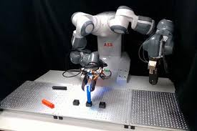
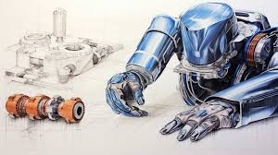
Core Subjects in a Mechanical Engineering Course
A mechanical engineering degree typically covers the following foundational subjects:
E. Control Systems & Robotics
Mechatronics (Sensors, Actuators, Embedded Systems)
Automation & Robotics (Industrial Robots, AI in Engineering)
Control Theory (PID Controllers, Feedback Systems)
F. Computational & Simulation Tools
Computer-Aided Design (CAD - SolidWorks, AutoCAD)
Finite Element Analysis (FEA - ANSYS, Abaqus)
Computational Fluid Dynamics (CFD - Fluent, OpenFOAM)
G. Engineering Ethics & Project Management
Professional Ethics in Engineering
Project Planning & Cost Estimation
Entrepreneurship in Mechanical Engineering

Slide 8


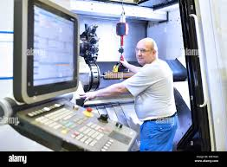
4. Practical Learning & Hands-on Experience
Mechanical engineering courses often include:
Lab Work: Material testing, fluid mechanics experiments, thermodynamics labs.
Workshops: Machining, welding, CNC operations.
Internships: Industry exposure in manufacturing plants, automotive companies, research labs.
Final Year Project: Designing and prototyping a mechanical system (e.g., robots, renewable energy devices, automation systems).

