Slide 1
SCHOOL OF MANAGEMENT THEORY
Prof: Reguia Abdehamid Cherroun
Magagement depatement
NB: the course is cited from the web site:
http://home.kku.ac.th/ssuwattana/

Slide 2
The schools of management contributed to the development of management thought. They are grouped as follows:
{A) The Classical Approach
{B) The Behavioral Approach
{C) The Systems Approach
{D) The Contingency or Situational Approach

Slide 3
INTRODUCTION TO CLASSICAL APPROACH

Slide 4
DEFINITION OF CLASSICAL APPROACH
"Classical approach of management professes the body of management thought based on the belief that employees have only economical and physical needs and that the social needs & need for job satisfaction either does not exist or are unimportant. Accordingly it advocates high specialization of labour, centralized decision making & profit maximization."

Slide 5
Classical approach is the oldest formal school of thought which began around 1900 and continued into the 1920s.
It is mainly concerned with increasing the efficiency of workers and organizations based on management practices, which were an outcome of careful observation.
It mainly looks for the universal principles of operation in the striving for economic efficiency.
Classical approach includes:
Scientific Management
Administrative Management
Bureaucratic Management

Slide 6
1- Scientific Management
SCIENTIFIC MANAGEMENT focuses on the "one best way" to do a job.
ADM INISTRATIVE MANAGEMENT focuses on the manager & basic managerial functions.
BUREAUCRATIC MANAGEMENT focuses on the guidelines for structuring with formalization of rules, procedures and a clear division of labour.

Slide 7
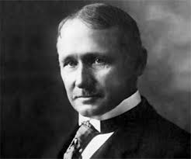
Frederick Winslow Taylor (1856-1915)
• Father of Scientific Management

Slide 8
STEPS IN SCIENTIFIC MANAGEM ENT
• Replaced old rule of thumb methods to eliminate ''soldiering''
• Selecting training, teaching, and developing workers
• Supervise employees to make sure they follow the prescribed methods for performing their jobs
• Continue to plan the work but use workers to actually get the work done

Slide 9
Taylor concentrated more on productivity and productivity based wages. He stressed on time and motion study and other techniques for measuring work.
Apart from this, in Taylor's work there also runs a strongly humanistic theme. He had an idea list s notion that the interests of workers, managers and owners should be harmonized.

Slide 10
CONTRIBUTIONS OF THE SCIENTIFIC MANAGEMENT APPROACH
• Maximum utility of effort, therefore, eliminating waste
• Emphasis placed on fitting workers to specified tasks and further training them to best utilize their abilities
• Work design development has led managers to seek the "one best way" to get a job done
• Development of efficient production line technique through time and motion studies
• Incentives which include compensation plays an important role in productivity boost

Slide 11
CRITICISMS OF THE SCIENTIFIC MANAGEMENT APPROACH
• The desire for job satisfaction and other psychological variables were overlooked
• It concentrated more on stress economy and efficiency, thus, neglecting human factors
• It was mainly concerned with problems at the operational level. Hence, higher levels of management such as planning, decision making and problem solving were ignored

Slide 12
CRITICISMS OF THE SCIENTIFIC MANAGEMENT APPROACH (Cont,d.)
It failed to take into account the impact of the forces of the environment on the organizations
• It did not offer a theory of administration or organization but only a set of principles and simple injunctions for administrators to follow

Slide 13
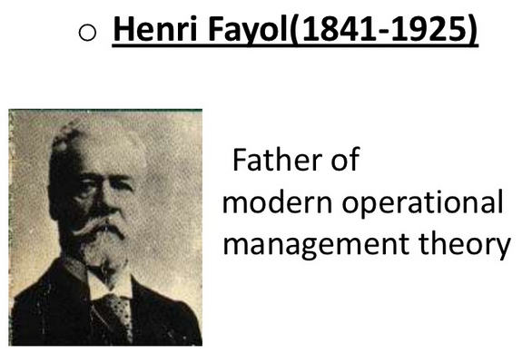
Henri Fayol(1841-1925)
1- Administrative Management
Father of modern operational management theory

Slide 14
Made three major contributions to the theory of Management:
(A)A clear distinction b/n technical & managerial skills.
(B} Identified functions constituting the management process.
(C) Developed principles of management

Slide 15
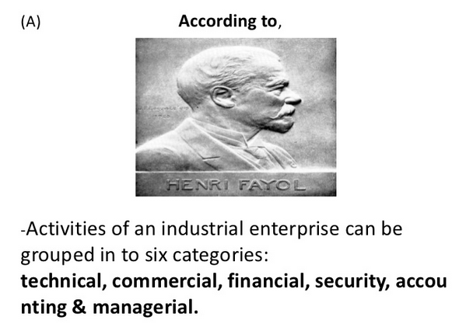
(A ) According to
-Activities of a n industrial enterprise ca n be grouped in to six categories:
technical, commercial, financial, security, accounting & managerial.,

Slide 16
( B) Fayal described management as a scientific process built up of five immutable elements:
Planning, Organizing, Commanding, Coordinating, Controlling
Organizing
Planning
Commanding
Coordinating
Coordinating

Slide 17
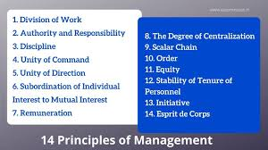

Slide 18
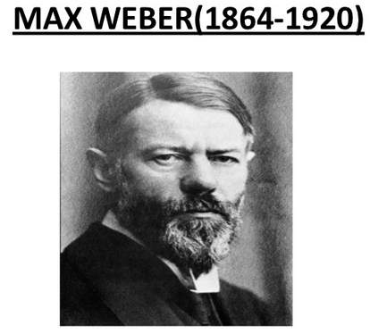
1- Bureacratic Management

Slide 19
Birth of Bureaucracy
During 1800’s European Org. were managed on a personal, family-like basis.
Employees loyal towards a single individual.
Resources used to realize individual desires.
Weber envisioned Org. would be managed on an impersonal, rational basis. This form of Org. is know as Bureaucracy.

Slide 20
Characteristics
Org. based on rational authority would be more efficient and adaptable to changes.
Employee selection and advancement is based on competence and technical qualification.
Org. relies on rules and regulations which are impersonal and applied uniformly to all employees.

Slide 21
Division of labour.
Positions in an Org. are organized in a hierarchy.
Managers depends not on personality for successfully giving orders but on legal power invested in managerial position.

Slide 22
Division of Labour
Managers subject to rules & procedures
Management & ownership is separate
The Ideal Bureaucracy
Positions organized in hierarchy
Decisions recorded in writing
Selection based on technical qualification

Slide 23
Limitations of Bureaucratic Management and Administrative Theory
Classical theorists ignored important aspects of organizational behavior. They stressed productivity above other aspects of management.
Weber’s concept of bureaucracy destroys individual creativity and the flexibility to respond to complex changes in the global environment

