Slide 1
3. Structure and Physicochemical Properties of Lipids

Slide 2
3. Structure and Physicochemical Properties of Lipids
3.1. Simple Lipids
3.2. Complex Lipids

Slide 3
I. General Characteristics of Lipids
I.1. Definition
Lipids are a group of molecules that are insoluble in water and soluble in non-polar organic solvents.
They are typically non-polar molecules.

Slide 4
I.2. Biological Role
Lipids make up about 20% of body weight.
They serve as a mobilizable energy reserve:
1g of lipids provides 9 Kcal.
They act as precursors, catalysts, and hormones.
Two unsaturated fatty acids are essential nutritional factors: linoleic acid and alpha-linolenic acid.
Membranes have a lipid structure.

Slide 5
I.3. Classification des lipides

Slide 6
II. Fatty Acids
II.1. Definition:
Carboxylic acids with an even number of carbon atoms, generally four or more, unbranched, and either saturated or unsaturated.

Slide 7
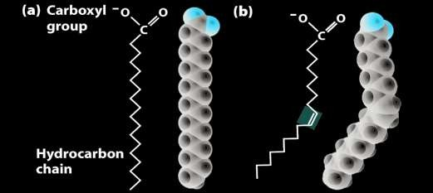
Notes:
Dans la numérotation, le carbone le plus oxydé portera l’indice le plus faible

Slide 8
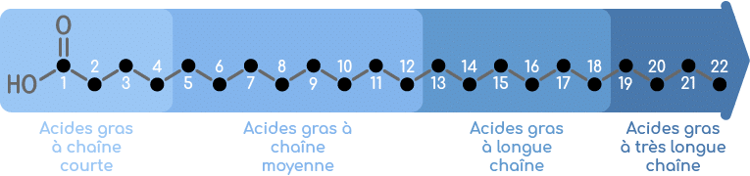
III.1.1 Saturated fatty acids (CnH2nO2):
· With the general formula CH3-(CH2)n-COOH, they are monoacids, linear, with an even number of carbon atoms, saturated.
The most abundant are:
Palmitic acid with 16C (16 :0)
Stearic acid with 18C. (18 :0)
Butyric acid with 4C(4 :0)
ALignoceric acid with 24C (24 :0)

Slide 9
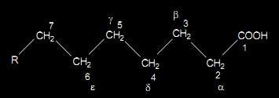
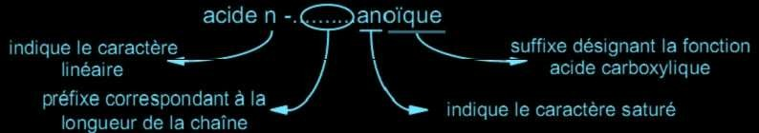
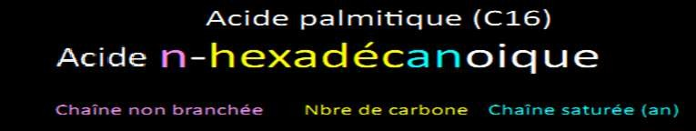
2.1.1 Saturated fatty acids
· Nomenclature
Saturated fatty acids C_{n} example : C₁₈
Example

Slide 10
Saturated fatty acids

Slide 11
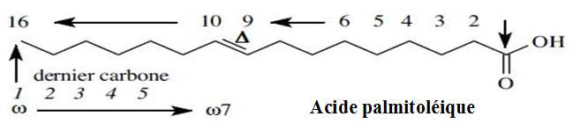
2.1.2 Unsaturated fatty acids Nomenclature
In unsaturated fatty acids, the position of the first double bond can be expressed:
Either starting from the carboxyl group (1st carbon); the symbol is Δ (delta)
Or starting from the methyl group (last carbon); the symbol is omega ω

Slide 12
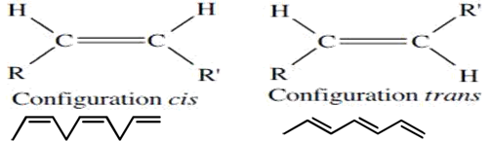
2.1.2 Unsaturated fatty acids
  For the double bond between carbons C9 and C10 in the example, an isomeric configuration can appear: cis or trans.
  Cis: the H substituents are located on the same side relative to the double bond.
  Trans: are found on opposite sides of the double bond.

Slide 13
2.1.2 Unsaturated fatty acids
MonoDi
tri
· Acide n CP X
énoïque
• n: Unbranched aliphatic chain
•CP : Configuration (cis or trans) and Position of double bonds
• X : Number of carbons
• Mono, Di, tri : Number of double bonds
• én : Unsaturated chain
_{Cn : x ∆}a,b,c
· Abbreviations
n : Number of carbons
x: number of double bonds
a, b, c: position of the double bonds

Slide 14
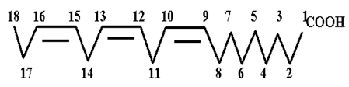
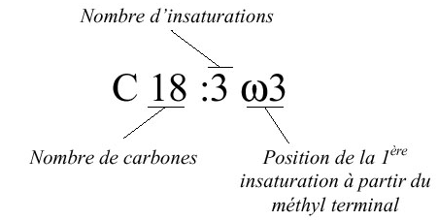
The series is of the form ωn where n is the position of the first double bond noted in relation to the ω position, the last carbon of the aliphatic chain.
Examples:
A. Systematic name : cis-9-hexadécénoïque acid;
( C₁₆: 1 Δ ⁹ ou C₁₆:1 ω₇ )
B. C₁₈: 3 Δ ^{9,12,15} or
C₁₈:3 ω_{3,6,9}

Slide 15
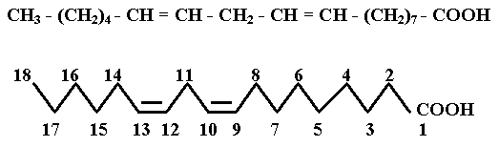
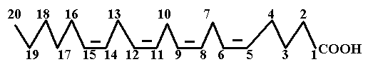
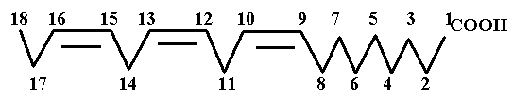
Unsaturated fatty acids
Linoléic Acid C₁₈ : 2 ω₆
2 Double bonds in ω_{6, 9}
Arachidonic Acid C₂₀: 4 ω₆
4 Double bonds in ω_{6, 9, 12, 15}
α Linolénique Acid C₁₈: 3 ω₃
3 Double bonds in ω_{3, 6, 9}

Slide 16
Polyunsaturated fatty acids

Slide 17
2.1. fatty acids
2.1.3 physical properties
· Solubility:
Insoluble in water for n>8 but soluble in nonpolar organic solvents: benzene, chloroform, …
Melting Point:
Augmente avec le nombre de C.
Diminue quand le nombre de doubles liaisons augmente.
: à 20°C- liquides si n < 10 C
- solides si n ≥ 10 C

Slide 19
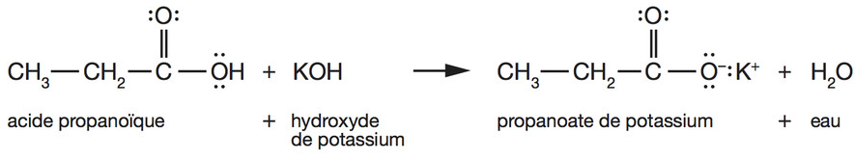
2.4. Chimical properties
      · Chemical properties related to the COOH function
1. Formation of sodium or potassium salts
➢ Sodium and potassium salts of fatty acids are soaps. They are obtained through alkaline treatment of lipids: saponification.
➢ The saponification index (Is): is the mass (mg) of KOH necessary to saponify the esters of 1 g of lipids.

Slide 20
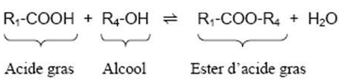
2. Esterification:
Fatty acids form esters with alcohols.
The reaction of a fatty acid with ethanol produces a methyl ester, which is more volatile than the non-esterified fatty acid..
Réaction lente
athermique
limitée

Slide 21

2. Chemical properties due to the presence of double bonds
1.Réaction d’addition des halogènes:
Halogens can be added to the double bonds of unsaturated fatty acids (UFA), such that each unsaturation will bind to 2 iodine atoms, for example. In this way, we can determine the number of double bonds in the UFA.
· Iodine index (I_{I}): It represents the amount of iodine
(in grams) that can bind to the double bonds present
in 100 grams of lipid.

Slide 22

2. Hydrogen Addition Reaction :
Addition of Hydrogen to Double Bonds
Hardening of Lipids (Margarine Production)

Slide 23
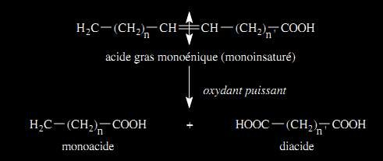
3.Oxidation
· Powerful oxidants (ozone, permanganate ion in an alkaline medium) cause the cleavage of an unsaturated fatty acid molecule into mono- and diacids.

Slide 24
2.2. Simple lipids
· Simple lipids, also called homolipids, are ternary compounds (C, H, O).
They are fatty acid esters that are classified according to their alcohol component:
➢ Glycerides: (acylglycerols) are esters of glycerol
➢ Cerides (waxes): are esters of long-chain alcohols (fatty alcohols)
➢ Sterides: are esters of sterols (polycyclic alcohols)

Slide 25
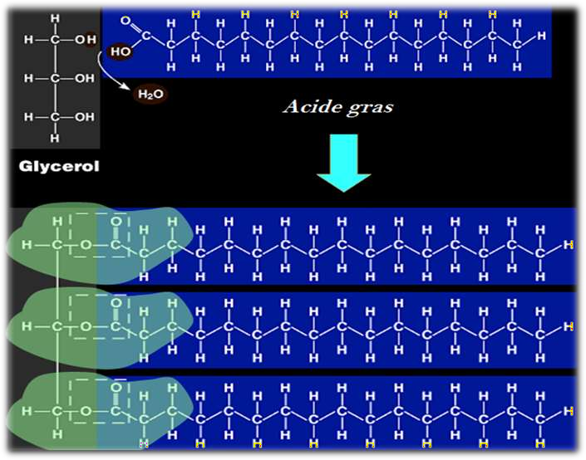
2.2. Simple lipids
2.2.1. Glycerides

Slide 26
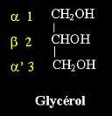
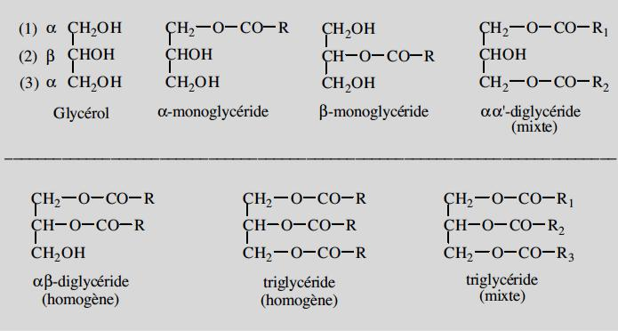
2.2. Simple lipids
2.2.1. Glycerides

Slide 27
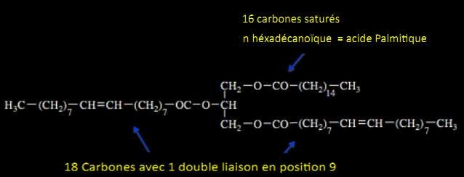
2.2. Simple lipids
2.2.1. Glycerides
· Nomenclature
Acyl groups preceded by their positions on the glycerol carbons 1-R1-2-R2-3-R3
· Example

Slide 28
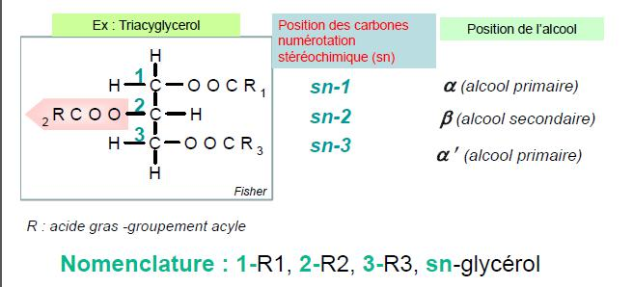
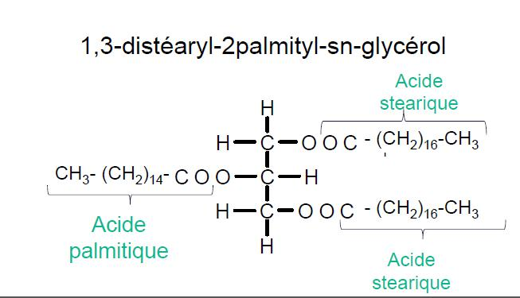
2.2. Simple lipids
2.2.1. Glycerides
· Nomenclature
Example: β-Palmitodistéarine

Slide 29
2.2.1. Glycerides: Physical Properties
Physical Properties:
A. Solubility:
They are insoluble in water and highly soluble in nonpolar solvents such as (ether, benzene, chloroform), hot alcohol, and acetone, which differentiates them from phospholipids that are insoluble in acetone.
B. Melting Point:
The melting point depends on the nature of the fatty acids (FA), it is lowered when the quantity of unsaturated fatty acids increases.

Slide 30
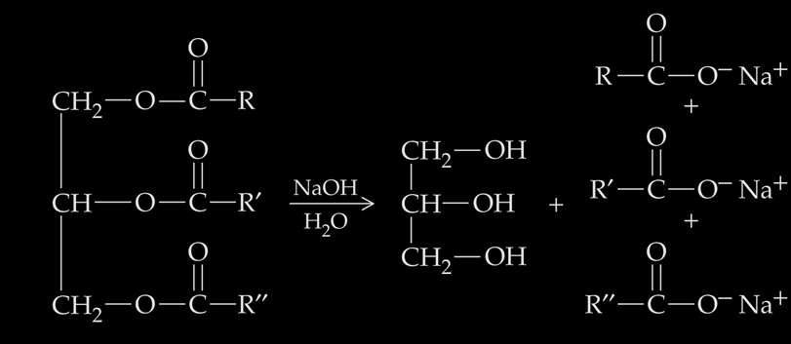
2.2. Simple lipids
2.2.1. Glycerides: Chimical properties
· Réaction de saponification
Corresponds to the cleavage of ester bonds through the action of sodium hydroxide (caustic soda) or potassium hydroxide (potash) when heated, resulting in the release of glycerol and fatty acids in the form of soap.
This reaction can also be used to determine the saponification index, which is defined as the quantity of potassium hydroxide (KOH) in milligrams required to saponify one gram of lipid..
· Alcoholysis of glycerides:
Alcohol (methanol) + glyceride
fatty acid methyl esters (FAMEs)

Slide 31
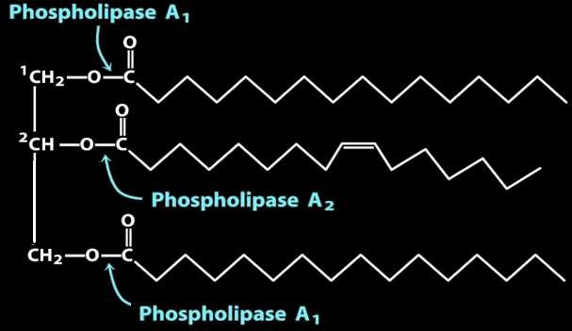
2.2. Simple lipids
2.2.1. Glycerides: Chimical properties
· Chemical Hydrolysis
In acidic medium , ester bonds are cleaved, yielding a mixture of glycerol and fatty acids..
· Enzymatic Hydrolysis

Slide 32
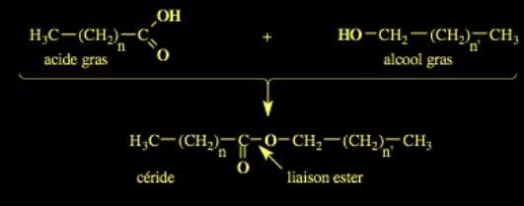
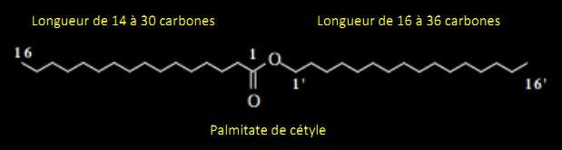
2.2. Simple lipids
2.2.1. Cerides:
· Main Components of Animal and Bacterial Waxes.
· Beeswax rich in ceryl palmitate (1-hexacosanol: 26 carbons) and myricyl (30 carbons).
Notes:
Substituants axiaux (parallèles à l’axe), moins réactifs. Substituants équatoriaux (perpendiculaires à l’axe), plus réactifs.

Slide 33
· Properties :
The structure with two long saturated carbon chains makes cerides/waxes compounds with: :
A. High melting temperature (60 to 100°C) and solid at room temperature
B. Very strong insolubility in water: they are only soluble in organic solvents when heated.
C. Chemically inert: they resist acids and most reagents and are difficult to saponify.
➢ The properties listed in the previous paragraph make them essential molecules for protective "coatings" of living organisms:- Waterproofing coating on aquatic birds' feathers. Found in marine animals' skin. Present in animal fur/pelts

Slide 34
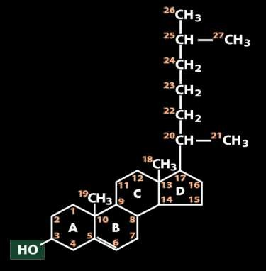
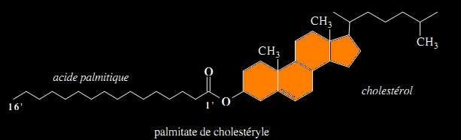
2.2. Simple lipids
2.2.1. Sterides/Sterol esters:
· Simple lipids composed of a sterol (steroid alcohol) esterified with a fatty acid. Cholesterol is the most representative example, it is composed of 3 hexagonal rings + one pentagonal ring
· Example
palmitate de cholestéryle

Slide 35
2.3. Complex Lipids
· These heterolipids contain phosphate, sulfate, or carbohydrate groups.
➢ Glycerophospholipids
➢Glyceroglycolipids
➢Sphingolipids

Slide 36
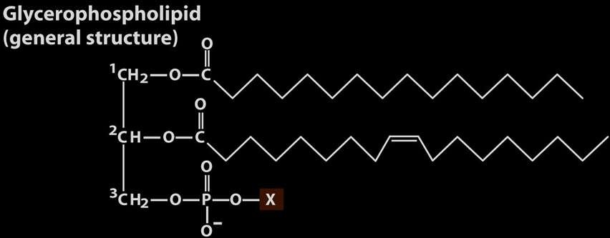
2.3. Complex Lipids
2.3.1. Glycerophospholipids
· They are composed of phosphatidic acid + alcohol.

Slide 37
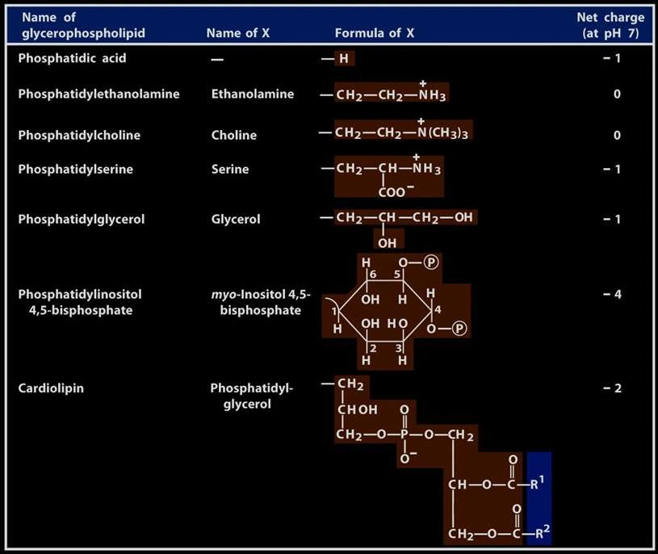
2.3. Complex Lipids
2.3.1. Glycerophospholipids
Notes:
Les acides aldoniques sont instables et se transforment rapidement en lactone par estérification interne.

Slide 38
2.3. Complex Lipids
2.3.1. Glycerophospholipids
· Cephalins: phosphatidylserines, phosphatidylethanolamines;
· Lecithins: phosphatidylcholines
· Glycerophospholipids are present in animals, plants and microorganisms
· For each group, the number of different molecules is very large, with up to 20 different phosphatidylcholines in human red blood cells and up to a hundred for milk lipids.
· These are amphoteric molecules because they have:
an acidic function provided by H3PO4
a basic function provided by serine, amino alcohol.

Slide 39
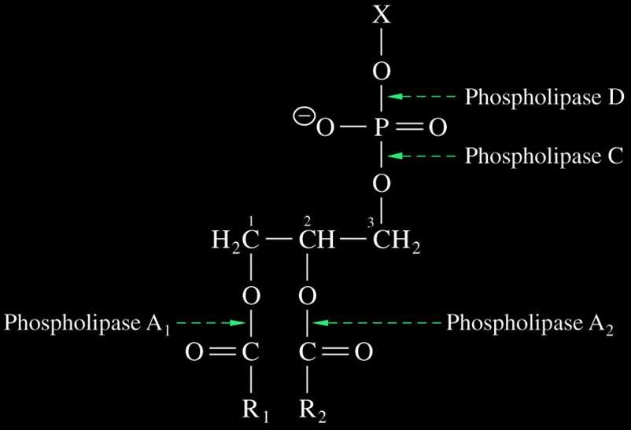
2.3. Complex Lipids
2.3.1. Glycerophospholipids
· Enzymatic Hydrolysis

Slide 40
2.3. Complex Lipids
2.3.2. Glycolipids
· The alcohols on carbons C1 and C2 of glycerol are esterified by fatty acids.
· Unlike in glycerolipids, the alcohol on carbon C3 is not esterified; instead, it is linked to a sugar by a glycosidic bond (with the anomeric carbon of the sugar).

Slide 41
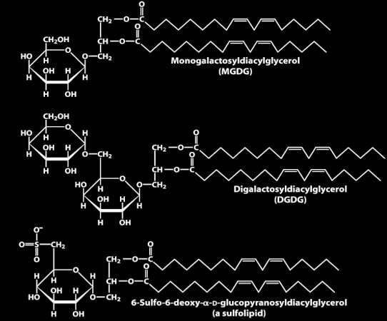
2.3. Complex Lipids
2.3.2. Glycolipids
· Three Glycolipids in the Thylakoid Membranes of the Chloroplast

Slide 42
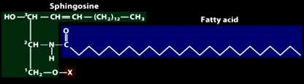
2.3. Complex Lipids
2.3.3. Sphingolipids
· The backbone of these lipids is not glycerol but sphingosine..
General Structure of Sphingolipids

Slide 43
2.3. Complex Lipids
2.3. 3. Sphingolipids
Depending on the nature of X, we distinguish:
· H | → | Céramides
· Phosphate | → | Céramides-1-phosphate
· Phosphocholine | → | Sphingomyélines
· Ose | → | Cérébrosides
Oses | → | globosides
· Oses + acide sialique | → | gangliosides

Slide 44
Faty acid containing lipids

