Slide 1
9.Metabolism of peptides
and proteins

Slide 2
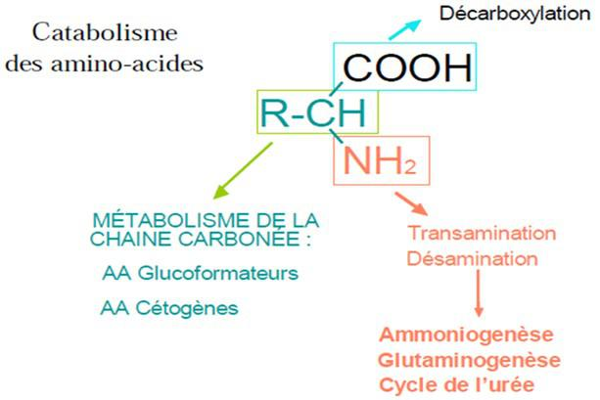
CATABOLISM OF AMINO ACIDS

Slide 3
1. Catabolism of Amino Groups
The removal of the amino nitrogen can occur through:
Transamination, common to all amino acids except lysine.
Oxidative deamination, in the case of glutamate.
Non-oxidative deamination, for serine, cysteine, and threonine.

Slide 4
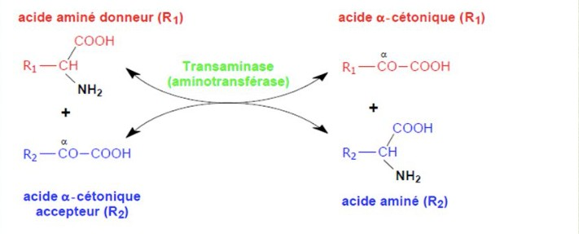
      Transamination
The general reaction can be represented as follows:
Amino Acid1 + α-Ketoacid2 ⇌ α-Ketoacid1 + Amino Acid2
General Scheme of the Reaction Catalyzed by an Aminotransferase

Slide 5
Transamination reactions occur in the intestine, liver, and muscles, and these are reversible reactions.
In the intestine and muscles, the reaction is catalyzed by ALT (Alanine Aminotransferase).
In the liver, the reaction is catalyzed by AST (Aspartate Aminotransferase).

Slide 6
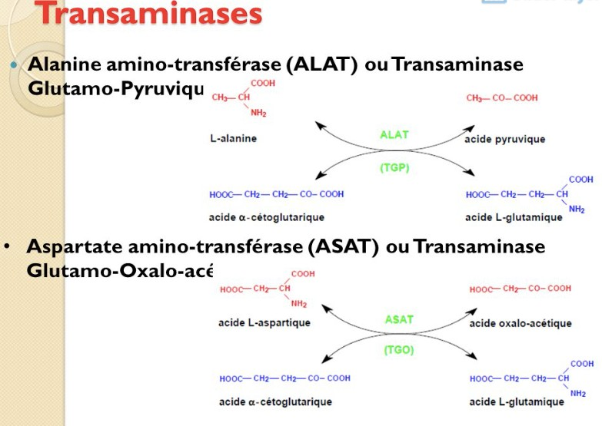
Transamination by ALT and AST

Slide 7
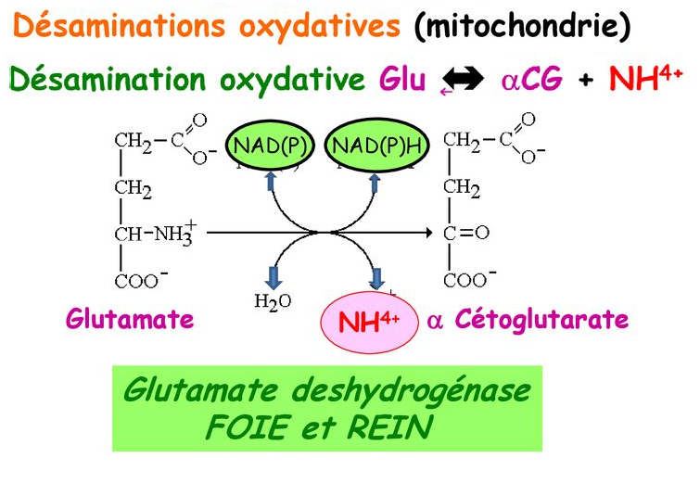

Slide 8
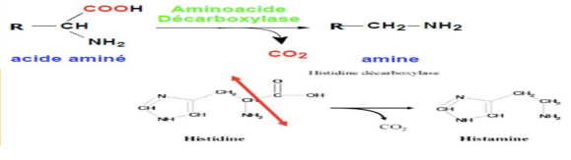
Catabolism of Carboxyl Groups
  Decarboxylation
This is the release of CO2 by a decarboxylase, resulting in an amine.

Slide 9
CATABOLISM OF GLUCOGENIC AMINO ACIDS
The catabolism of the carbon skeleton of 19 glucogenic amino acids converges with intermediates of glycolysis and the citric acid cycle:
Pyruvate (C3 entry): Amino acids: threonine, glycine, serine, cysteine, tryptophan, alanine
Oxaloacetate (C4 entry): Amino acids: asparagine, aspartate
α-Ketoglutarate (C5 entry): Amino acids: glutamate, histidine, arginine, proline, glutamine
Succinyl CoA (C4 entry): Amino acids: isoleucine, valine, methionine, threonine
Fumarate (C4 entry): Amino acids: phenylalanine, tyrosine
Au total : 19 acides aminés glucoformateurs pour 5 entrées seulement :
Une entrée « glycolyse » et 4 entrée « cycle de Krebs ».

Slide 10
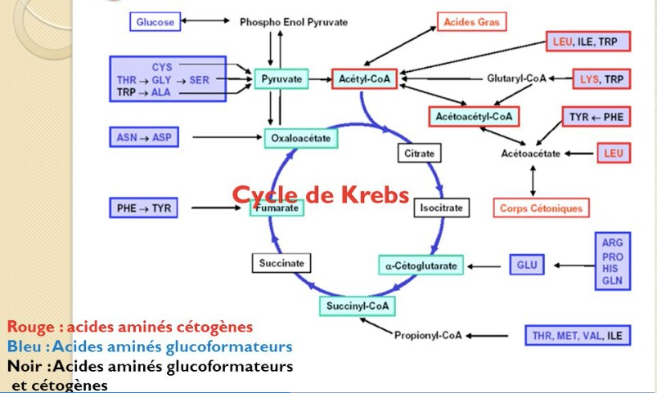
Glucogenic and ketogenic acids

Slide 11
CATABOLISM OF KETOGENIC AMINO ACIDS
The catabolism of the carbon skeleton of the 6 ketogenic amino acids joins the intermediates of ketogenesis or a ketone body itself:
Acetyl CoA (C2 entry): isoleucine
Acetoacetyl CoA (C4 entry): lysine, tryptophan
β-hydroxy-β-methylglutaryl-CoA (C5 entry): leucine
Acetoacetate (C4 entry): tyrosine, phenylalanine
Total: 6 ketogenic amino acids and 4 entry points

Slide 12
MIXED AMINO ACIDS
Some amino acids are both glucogenic and ketogenic because they give rise to intermediates necessary for the synthesis of glucose and ketone bodies. -Four amino acids are mixed: isoleucine, phenylalanine, tryptophan, tyrosine.

Slide 13
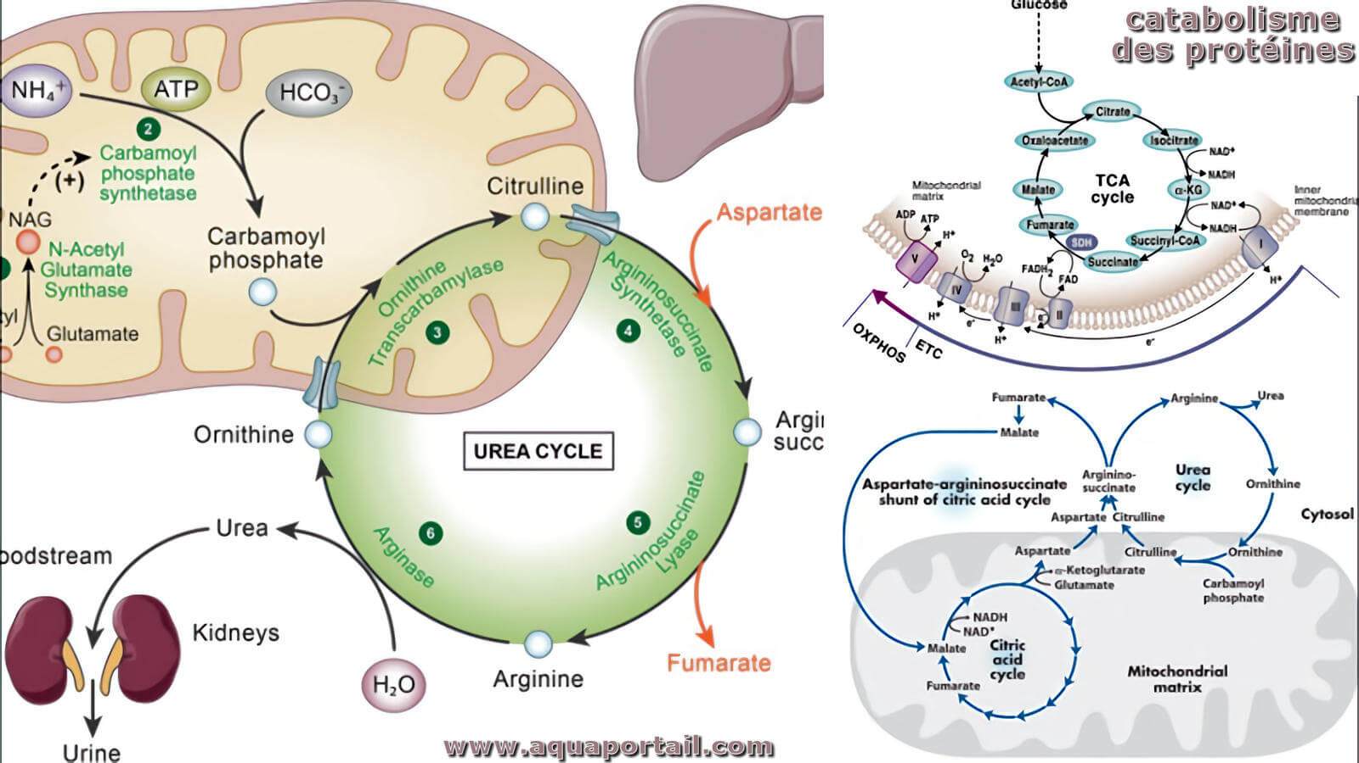

Slide 14
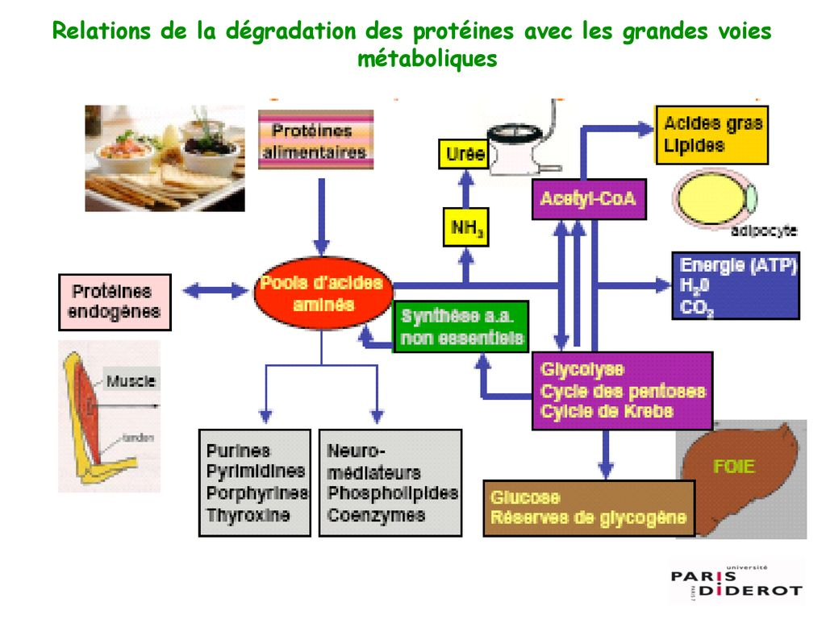

Slide 15
AMINO ACID SYNTHESIS
Transamination: α-ketoglutarate is precursor of Glutamate, glutamine, proline and arginine.
Oxaloacetate is precursor of aspartate, asparagine, methionine, threonine, lysine, isoleucine.
3-phosphoglycerate is precursor of serine, cysteine and glycine.
Pyruvate is precursor of alanine, valine and leucine.
Phosphoenolpyruvate and erythrose-4-phosphate are precursors of tryptophan, phenylalanine and tyrosine.
Ribose 5 phosphate is precursor of histidine.

Slide 16
Transamination: Transfer of an NH2 group to an
α-keto acid,
NH2 donor = glutamic acid; enzyme = transaminase
AMINO ACID SYNTHESIS
Ac glutamique + α -céto acide Ac
α -céto glutarique + Ac aminé

Slide 17
Amino Acid | Corresponding α-keto acid
Serine | Hydroxypyruvic acid
Glutamate | α-ketoglutaric acid
Aspartate | Oxaloacetic acid
Alanine | Pyruvic acid
Conversion: Synthesis of an AA from another AA.
Reversible: Glycine ↔ Serine
Non-reversible:
Methionine ⇒ Cysteine (homocysteine transsulfuration)
Phenylalanine ⇒ Tyrosine (hydroxylation)
Aspartate ⇒ Alanine (decarboxylation)
Glutamate ⇒ Proline (cyclization)

Slide 18
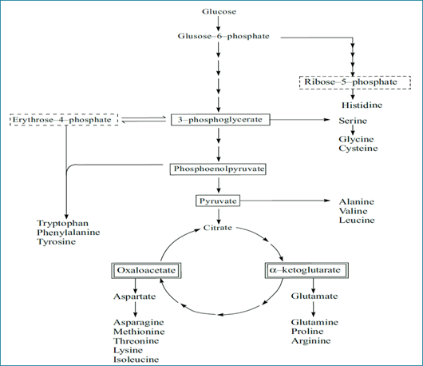
Biosynthesis of essential amino acids

Slide 19
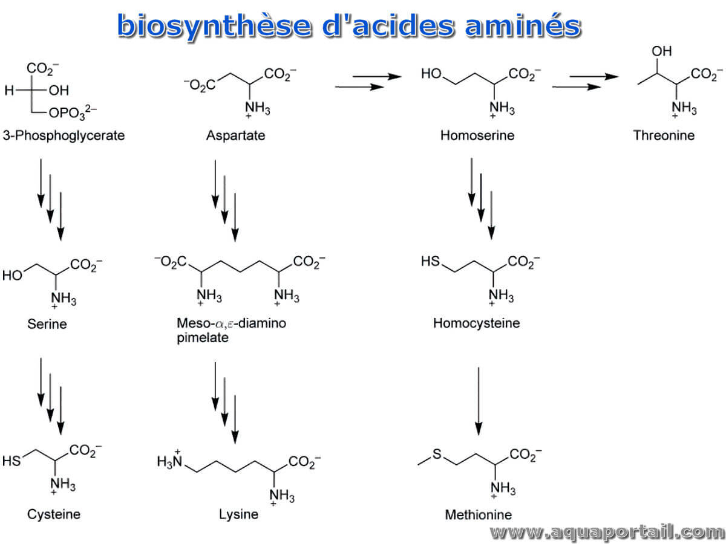

Slide 20
Nitrogen Elimination
The NH2 groups are transported by glutamic acid or by glutamine.
These amino acids can be locally deaminated (Gln: glutaminase; Glu: L-glutamate dehydrogenase), releasing NH3 which is then eliminated:
Either through the urea cycle (liver)
Or directly at the kidney level (ammoniogenesis)
Elimination through the urea cycle >>ammoniogenesis

Slide 21
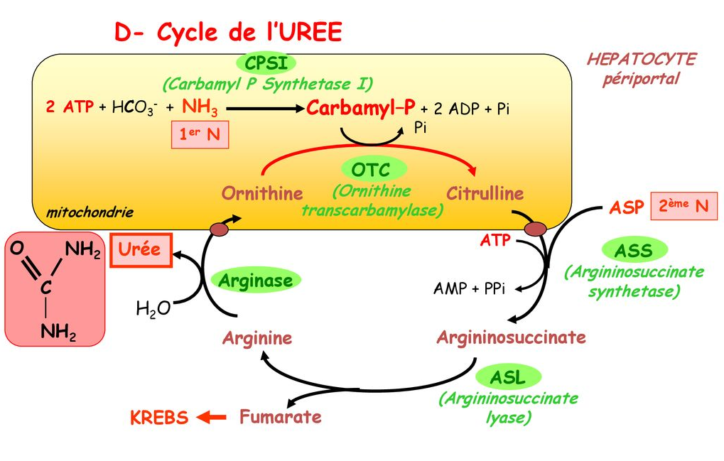

Slide 22
Assessment: Global Reaction of the Urea Cycle
NH3 + CO2 + Aspartate Fumarate + Urea
Consommation of 3 ATP 2 ADP + AMP
Therefore:
4 high-energy bonds = equivalent to 4 ATP
One nitrogen atom of urea comes from ammonia, the other from asp (aspartate)

