Slide 1

MARKET ENVIRONMENT
SWOT ANALYSIS
Dr.DJOUDI Hanane
Faculty of ECMS/ University of Biskra
December, 2024
REF: Professional English in use

Slide 2
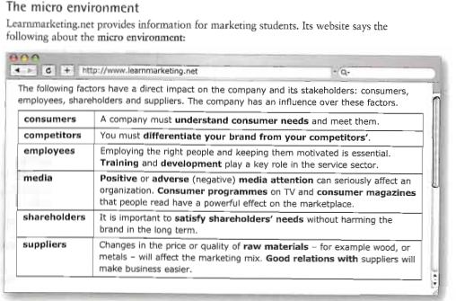
A

Slide 3
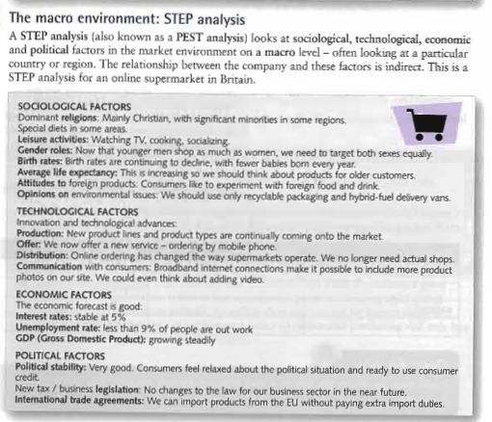
B

Slide 4
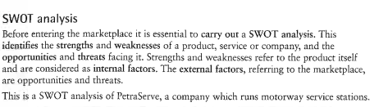
C

Slide 5
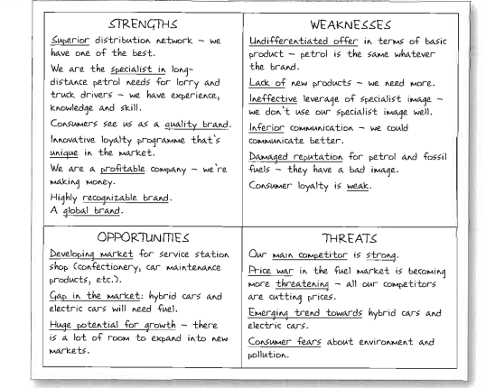
D

Slide 6
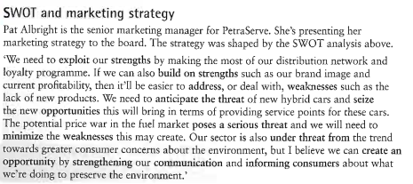
E

Slide 7
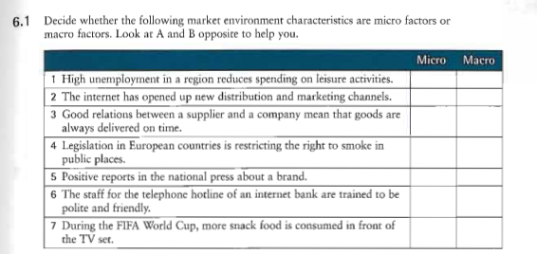
EX 1

Slide 8
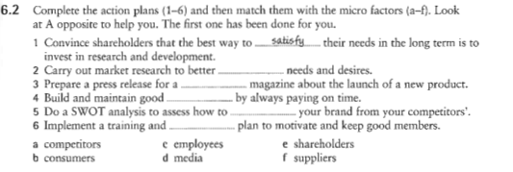
EX 2

Slide 9
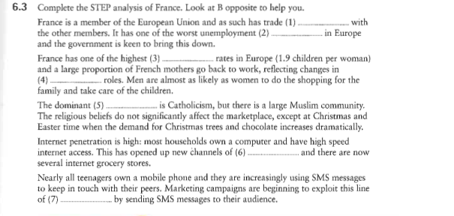
EX 3

Slide 10
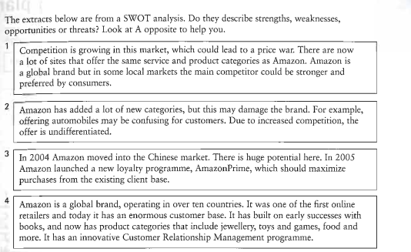
EX 4

Slide 11
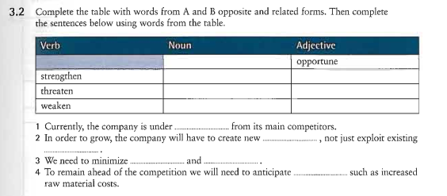
EX 5

Slide 12
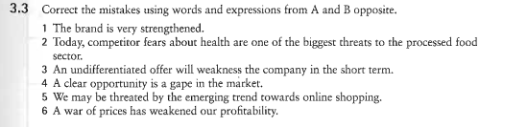
EX 6

Slide 13
Thanks

