Slide 1
TQM culture
Course 10
محاضرات موجهة لطلبة السنة ثانية ماستر اقتصاد وتسيير المؤسسات
قسم العلوم الإقتصادية- جامعة بسكرة

Slide 2
Introduction
Quality culture means different things to different organizations. Every organization has a unique culture, and it is virtually impossible to achieve excellence unless a good quality culture has been fostered because culture is the driving force of quality.

Slide 3
Definitions
Behavioral scientists have come to the conclusion that culture is closely related to the complex mental state of the individual and includes beliefs, feelings, values, and dispositions to act in a certain way.
Quality occurs in elements and is expressed in relations. It influences its users—customers, clients, and influences their behavior in the market according to their satisfaction and experience with a particular product or service. Values that customers recognize are affected by their culture, and their expectations in relation to quality are usually influenced by their culture and customs.
Each organization has its own culture, and within this, different subcultures can be distinguished, which set the standards of conduct of the organization.

Slide 4
Organizational culture presents common beliefs, values, attitudes, and expectations related to certain behavior of the people belonging to an organization. It refers to the beliefs, attitudes, etiquette, and system of values of its management, employees, and other related parties in a given area and given time. A suitably chosen strategy significantly affects the quality and performance of the organization and the possibility of varying the means of improvement of its culture; the result of the strategy is that the culture affects the way the organization works. It depends on the formality of the organization, personality types, location, and groups that are formed within the organization.

Slide 5
There are many factors that contribute to the quality culture in an organization. The following factors are associated with the hierarchy of human needs, whether of an individual or of different interests of an organized group of people:
• Psychological needs
• Social needs
• Safety needs
• Needs for self-realization
The organization shapes the behavior of its people, while the people create its culture by their ethics, structure, and method of communication and information flow. The culture evolves as the organization and its surroundings change and become gradually differentiated.
Martin Reimann, Ulrich F. Lünemann, and Richard B. Chase in their research recognize that the perception of the level of service quality varies in different cultures, and this significantly affects customer satisfaction.

Slide 6
It’s important to note that an organization's quality culture is associated with TQM. The organizational culture and the quality management system influence each other, including each other’s functionalities. This makes assessing the current organizational culture all the more critical—before implementing TQM. In this way, you can identify aspects of the organizational culture that will support or constrain the cultural change.

Slide 7
Lahke & Mohanty (1994) deemed the following measures fundamental for achieving cultural change:
Policies, procedures, and processes should emphasize quality.
All employees should be aware of the importance of quality in achieving their business goals.
Employees at all levels should be aware of the customer’s requirements and needs.
The organizational structure should allow for the implementation of continuous improvement activities.
The business plan must describe the integration of internal and external customer requirements.
The use of customer-based measures of performance is critical.
Strong communication lines must be in place.
Teams should foster customer commitment.
Top management should emphasize customer-oriented values and beliefs.

Slide 8
The organization seeking to implement TQM needs a culture that deals effectively with change, including any changes associated with adapting to the external environment and responding to internal processes (Kujala, 2002).
Dellana & Hauser (1999), in their research, found that “the ideal cultural profile for supporting TQM may be characterized to a degree by the adhocracy culture type, and secondarily by the group culture type.”
It is obvious that flexibility-oriented organizations, such as those with group or adhocracy cultures, already possess a climate of trust and a positive attitude toward the organization; for this reason, one can expect less resistance to TQM implementation. Tata & Prasad (1998) examined the structural and cultural influences on TQM implementation through the building blocks of TQM, suggesting that organic structures and flexibility-oriented cultures are more conducive to TQM success than mechanistic structures and control-oriented cultures.

Slide 9
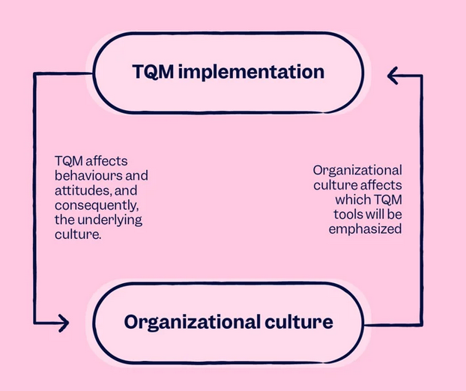
Source: https://www.scilife.io/blog/build-quality-culture-with-tqm

