Slide 1
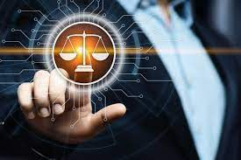
Course 3: CONCEPTS
By: GAOUAOUI R

Slide 2
CONCEPTS
Morality
Ethics
Deontology
Professional values
Rights

Slide 3
Ethics and morality
Ethics and morality are two closely related terms that are often poorly differentiated in the literature because they are etymologically equivalent.
It is appropriate to reserve the term "ethics" for all questioning that precedes the introduction of the idea of moral law and to use "morality" for everything related to imperatives (Ricoeur, 1988).

Slide 4
Ethics and morality
Etymologically, the word "ethics" is a Greek synonym for "morality." However, today it carries a less pejorative connotation than "morality," as it is more theoretical or philosophical.
While morality is a set of rules or laws that have a universal, irreducible, or even eternal character, ethics focuses on values and is determined relatively in time and space, depending on the human community it addresses.

Slide 5
Ethics and morality
The philosopher André Comte-Sponville distinguishes between the moral order and the ethical order. For him, morality is what we do out of duty (by exercising will), while ethics is everything we do out of love (by exercising feelings).
"Ethics is the aesthetics of the inner self."
Pierre Reverdy - 1889-1960 - Le Livre de mon bord, 1948

Slide 6
Differences between morality and ethics
Morality is defined as a set of norms and rules that must apply to everyone; it determines what is right and wrong, serving as both a reference point and an imperative.
Ethics introduces an additional dimension: it requires acknowledging the individual, who is recognized as capable of asserting their own voice and interests. The shift from morality to ethics is one from the universal to the particular.

Slide 7
Morality
Definition:
Morality (Etymology from the Latin mores, mœurs): A set of rules of action and values that function as norms in a society.

Slide 8
Sources of morality
Sources of morality:
  Religionالدين
  Conscience وعي
  Sense of dutyالإحساس بالواجب
  Sense of respectالشعور بالاحترام
  Justiceعدالة
  Virtue فضيلة

Slide 9





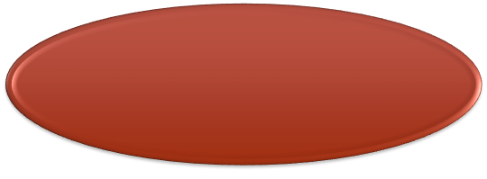



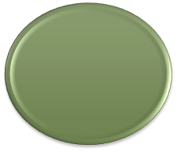
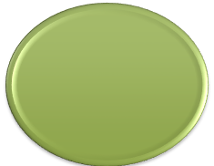
Sources of morality
Religion
Virtue
Conscience
Sources of morality
Justice
Sense of duty
Sense of respect

Slide 10
Sources of morality
Religion: Moral action stems from religious sources (Qur'an).
Conscience: It is my conscience that indicates to me what is right or wrong.
Sense of duty: Doing good or seeking it is, above all, a duty.
Sense of respect: Interpersonal relationships should be governed by respect. Prohibitions, rules, and injunctions can vary greatly from one culture to another.

Slide 11
Sources of morality
5. Justice: "Justice is the right of the weakest."
Joseph Joubert - 1754-1824. ustice is a moral principle of social life based on the recognition and respect for the rights of others, which can be either natural law (equity) or positive law (the law).
6. Virtue: Virtue is inherent to a person's character and identity. A good person, a virtuous person, will accomplish good things.

Slide 12
Ethics
Ethics is not a legal system or a law of general application.
Ethics should provide a way of acting as well as justifications for our actions (individualization).

Slide 13
Ethics
Definition 1:
Etymology: from the Greek "ethikos," meaning moral, derived from "ethos," meaning customs.
Ethics is the science of morality and customs. It is a philosophical discipline that reflects on the purposes, values of existence, the conditions for a happy life, the concept of "good," and questions of morals or ethics.
Definition 2: Ethics can also be defined as a reflection on the behaviors to adopt to make the world a habitable place for humanity. In this sense, ethics is a pursuit of an ideal society and a way of living.

Slide 14
Ethics
Definition 3: Ethics can be defined as the philosophical study of moral behavior, moral decision-making, or well-being.
Definition 4: Ethics can be distinguished from morality, understood as the activity of choosing, deciding, judging, justifying, and defending behaviors, while ethics studies how moral choices should be made.

Slide 15
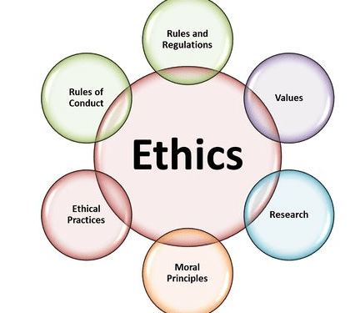
Ethics

Slide 16
Deontology
Etymology:
from the English "deontology," derived from the Greek " deontos," meaning what must be done, duty, with the suffix "-logy" from the Greek "lógos," meaning study, science.
Deontology → "theory of duties.“
Deontology is a branch of ethics that establishes the foundations of a person's duties based on morality.

Slide 17
Deontology
Deontology is the set of rules or duties governing the conduct expected of members of a profession or individuals holding a position in society.
Whether imposed by law or not, it constitutes the ethics of a profession.
This is the case, for example, for medical professions (Hippocratic oath), journalists (Munich Charter), lawyers, etc.

Slide 18
Deontology
Ethics applies to the professional world by establishing a series of rules and duties to which members of the same profession.
A professional code of ethics governs the practice of a profession. It outlines the ethics as well as the rights and duties of those who practice it.

Slide 19
Differences between deontology and ethics
Unlike professional ethics, which defines what an individual considers morally correct in their profession, professional deontology is a code of conduct that applies to all professionals.
The formulation of an ethics code for the practice of helping relationships serves to establish the standards to be followed in the training or practice of the profession.
A code of deontology aims to protect and promote the well-being of the professional.

Slide 20
What does ethics and deontology mean?
Ethics is the flexion that analyses man’s action with regard to moral values and standards. It also concerns with man’s principles and his relation with his counterpart in society”. It determines and motivates actions for better acting.
Deontology has practical aim, wherein it intends to define a common set of rules, recommendations and procedures for a given professional practice.
It aims at regulating the activities of a certain profession and, therefore, constitutes a better conducting code that defines a professional identity.

Slide 21
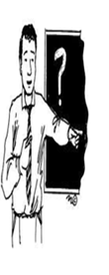

Deontology (example)
Teaching deontology
Medical deontology

Slide 22
Profession and Trade
It's difficult to establish a precise difference between the terms "trade" and "profession.
" Originally, this was not the case: a trade referred to a more manual activity, while a profession was associated with more intellectual activities.
However, the meaning of words evolves, and the distinction is less clear today.

Slide 23
Profession and Trade
Today, "profession" more often refers to the collective group of people engaged in the same activity.
According to sociologist M. Sorel, a profession is thus "a socially organized and recognized trade."
On the other hand, "trade" would refer to the execution of a specific activity, viewed from a practical perspective. A trade encompasses the sum of professional actions and skills necessary to complete a given task.

Slide 24
Profession and Trade
The difference between a trade and a profession lies primarily in their definition and scope.
A trade refers to an activity that is often manual or technical, focused on practical skills and specific know-how. It concentrates on the execution of concrete tasks.
A profession, on the other hand, generally involves a higher level of qualification and is often associated with intellectual or academic activities. It refers to a group of individuals who practice the same activity, with ethical standards and social recognition.

Slide 25
Professional values
Professional values are principles and beliefs that guide individuals' behavior and decisions in their work environment.
They reflect what is considered important in a profession or field of activity.

Slide 26
Professional values
Due to its missions and its impact on the economy and society, the university must urgently define and promote its values, while clarifying them for its members: students, faculty, and administrative and technical staff, in order to address the many challenges it faces.

Slide 27
Professional values (Examples)
Competence
Attendance
Scientific integrity
Intellectual property
Integrity
Transparency
Continuity

Slide 28
Professional values (Examples)
Efficiency in execution
Diligence
Compliance
Disinterest
Confidentiality
Accountability
Academic freedom

Slide 29
Rights
"All governments have, at all times, violated all rights, starting with the rights of people. The cannons were called 'ultima ratio.' 'Whoever has power has rights,' such was the maxim; small states devoured by large ones; chickens eaten by foxes, foxes eaten by wolves, wolves eaten by lions—this was the practice. What is new is the respect for rights. This is the honor of the civilization of the 19th century, to wish that the weak be respected by the strong, and that eternal morality be above pikes and muskets."
Victor Hugo - 1802-1885 - Choses vues

Slide 30
Rights
Definition:
Etymology: from the Latin directus, meaning straight, direct.
A right is a fee whose payment allows the use or realization of something, or grants an entry right, advantage, or prerogative...
For example: copyright, withdrawal right.

Slide 31
Rights
Law is distinguished from morality and ethics in that it does not comment on the value of actions, good/bad, right or wrong, and only defines what is permitted.

Slide 32
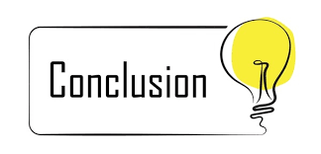

Slide 33
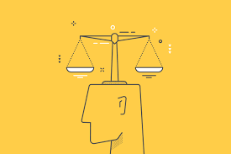
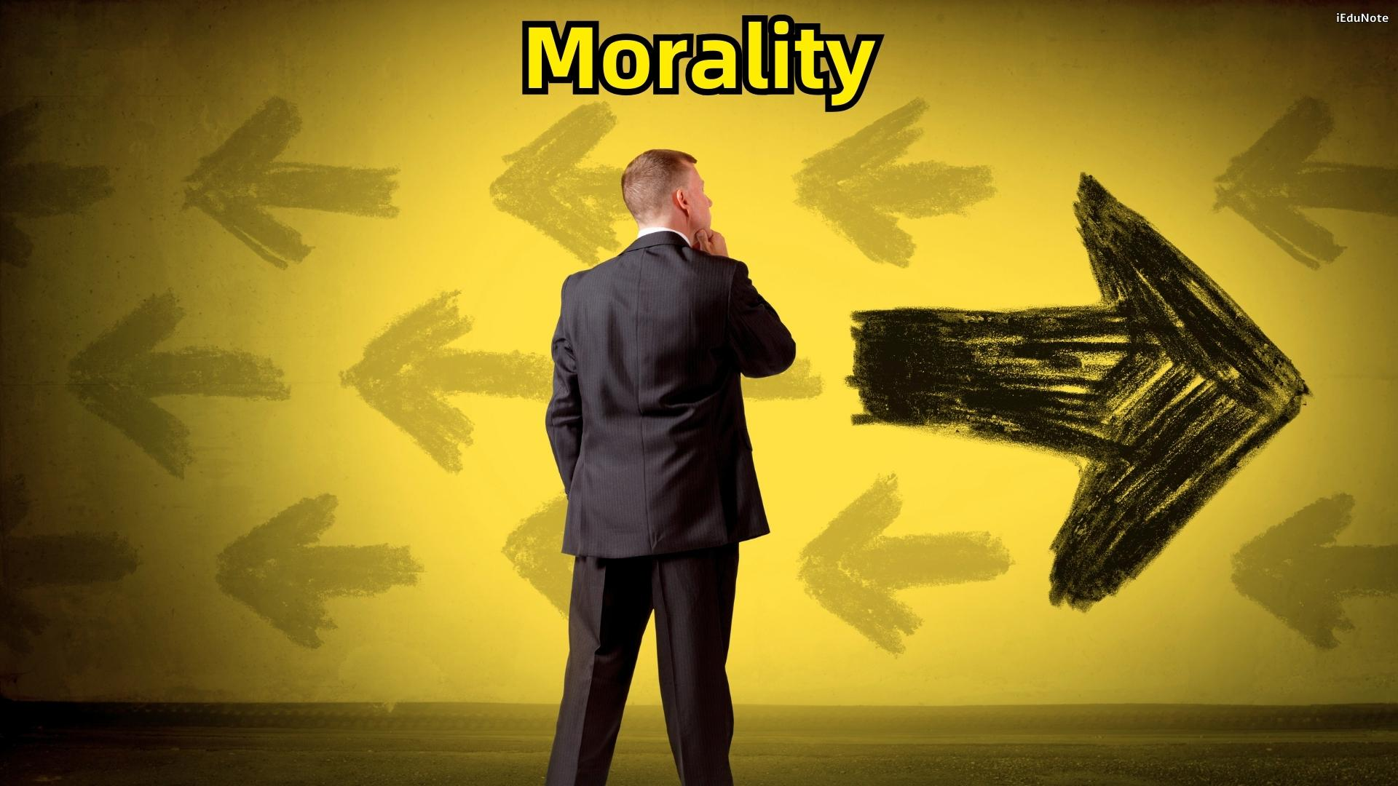

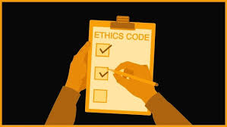
Ethics
what society deems good.
what I deem good
Rights
Deontology
what the law defines as permitted or prohibited
what the profession imposes on me

