Slide 1

MARKETING MIX 2
Dr.DJOUDI Hanane
Faculty of ECMS/ University of Biskra
November, 2024
REF: Professional English in Use Marketing

Slide 2
BUSINESS
PLAN
A business plan is a comprehensive document that outlines a company's goals, strategies, and financial projections. It provides a detailed description of the business, including its products or services, target market, competitive landscape, and marketing and sales strategies. The plan also includes a financial section that forecasts revenue, expenses, and cash flow, as well as a funding request if the business is seeking investment.

Slide 3
BUSINESS
PLAN
The business plan is an undeniably critical component to getting any company off the ground. It's key to securing financing, documenting your business model, outlining your financial projections, and turning that nugget of a business idea into a reality.
https://blog.hubspot.com/marketing/what-is-business-plan

Slide 4
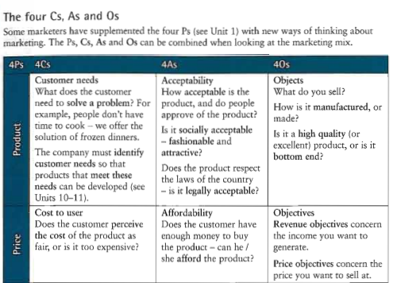
A

Slide 5
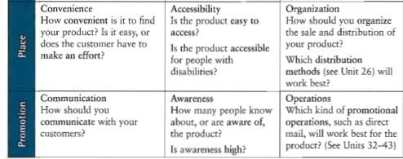
A

Slide 6
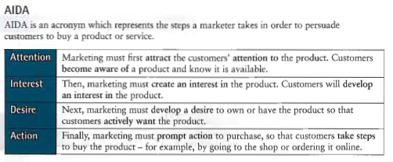
B

Slide 7
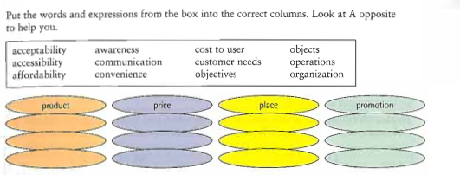
EX 1

Slide 8
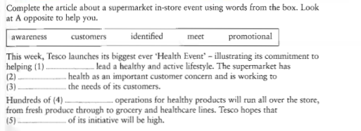
EX 2

Slide 9
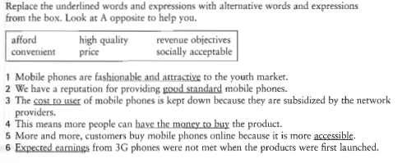
EX 3

Slide 10
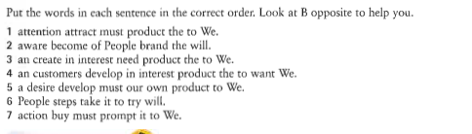
EX 4

Slide 11
Thanks

