Slide 1
Quality tools and techniques (part 02)
Course 08
محاضرات موجهة لطلبة السنة ثانية ماستر اقتصاد وتسيير المؤسسات
قسم العلوم الإقتصادية- جامعة بسكرة

Slide 2
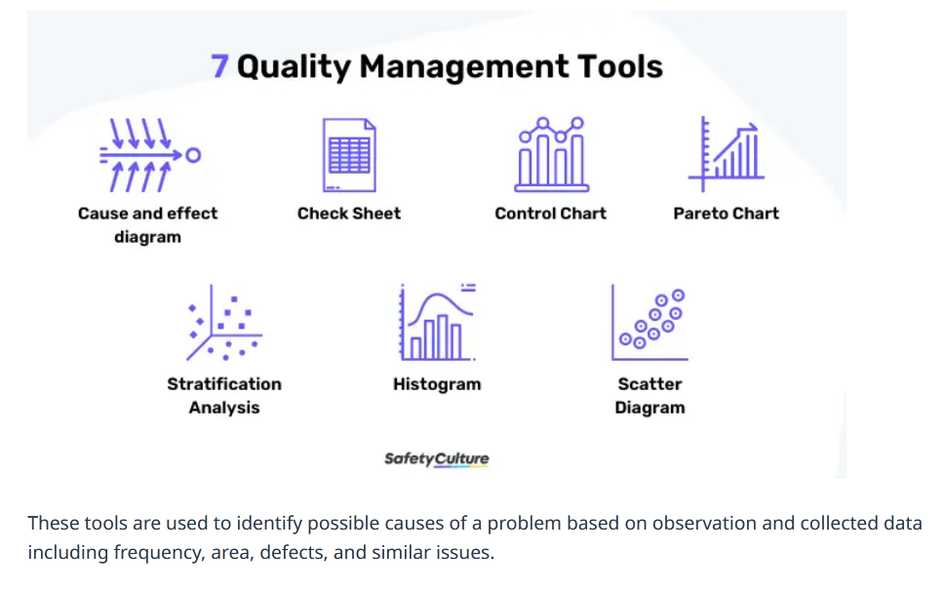
Source: https://safetyculture.com/topics/quality-management-tools/

Slide 3
4. Histogram
A Histogram is a statistical tool that plays a critical role in quality management and process improvement. It is essentially a bar chart representing the distribution of numerical data. By showing the frequency of data points within successive intervals, histograms provide a clear visual snapshot of data variation and distribution, which is vital for understanding and improving processes.
Fundamentals of Histograms
Histograms display data in columns, where each column represents a range or bin of values, and the height of the column indicates the frequency of data points within that range. This representation makes it easy to see patterns such as skewness, the presence of outliers, and whether data is evenly or unevenly distributed.
Application Across Fields
In manufacturing, histograms can be used to analyze the consistency of product dimensions, like the diameter of a batch of bearings. In service industries, they might be utilized to understand customer wait times or service delivery times. This versatile tool can be applied to any process where quantifiable data is collected.

Slide 4
Benefits
Visualization of Data Distribution: Histograms clearly visualize how data is distributed across different ranges.
Identification of Patterns and Anomalies: They help in identifying common patterns, outliers, or anomalies in the data.
Facilitation of Comparative Analysis: Histograms allow for the comparison of data distributions over different periods or under different conditions.
Informing Process Improvements: Organizations can make informed decisions to streamline and improve processes by understanding data distribution.
Challenges
Data Misinterpretation: Without proper statistical knowledge, there’s a risk of misinterpreting what the histogram represents.
Selection of Bins: Choosing inappropriate bin sizes or ranges can lead to misleading data representations.
Over-Simplification: While histograms are great for displaying distribution, they don’t show everything, such as the relationship between two variables.
Best Practices
Appropriate Bin Size: Carefully determine the range and size of bins to accurately reflect the distribution of data.
Contextual Analysis: Always analyze histogram data in the context of other relevant data and information.
Integration with Other Tools: Combine the insights from histograms with other quality tools like Control Charts and Pareto Charts for a more comprehensive analysis.
Histograms are invaluable in the quality manager’s toolkit, offering a simple yet effective means to visualize and analyze data distribution. This insight is essential for identifying potential areas for process improvement and ensuring that decisions are data-driven and focused on enhancing quality and efficiency.

Slide 5
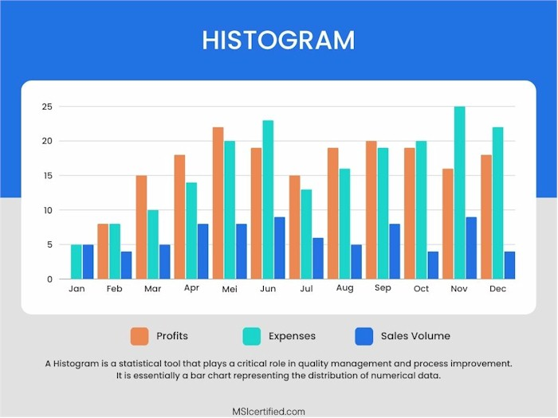

Slide 6
5. Pareto Chart
The Pareto Chart is a vital tool in the quality management field, embodying the principle that a small number of causes are often responsible for a large percentage of the effect – a concept known as the Pareto Principle or the 80/20 rule. This tool is crucial for prioritizing problem-solving efforts and focusing on the changes that will have the greatest impact.
Overview of Pareto Charts
A Pareto Chart is a visual tool that combines both a bar graph and a line graph. The individual values are represented in descending order by bars, and the cumulative total is represented by the line. This format helps in identifying the most significant factors in a dataset.
Applications in Different Sectors
In manufacturing, Pareto Charts can be used to identify the most common sources of defects or production delays. In service industries, they can help pinpoint the most frequent types of customer complaints or service bottlenecks. They are valuable in any scenario where prioritizing resources and efforts can lead to significant improvements.

Slide 7
Advantages
Focuses Efforts on Key Issues: By identifying the most critical factors contributing to a problem, Pareto Charts help in focusing efforts where they can make the most difference.
Data Visualization: They provide a clear visual representation of data, making it easier to understand and communicate issues.
Decision-making Aid: Pareto Charts are powerful tools for decision-makers, guiding them in allocating resources effectively.
Potential Challenges
Over-Simplification: While Pareto Charts are useful for highlighting major issues, they may oversimplify complex situations where multiple interrelated factors contribute to a problem.
Data Interpretation: Misinterpretation of data can lead to incorrect conclusions about what the key issues are.
Effective Implementation
Accurate Data Collection: Ensure the data used is accurate and comprehensive.
Regular Updates: Update the Pareto Chart regularly to reflect the current state of the process or problem.
Combine with Other Tools: Use in conjunction with other quality tools, such as the Cause-and-Effect Diagram, to delve deeper into the root causes of the issues identified.
Pareto Charts are essential in the toolkit of quality improvement methodologies. They guide teams to focus on the ‘vital few’ rather than the ‘trivial many’, ensuring that efforts and resources are channeled towards making the most impactful improvements. As a result, they play a pivotal role in enhancing the efficiency and effectiveness of business processes.

Slide 8
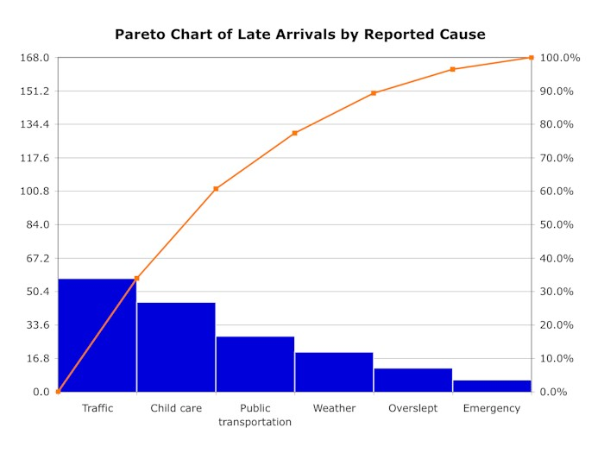

Slide 9
6. Scatter Diagram
The Scatter Diagram, also known as the scatter plot, is an indispensable tool in quality management and process improvement, primarily used for analyzing the relationship between two variables. This tool is crucial for identifying patterns, correlations, or potential cause-and-effect relationships, providing invaluable insights for decision-making and process optimization.
The Essence of Scatter Diagrams
A Scatter Diagram plots pairs of numerical data, with one variable on each axis, to look for a relationship or trend between them. Each point on the graph represents an individual data point. The pattern of these points can indicate whether and how strongly two variables are related.
Application Across Various Domains
Scatter Diagrams are widely used in numerous industries. In manufacturing, they might be used to examine the relationship between machine settings and product defects. They can analyze the correlation between advertising spend and sales revenue in marketing. These diagrams are versatile and can be applied to any scenario where understanding the relationship between two variables is beneficial.

Slide 10
Benefits
Identifying Correlations: Scatter Diagrams are excellent for identifying whether a relationship exists between two variables and how strong that relationship is.
Visual Clarity: They provide a clear visual representation that can often reveal trends and patterns more effectively than numerical statistics.
Hypothesis Testing: They can be used to test hypotheses about cause-and-effect relationships.
Data Exploration: Scatter Diagrams are useful for initial exploration of data, guiding further detailed analysis.
Challenges
Causation vs. Correlation: A common pitfall is mistaking correlation (how variables are related) for causation (one variable causing the other).
Over-interpretation: There’s a risk of over-interpreting the data without proper statistical knowledge.
Complex Relationships: They may not effectively reveal complex relationships involving more than two variables.
Best Practices
Use with Other Tools: For a comprehensive analysis, combine Scatter Diagrams with other tools like the Cause-and-Effect Diagram to explore underlying causes.
Statistical Expertise: Seek statistical expertise when necessary to interpret the diagrams correctly.
Continual Refinement: Continuously refine and explore data with additional scatter plots as more variables and data are considered.
In summary, Scatter Diagrams are a powerful tool in the quality improvement toolkit, providing clarity and insights into the relationships between variables. By effectively utilizing this tool, organizations can uncover hidden patterns and relationships, leading to more informed decisions and improved processes and products.

Slide 11
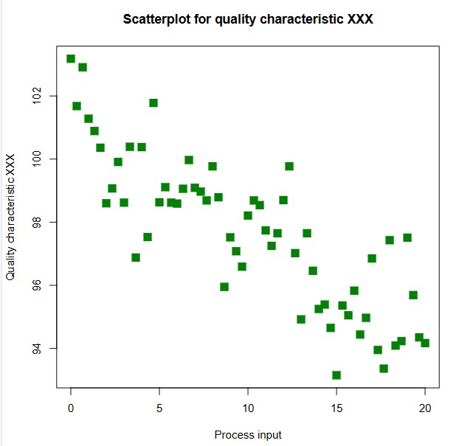

Slide 12
7. Flow Chart
The Flow Chart is a fundamental tool in process improvement, offering a clear and systematic visual representation of a process from start to finish. It is instrumental in understanding, analyzing, and optimizing complex processes, thereby playing a critical role in enhancing efficiency and effectiveness in various business operations.
Basics of Flow Charts
A Flow Chart is a diagram that depicts the steps of a process through a series of shapes connected by arrows. Each shape represents a different type of action or decision point, and the arrows show the flow and sequence of these steps. This tool is essential for mapping out processes in a way that is easy to understand and communicate.
Wide-Ranging Applications
In manufacturing, Flow Charts can be used to detail the production process, from raw material handling to finished product. In services, they can map out customer service protocols or administrative procedures. Their versatility makes them applicable in virtually any industry where processes need to be understood and improved.

Slide 13
Advantages
Clarifies Complex Processes: Flow Charts make it easier to understand even the most complex operations by visually breaking down a process.
Identifies Redundancies and Inefficiencies: They help pinpoint redundant or inefficient steps, paving the way for streamlining and optimization.
Facilitates Communication: They are an excellent tool for communicating processes and changes within a team or organization.
Enhances Problem-Solving: By providing a clear view of the process, Flow Charts aid in identifying areas for improvement and problem-solving.
Potential Challenges
Over-Simplification: There’s a risk of oversimplifying complex processes, which might lead to missing out on important nuances.
Maintenance: As processes evolve, Flow Charts need to be regularly updated, which can be time-consuming.
Best Practices for Implementation
Detailing Each Step: Ensure that every step of the process is clearly and accurately represented.
Involving Stakeholders: Include input from all stakeholders involved in the process to get a comprehensive view.
Regular Review and Update: Continually review and update the Flow Chart to reflect any changes in the process.
Use in Conjunction with Other Tools: Combine Flow Charts with other quality tools, like Pareto Charts or Control Charts, for a holistic approach to process improvement.
Flow Charts are invaluable in the quality management toolkit, offering a structured and clear methodology for dissecting and understanding processes. Their use facilitates a deeper insight into operational workflows, aiding businesses in refining and optimizing their processes for greater efficiency and effectiveness.

Slide 14
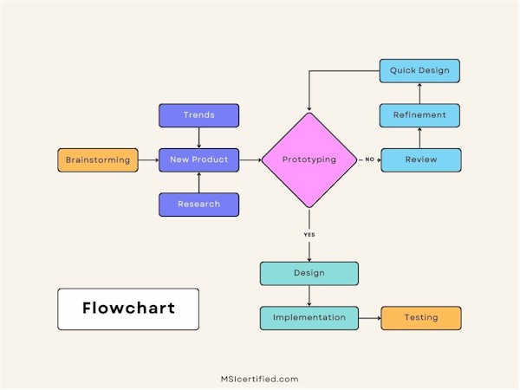

Slide 15
Conclusion
The 7 Basic Quality Tools for Process Improvement are foundational in any quality improvement initiative. They are versatile and can be applied in various industries and processes. Organizations can significantly improve quality, efficiency, and overall performance by effectively utilizing these tools. These tools help in problem-solving and foster a culture of continuous improvement and strategic thinking within the organization.

Slide 16
Other tools/ techniques of TQM
Add the benchmarking from the bool of TQM
Definition: Benchmarking
Benchmarking is defined as the process of measuring products, services, and processes against those of organizations known to be leaders in one or more aspects of their operations. Benchmarking provides necessary insights to help you understand how your organization compares with similar organizations, even if they are in a different business or have a different group of customers.
Benchmarking can also help organizations identify areas, systems, or processes for improvements—either incremental (continuous) improvements or dramatic (business process re-engineering) improvements.

