Slide 1
Quality tools and techniques (part 01)
Course 07
محاضرات موجهة لطلبة السنة ثانية ماستر اقتصاد وتسيير المؤسسات
قسم العلوم الإقتصادية- جامعة بسكرة

Slide 2
introduction
In the fast-paced and competitive world of business and manufacturing, the pursuit of excellence is not just an ambition but a necessity. Quality and efficiency are the cornerstones of this pursuit, and mastering the art of process improvement is crucial for any organization aiming to thrive. This is where the “7 Basic Quality Tools for Process Improvement” come into play, serving as essential instruments in the toolkit of quality management professionals.
Originating from the foundational practices of Total Quality Management (TQM) and Six Sigma, these tools are not just tools but beacons that guide businesses through the complexities of process optimization. They are revered for their simplicity, versatility, and profound impact. Whether it’s a multinational corporation or a small startup, these tools are universally applicable, transcending industry boundaries and scaling to fit various operational scopes.
The beauty of these tools lies in their ability to transform complex, abstract problems into tangible, manageable components. They enable teams to dissect issues, analyze data, and craft strategic solutions. By implementing these tools, organizations can identify and rectify inefficiencies and foster a culture of continuous improvement and strategic foresight.
The 7 Basic Quality Tools are more than methodologies; they build a resilient, agile, and quality-focused business environment. As we delve into each of these tools, it becomes evident how they collectively form a powerful arsenal for driving process improvement, enhancing product quality, and ensuring customer satisfaction in today’s dynamic business landscape.

Slide 3
The 7 Basic Quality Tools for Process Improvement
Quality Glossary Definition: Seven tools of quality
"The Old Seven." "The First Seven." "The Basic Seven."
Quality pros have many names for these seven basic tools of quality, first emphasized by Kaoru Ishikawa, a professor of engineering at Tokyo University and the father of "quality circles." Start your quality journey by mastering these tools, and you'll have a name for them too: indispensable.
Cause-and-effect diagram (also called Ishikawa or fishbone diagrams): Identifies many possible causes for an effect or problem and sorts ideas into useful categories.
Check sheet: A structured, prepared form for collecting and analyzing data; a generic tool that can be adapted for a wide variety of purposes.
Control chart: Graph used to study how a process changes over time. Comparing current data to historical control limits leads to conclusions about whether the process variation is consistent (in control) or is unpredictable (out of control, affected by special causes of variation).
Histogram: The most commonly used graph for showing frequency distributions, or how often each different value in a set of data occurs.
Pareto chart: A bar graph that shows which factors are more significant.
Scatter diagram: Graphs pairs of numerical data, one variable on each axis, to look for a relationship.
Stratification: A technique that separates data gathered from a variety of sources so that patterns can be seen (some lists replace stratification with flowchart or run chart).

Slide 4
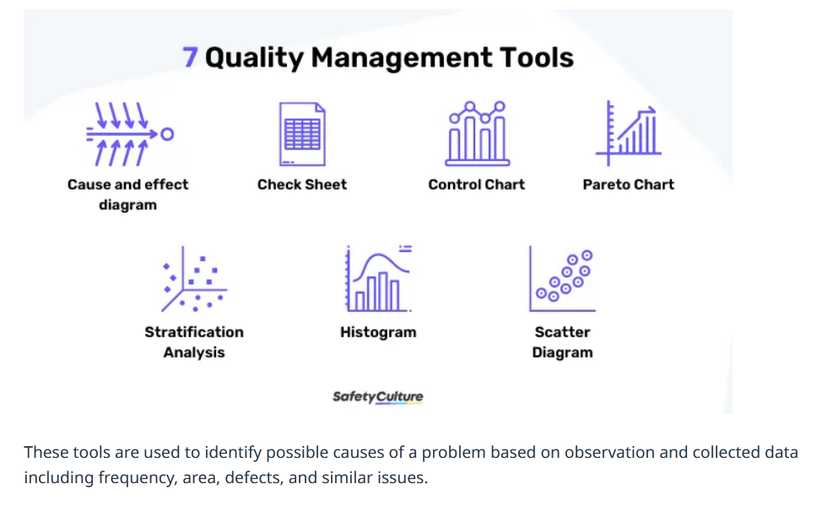
Source: https://safetyculture.com/topics/quality-management-tools/

Slide 5
1. Cause-and-Effect Diagram (Ishikawa or Fishbone Diagram)
The Cause-and-Effect Diagram, also known as the Ishikawa or Fishbone Diagram, is a fundamental tool in the quality management arsenal. It is named after its creator, Kaoru Ishikawa. Its primary function is to facilitate the systematic exploration of potential causes for a specific problem or issue. The diagram’s unique fishbone structure visually organizes the causes into various categories, making complex problem-solving more manageable and structured.
How it Works
The diagram typically starts with a problem statement, placed at the “head” of the fish. Branching out from this problem statement are the “bones,” representing different categories of potential causes. Common categories include Methods, Machinery, Materials, Manpower, Measurement, and Environment, though these can vary depending on the problem’s specific context.

Slide 6
Application in Business
In a business context, the Cause-and-Effect Diagram is a powerful brainstorming tool. It encourages teams to consider all possible aspects of a problem, avoiding a narrow focus on the most apparent causes. For example, suppose a manufacturing company is facing a decline in product quality. In that case, the diagram can help the team explore various potential causes such as equipment malfunctions (Machinery), untrained staff (Manpower), inconsistent raw materials (Materials), or even environmental factors like humidity or temperature (Environment).
Benefits
Comprehensive Analysis: It ensures a thorough exploration of all potential causes of a problem, not just the most apparent ones.
Team Collaboration: It fosters team collaboration and collective problem-solving, as various team members can contribute insights from their expertise.
Visual Clarity: The visual nature of the diagram makes complex problems more understandable and manageable.
Root Cause Identification: It aids in identifying the root causes of problems, which is crucial for developing effective solutions.
Challenges
Over-Complexity: The diagram can sometimes become overly complex if too many potential causes are considered.
Misidentification of Causes: There is a risk of incorrectly identifying causes, leading to ineffective solutions.
Overall, the Cause-and-Effect Diagram is a versatile and effective tool for identifying, categorizing, and exploring the potential causes of problems in business processes. Its ability to break down complex issues into manageable parts makes it an invaluable quality and process improvement tool.

Slide 7
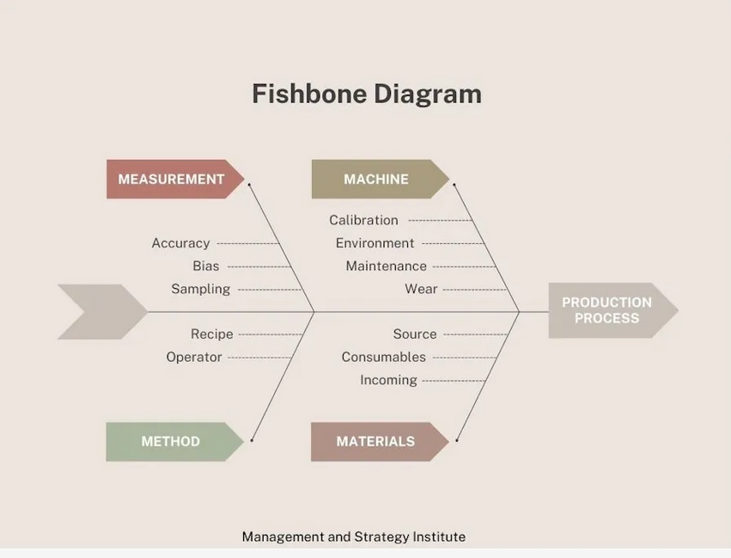
source: https://www.msicertified.com/blog/the-7-basic-quality-tools-for-process-improvement/

Slide 8
2. Check Sheet (Tally Sheet)
The Check Sheet, often referred to as a Tally Sheet, is a fundamental data collection tool in quality management. Its simplicity belies its power in capturing, organizing, and analyzing data, which is crucial for any process improvement initiative.
Nature and Functionality
A Check Sheet is a structured, prepared form for collecting and analyzing data. This customizable tool allows users to record and compile data systematically in real-time. It typically consists of several rows and columns, where each row represents a category or specific item to be observed, and each column is often used to tally the occurrences or measure other relevant data.
Diverse Applications
In a business context, Check Sheets serve various purposes, such as tracking defects’ frequency, monitoring events’ occurrence over time, or even conducting simple surveys. For instance, a Check Sheet might be used in a manufacturing setting to record the types and frequencies of machine breakdowns. In customer service, it could track the nature and number of customer complaints.

Slide 9
Advantages
Ease of Use: Its simple format makes it easy for anyone to use without extensive training.
Real-Time Data Collection: It facilitates on-the-spot recording, reducing the likelihood of errors and omissions.
Versatility: It can be customized for various data collection needs.
Visual Representation: When analyzed, the data from Check Sheets can be easily transformed into other quality tools like histograms or Pareto charts for further analysis.
Challenges
Subjectivity in Data Recording: The effectiveness of a Check Sheet can be compromised if the data recording is not standardized or if there’s ambiguity in what is being recorded.
Limited to Quantitative Data: It primarily collects quantitative data, and might not be suitable for capturing more nuanced, qualitative information.
Implementation Tips
Clear Definition: Ensure each category or item on the Check Sheet is clearly defined to avoid ambiguity.
Training: Train staff on how to use the Check Sheet effectively.
Review and Adaptation: Regularly review the Check Sheet for its relevance and adapt as necessary to meet changing needs.
The Check Sheet is a versatile and straightforward tool in the quality management toolkit. When used effectively, it can provide invaluable insights into process performance, thereby laying the groundwork for more detailed analysis and improvement strategies.

Slide 10
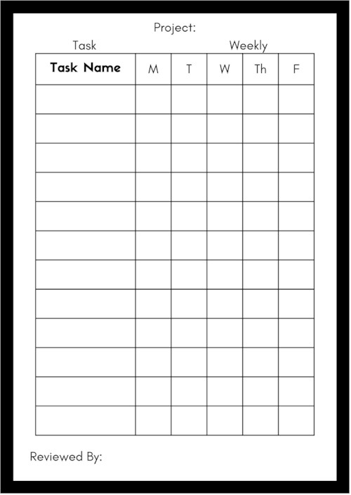

Slide 11
3. Control Charts
Control Charts, a pivotal tool in statistical process control, are crucial in monitoring and improving process performance over time. Developed by Walter A. Shewhart in the 1920s, these charts are fundamental for ensuring that processes are stable and predictable, a key aspect in maintaining consistent quality.
Understanding Control Charts
A Control Chart is a graphical representation used to monitor the variability and performance of a process. It typically consists of points plotted in time order, a central line for the average, an upper control limit, and a lower control limit. These limits are calculated based on the data and represent the threshold at which the process is considered in or out of control.
Applications in Various Sectors
In manufacturing, Control Charts can track production processes to detect any deviations from the norm, such as variations in product dimensions. In service industries, they might monitor transaction times or service quality. Essentially, any process that can be measured over time can benefit from the use of Control Charts.

Slide 12
Advantages
Early Detection of Problems: They help identify process variations before they escalate into more significant issues.
Process Optimization: By monitoring process stability, they aid in identifying opportunities for process improvement.
Reduced Variation: They assist in maintaining process consistency, which is crucial for quality assurance.
Data-Driven Decision Making: Decisions based on Control Charts are grounded in concrete data, enhancing the reliability of the decisions.
Potential Challenges
Misinterpretation of Data: Misunderstanding the data or control limits can lead to incorrect conclusions about process stability.
Setting Inappropriate Limits: Inaccurately set control limits can either fail to detect real problems or signal problems where none exist.
Over-Reliance on the Tool: While Control Charts are powerful, they need to be used as part of a broader quality management approach.
Effective Usage
Regular Monitoring: Regularly update and review the Control Charts to keep track of the process performance.
Training: Ensure that staff responsible for monitoring and interpreting the charts are adequately trained.
Integration with Other Tools: Combine Control Charts with other quality tools, like Pareto Charts or Cause-and-Effect Diagrams, for comprehensive process analysis.
Control Charts are indispensable in the quality management toolkit, especially for maintaining and improving the stability of processes. Their ability to provide visual and statistical analysis of process variations makes them essential for organizations striving for excellence in their operations.

Slide 13
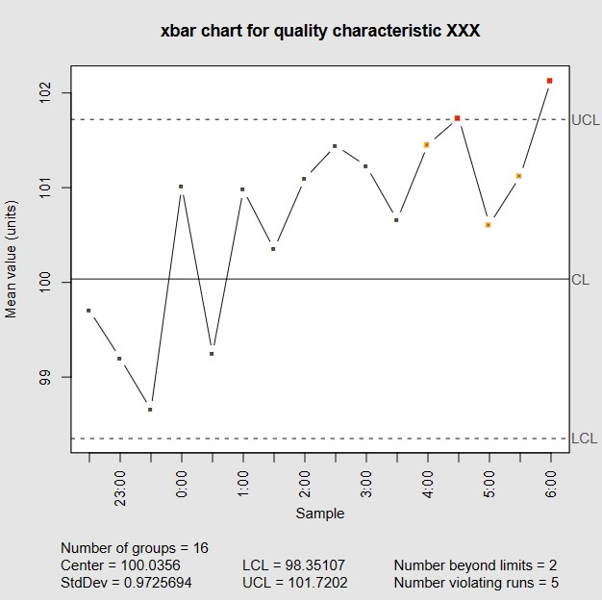
https://www.msicertified.com/blog/the-7-basic-quality-tools-for-process-improvement/

