Slide 1
Lecture starting soon

Slide 2

STATISTICS
Quantitative Data Analysis in Applied Linguistics
LECTURE 5:
APPLICATIONS OF DESCRIPTIVE STATISTICS
Moustafa Amrate
Department of English, University of Biskra
moustafa.amrate@univ-biskra.dz

Slide 3
This lecture will cover
An example of a questionnaire
Parts of a Questionnaire (Participant information sheet/ Consent/ profile information/ questions)
Questionnaire data entry in Excel
Descriptive analysis of questionnaire data in Excel
Descriptive analysis of questionnaire data in SPSS
Visualizing descriptive statistics of a questionnaire in Excel & SPSS

Slide 4
Questionnaire parts
Participant information sheet
Consent singnature
Profile information
Questions

Slide 5
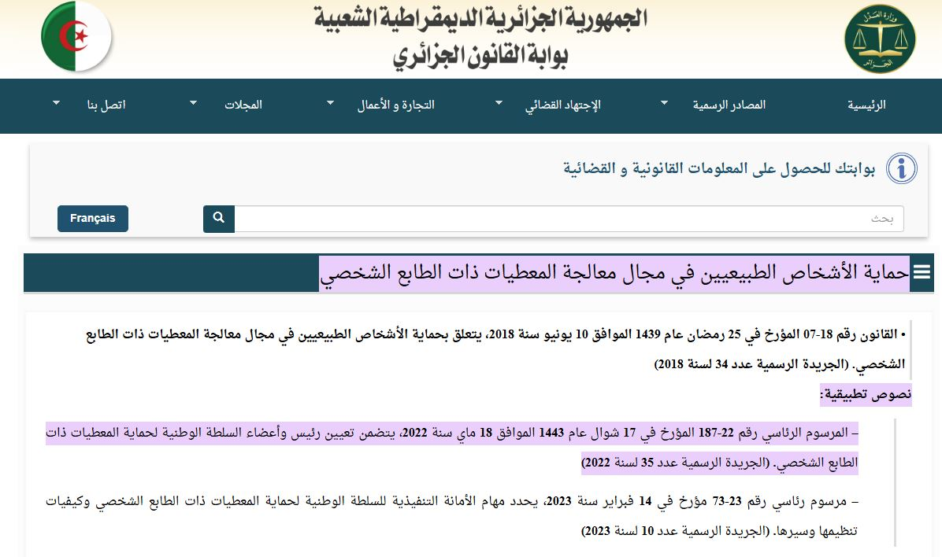
The data protection act in Algeria 18/ 07 2023

Slide 6

The data protection act in Algeria 18/ 07 2023

Slide 7
Demonstration

Slide 8
Branches of statistics
Descriptive statistics
Inferential statistics

Slide 9
This lecture will present an overview of three different types of descriptive statistics:
Measures of frequency
Measures of central tendency
Measures of variability or dispersion

Slide 10
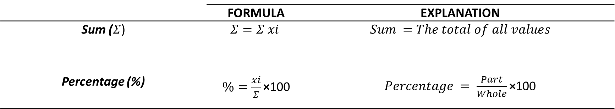
 | FORMULA | EXPLANATION
Sum ($Σ$) | $$Σ=Σ xi$$ | $$Sum =The total of all values$$
Percentage (%) | $\%=\frac{xi}{Σ}\text{×}$100 | $Percentage = \frac{Part}{Whole}\text{×}$100

Slide 11
2) Measures of central tendency
Second language researchers often use one or more measures of central tendency to provide precise quantitative information about the typical behavior of learners with respect to a particular phenomenon. There are three commonly used measures of central tendency, namely: 1) the mode, 2) the median, and 3) the mean.

Slide 12
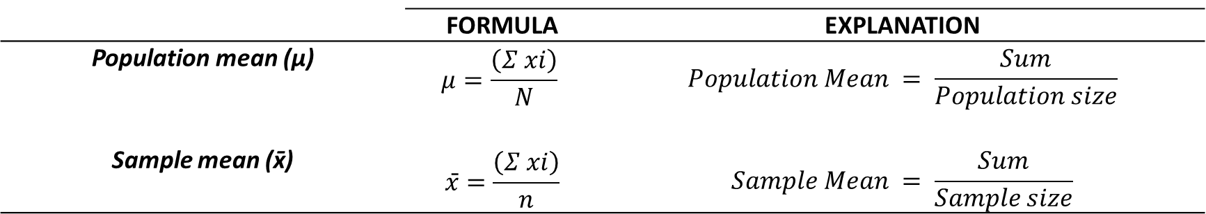
 | FORMULA | EXPLANATION
Population mean (μ) | $$μ=\frac{\left(Σ xi\right)}{N}$$ | $$Population Mean = \frac{Sum}{Population size}$$
Sample mean (x̄) | $$x̄=\frac{\left(Σ xi\right)}{n}$$ | $$Sample Mean = \frac{Sum}{Sample size}$$

Slide 13

ANY QUESTIONS?

Slide 14
3) Measures of spread (dispersion):
“Measures of dispersion describe variability of the numeral data away from the central tendency” (Phakiti, 2010, p. 44) .
“Measures of dispersion [particularly standard deviation] can serve as a quality control for measures of central tendency; the smaller the standard deviation, the better the mean captures the behavior of the sample.” (Mackey & Gass, 2015, p. 303)1.

Slide 15
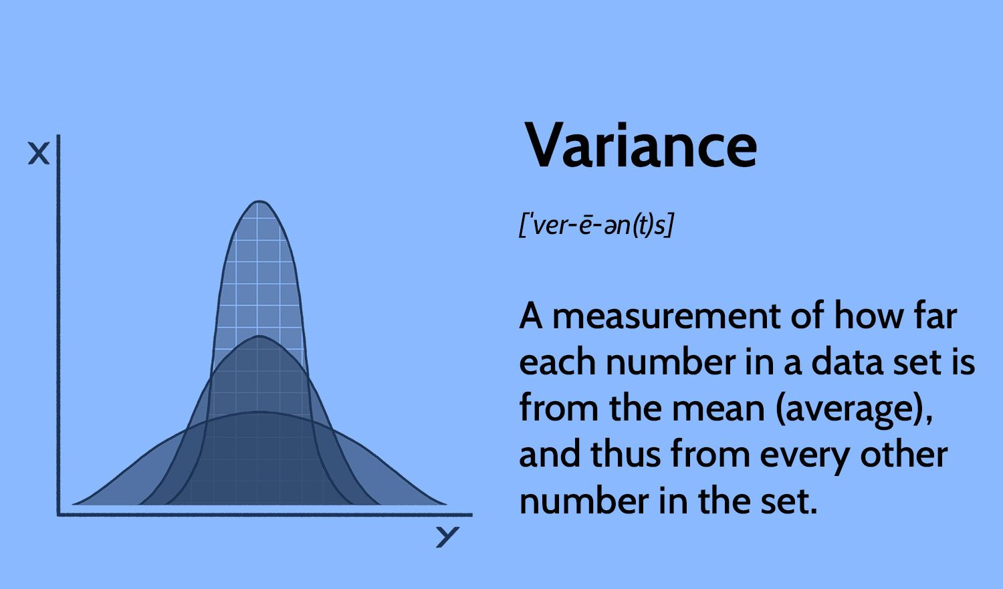
A) The variance:
The mean

Slide 16
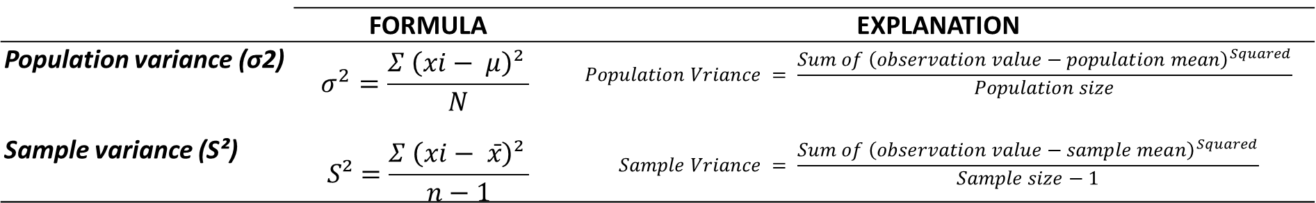
Variance formula
 | FORMULA | EXPLANATION
Population variance (σ2) | $$σ^{2}=\frac{Σ \left(xi− μ\right)² }{N}$$ | $$Population Vriance = \frac{Sum of {\left(observation value−population mean\right)}^{Squared}}{Population size}$$
Sample variance (S²) | $$S²=\frac{Σ \left(xi− x̄\right)² }{n−1}$$ | $$Sample Vriance = \frac{Sum of {\left(observation value−sample mean\right)}^{Squared}}{Sample size−1}$$

Slide 17
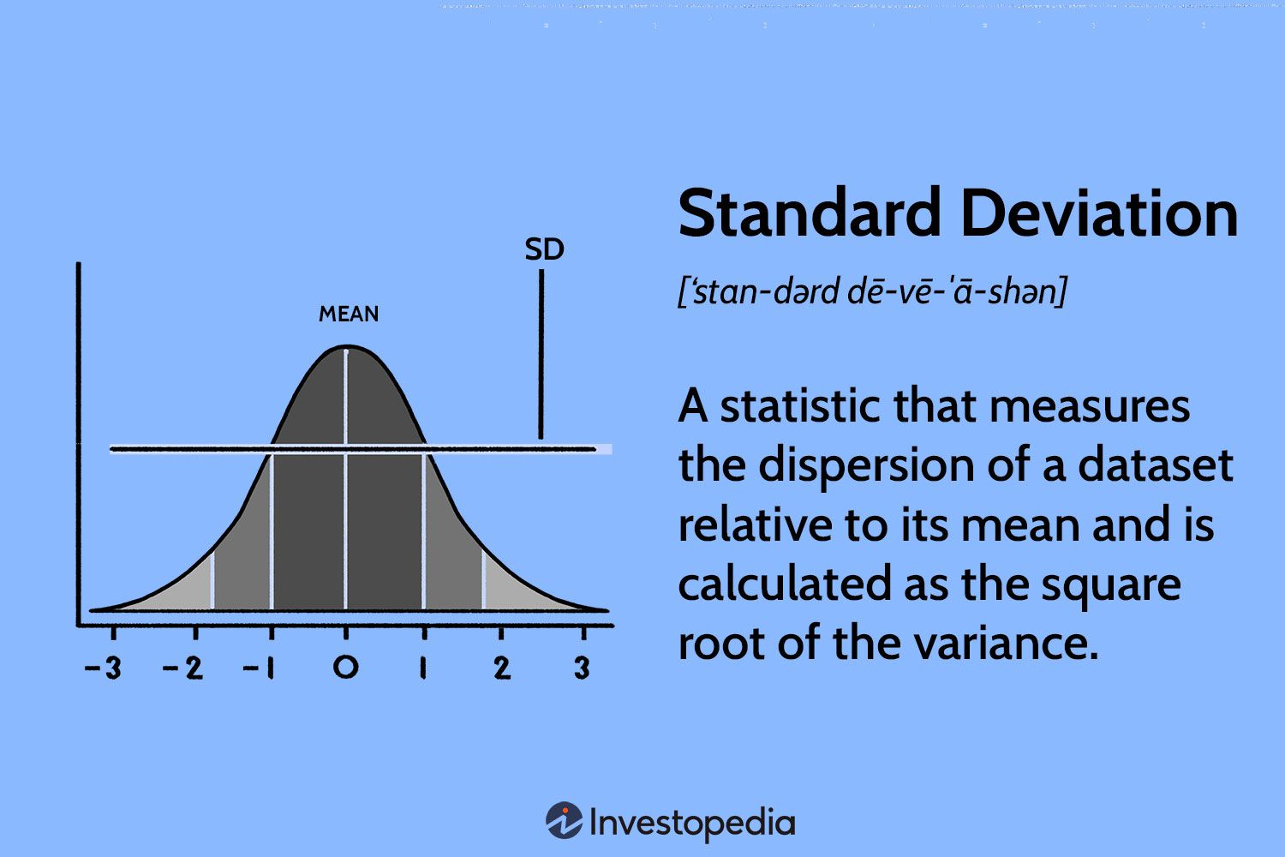

B) The Standard deviation (SD):
$σ$/ S

Slide 18
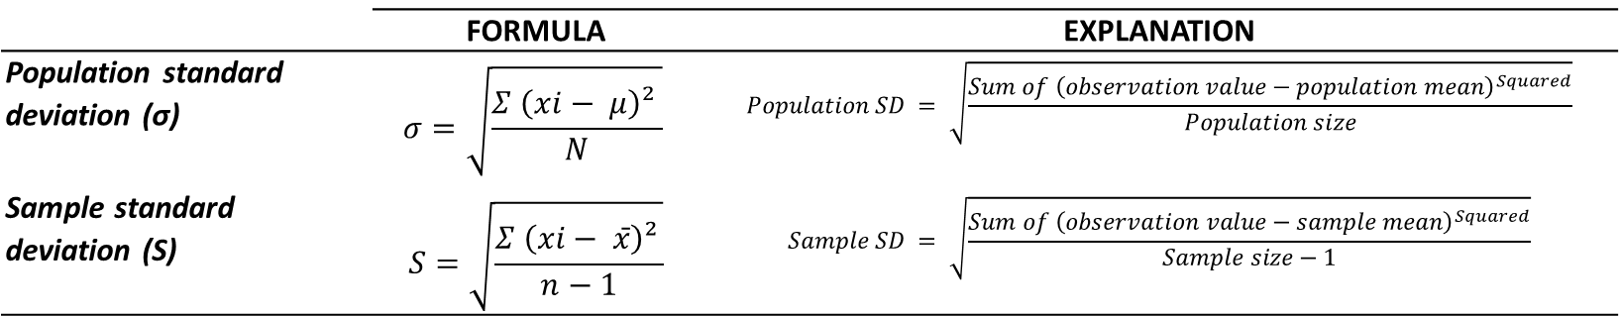
Standard deviation (SD) formula
 | FORMULA | EXPLANATION
Population standard deviation (σ) | $$σ=\sqrt{\frac{Σ \left(xi− μ\right)² }{N}}$$ | $$Population SD = \sqrt{\frac{Sum of {\left(observation value−population mean\right)}^{Squared}}{Population size}}$$
Sample standard deviation (S) | $$S=\sqrt{\frac{Σ \left(xi− x̄\right)² }{n−1}}$$ | $$Sample SD = \sqrt{\frac{Sum of {\left(observation value−sample mean\right)}^{Squared}}{Sample size−1}}$$

Slide 19
Your questions

Slide 20
Your questions
What is the difference between sample variance/ standard deviation and population variance/ standard deviation?
What is the difference between variance and standard deviation?
Why do we need the variance/ standard deviation?
How do we visualize the variance/ standard deviation?
How do we round up numbers in statistics?

Slide 21
Rounding up
Rounding up to the next whole number:
E.g., 1.9673 would be rounded up to 2
Rounding up to the next decimal place:
E.g., 1.9673 would be rounded up to 1.967 (if we want 3 decimal places)
E.g., 1.9673 would be rounded up to 1.97 (if we want 2 decimal places)

Slide 22
Rounding up
Rounding up to the next whole number:
E.g., 1.9673 would be rounded up to 2
(LESS PRECISE it completely eliminates the decimal part of the number.)
Rounding up to the next decimal place: E.g., 1.9673 would be rounded up to 1.967 (if we want 3 decimal places)
E.g., 1.9673 would be rounded up to 1.97 (if we want 2 decimal places)
(MORE PRECISE because it retain more of the original data's precision)

Slide 23
PRACTICE

Slide 24
Practice
The following dataset represent the scores achieved by university Algerian EFL students in the International English Language Testing System (i.e., IELTS): 6.00, 5.50, 6.00, 7.00, 6.00, 6.50, 5.50, 6.50, 5.00, 6.00.
Using these results, calculate the sum, mode, median, sample mean, sample variance, and standard deviation.
Students | IELTS Scores | Differences (xi- x̄) | Differences squared (xi- x̄)²
Student 1 | 6.00
Student 2 | 5.50
Student 3 | 6.00
Student 4 | 7.00
Student 5 | 6.00
Student 6 | 6.50
Student 7 | 5.50
Student 8 | 6.50
Student 9 | 5.00
Student 10 | 6.00
Sum (Σ): |  |  | Σ(xi- x̄)² =
Mode:
Median:
Sample mean (x̄):
Sample variance (S²):
Sample standard deviation (S):

Slide 25
ANY QUESTIONS?

Slide 26
Thank you for attending!
Q& A

