Slide 1

MARKETING MIX
Dr.DJOUDI Hanane
Faculty of ECMS/ University of Biskra
November, 2024
REF: Professional English in Use Marketing

Slide 2
Business opportunity
A business opportunity, also called bizopp,
A business opportunity can be defined as an identified situation or chance that can be turned into a real and profitable business.
An opportunity is a favorable set of circumstances that creates a need for a new product, service, or business. Such opportunities are determined by customer requirements and lead to the provision of a product or service which creates or adds value for its buyers or end-users.
A business opportunity is said to be viable, when it has the ability to grow and expand.

Slide 3
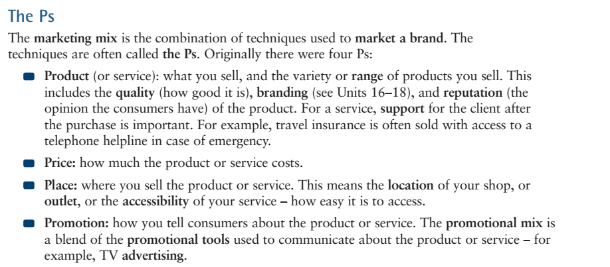
A

Slide 4
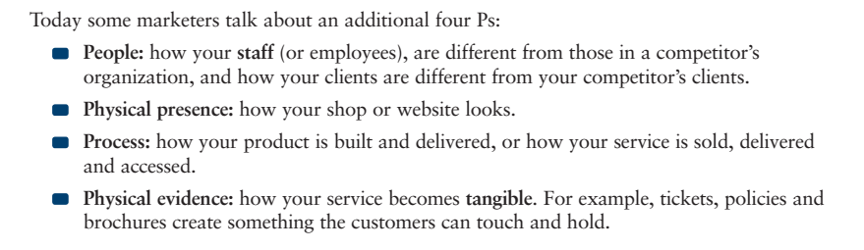
A

Slide 5
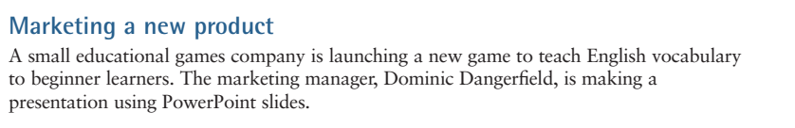
B

Slide 6
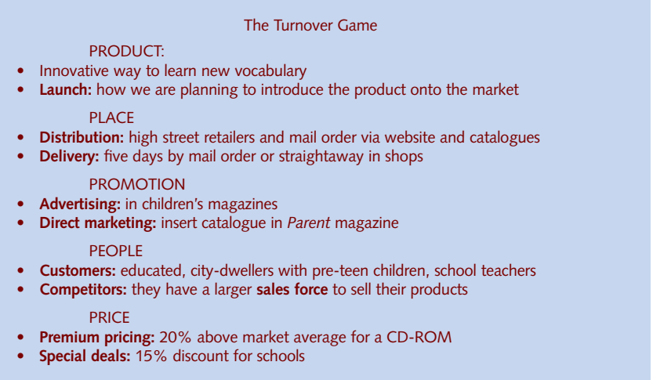
B

Slide 7
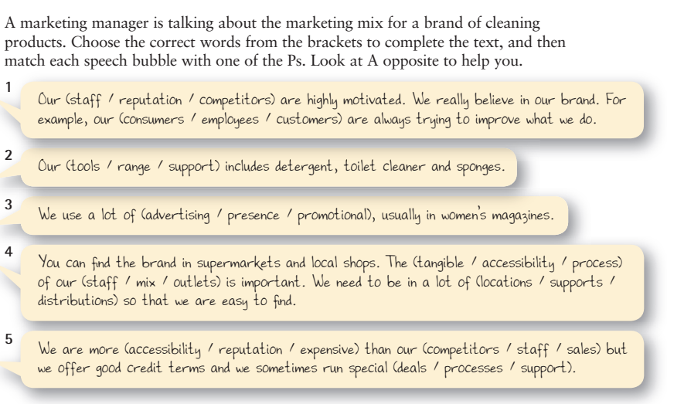
EX 1

Slide 8
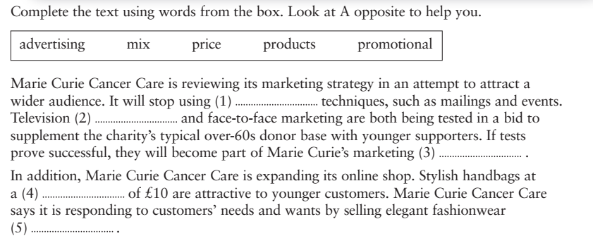
EX 2

Slide 9
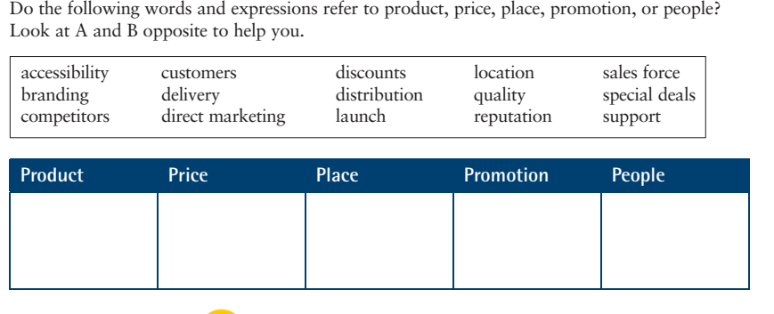
EX 3

Slide 10
Thanks

