Slide 1
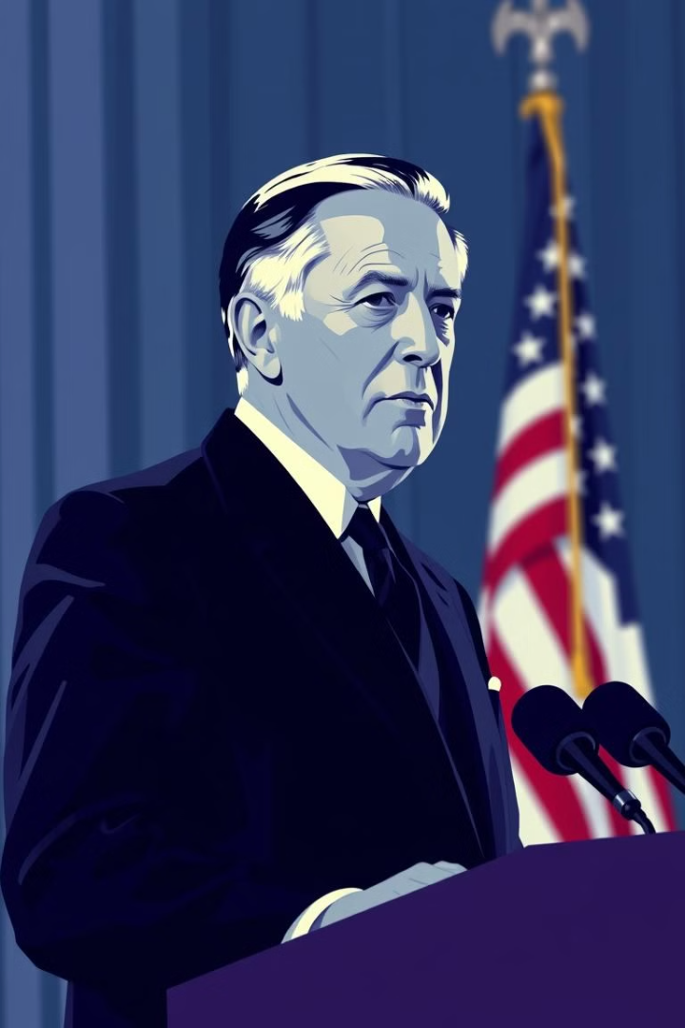
The Origins and Principles of Wilsonian Internationalism in US Foreign Policy
Wilsonian Internationalism, named after President Woodrow Wilson, represents a significant shift in American foreign policy that emerged in the early 20th century. This approach to international relations emphasizes global cooperation, democracy promotion, and collective security as key pillars of US engagement with the world. Rooted in Wilson's idealistic vision for a new world order following World War I, this doctrine has profoundly influenced American diplomacy and continues to shape debates about the United States' role on the global stage.
This presentation will explore the origins, core principles, and lasting impact of Wilsonian Internationalism on US foreign policy, examining its evolution from Wilson's presidency to its modern manifestations and critiques.
sk
by salim kerboua

Slide 2
Historical Context: Pre-Wilsonian Foreign Policy
1
Isolationism and Expansionism
Prior to Wilson's presidency, US foreign policy oscillated between isolationism and expansionism. The Monroe Doctrine of 1823 asserted American dominance in the Western Hemisphere while advocating non-intervention in European affairs.
2
Spanish-American War
The Spanish-American War of 1898 marked a turning point, propelling the US onto the world stage as an emerging power with overseas territories.
3
Roosevelt Corollary
Theodore Roosevelt's "Big Stick" diplomacy and the Roosevelt Corollary to the Monroe Doctrine further expanded American influence in Latin America and the Caribbean.
4
World War I
The outbreak of World War I in 1914 initially saw the US maintain neutrality, but growing tensions with Germany eventually led to American involvement in 1917.

Slide 3

Woodrow Wilson's Idealism and Vision
1
Academic Background
Wilson's academic career as a political scientist and historian shaped his idealistic worldview and belief in the power of institutions to promote peace and progress.
2
Progressive Reforms
His domestic progressive agenda, emphasizing democratic reforms and social justice, influenced his approach to international relations.
3
Moral Diplomacy
Wilson's "Moral Diplomacy" sought to promote American values abroad, rejecting purely economic or military motivations for foreign intervention.
4
New World Order
The devastation of World War I reinforced Wilson's conviction that a new international system was necessary to prevent future conflicts and promote global stability.

Slide 4

The Fourteen Points: Blueprint for Peace
Open Diplomacy
Freedom of the Seas
Free Trade
Arms Reduction
Colonial Adjustments
Evacuation of Occupied Territories
Self-Determination
Territorial Integrity
League of Nations

Slide 5
Core Principles of Wilsonian Internationalism
Collective Security
Democracy Promotion
Self-Determination
Wilson advocated for a system of mutual defense among nations, believing that collective action could deter aggression and maintain peace. This principle underpinned his vision for the League of Nations and later influenced the formation of the United Nations.
Wilsonian Internationalism posits that spreading democracy globally enhances international stability and security. This belief in the pacifying effects of democratic governance has remained a cornerstone of US foreign policy.
Wilson championed the right of peoples to determine their own political fate, a principle that profoundly impacted the post-World War I redrawing of national boundaries and continues to influence debates on sovereignty and independence.

Slide 6





The League of Nations: Wilson's Grand Design
Conception
Wilson envisioned the League as a forum for international cooperation and conflict resolution, designed to prevent future wars through collective action and diplomacy.
Structure
The League consisted of an Assembly, Council, and Secretariat, with mechanisms for arbitration, economic sanctions, and military action against aggressors.
Challenges
Despite initial enthusiasm, the League faced significant obstacles, including the absence of the United States due to Congressional opposition and limited enforcement capabilities.
Legacy
While ultimately unsuccessful in preventing World War II, the League laid the groundwork for future international organizations and solidified the concept of collective security in global affairs.

Slide 7
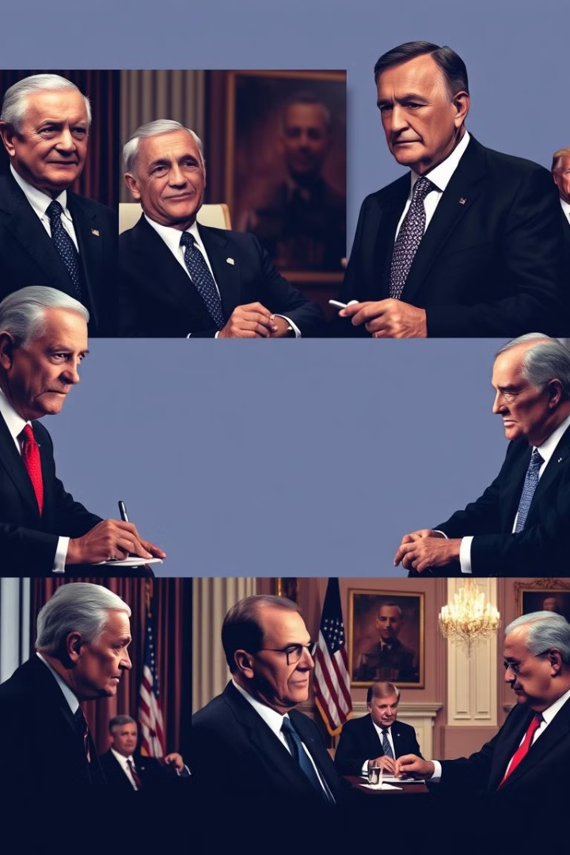




Impact on US Foreign Policy
Global Engagement
Wilsonian principles encouraged greater US involvement in world affairs, moving away from isolationism towards a more active international role.
International Institutions
The emphasis on multilateralism and international cooperation influenced US support for organizations like the UN, NATO, and World Bank.
Human Rights
Wilsonian ideals contributed to the development of human rights as a key consideration in US foreign policy decisions.
Democracy Promotion
The belief in spreading democracy as a means to ensure peace has remained a recurring theme in US diplomatic and military interventions.

Slide 8

Critiques and Controversies
Idealism vs. Realism
Critics argue that Wilsonian Internationalism is overly idealistic and fails to account for the realities of power politics in international relations. Realist scholars contend that national interests, rather than moral principles, should guide foreign policy decisions.
Interventionism
The emphasis on democracy promotion and collective security has been criticized as a justification for unwarranted US interventions abroad, leading to accusations of imperialism and overreach.
Cultural Imperialism
Some argue that Wilsonian principles reflect a Western-centric worldview and may not be universally applicable or desirable in diverse cultural contexts.
Unintended Consequences
Well-intentioned interventions based on Wilsonian principles have sometimes led to unintended negative outcomes, destabilizing regions and exacerbating conflicts.

Slide 9

Contemporary Relevance and Future Prospects
1
Post-Cold War Era
The collapse of the Soviet Union reinvigorated Wilsonian ideals, with renewed emphasis on democracy promotion and humanitarian interventions in the 1990s.
2
War on Terror
The 9/11 attacks and subsequent wars in Afghanistan and Iraq challenged Wilsonian principles, highlighting tensions between idealism and national security concerns.
3
Multilateralism vs. America First
Recent debates between internationalist and isolationist tendencies in US foreign policy reflect ongoing tensions inherent in the Wilsonian legacy.
4
Future Challenges
Global issues like climate change, cyber security, and transnational terrorism may require new interpretations of Wilsonian principles to address 21st-century challenges.

