Slide 1

BUSINESS PEOPLE AND
BUSINESS LEADERS
Dr.DJOUDI Hanane
Faculty of ECMS/ University of Biskra
October, 2024
REF: Business Vocabulary in Use

Slide 2
THE ENTREPRENEUR
An entrepreneur is an individual who creates a new business, bearing most of the risks and enjoying most of the rewards. The process of setting up a business is known as entrepreneurship.
Entrepreneurs play a key role in any economy, using the skills and initiative necessary to anticipate needs and bring new ideas to market. Entrepreneurship that proves to be successful in taking on the risks of creating a startup is rewarded with profits and growth opportunities.

Slide 3
Characteristics of Entrepreneurs
Versatility
Flexibility
Money Savviness
Resiliency
Focus
Business Smarts
Communication Skills

Slide 4
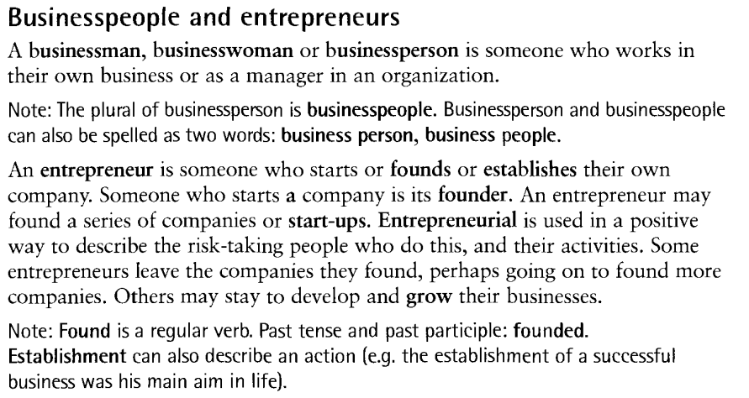
A

Slide 5
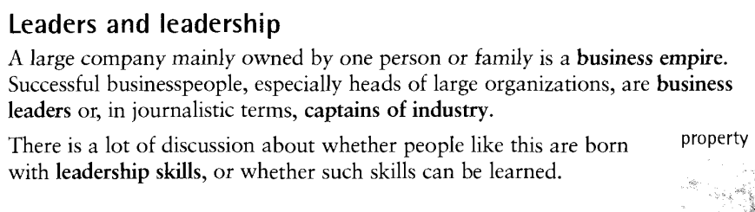
B

Slide 6
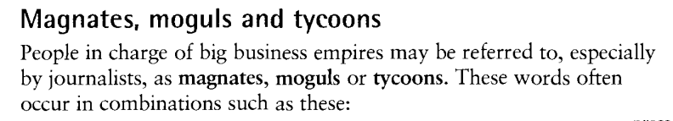
c

Slide 7
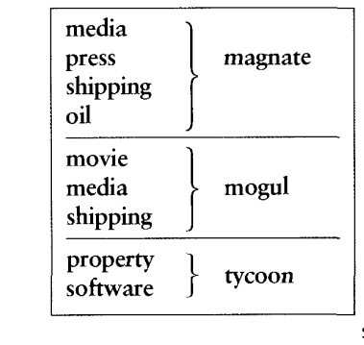
c

Slide 8
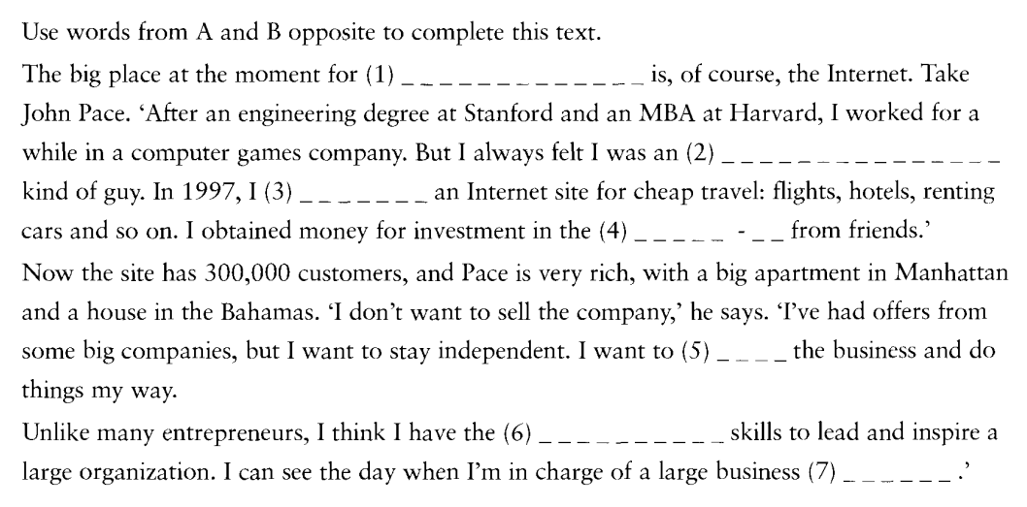
EX 1

Slide 9
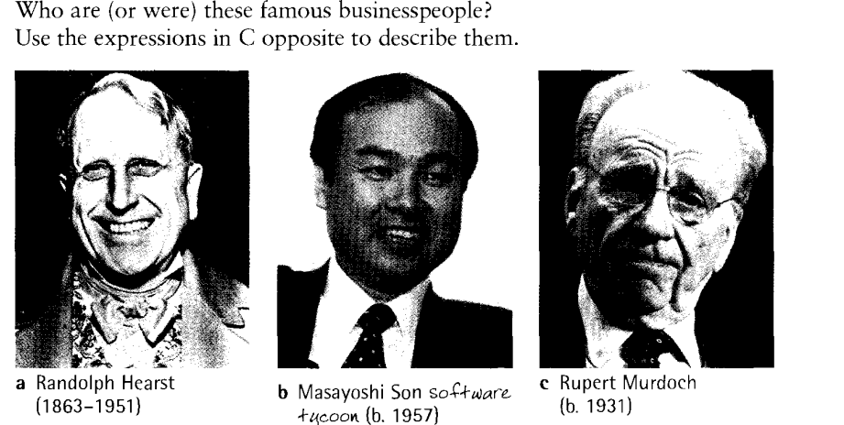
EX 2

Slide 10
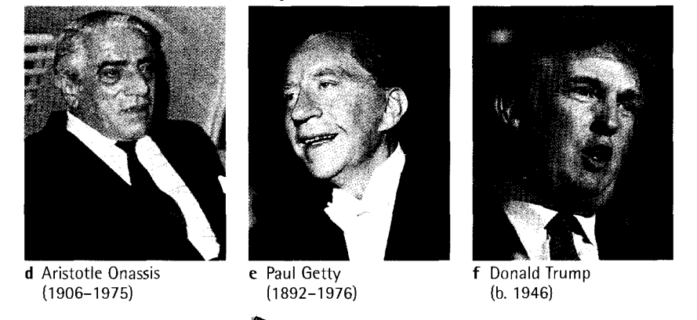
EX 2

Slide 11
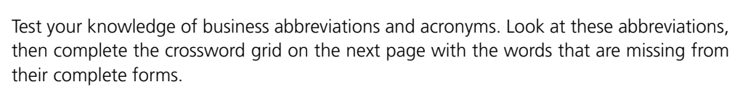
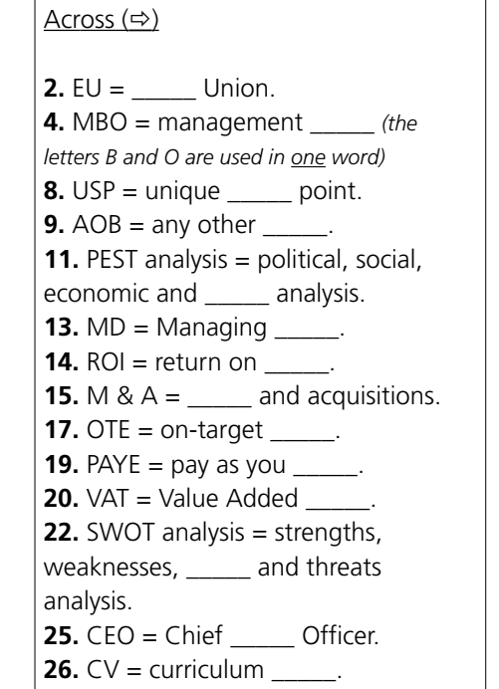
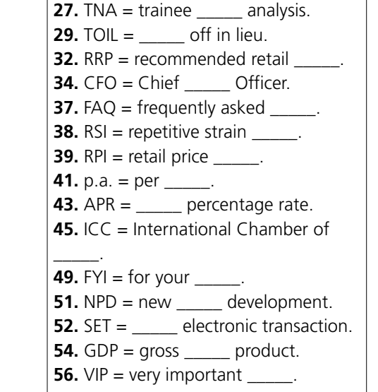
TEST YOUR
BUSINESS
KNOWLEDGE

Slide 12
Thanks

