Slide 1
Gurus of TQM
Course 03
محاضرات موجهة لطلبة السنة ثانية ماستر اقتصاد وتسيير المؤسسات
قسم العلوم الإقتصادية- جامعة بسكرة

Slide 2
Origin of the quality movement (Gurus of TQM)
There seems to be no consensus on the date and original source for TQM innovation, but most literature reports that the founders include Feigenbaum, Ishikawa, Deming, Juran, and Crosby. Stuelpnagel (1993) traces the origin of TQM to 1926, in Ford and Crowter’s book My Life and Work.
Japan adopted the notion of TQM around 1949, from the consensus of a committee of scholars, engineers, and government officials formed by the Union of Japanese Scientists and Engineers (Martinez-Lorente et al., 1998).
The need arose from the desire to improve productivity levels in Japan and to enhance post-war quality of life. Bemowski (1992) argues that the term “total quality management” was formally coined in 1985 by the Naval Air Systems Command to describe its Japanese management approach to quality improvement.

Slide 3
Gurus of TQM: Feigenbaum
TQM is presumed to have emerged in place of total quality control (TQC), which was originated by Feigenbaum (1951, 1956, 1961). Feigenbaum sees TQC as an effective system for integrating the quality development, quality maintenance, and quality-improvement efforts of the various groups in an organization so as to enable production and service at the most economical levels that allow for full customer satisfaction. It was argued that further control must start with the design of the product and end only when the product has been placed in the hands of a customer, with product satisfaction guaranteed.
Feigenbaum believes that all departments in a company have some responsibilities for the achievement of quality, but his conceptualization of TQC did not include other management ideologies like people empowerment, teamwork, and supplier development relationships (Price, 1989). These management ideologies are now incorporated into the new management concept, TQM. Thus, TQM is an alternative to management by control (Price, 1989). Hence, Paton (1994) considered Feigenbaum as the originator of the term “total quality management”.

Slide 4
Gurus of TQM: Kaoru Isikawa
Kaoru Isikawa shaped the Japanese style of TQC and originated an alternative concept – company wide quality control (CWQC). The term “company wide quality control” was introduced in Japan in 1968, some ten years after Feigenbaum introduced the term “total quality control” (Garvin, 1988).
Isikawa (1986) opines that quality control consists of developing, designing, producing, marketing, and servicing products and services with optimum cost-effectiveness and usefulness, which customers will purchase with satisfaction. To achieve these management demands, all the separate parts of a company must work together (Isikawa, 1990).
The literature reports that the word “management”, is a better substitute for “control”, with the idea that quality does not just have to be controlled, but managed (Martinez-Lorente et al.,1998). This idea gave birth to total quality management (TQM), in place of total quality control (TQC) or company wide quality control (CWQC).

Slide 5
Gurus of TQM: W. Edwards Deming
Many authors (e.g. Davis and Fisher, 1994; Grandzol and Traaen, 1995; Milakovich, 1991; Muchinsky, 2003; Schay, 1993; Tamimi and Gershon, 1995) report that W. Edwards Deming formulated the TQM concept.
Deming, an American, gained much popularity in 1980 after a NBC television documentary about the success of TQM in Japan, where he was a key factor. Deming appeared on CBS in June of 1980 in a documentary entitled If Japan Can . . . Why Can’t We? (cited Grant et al., 1994). It is believed that this television program introduced the organizational design that sparked the spread of TQM as a management theory. Deming first implemented his ideas in Japan because the Japanese were interested, and there was lack of interest in the USA. Japan thus established the Deming Prize in 1951 (Watson and Korukonda, 1995).
When Deming came to the USA he took the plan of implementation that he used in Japan and put it into the context of American culture (Hackman and Wageman, 1995). The peak of the popularity of TQM was aided by Deming as he made the bestseller list in 1986 with a book called, Out of the Crisis, which talked about the implementation of TQM. In the book, Deming (1986) challenged modern organizations to focus on the customer as an indicator of organizational effectiveness, and introduced the concept of TQM to justify that challenge. Deming is notable in the history of TQM for his 14-point plan for TQM (see Wilson, 1995).

Slide 6
Gurus of TQM: Joseph M. Juran
Another contributor to the development of the TQM concept is Joseph M. Juran (English, 1996). Juran is considered as the father of quality management and his Quality Control Handbook, first published in 1951, became the “bible” for quality management (Whaley, 2003). According to Peter Drucker (1990), “Whatever advances American manufacturing has made in the last 30 to 40 years, we owe to Joe Juran”.
Although Juran did not directly use the term “total quality management” in some of his books (see Juran and Gryna, 1988; Juran et al., 1974), he briefly mentioned it in his 1995 book A History of Managing for Quality (Juran, 1995). To Juran, quality management is not simply the issue of identifying and eliminating variations, it is serving customer needs – focusing the entire company on customers. Juran’s approach links quality improvement and control with quality planning and thereby extending quality management from the realm of operations into strategic planning.
Juran’s 1969 book on Managerial Breakthrough is devoted to two modes of management: control and breakthrough (Juran, 1969). Although Crosby (1980) is also acknowledged as one of the TQM theorists, Drensek and Grubb (1995) report that he did not actually use the term “total quality management” in his book Quality Is Free (Crosby, 1980), or in Quality without Tears (Crosby, 1987), or in Completeness: Quality for the 21st Century (Crosby, 1992).

Slide 7
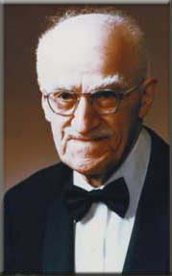
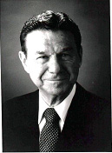
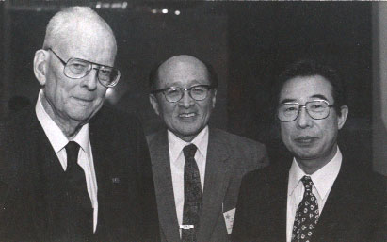
Total Quality Management (TQM)
The Americans who went to Japan:
J. Edward Deming
Joseph M. Juran
Armand V Feigenbaum

Slide 8
Total Quality Management (TQM)
Joseph Juran
Juran is a founder of the Juran Institute in Wilton, Connecticut. He promoted the concept known as Business Process Quality, which is a technique of Cross-Functional Quality Improvement.
He was invited to Japan in 1954 by the Union of Japanese Scientists and Engineers (JUSE)
He predicted the quality of Japanese goods would overtake the quality of goods produced in US by Mid-1970s because of Japan’s revolutionary rate of quality improvement

Slide 9
Total Quality Management (TQM)
W. Edward Deming
Deming, who had become frustrated with American managers when most programs of statistical quality control were terminated once the war and government contracts came to an end, was invited to Japan in 1954 by the Union of Japanese Scientists and Engineers (JUSE).
Deming was the main figure in popularizing quality control in Japan and regarded as national hero in that country.
He believes that quality must be built I into the product at all stages in order to achieve a high level of excellence.
His thoughts were highly influenced by Walter Shwartz who was the proponent of Statistical Quality Control (SQC). He views statistics as a management tool and relies on statistical process control as means in managing variations in a process.

Slide 10
Total Quality Management (TQM)
W Edwards Deming placed great importance and responsibility on management, at both the individual and
company level, believing management to be responsible for 94% of quality problems. His fourteen point
plan is a complete philosophy of management, that can be applied to small or large organizations in the
public, private or service sectors:
Create constancy of purpose towards improvement of product and service
Adopt the new philosophy. We can no longer live with commonly accepted levels of delay, mistakes
and defective workmanship
Cease dependence on mass inspection. Instead, require statistical evidence that quality is built in
End the practice of awarding business on the basis of price
Find problems. It is management’s job to work continually on the system
Institute modern methods of training on the job
Institute modern methods of supervision of production workers, The responsibility of foremen must
be changed from numbers to quality
Drive out fear, so that everyone may work effectively for the company
Break down barriers between departments
Eliminate numerical goals, posters and slogans for the workforce asking for new levels of productivity without providing methods
Eliminate work standards that prescribe numerical quotas
Remove barriers that stand between the hourly worker and their right to pride of workmanship
Institute a vigorous program of education and retraining
Create a structure in top management that will push on the above points every day

Slide 11
Total Quality Management (TQM)
Armand V Feigenbaum was the originator of “total quality control”, often referred to as total quality.
He defined it as:
“An effective system for integrating quality development, quality maintenance and quality improvement efforts of the various groups within an organization, so as to enable production and
service at the most economical levels that allow full customer satisfaction”.
He saw it as a business method and proposed three steps to quality:
• Quality leadership
• Modern quality technology
• Organisational commitment

Slide 12
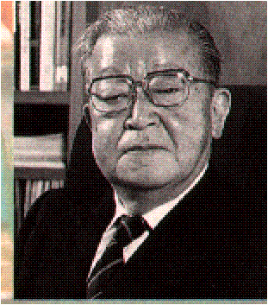
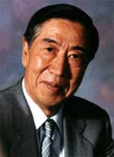
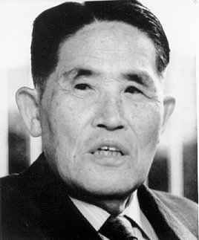
Total Quality Management (TQM)
Japanese who developed new concepts in response to the Americans
Dr Kaoru Ishikawa Dr Genichi Taguchi Shigeo Shingo

Slide 13
Dr Kaoru Ishikawa
made many contributions to quality, the most noteworthy being his total quality viewpoint, company wide quality control, his emphasis on the human side of quality, the Ishikawa diagram and the assembly and use of the “seven basic tools of quality”:
  Pareto analysis which are the big problems?
  Cause and effect diagrams what causes the problems?
  Stratification how is the data made up?
  Check sheets how often it occurs or is done?
  Histograms what do overall variations look like?
  Scatter charts what are the relationships between factors?
  Process control charts which variations to control and how?

Slide 14
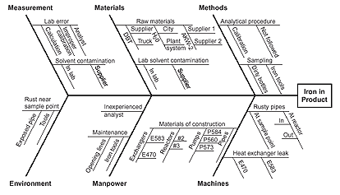
Total Quality Management (TQM)
Ishikawa Diagram (Cause & Effects Diagram)
Also known as Fishbone Analysis

Slide 15
Total Quality Management (TQM)
Shigeo Shingo
Shingo is strongly associated with Just-in-Time manufacturing, and was the inventor of the single minute exchange of die (SMED) system, in which set up times are reduced from hours to minutes, and the Poka-Yoke (mistake proofing) system.
In Poka Yoke, defects are examined, the production system stopped and immediate feedback given so that the root causes of the problem may be identified and prevented from occurring again.

Slide 16
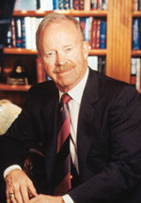
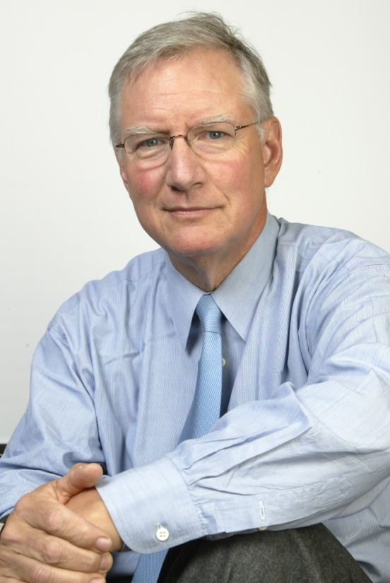
Total Quality Management (TQM)
Western gurus who followed the Japanese industrial success
Philip B Crosby Tom Peters

Slide 17
Total Quality Management (TQM)
Philip B Crosby
Crosby is known for the concepts of “Quality is Free” and “Zero Defects”, and his quality improvement process is based on his four absolutes of quality:
  Quality is conformance to requirements
  The system of quality is prevention
  The performance standard is zero defect
  The measurement of quality is the price of non-conformance

Slide 18

Total Quality Management (TQM)
Tom Peters
Tom Peters identified leadership as being central to the quality improvement process, discarding the word “Management” for “Leadership”. The new role is of a facilitator, and the basis is “Managing by walking about” (MBWA), enabling the leader to keep in touch with customers, innovation and people, the three main areas in the pursuit of excellence.
He believes that, as the effective leader walks, at least 3 major activities are happening:
  Listening suggests caring
  Teaching values are transmitted
  Facilitating able to give on-the-spot help

Slide 19


The Trends Accelerating Use of TQM: 1970s the era of Hue & Cry!
“If Japan Can… Why Can’t We?”
At first U.S. manufacturers held onto to their assumption that Japanese success was price-related, and thus responded to Japanese competition with strategies aimed at reducing domestic production costs and restricting imports.
This, of course, did nothing to improve American competitiveness in quality.
As years passed, price competition declined while quality competition continued to increase.
By the end of the 1970s, the American quality crisis reached major proportions, attracting attention from national legislators, administrators and the media.
A 1980 NBC-TV News special report, “If Japan Can… Why Can’t We?” highlighted how Japan had captured the world auto and electronics markets. Finally, U.S. organizations began to listen.

Slide 20
The American Response
The US Business Community Wakes up in 1980s from Deep Slumber
The chief executive officers of major U.S. corporations stepped forward to provide personal leadership in the quality movement.
The U.S. response, emphasizing not only statistics but approaches that embraced the entire organization, became known as Total Quality Management (TQM).
Several other quality initiatives followed. The ISO 9000 series of quality-management standards, for example, were published in 1987.

Slide 21
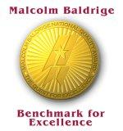
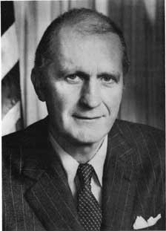
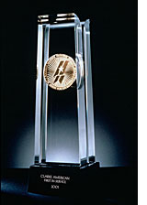
Total Quality Management (TQM)
The American Response
The US Business Community Wakes up in 1980s from Deep Slumber
Several other quality initiatives followed. The ISO 9000 series of quality-management standards, for example, were published in 1987. The Baldrige National Quality Program and Malcolm Baldrige National Quality Award were established by the U.S. Congress the same year. American companies were at first slow to adopt the standards but eventually came on board.
The major rationale behind establishment of this law was intense foreign competition especially from Japan.
The award has set a national standard for quality, and hundreds of major corporations used the criteria in application form as a basic management guide for quality improvement programs.
Meeting criteria is not an easy matter. A perfect score is 1000

Slide 22
Total Quality Management (TQM)
TQM Beyond 2000
As the 21st century begins, the quality movement has matured. The new quality systems have evolved beyond the foundations laid by Deming, Juran and the early Japanese practitioners of quality
  In 2000 the ISO 9000 series of quality management standards was revised to increase emphasis on customer satisfaction. Sector-specific versions of the ISO 9000 series of quality management standards were developed for such industries as automotive (QS-9000), aerospace (AS9000) and telecommunications (TL 9000 and ISO/TS 16949) and for environmental management (ISO 14000).
  Six Sigma, a methodology developed by Motorola to improve its business processes by minimizing defects, evolved into an organizational approach that achieved breakthroughs – and significant bottom-line results. When Motorola received a Baldrige Award in 1988, it shared its quality practices, like Toyota Motor Corporation, with others.

