Slide 1

Information and communication technologies
TELLI AbdelmoutiA
Class A Associate Professor
Computer Science Department
Biskra University
2023-2024

Slide 2
Plan
Chapter 1: ICT: tools and applications
Chapter 2: Introduction to web technologies
Chapter 3: The contributions of NICTs to external communication

Slide 3
Chapter 1: ICT: tools and applications
Definitions: Interaction, Interactivity, ...
ICT tools
ICT applications

Slide 4
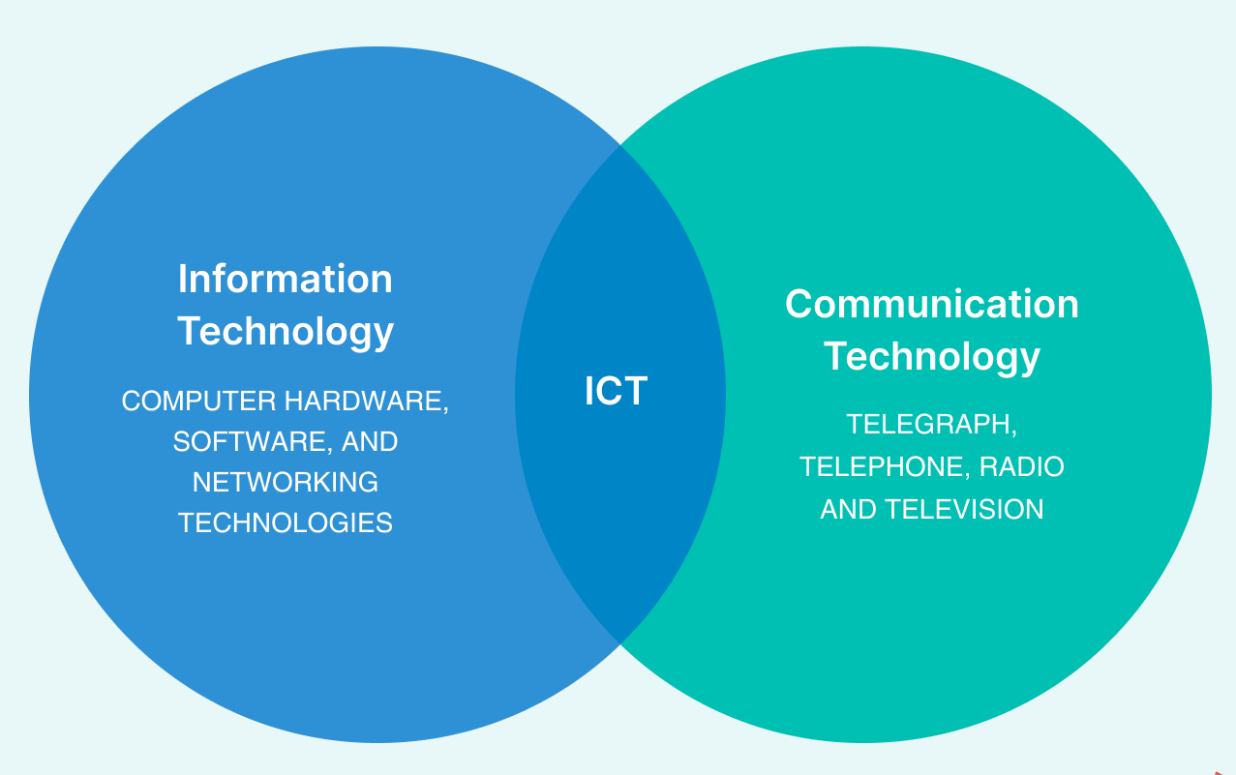
Chapter 1: ICT: tools and applications
1. Definitions

Slide 5
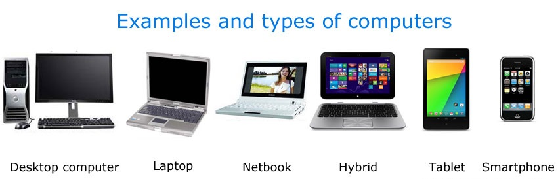
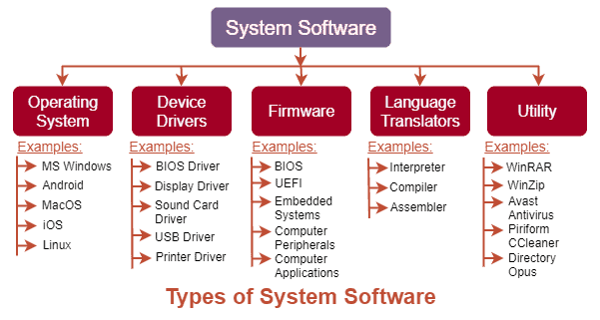
Chapter 1: ICT: tools and applications
2. ICT Tools
Computers
Software
Communications networks
Smart chips

Slide 6
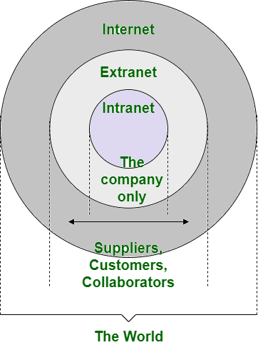
Chapter 1: ICT: tools and applications
2. ICT applications
  Communications spaces
  Databases
  Multimedia
  Audioconferencing
  Videoconferencing

Slide 7
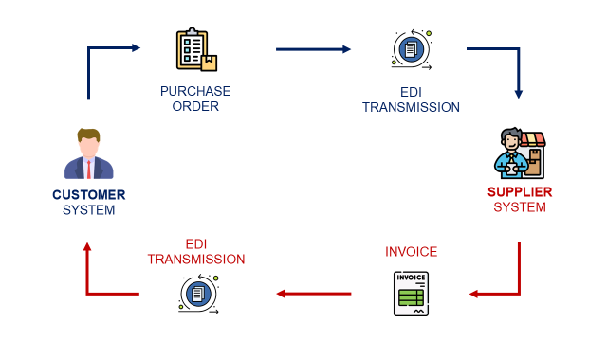
Chapter 1: ICT: tools and applications
3. Electronic data interchange (EDI)

Slide 8
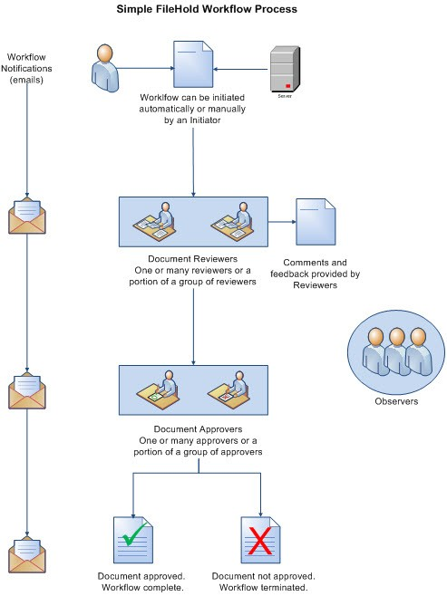
Chapter 1: ICT: tools and applications
4. Workflows

Slide 9
Chapter 2:
Introduction to web technology
Presentation of the Internet
Searching the web

Slide 10
Chapter 2: Introduction to web technologies
2. Terminologies
1. Presentation of the Internet:
URL (Uniform Resource Locator
HTTP (Hypertext Transfer Protocol)
HTML (Hypertext Markup Language)
IP Address (Internet Protocol Address)
DNS (Domain Name System)
ISP (Internet Service Provider)
Firewall
VPN (Virtual Private Network)
TCP/IP (Transmission Control Protocol/Internet Protocol)
FTP (File Transfer Protocol)
VoIP (Voice over Internet Protocol)
Communication
Information Retrieval
E-commerce
Education
Telecommution
Healthcare:

Slide 11
Chapter 2: Introduction to web technologies
3. Searching the web
Define Your Search Query
Use Relevant Keywords
Choose Reliable Sources
Check the Authority of the Source
Explore Different Types of Content
Utilize Advanced Search Techniques
Stay Updated

Slide 12
Chapter 2: Introduction to web technologies
Search engines:
Google
Bing
Yahoo
DuckDuckGo
Baidu
Yandex
Ask
    Directories:
Yahoo Directory 2014
DMOZ (Open Directory Project) 2017
Best of the Web (BOTW)
Business.com
Yelp
TripAdvisor

Slide 13
Chapter 2: Introduction to web technologies
Automatic indexing:
Discovery
Crawling
Indexing
Ranking
….
Browsers:
Google Chrome
Mozilla Firefox
Microsoft Edge
Apple Safari
Opera
Brave
….

Slide 14
Chapter 2: Introduction to web technologies
Search refinement:
Choice of keywords
Be specific
Use synonyms
Include key phrases
Use quotation marks
Exclude irrelevant terms
Boolean operators: AND, OR, NOT
Field queries, advanced search:
Field Queries:
Advanced Search:
Filters
Search Alerts
Voice Search

Slide 15
Chapter 2:
The contributions of NICTs to external communication
Internet advertising
Online site promotion
The security of an online payment system

Slide 16
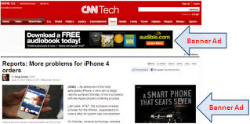
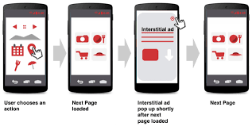
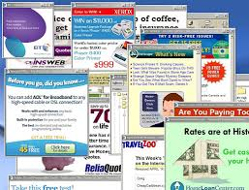
Chapter3: The contributions of NICTs to external communication
1. Internet advertising:
Banners
Interstitial
The Windows

Slide 17
Chapter3: The contributions of NICTs to external communication
2. Online site promotion
  Sponsorship
  The electronic community
  Emailing
3. The security of an online payment system
Encryption
Website data protection

