Slide 1
Lecture starting soon

Slide 2

STATISTICS
Quantitative Data Analysis in Applied Linguistics
LECTURE 2:
SAMPLING IN RESEARCH
Moustafa Amrate
Department of English, University of Biskra
moustafa.amrate@univ-biskra.dz

Slide 3
Lecture outline
Population vs. sample
Sampling approaches
Probability sampling approaches
Non-probability sampling approaches

Slide 4
The goal of large scale quantitative studies is to infer/ generalize their results to the larger population

Slide 5
Conditions/ assumption of inference
Random recruitment of participants
Numerical data
Normal distribution of results
Homogeneous variances

Slide 6
A population vs. a sample
A population is the entire group that the researcher wants to draw conclusions about.
A sample is the specific group that the researcher will collect data from. The size of the sample is always less than the total size of the population.

Slide 7
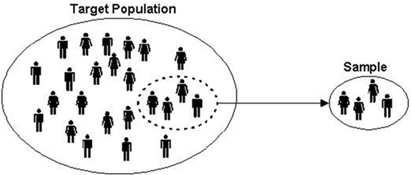
A population vs. a sample
Algerian postgraduate (M2) EFL learners at Biskra University
Algerian EFL learners
n
N

Slide 8
Sampling approaches
Probability sampling
Non-probability sampling
Generalizable
Non-generalizable

Slide 9
PROBABILITY SAMPLING (REPRESENTATIVE):
A type of sampling where all of the participants of the population have an equal chance (probability) of being selected in the sample.
We have 4 probability sampling approaches:
Probability sampling includes random sampling, systematic sampling, stratified random sampling, and cluster sampling.

Slide 10
1. Random sampling:
the key to random sampling is that each unit in the population has an equal probability of being selected in the sample. Using random sampling protects against bias being introduced in the sampling process, and hence, it helps in obtaining a representative sample.
Example: Researcher goes to an English school and randomly selects 60 participants to take part in a study.

Slide 11
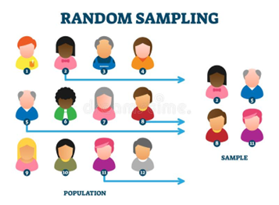
1. Random sampling:

Slide 12
2. Systematic random sampling
Is similar to random sampling, but it is usually slightly easier to conduct. Every member of the population is listed with a number, but instead of randomly selecting participants, individuals are chosen according to some systematic rule – e.g., every fourth unit/student, etc.
Example: Researcher goes to a classroom at an English school and selects every 3rd student from a list.

Slide 13
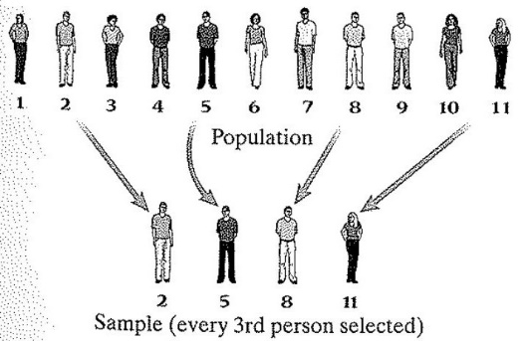
2. Systematic random sampling

Slide 14
3. Stratified random sampling:
Used when the population has different groups (strata) and the researcher needs to ensure that those groups are fairly represented in the sample. In stratified random sampling, independent samples are randomly drawn from each group.
Example: Researcher goes to an international English school with students from Arabic, French, Italian, and Chinese L1 backgrounds. In stratified sampling, the researcher has to randomly select participants from each L1 subgroup in the English school.

Slide 15
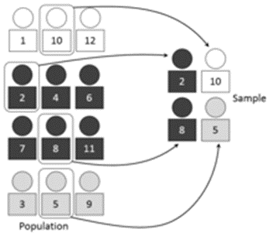
3. Stratified random sampling:
Upper Class
Middle Class
Lower class

Slide 16
4. Cluster sampling
Is a probability sampling method in which you divide a population into clusters, such as districts, schools or classrooms, and then randomly select some of these clusters (groups) as your sample.
Example: Researcher goes to an English school with eight classrooms. In cluster sampling, the researcher can randomly select two classrooms to do the study.

Slide 17
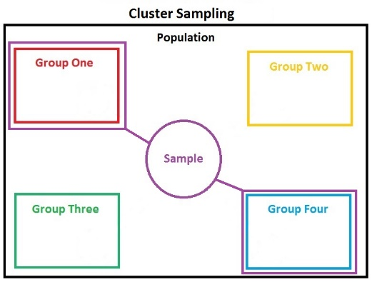
4. Cluster (group) sampling

Slide 18

ANY QUESTIONS?

Slide 19
NON-PROBABILITY SAMPLING (NON- REPRESENTATIVE):
A type of sampling where the participants do not have an equal chance (probability) of being selected in the sample.
We have 5 types of non-probability sampling:
Non-probability sampling includes convenience sampling, voluntary sampling, snowball sampling, quota sampling, and purposive sampling.

Slide 20
1. Convenience sampling (also known as availability sampling)
Relies on data collection from population members who are conveniently available to participate in study. In other words, this sampling method involves getting participants who are not very far from the researcher wherever convenient.
Example: An MA student investigating students’ opinions on university support services. After each class, the student asks one of their friends to complete a survey. This is a convenient way to gather data, but as the student only surveyed their friends, the sample is not representative of all university students.

Slide 21
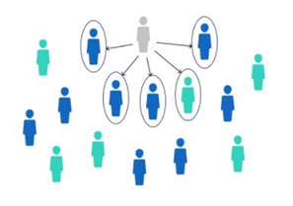
1. Convenience sampling (also known as availability sampling)

Slide 22
2. Voluntary response sampling
Similar to a convenience sample, a voluntary response sample is mainly based on ease of access. However, instead of the researcher choosing participants and directly contacting them, people volunteer themselves. Voluntary response samples are always at least somewhat biased, as some people will inherently be more likely to volunteer than others.
Example: A researcher posts an advertisement for an experiment at an English school. Only motivated students join the study.

Slide 23
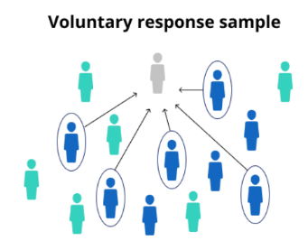
2. Voluntary response sampling

Slide 24
3. Snowball sampling
Snowball sampling is usually done when there is a very small population size. In this type of sampling, the researcher asks the initial participant to identify another potential participant who also meets the criteria of the research.
Example: A researcher doing a study on disabled EFL teachers in Algerian high schools. After interviewing one participant, and due to the limited number of potential participants, the researcher asks the first participant to identify other disabled EFL teachers who work in high schools.

Slide 25
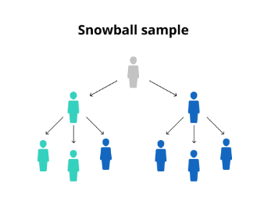

3. Snowball sampling

Slide 26
4. Quota sampling
Quota sampling is defined as a non-probability sampling method in which researchers create a sample involving individuals that represent a population with its various subgroups (e.g. age, gender, education, race, or religion). However, unlike Stratified Random Sampling, participants are chosen through a non-random sample selection (i.e. only available/ volunteering participants).
Example: In an English school where students are 20% male and 80% female, the researcher chooses to interview a quota of 20 male students and 80 female students to get a proportional balance. However, unlike Stratified Random Sampling, the researcher interviews only the participants who are conveniently available.

Slide 27
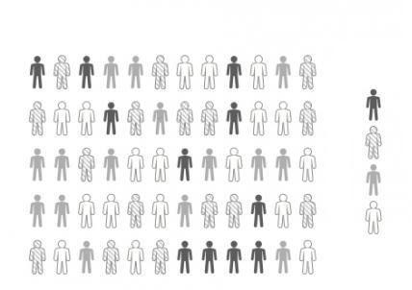
4. Quota sampling

Slide 28
5. Purposive sampling (judgement sampling):
Subjects are chosen to be part of the sample with specific purpose in mind. The researcher believes that some subjects are more fit for the research compared to other individuals.
Example: A researcher at an English school chooses only students with fluent English to do interviews.

Slide 29
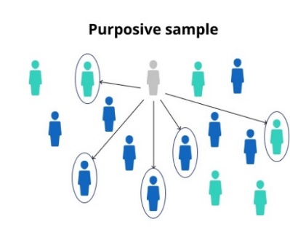
5. Purposive sampling (judgement sampling):

Slide 30
ANY QUESTIONS?

Slide 31
Research type
Probability sampling
Non-probability sampling
Quantitative research
✔
Qualitative research
✔
Quasi-experimental studies
✔
✔
Survey studies
✔
Exploratory studies
✔
Descriptive studies
✔
✔
Interviews and focus groups
✔

Slide 32
Thank you for attending!
Q& A

