Slide 1

Methanization (Anaerobic Digestion) and Biogas -Phase 1
Université Mohamed Khider Biskra
Faculté SNVSTU
Département des Sciences de la nature et de vie
Niveau : Master Spécialité «Microbiolgie appliquée »
Année universitaire 2026/2027
Dr Charifi Samia

Slide 2





1.INTRODUCTION
Improvement in the standard of living
Increased consumption
Increasing energy needs
Food packaging
Organic waste
Changes in dietary habits
Animal waste: manure and slurry
Agricultural activities
Crop residues
Straw
Fruit and vegetable waste
Manure: a mixture of animal feces and bedding mate
Slurry: a liquid mixture of animal feces and water.

Slide 3


Growth in waste production
Effective waste management policies
Encouraging sustainable practices
Biological processes for the treatment and valorization of organic matter

Slide 4



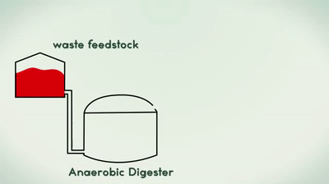
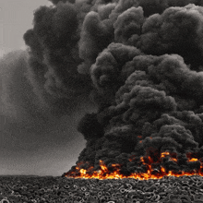

PART 1: WASTE VALORIZATION THROUGH ANAEROBIC DIGESTION
I. Waste Valorization through Anaerobic Digestion
I.1. Waste Management
Waste management encompasses all operations involving
Energy Recovery: This is where biomethanation sits,
Disposal: Landfilling or incineration without energy capture (last resort).
Prevention / Reduction at Source: Minimizing raw waste production.
Reuse: Finding direct secondary uses for materials.
Recycling & Material Recovery: Composting, structural recycling.

Slide 5

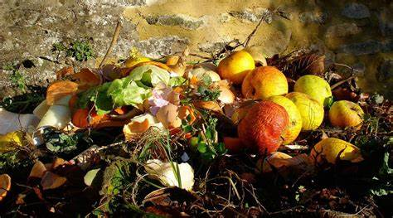
Definition of Methanogenic Waste and Effluents
These wastes represent a valuable source of organic matter that can be converted into biogas, mainly Methane (CH₄).
This organic matter is found in various sources, ranging from municipal waste to industrial effluents, including sewage sludge.

Slide 6
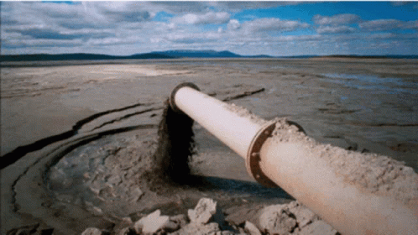

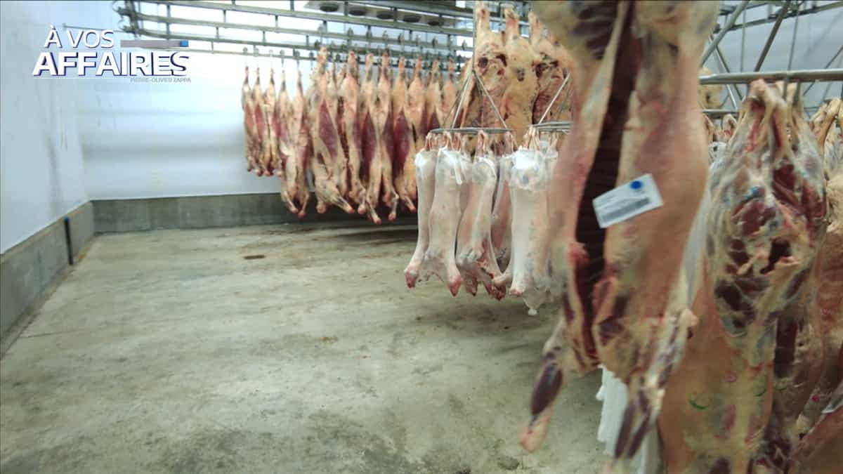
I.2.1 Main Types of Waste Concerned
The available feedstock corresponds to the biodegradable fraction of waste (biodegradable organic fraction)
Classification by Origin:
Household and municipal waste:Household biowaste (food scraps, fruit and vegetable peelings).
Agricultural Residues:ivestock manure: slurry and solid manure (rich in nitrogen and microorganisms). Crop residues (straw, corn stalks)
Agri-food and industrial waste:
(slaughterhouse by-products, Lactosérum
Urban waste and wastewater treatment plant (WWTP) sludge:
sludge generated during wastewater treatment.

Slide 7

How Do Microorganisms Obtain Energy?
The key question: Who accepts the electrons?
ORGANIC MATTER
e⁻
Who receives the electrons?
The final electron acceptor determines the metabolic pathway.

Slide 8
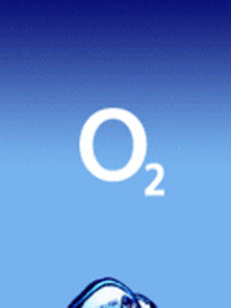
1. Aerobic Respiration
Oxygen is available
e⁻
ORGANIC
MATTER
H₂O
Organic matter + O₂ → CO₂ + H₂O + energy
O₂ = final electron acceptor

Slide 9


2. Anaerobic Respiration
No free oxygen: another electron acceptor is used
NO₃⁻
N₂
ELECTRON
DONOR
e⁻
SO₄²⁻
H₂S
CO₂
CH₄
NO₃⁻ → N₂ | SO₄²⁻ → H₂S | CO₂ → CH₄

Slide 10

FERMENTATION
ORGANIC MATTER
NO O₂ + NO EXTERNAL
ELECTRON ACCEPTOR
The organic substrate provides both the electron donor
and the electron acceptor.

Slide 11
ALCOHOLIC FERMENTATION
Glucose → ethanol + CO₂
GLUCOSE
C₆H₁₂O₆
ETHANOL
C₂H₅OH
CO₂
C₆H₁₂O₆ → 2 C₂H₅OH + 2 CO₂ + energy
Main products: ethanol and carbon dioxide.

Slide 12
LACTIC FERMENTATION
Glucose → lactate
GLUCOSE
LACTATE
C₃H₅O₃⁻
C₆H₁₂O₆ → 2 C₃H₆O₃ + energy
Lactic fermentation produces mainly lactate (lactic acid in its protonated form.

Slide 13
BUTYRIC FERMENTATION
An example of acid fermentation
H₂
GLUCOSE
BUTYRATE
CO₂
C₆H₁₂O₆ → C₄H₈O₂ + 2 CO₂ + 2 H₂
Fermentation pathways vary with microorganisms and environmental conditions.

Slide 14

The Key Idea to Remember
AEROBIC
ANAEROBIC RESPIRATION
FERMENTATION
O₂ → H₂O
NO₃⁻ → N₂
SO₄²⁻ → H₂S
CO₂ → CH₄
No external electron
acceptor
The key question is: What is the final electron acceptor?

Slide 15
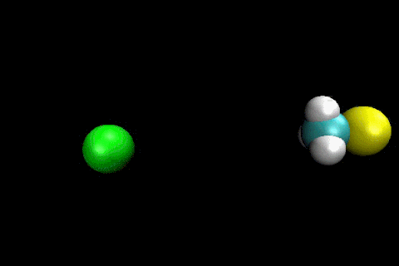
Energy Metabolisms and Their Practical Implications:
The biological degradation of organic matter is a metabolic oxidation–reduction (redox) reaction.
Microorganisms obtain energy by transferring electrons from organic matter to an electron acceptor. The nature of the final electron acceptor determines the metabolic pathway:
Aerobic metabolism: the final electron acceptor is molecular oxygen (O₂).
Anaerobic metabolism: the final electron acceptor is a mineral compound other than oxygen (such as NO₃⁻ or SO₄²⁻) or, in fermentation, an organic molecule derived from the substrate itself.

Slide 16
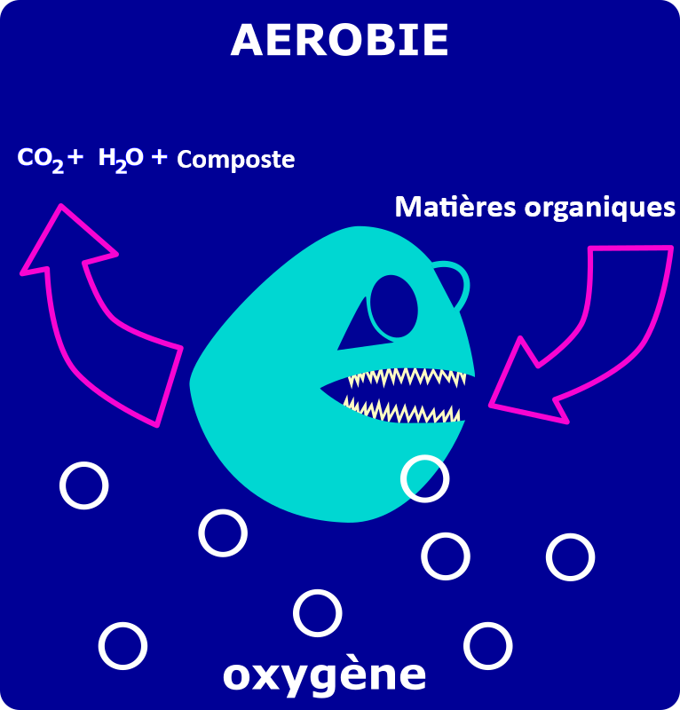

Procédé aérobie
Aerobic Respiration: Oxygen (O2) acts as the final electron acceptor. It produces CO2, water (H2O), and a high amount of energy (ATP), leading to significant cellular biomass production (e.g., composting). C₆H₁₂O₆ + 6 O₂ → 6 CO₂ + 6 H₂O + energy

Slide 17
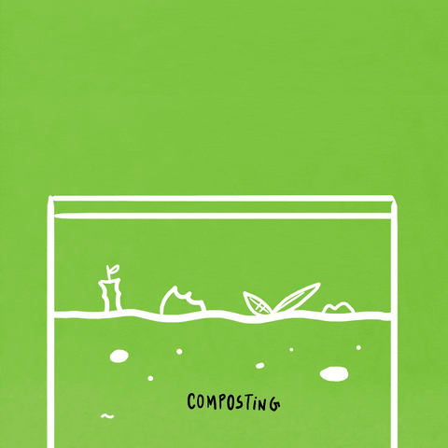
Procédé aérobie
Energy yield: High. approximately 30–32 ATP molecules per glucose molecule .
High biomass production: A significant fraction of the organic carbon is incorporated into new microbial biomass, generating excess biomass or sludge.
High heat production: Aerobic degradation is strongly exothermic. This heat generation is fundamental to composting, where temperatures can rise to approximately 50–70°C, contributing to the hygienization of the material.
Need for aeration: Continuous or periodic oxygen supply is required, which may involve significant energy consumption for forced aeration, turning, or mixing.
Final products: Mainly CO₂, H₂O, microbial biomass, and, in composting, stabilized organic matter (compost)

Slide 18

I.2.2.3 Anaerobic Respiration and Fermentation
In the absence of free oxygen (O₂), microorganisms can degrade organic matter through different anaerobic pathways, mainly anaerobic respiration and fermentation.
1. Anaerobic Respiration External Mineral Electron Acceptor
In anaerobic respiration, the final electron acceptor is a mineral compound other than oxygen.
Examples include:
Denitrification: nitrate (NO₃⁻) acts as the electron acceptor and is ultimately reduced to gaseous nitrogen (N₂).
Sulfate reduction: sulfate (SO₄²⁻) is reduced, producing hydrogen sulfide (H₂S).
Methanogenesis: in hydrogenotrophic methanogenesis, CO₂ acts as an electron acceptor and is reduced to CH₄:

Slide 19
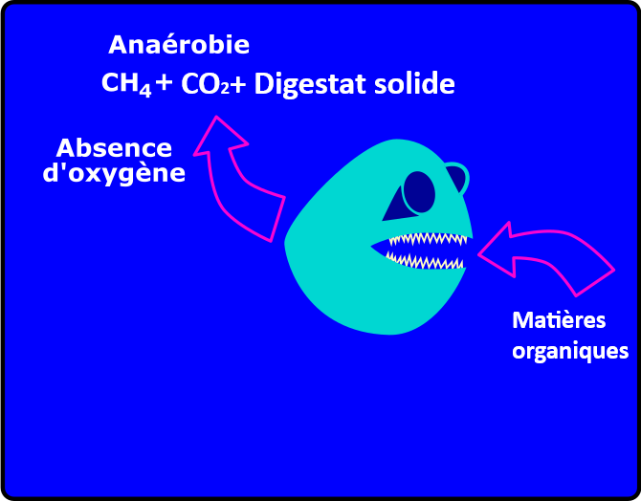

Anaerobic Respiration and Fermentation
Occurs in the complete absence of oxygen (O2). Electron acceptors are inorganic compounds (NO3- SO4 2-, CO2) or organic molecules. Energy yield is lower, generating methane (CH4), CO2, and a small amount of residual biomass.

Slide 20
Technological and Operational Implications for Anaerobic Digestion
Low energy yield for microorganisms: Anaerobic metabolism generally provides less usable energy for microbial growth than aerobic respiration.
Lower biomass production: Because less energy is available for growth, anaerobic processes generally produce less excess microbial biomass than aerobic treatment.
Energy conservation in methane: A substantial portion of the chemical energy originally contained in the organic matter remains stored in the reduced methane molecule CH₄.
Biogas production: Anaerobic digestion produces biogas, mainly composed of CH₄ and CO₂, with smaller quantities of H₂S, H₂, NH₃ and water vapor, depending on the substrate and operating conditions.
Digestate production: The process also produces digestate, which contains stabilized organic matter and nutrients and can potentially be used as a soil amendment or fertilizer, subject to appropriate quality and safety requirements.

Slide 21
Influence of the Medium Composition on Anaerobic Metabolism
1. If the medium is anaerobic or anoxic and contains nitrate (NO₃⁻), certain microorganisms can use nitrate as the final electron acceptor.
NO₃⁻ → NO₂⁻ → N₂
This process is called denitrification and product is nitrogen gas (N₂),
2. If the anaerobic medium contains sulfate (SO₄²⁻), certain microorganisms can use sulfate as the final electron acceptor:
SO₄²⁻ → H₂S / HS⁻
This process is called sulfate reduction and product is hydrogen sulfide (H₂S),
The microorganisms involved are called sulfate-reducing microorganisms.
3. Methanogenesis requires strictly anaerobic conditions Methanogenic archaea use different substrates, mainly H₂/CO₂
One of the main reactions is:
CO₂ + 4 H₂ → CH₄ + 2 H₂O
Therefore, the composition of the medium strongly influences the metabolic pathways that can occur.
Anaerobic medium + NO₃⁻ → denitrification → N₂
Anaerobic medium + SO₄²⁻ → sulfate reduction → H₂S
Favorable anaerobic conditions + CO₂/H₂ → methanogenesis → CH₄

Slide 22
Criterion | Aerobic pathway (e.g., composting) | Anaerobic pathway (e.g., anaerobic digestion)
Electron acceptor | O₂ | NO₃⁻, SO₄²⁻, CO₂, or organic compounds depending on the pathway
Energy available to microorganisms | Generally high | Generally lower
Biomass production | Relatively high | Relatively low
Main products | CO₂ + H₂O + biomass | CH₄ + CO₂ + digestate
Energy recovery | Mainly dissipated as heat | Energy retained in methane and recoverable as biogas
Oxygen requirement | Required | No free oxygen
Main infrastructure | Aeration and/or turning systems | Airtight anaerobic digesters and gas collection systems
Main application | Composting and aerobic biological treatment | Biogas production and digestat

Slide 23

Critères | Description of Anaerobic Process | Description of Aerobic Process
Energy efficiency | Efficient conversion of waste into biogas | Energy consumption for aeration
Waste reduction | Significant reduction of organic waste | Efficient degradation of organic matter
Operational costs | Complex installation | Relatively simple technical means
Environmental sustainability | Global environmental impact | Global environmental impact
Production | Quantity and quality of biogas; digestate | Compost production
Residues | Quality of solid residue after digestion | Elimination of pollutants in the effluent
++
++
++
++
++
++
++
++

