Slide 1
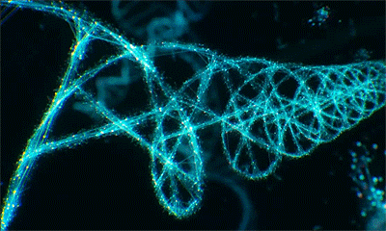
BIOLOGIE MOLECULAIRE ET GENIE GENETIQUE
Dr.Charifi Samia

Slide 2
Expression of genetic information: protein synthesis (Transcription, Translation).
Expression of genetic information:
The information contained in DNA is used to synthesize proteins.
Transcription
Translation

Slide 3
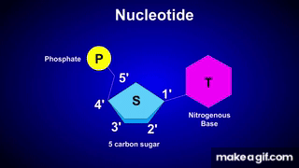

Slide 4


Slide 5
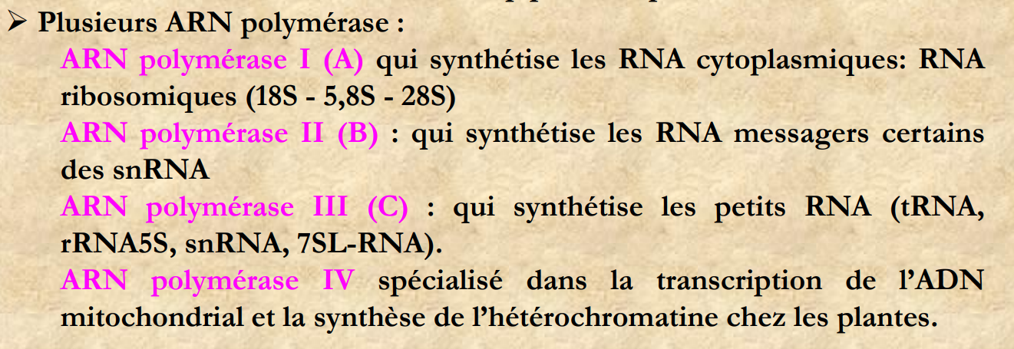
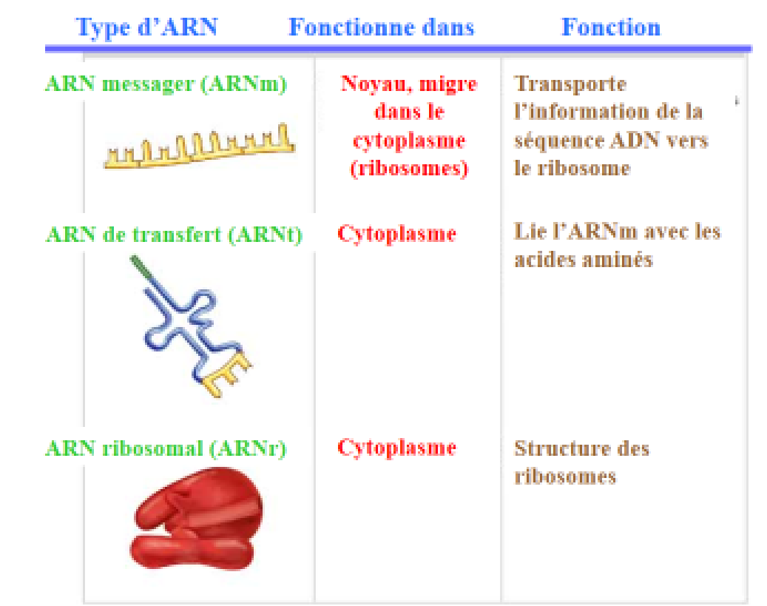

Slide 6
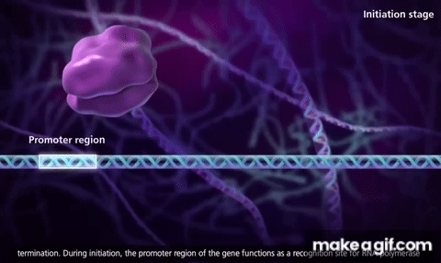
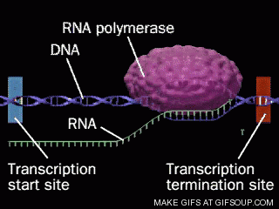
1. INITIATION
Opening of the DNA
The enzyme RNA polymerase attaches to a specific region of the DNA called the promoter and separates the two DNA strands. The DNA begins to unwind, forming a kind of “transcription fork.”
Au niveau du noyau

Slide 7
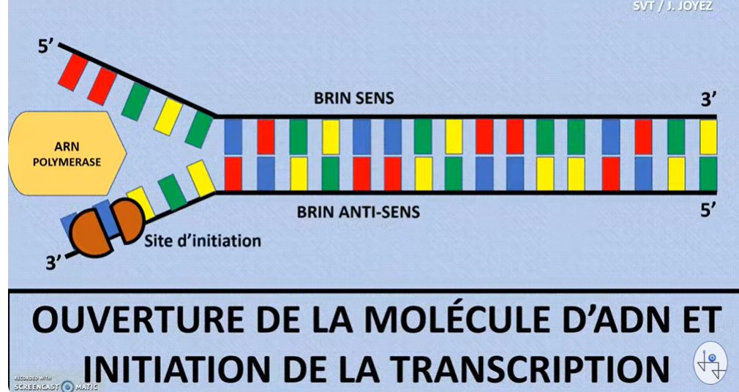
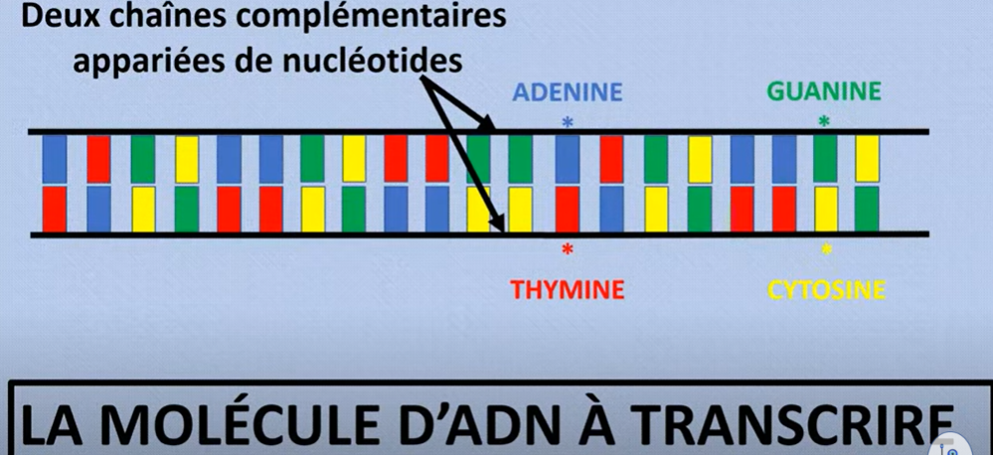
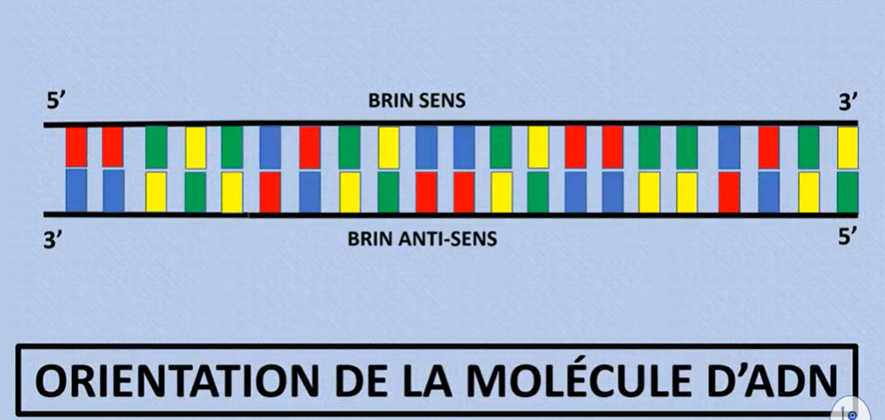
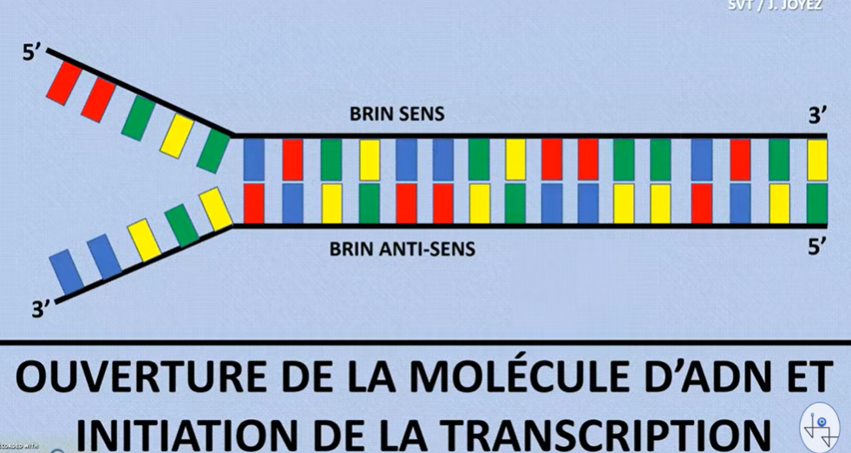
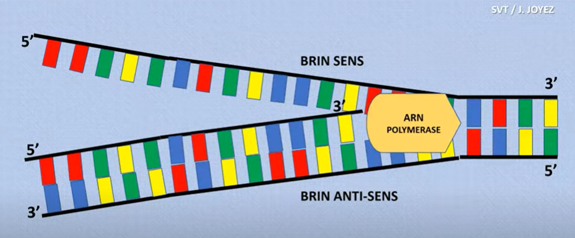
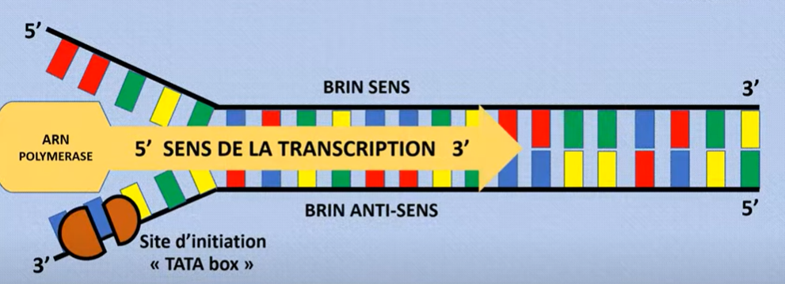
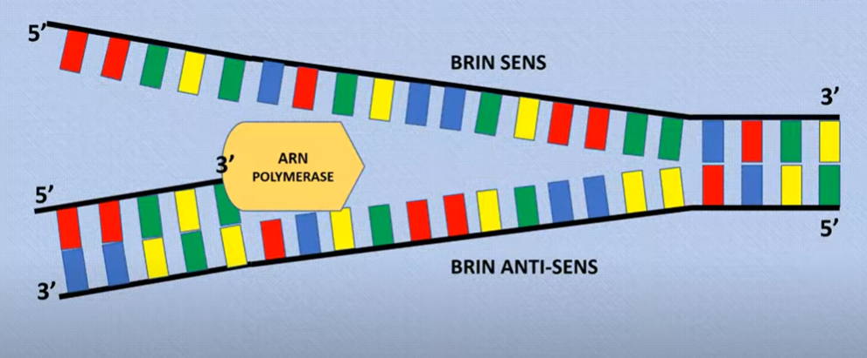

Slide 8
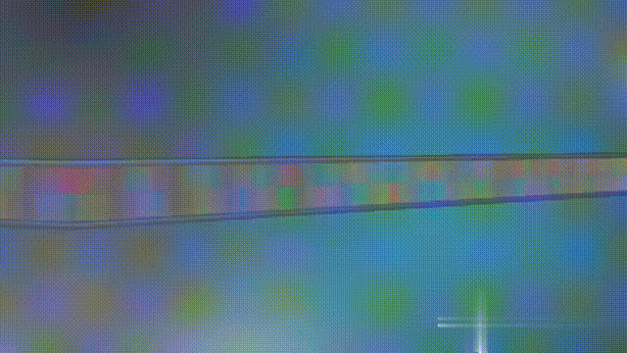
2. ELONGATION
Synthesis of mRNA
RNA polymerase begins copying one of the DNA strands, called the template strand or transcribed strand, to produce a messenger RNA (mRNA) molecule.
The nitrogenous bases of the DNA template strand are read, and complementary RNA nucleotides are added. This is where you see U (uracil) in RNA instead of T (thymine): A (adenine) in DNA pairs with U (uracil) in RNA.
3. Elongation of the mRNA strand
As RNA polymerase moves along the DNA strand, it continues to assemble the mRNA strand by adding complementary nucleotides one by one.
Release of the mRNA strand
At the end of transcription, RNA polymerase reaches a termination sequence on the DNA that signals it to stop transcription. The mRNA is released. In eukaryotic cells, it is still immature and must undergo additional modifications (maturation) before being translated into a protein.

Slide 9
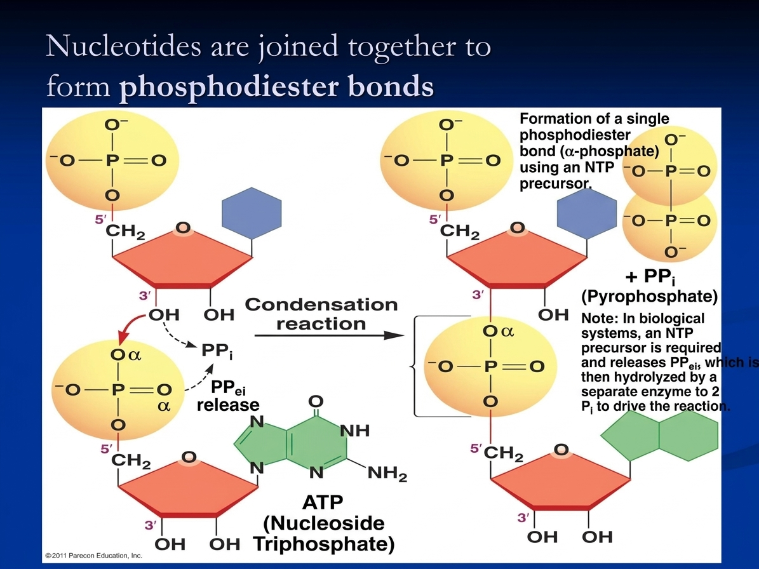

Slide 10
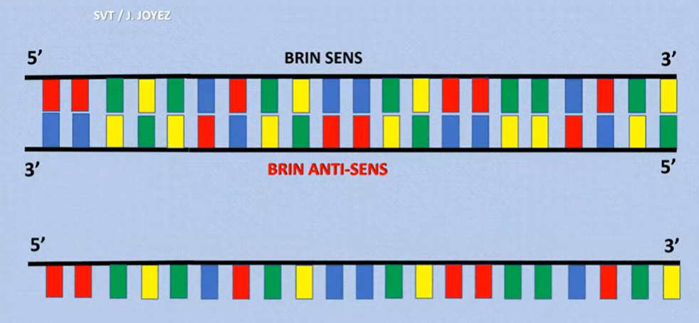
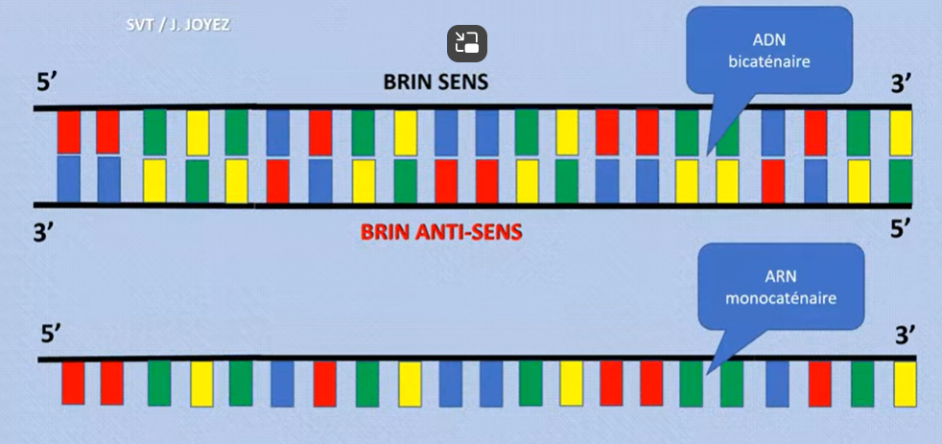
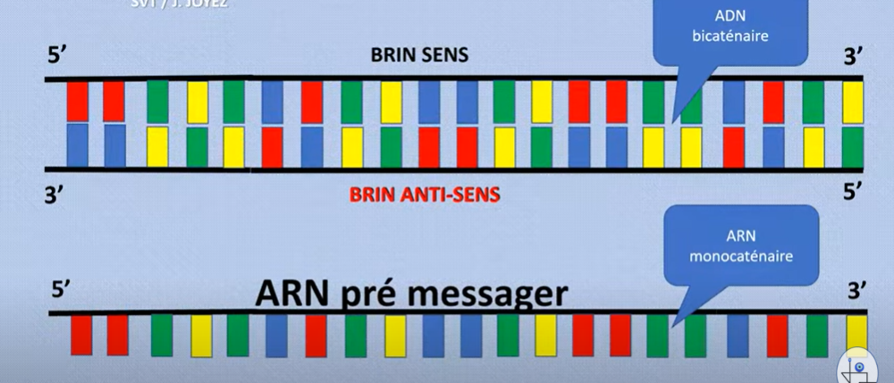
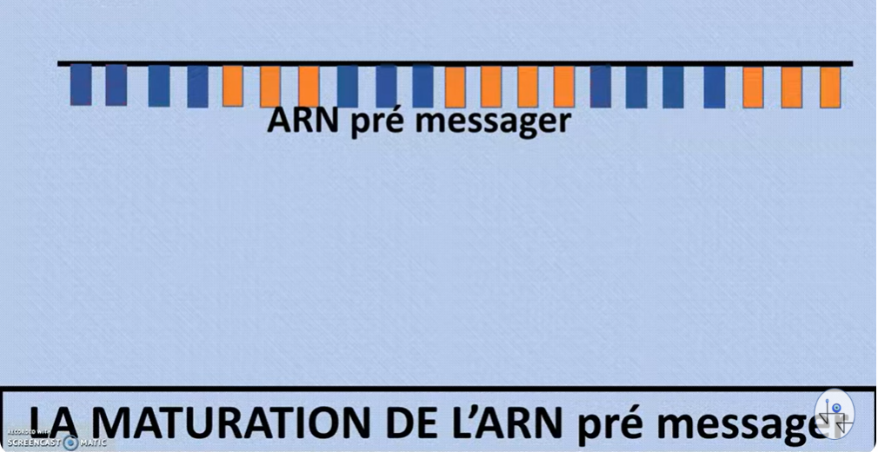
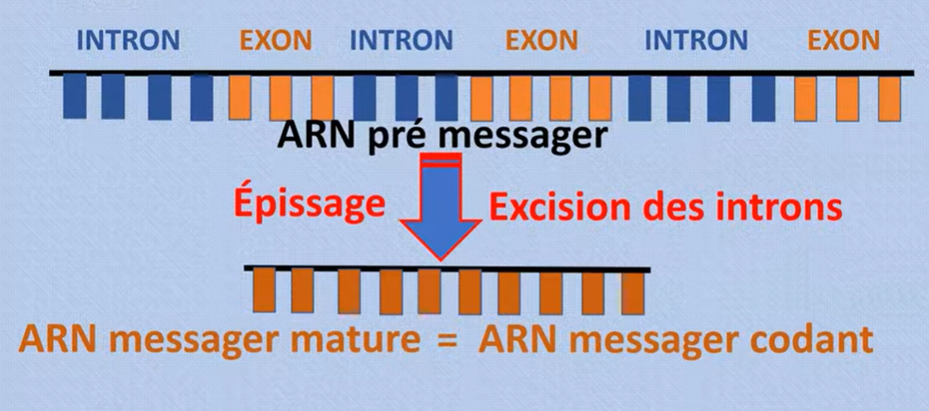
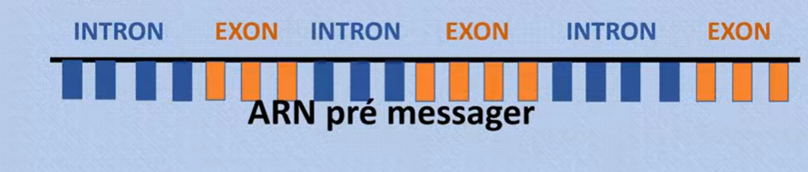
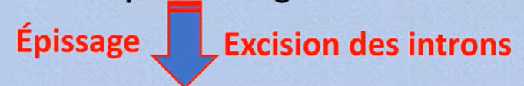

Slide 11
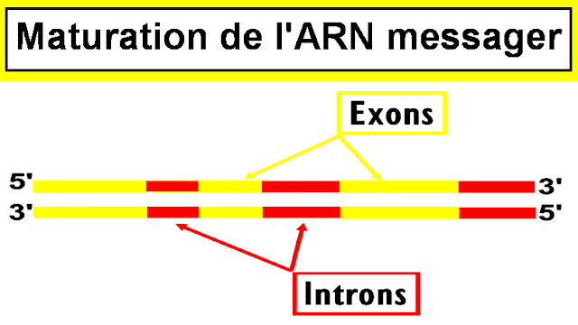
mRNA maturation (only in eukaryotes):
Before mRNA can be translated into a protein, it must undergo post-transcriptional modifications. These steps include the addition of a 5' cap at the beginning of the mRNA, the addition of a poly-A tail (a series of adenines) at the 3' end, and splicing to remove introns (non-coding sequences) while keeping only exons (coding sequences).
Export of mRNA:
Once the mRNA has matured, it is exported from the nucleus to the cytoplasm through nuclear pores for the next phase: translation.

Slide 12
