Slide 1
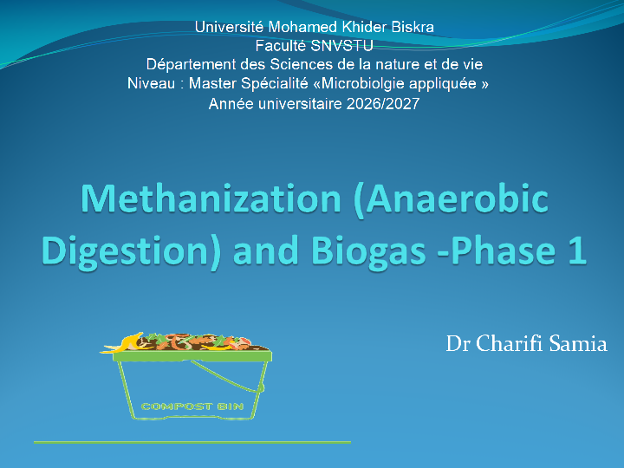


Slide 2

PARTIE 1 : Présentation du Module
Intitulé de la matière : UEF1.5.2 — Méthanisation et Biogaz : phase 1
Volume horaire : 67.5h (Cours + Travaux Pratiques)
Crédits : 6 | Coefficient : 3 Duration: 13 weeks
Instructor: Dr. Samia CHARIFI
Contact: Samia.charifi@univ-biskra.dz

Slide 3

All questions related to the course must be posted on the dedicated forum on Moodle. I commit to answering questions posted there within 24–48 hours.
By email: I commit to replying by email within 48 hours of receiving the message (in case of problems accessing the platform).
English: PowerPoint code 7291

Slide 4

Évaluation :
Examen final (60%)
Contrôle continu (40%) : comprenant la participation 2pts, Exposé 2pts de 2 courtes interrogations 6 pts.

Slide 5
INTRODUCTION Pré requis
Partie 1 :
I. Valorisation des déchets par méthanisation
I.1 Gestion des déchets
I.2.Traitement biologique des déchets (généralités)
I.2.1. Principaux déchets concernés
I.2.2. Métabolismes énergétiques et leurs incidences
I.2.2.1 Aspects théoriques
.2.2.2 Respiration aérobie
I.2.2.3 Respiration anaérobie et fermentations
I.2.2.4 Incidences pratiques
II. Digestion Anaérobie des déchets : BIOMÉTHANISATION
II.1. Définition
II. 2. Les étapes métaboliques de la méthanisation
II.2.1 Hydrolyse et acidogénèse
II.2.2. Acétogènèse
II.2.3. Méthanogènèse

Slide 6
II.3. Les paramètres de la fermentation méthanique
II.3.1. La température
II.3.2. Le potentiel Red Ox
II.3.3. Le potentiel à hydrogène et les équilibres tampons
II.3.4. La pression partielle en hydrogène
II.3.5. Les besoins en nutriment
II.3.6. Rapport C/N
II.3.7.Degré d’humidité
II.3.8. Prétraitements
II.3.6. Les inhibiteurs de la méthanisation
III.4. Biogaz
III.4.1. Définition
III.4.2. Caractérisation du biogaz
III.4.2.1. La composition chimique de biogaz
III.4.2.2. Les caractéristiques du biogaz
III.4.2.3. La valorisation de biogaz

Slide 7
III.5. Les réacteurs de méthanisation
III.5.1. Classification selon le mode d’alimentation
III.5.2. Classification selon le type de substrat
III.5.3. Classification selon le nombre d’étapes
III.6. Système de purification du gaz
III.6.1. Système d’élimination de CO2
III.6.2. Système d’élimination de l’H2S
III.7. Avantages et inconvénients de la digestion anaérobie
IV. Le rumen

Slide 8


"By the end of this module, you will be expected to master the natural depollution and energy recovery process known as anaerobic digestion (methanisation).
You will understand how to transform livestock effluents and organic waste into energy

Slide 9

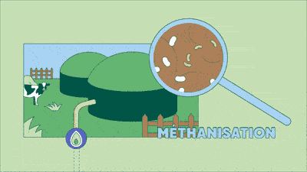
Anaerobic Digestion (Methanisation): It is a natural biological process of organic matter degradation driven by a complex consortium of microorganisms operating in the complete absence of oxygen (anoxic / anaerobic environment).
To Generate energy

Slide 10

Why Use Anaerobic Digestion?
Waste Management and Treatment: Reduction of the pollutant load from livestock effluents, sewage sludge (boues d'épuration), and agri-food waste.
Energy Transition: Production of renewable, dispatchable (storable) energy.
Environmental Protection: Mitigation of gas emissions (atmospheric methane has a global warming potential 28 times higher than CO2 and odor reduction.

Slide 11

3. Main Types of Substrates Involved
Agricultural: Slurry , manure, crop residues.
Urban: Sewage sludge from wastewater treatment plants , organic fraction of municipal solid waste .
Industrial: Slaughterhouse waste, agri-food industry waste.

Slide 12

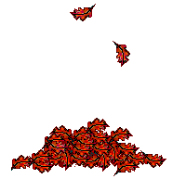
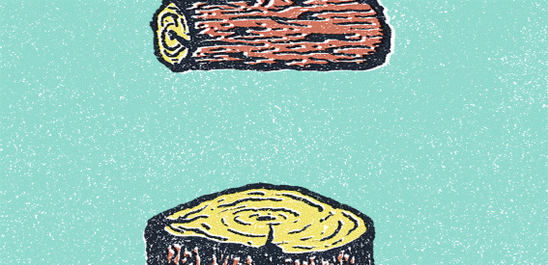
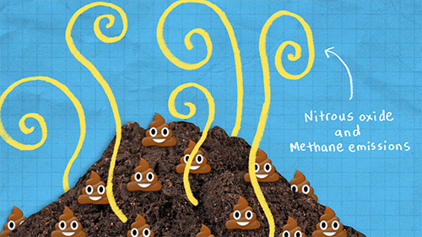

ORGANIC WASTE
CARBON-RICH WASTE
(Browns / Dry)
NITROGEN-RICH WASTE
(Greens / Wet)
Rich in Carbon (Energy)
Rich in Nitrogen (Proteins)
Solid / Fibrous structure
High moisture / Liquid or Slurry
Fast degradation
Slow degradation
Examples: Livestock effluents (slurry,manure), slaughterhouse (blood, digestive tract contents), food/catering waste
Key Examples: Straw, dried crop residues, wood waste, dead leaves.
Role: Provides the carbon required for energy production, though it degrades slowly.
Role: Supplies essential nitrogen for bacterial growth and provides the water necessary for the medium.

Slide 13
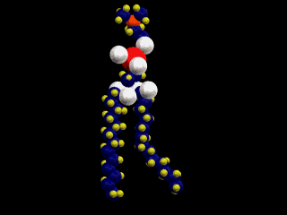

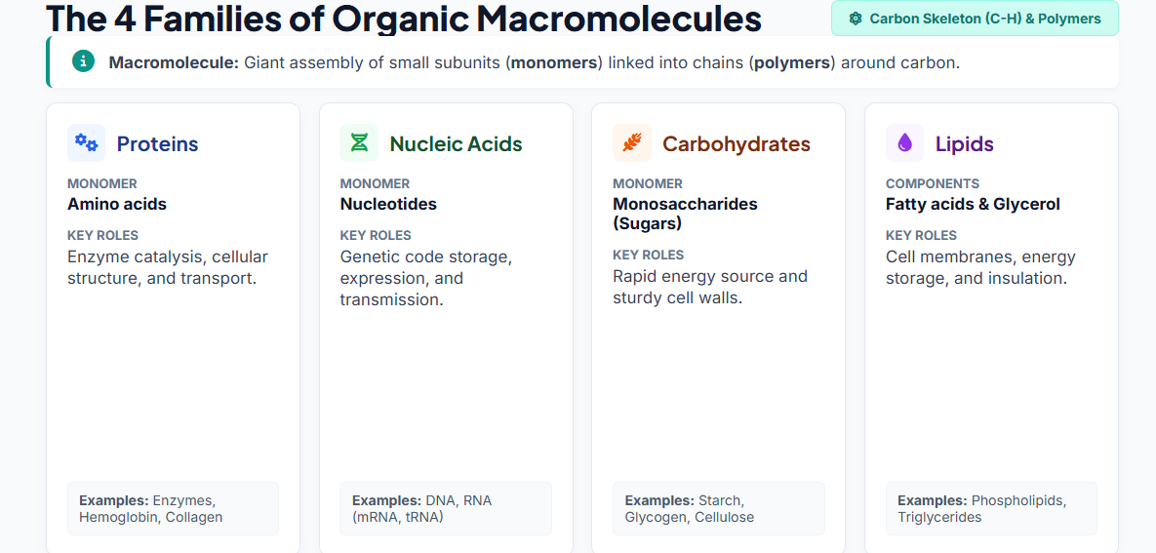
Review of Fundamental Prerequisites
A. Biochemistry and Cellular Biology
Organic Macromolecules:

Slide 14
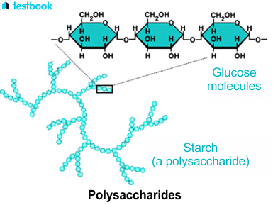
COURSE PREREQUISITES
BIOCHEMISTRY: MACROMOLECULAR STRUCTURES
In a methanisation reactor, organic matter (biomass) is composed of complex polymers. The hydrolysis step consists of breaking down these macromolecular structures to transform them into soluble monomers that can be assimilated by microorganisms.
1. Carbohydrates
Carbohydrates, composed of carbon, hydrogen, and oxygen , represent the main source of carbon and energy.
Monomers (Monosaccharides): Glucose, fructose, galactose. Directly assimilable by acidogenic bacteria.

Slide 15
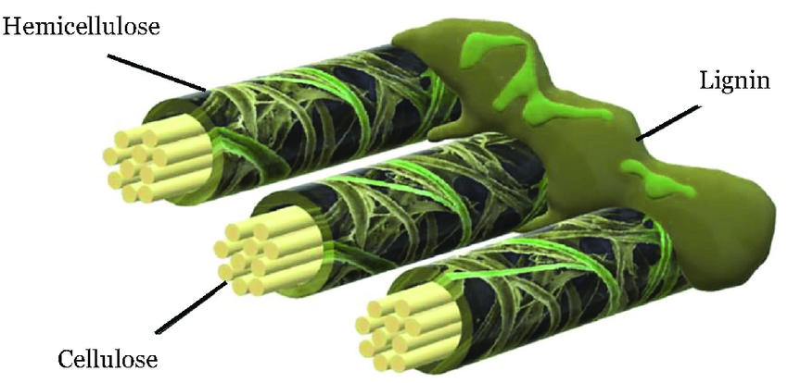
2. Lignocellulose
Lignocellulose forms the structural framework of plant cell walls (straw (Paille), manure, crop residues). It is the most resistant structure to biological degradation.
Cellulose: Linear homopolymer of glucose linked by glycosidic bonds, forming highly stable crystalline microfibrils. Only specific cellulases can break these bonds.
Hemicellulose: Branched heteropolymer composed of various sugars Easier to hydrolyze than cellulose.
Lignin : is virtually non-degradable under anaerobic conditions; it forms a tight physical barrier around cellulose and hemicellulose, often requiring pretreatment (grinding, steam explosion) to make cellulose accessible.

Slide 16
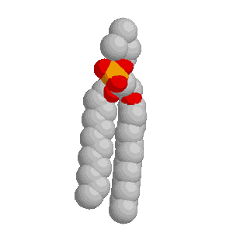
3. Lipids
Lipids have the highest biomethane potential
Structure: Mainly in the form of triacylglycerols (triglycerides), consisting of a glycerol molecule esterified by three fatty acids (short or long-chain, saturated or unsaturated).
Hydrolysis: Performed by extracellular lipases that release glycerol (easily fermented) and Long-Chain Fatty Acids

Slide 17
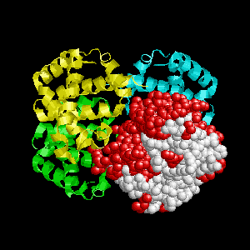
Found in animal manure, sewage sludge
Structure: Polymers of amino acids joined by peptide bonds, structured into primary to tertiary/quaternary configurations.
Hydrolysis: Proteases and peptidases break proteins down into peptides and then free amino acids.
Impact on Methanisation: releases ammoniacal nitrogen While ammonia is an essential nutrient, high concentrations make it a major inhibitor of methanogenesis.
4. Proteins

Slide 18


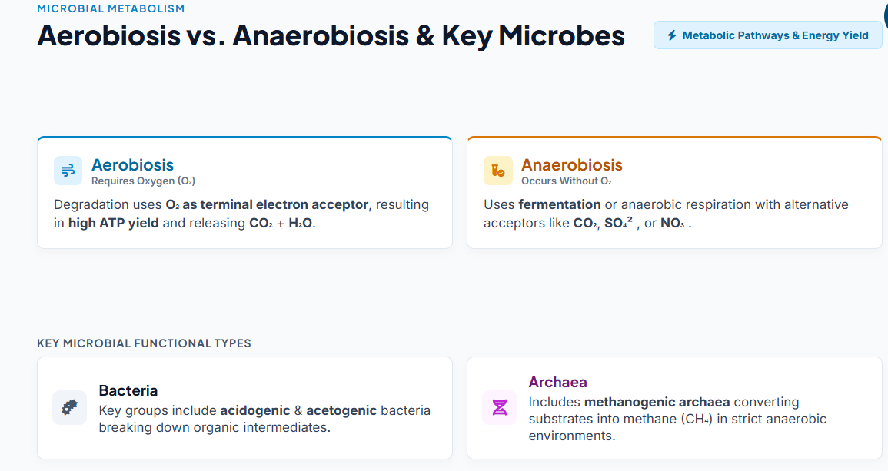
Microbiology and Energy Metabolism
Aerobiosis vs. Anaerobiosis:

Slide 19
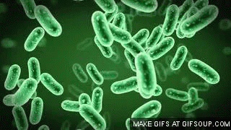
Microbiology and Energy Metabolism
Role of Bacteria: They secrete hydrolytic enzymes and ferment monomers into (Volatile Fatty Acids), Co2 and H2 They grow rapidly (doubling time of a few hours).
Role of Methanogenic Archaea: Strict anaerobic organisms. They consume acetate, H2, and CO2 to form CH4. Their growth rate is very slow (doubling time of several days), and they are highly sensitive to environmental variations (pH, thermal shock, presence of oxygen, inhibitors).

