Slide 1

Molecular Biology and Genetic Engineering
Dr. CHARIFI SAMIA

Slide 2
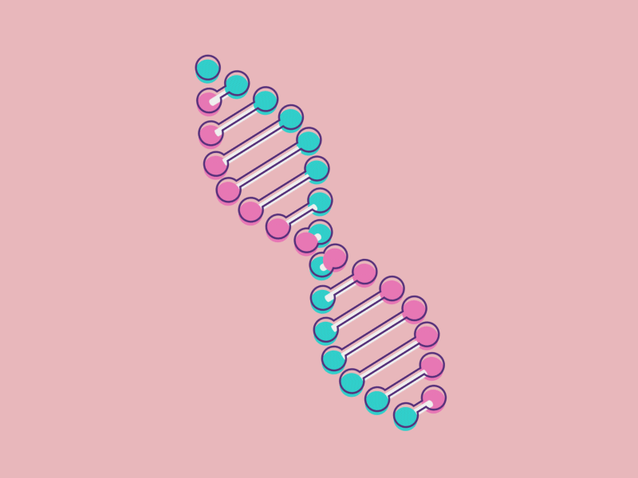
Course Presentation
The course in Molecular Biology and Genetic Engineering focuses on the study of the molecular mechanisms governing cellular function, including DNA replication, transcription, protein translation, and genetic regulation mechanisms. The genetic engineering component addresses techniques for manipulating genetic material, such as PCR, gene cloning, genome editing and the use of these methods in fields such as medicine, agriculture, and biotechnology. The course also explores the ethical implications and industrial applications of modern biotechnologies.

Slide 3

Course Information
University: Mohamed Khider University of Biskra
Faculty: Faculty of Exact Sciences and Natural and Life Sciences
Department: Department of Natural and Life Sciences
Target Audience:
L3 Specialization: Microbiology
Course Title: Molecular Biology and Genetic Engineering
Credits: 5
Coefficient: 3
Duration: 13 weeks
Instructor: Dr. Samia CHARIFI
Contact: Samia.charifi@univ-biskra.dz

Slide 4

Assessment Method:
Continuous Assessment – 40% (8 points from two interrogation + 2 points from participation)
Final Exam – 60% (20 points)

Slide 5

General Biology:
Understanding the cell as the basic unit of life, including cellular organelles (nucleus, mitochondria, ribosomes, etc.).
Basic concepts of mitosis and meiosis.
Understanding the structure of DNA, genes, chromosomes.
Biochemistry:
Knowledge of metabolic pathways such as glycolysis and the Krebs cycle.
Genetics:
Basic knowledge of gene transmission, mutations, and principles of heredity.

Slide 6

All questions related to the course must be posted on the dedicated forum on Moodle. I commit to answering questions posted there within 24–48 hours.
By email: I commit to replying by email within 48 hours of receiving the message (in case of problems accessing the platform).
English: PowerPoint code 7291

Slide 7

Part I: Molecular Biology
Expression of genetic information: protein synthesis (Transcription, Translation).
Regulation of gene expression: Transcriptional regulation, Translational regulation.
Basic techniques in molecular biology:
  Preparation of nucleic acids (extraction and purification)
  Separation of nucleic acids (agarose gel electrophoresis, pulsed-field gel electrophoresis, etc.)
  Detection, characterization, and identification of nucleic acids (membrane transfer, labeling, hybridization, etc.)
  DNA sequencing
  In vitro amplification of nucleic acids (PCR, RT-PCR (reverse transcriptase PCR), etc.)

Slide 8

Part II: Genetic Engineering
In vivo cloning:
1.1. Elements required for cloning: DNA to be cloned, restriction enzymes, ligation enzymes, cloning vectors (their construction and characteristics), and host cells.
1.2. Steps of cloning: vector construction, insertion of the DNA fragment to be cloned, bacterial transformation, selection of recombinants, analysis of recombinants.
Recombinant DNA technology: Recombinant protein synthesis, cDNA and expression vectors. Example of protein production in E. coli and Saccharomyces cerevisiae.
Tutorials (TDs):
No. 1: Restriction enzymes – 11.11
No. 2: Molecular hybridization – 18.11
No. 3: DNA sequencing – 25.11
No. 4: PCR – 02.12
No. 5: Cloning – 09.12
16.12 Final short quiz

