Slide 1
Chapter III: Sampling Plans

Slide 2
Introduction
In non-probability sampling methods, items are included in the sample with no known probability. An assessment of the accuracy of the results cannot be made. In probability sampling methods, the selected items have a known probability of being in the sample.
Selecting the sampling design involves selecting how the data will be collected in the field (at selected locations at random, in all habitats frequented by the target species,... etc.). It also conditions the way in which the data is processed and therefore the results.
Depending on the goal and the constraints encountered, several sampling plans are available and meet specific needs. There are two main families of sampling protocols: probability sampling and non-probability sampling.

Slide 3
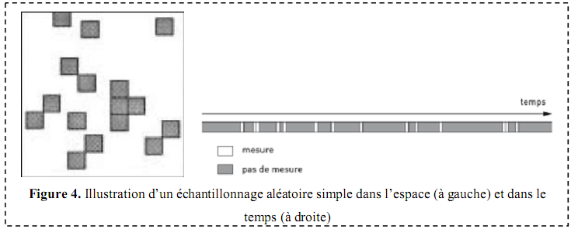
1.1. Simple random sampling
1. Probability sampling protocols
Simple random sampling, or random sampling, is a method of randomly and independently sampling "n" sampling units from a population of "N" elements. Each point in the space studied therefore has an equal chance of being sampled.
Probabilistic protocols are based on a random selection of the statistical units in the sample. Each statistical unit included in the sample is therefore selected with an associated and known probability of inclusion.
Note: Each selected item can be returned to the population after it has been drawn and possibly selected a second time: this is called discounted sampling, also known as non-exhaustive sampling. If the selected element is not returned to the population after it has been drawn, it is referred to as non-delivery sampling or full sampling.
1

Slide 4
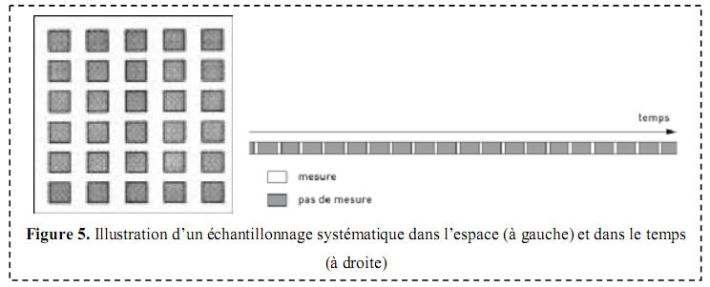
1.2. Systematic sampling
Sampling is systematic if individuals are selected at regular intervals (e.g. one daily measurement every six days). It also involves distributing the samples on a regular basis (e.g. all "x" meters). It is less time-consuming than random sampling. A grid pattern is usually used (often positioned on the aerial photograph of the territory studied). This makes it easy to locate sampling points for each survey.
2

Slide 5
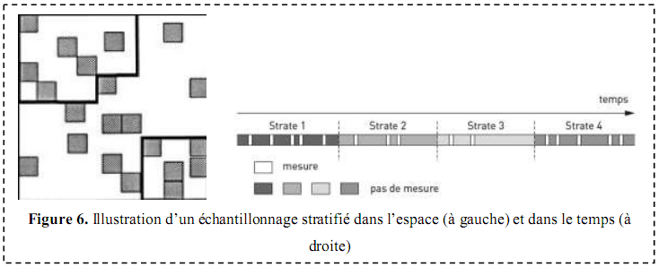
1.3. Stratified sampling
It is particularly used when the study area is divided into differentiated zones (strata). The strata may correspond to administrative divisions, areas with different topography,... etc. It consists of subdividing a heterogeneous population into more homogeneous subpopulations or strata.
Stratification is required when outcomes are sought at the level of each subpopulation. The samples are then distributed within the strata (possibly by random sampling for example) with a number proportional to the area of each one.
3

Slide 6
2. Non-probability sampling protocols
In the case of non-probability sampling, since units are arbitrarily selected, there is no way to estimate the probability of any unit being included in the sample. Also, since the method in question does not provide any assurance that each unit will have a chance of being included in the sample, it is not possible to estimate the variability of the sampling or identify the possible bias.

Slide 7
The reliability of non-probability sampling cannot be measured; The only way to measure the quality of the resulting data is to compare some of the survey results with the information available about the population. Again, there is no assurance that the estimates will not exceed an acceptable level of error. Statisticians are reluctant to use non-probability sampling methods because there is no way to measure the precision of the resulting samples.
2.1. Convenience sampling
2.2. Voluntary sampling
2.3. Judgement Sampling
2.4. Quota sampling

Slide 8
3. Sampling quality
Let's make a clear distinction between these three expressions before moving on to sampling quality: The sampling frame refers to the set of all possible sampling units; The sampling design refers to the selection of a subset of sampling units that represent the population; The plot configuration refers to the size, shape and components of a plot recorded in the field.
The most accurate description of a population is obtained from the precise measurements of each member of the population. Estimates based on data from a measured sample are then extrapolated to the entire population, most of which has not been measured. It is therefore a question of "guessing" or "estimating" the state of a population after sampling a few members of this population.
If the sample is representative of the entire population, the estimate will be accurate and less prone to deviations from the actual population values. Otherwise, the estimate will be inaccurate and misleading; it will not be obvious that it is inaccurate, and its inaccuracy will be ignored because the true state of the entire population will be ignored.
The best that can be done is to increase the chances of measuring a representative sample. To achieve this, scientifically defensible rules must be applied to select the sample, increase the number of sample units observed or measured, and decrease the measurement errors of each sample.

Slide 9
Sampling depends on several criteria for a better study, which is translated into:
3.3. Consider the size of the sample units and the site
3.2. Consider reliability and accuracy:
3.4. Consider the recommendations of standardized methods
3.5. Consider the needs for data analysis and interpretation
3.1. Taking into account representativeness
Representativeness is the first quality that a sample must have. For the results to be generalizable to the statistical population, the sample must be representative of the statistical population, i.e., it must accurately reflect its composition and complexity and provide an accurate and unbiased estimate of the parameters measured on objects in a given area at a given time. This is one of the major difficulties of sampling.
The results of a study are all the more reliable the larger the amount of data to be processed. The latter depends on the intensity of the samples, and therefore on the number of samples. The larger the number of samples, the more accurate the results will be, the closer the estimated value is to the real value. The result becomes more precise.
If the number of samples is insufficient, in the field of pollution analyses for example, it may be necessary to declare that there is no impact when there is not the quantity of samples necessary to certify this "non-impact" (SHEPPARD, 1999). Wanting to increase accuracy takes longer.
The smaller the sampling units, the more numerous they must be for habitats in particular. When the possibility is available, it is better to define small elements and constitute a large sample size than the other way around. Also, the smaller the size, the less time the manager will have to spend per sample. This allows, for example, the use of more quadrats for a vegetation study, which increases the accuracy of the estimates (Goldsmith, 1991).
They must be large enough for the observer to achieve, at the end of spring, an almost complete knowledge of the population of birds that have nested on the quadrat. With this method, a test carried out on the least well-represented species makes it possible to assess the number of visits required. However, it is recommended to carry out a minimum number of visits in an open environment and 10 in a secure environment.
In standardised methods, the exact number of samples required is usually not specified, as it can vary from site to site, but guidance is given to the manager. With the grid plan method (mapping of bird territories), the number and duration of visits are neither defined nor limited.
The number of samples must be large enough for a statistically relevant analysis of the results. Traditionally, the minimum number of samples proposed is 30, for example for factor analyses. However, nonparametric statistics allow you to work with a smaller number of samples.
It is not clear to demonstrate (statistically) significant changes over time for species that have a low frequency in surveys (FROM et al. 1997). However, if we want to show variations, it is important that these variations appear between the samples. The manager will define a sufficient number of samples to highlight changes in time or space.
For example, a gradient between the different types of vegetation studied along a transect. If population densities are low, the number of individuals detected during a count is low. In order to obtain a larger dataset, it is necessary to repeat the counts on each of the prospecting sites.
The number of samples will depend on the size of the site, their nature, heterogeneity and diversity or the statistical population.

