Slide 1
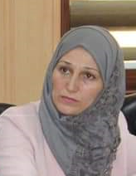
THE RIGHT SKILLS
Dr.DJOUDI Hanane
Faculty of ECMS/ University of Biskra
March, 2025
REF: Business Vocabulary in Use-Advanced

Slide 2
A

Slide 3
B

Slide 4
c

Slide 5
EX 1

Slide 6
EX 2

Slide 7
EX 3

Slide 8
OVER TO YOU

Slide 9
Thanks

