Slide 1
Careers in Civil Engineering and Training Programs Offered by the Civil Engineering Department
Presented by: Dr Mahdi Abdeddaim
Associate Professor at the department of Civil Engineering and hydraulics
Faculty of Architecture, Urbanism, Civil Engineering and hydraulics
Notes:
Slide 1: Title
Title: Careers in Civil Engineering and Training Programs Offered by the Civil Engineering Department
Content Suggestions:
University name and logo
Your name and title
Date of presentation

Slide 2
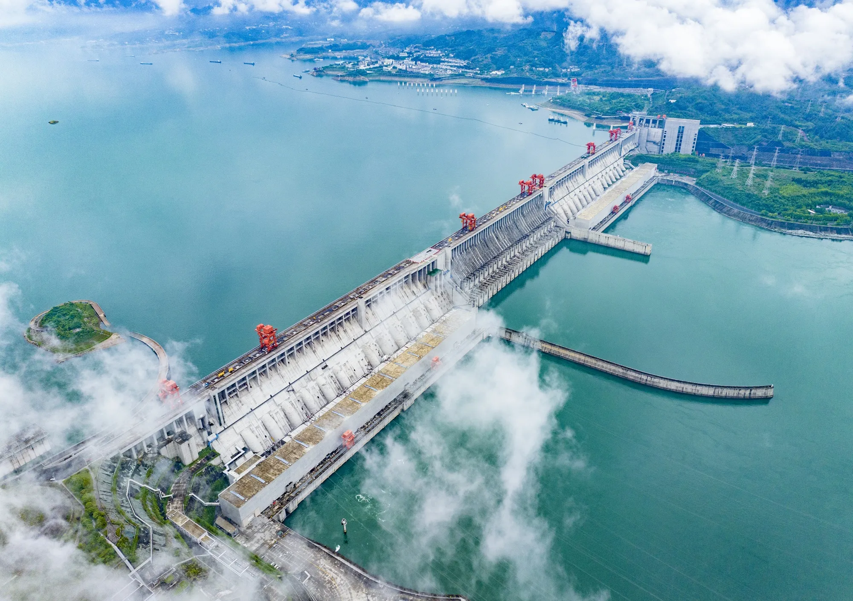
Introduction to Civil Engineering
Definition: Civil Engineering involves the design, construction and maintenance of all type of infrastructure such as buildings, bridges, roads, dams and water systems.
Importance: Civil Engineering is essential of societal development, urban planning and improving quality of life.
Millau Viaduct 343 meters height
Three gorges dam 2309 meters width
Notes:
Slide 2: Introduction to Civil Engineering
Content:
Definition: Civil engineering involves the design, construction, and maintenance of infrastructure such as buildings, bridges, roads, dams, and water systems.
Importance: Civil engineering is essential for societal development, urban planning, and improving quality of life.
Visuals:
Short quote about civil engineering’s impact

Slide 3
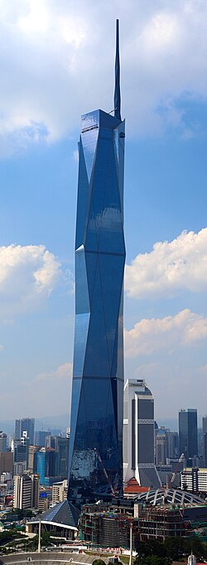
Introduction to Civil Engineering … contd.
Burj Khalifa 829,8 meters height
Taipei 101 skyscraper 508 meters
Merdeka 118 skyscraper 678.9 m

Slide 4
Objectives of Civil Engineering Education
Scientific and Technical Foundations
Mathematics, Physics
Engineering principles
Academic and Practical Knowledge
Classroom learning
Hands-on projects
Internships in consulting firms
Professional Skills
Preparation for employment
Notes:
Slide 3: Objectives of Civil Engineering Education
Content:
Solid Scientific and Technical Foundation: Emphasis on mathematics, physics, and engineering principles.
Academic and Practical Knowledge: Exposure to both classroom learning and hands-on projects.
Professional Skills: Preparation for employment in companies, consulting firms, and government agencies.
Visuals:
Diagram showing the balance between theory and practice
List or icons representing key skills (problem-solving, teamwork, communication)

Slide 5
Careers in Civil Engineering
Structural Engineer
Designs and analyzes buildings and bridges
Oversees construction sites and project execution
Technical Consultant
Provides expertise for technical studies and project planning
Supports on-site operations and quality control
Project Manager
Field Technician
Site/Construction Manager
Specialists
Leads and coordinates large-scale construction projects
Geotechnical, materials, or environmental engineers
Notes:
Slide 4: Careers in Civil Engineering
Content:
Structural Engineer: Designs and analyzes buildings and bridges.
Site Manager/Construction Manager: Oversees construction sites and project execution.
Technical Consultant: Provides expertise for technical studies and project planning.
Field Technician: Supports on-site operations and quality control.
Construction Inspector: Ensures compliance with standards and safety.
Project Manager: Leads and coordinates large-scale construction projects.
Specialists: Geotechnical, materials, or environmental engineers.
Visuals:
Photos or icons for each career
Flowchart showing career progression

Slide 6
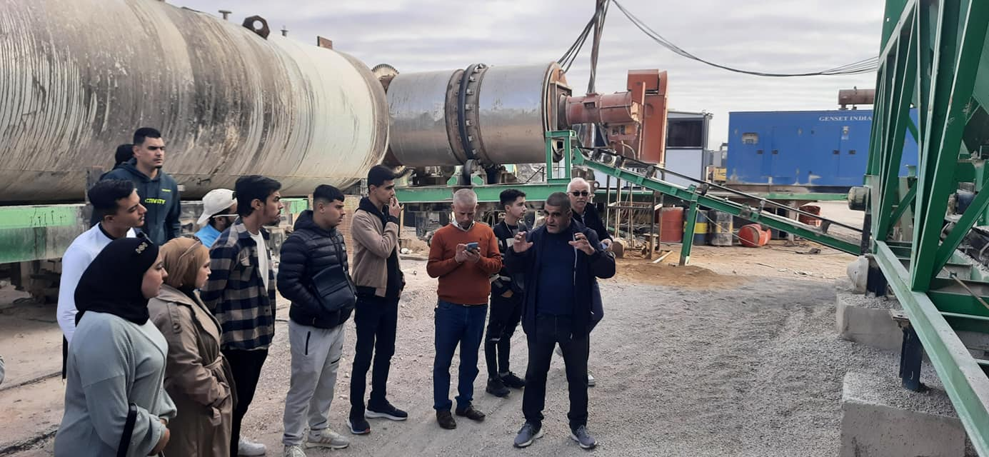
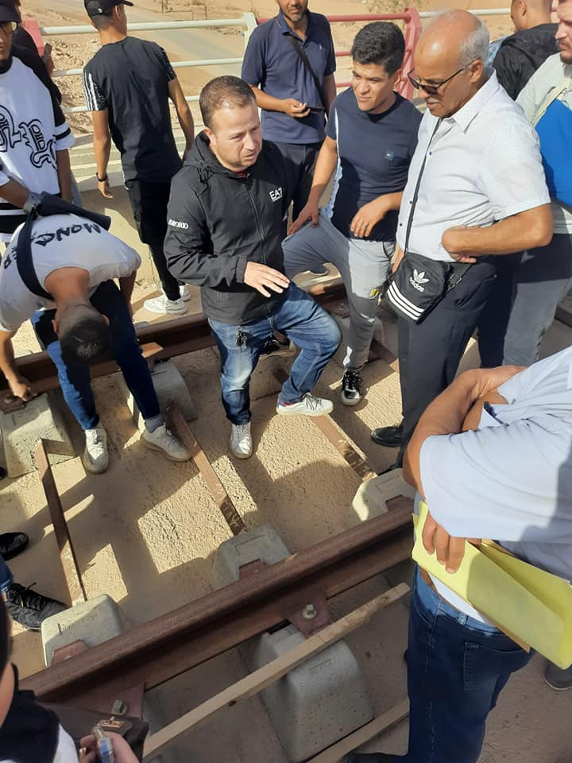
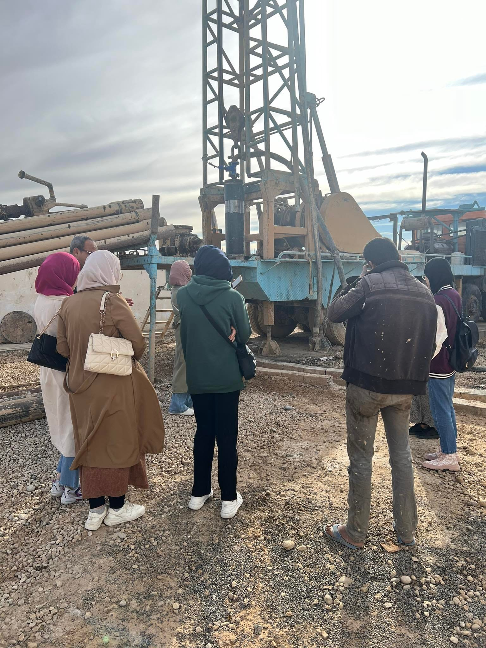
Bachelor’s Degrees Offered by the Department
Bachelor’s degree
Civil Engineering
Public works
Notes:
Slide 5: Bachelor’s Degrees Offered by the Department
Content:
Bachelor in Civil Engineering:
Core scientific and technical training.
Prepares for roles such as junior engineer, site supervisor, or for further studies.
Bachelor in Public Works:
Focus on the management and execution of public infrastructure projects (roads, bridges, utilities).
Prepares for roles in public works companies, municipalities, and consulting firms.
Visuals:
Table comparing both programs (duration, curriculum highlights, career paths)
Photos of students in labs or on site visits

Slide 7
Master’s Degrees Offered by the Department
Master Degrees
Structures
Geotechnical
Materials
CTC (Professional)
Advanced study of structural design and analysis
Careers: Structural engineer, design office, research
Focus on soil mechanics, foundations, and earthworks
Careers: Geotechnical engineer, site investigation
Specialization in material selection, testing, and durability
Careers: Laboratory analyst, materials engineer
Emphasis on diagnostics, safety
Technical controller, building inspector, expert in construction pathology
Notes:
Slide 6: Master’s Degrees Offered by the Department
Content:
Academic Master in Structures:
Advanced study of structural design and analysis (concrete, steel, composite structures).
Careers: Structural engineer, design office, research.
Academic Master in Civil Engineering Materials:
Specialization in material selection, testing, and durability.
Careers: Laboratory analyst, materials engineer, R&D.
Academic Master in Geotechnics:
Focus on soil mechanics, foundations, and earthworks.
Careers: Geotechnical engineer, site investigation, large-scale projects.
Professional Master in Construction Technical Control:
Emphasis on diagnostics, safety, and regulatory compliance.
Careers: Technical controller, building inspector, expert in construction pathology.
Visuals:
Infographic showing the four master’s tracks
Example research or project topics for each specialization

Slide 8
Skills Acquired
Technical Skills:
Structural analysis, design software (ROBOT, Autocad, SIG), project management.
Analytical Skills:
Material testing, structural modeling.
Professional Skills:
Teamwork, communication, ethics
Notes:
Slide 7: Skills Acquired
Content:
Technical Skills: Structural analysis, design software (BIM, CAD), project management.
Analytical Skills: Material testing, structural modeling, environmental assessment.
Professional Skills: Teamwork, communication, leadership, ethics.
Sustainability: Knowledge of sustainable practices and environmental regulations.
Visuals:
List of skills with icons
Example screenshots of engineering software

Slide 9
Further Studies and Career Prospects
Doctoral Studies
Opportunities for research and university teaching
Professional Insertion
Employment in private companies, consulting firms, public administration, and laboratories
International Mobility
Student exchanges, internships, and work opportunities abroad
Notes:
Slide 8: Further Studies and Career Prospects
Content:
Doctoral Studies: Opportunities for research and university teaching.
Professional Insertion: Employment in private companies, consulting firms, public administration, and laboratories.
International Mobility: Student exchanges, internships, and work opportunities abroad.
Visuals:
Flowchart showing study and career pathways
World map highlighting international opportunities

Slide 10
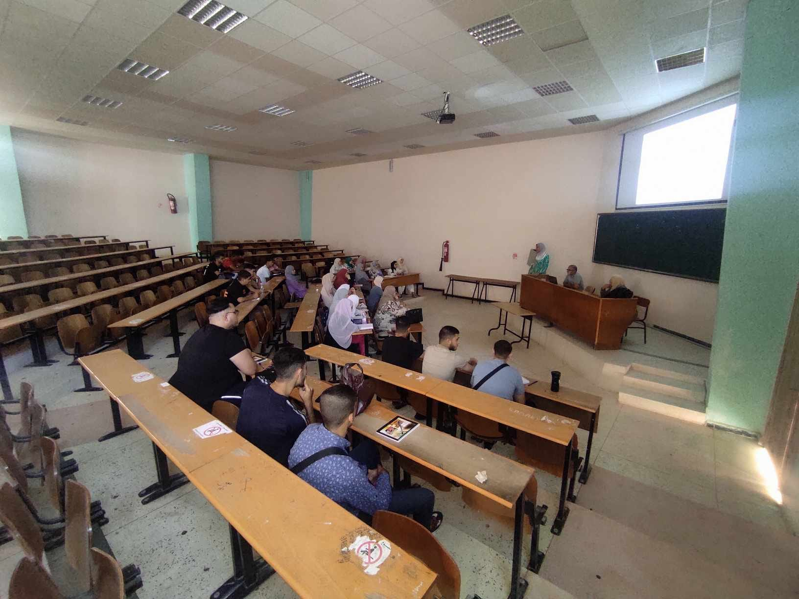
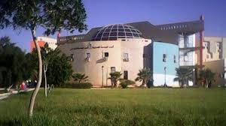
Conclusion
Civil engineering offers diverse and rewarding careers.
The department’s programs are designed to meet industry needs and technological advancements.
Civil engineering is a dynamic field with strong job prospects and societal impact.
Notes:
Slide 9: Conclusion
Content:
Civil engineering offers diverse and rewarding careers.
The department’s programs are designed to meet industry needs and technological advancements.
Civil engineering is a dynamic field with strong job prospects and societal impact.
Visuals:
Inspirational image (e.g., skyline, bridge, or students working together)
Motivational quote

Slide 11
Questions / Discussion
Notes:
Slide 10: Questions / Discussion
Content:
Thank the audience for their attention.
Invite questions and discussion.
Visuals:
Simple background
Contact information (optional)

