Slide 1
6. Concepts of Bioenergetic

Slide 2
Generalities
To survive, grow, and reproduce, the cells of any living organism need energy.
This energy can be classified as:
▪ Chemical: the energy that enables chemical reactions in various metabolic pathways.
▪ Mechanical: the energy that allows movement during muscle contraction.
▪ Caloric: when heat is produced.

Slide 3
▪ Osmotic: the energy that enables the transfer of molecules through a concentration gradient in various cellular compartments.
▪ Electrical: the energy that allows the transfer of molecules through an ionic gradient managed by membrane potentials.
In humans, it is the chemical energy of ingested substances (carbohydrates, lipids, amino acids, purine and pyrimidine bases) that will be used to be converted into other forms of energy.

Slide 4
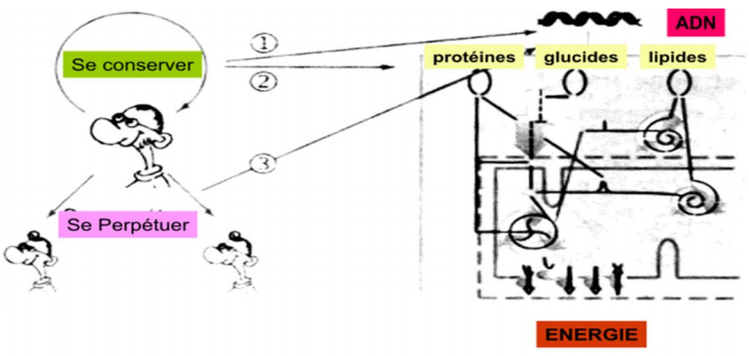
V.1. Definitions
Bioenergetics?
Is the science that studies all these energy reactions at the cellular level of living organisms.

Slide 5
The fundamental principle of bioenergetics
To survive, organisms must extract energy from environmental matter and convert it into other forms of energy necessary for their existence.

Slide 6
II. BIOENERGETICS AND THERMODYNAMICS
Energy production follows the laws of thermodynamics, which comprise two principles.
The concept of system:
A system: The part of the universe being studied, which is the set of matter that will undergo physical or chemical changes; everything surrounding the system is its environment;
Examples of systems: an organism, a cell, two compounds involved in a chemical reaction;

Slide 7
A closed system refers to a system that does not lose or gain materials from other systems, but energy can be exchanged with the surrounding.
An open system is classified as a system that exchanges both its material and energy to other systems.For instance, a coffee mug with a sealed lid can be regarded as a closed system because energy exchange with the immediate surroundings only occurs on the surface of the mug and the lid.
An isolated system is a system that does not exchange any material or energy with its surroundings or another system. The universe is thought to be the only true isolated system.

Slide 8
Types of Bioenergetic Reactions
1. Exergonic Reactions
Exergonic reactions refer to chemical reactions that release free energy when they are complete. Hence, exergonic reactions can occur spontaneously in a closed system subjected to stable temperature and pressure.
From a metabolic point of view, exergonic reactions are in the catabolic branch, where macromolecules are dissimilated to smaller units. For example, starch and glycogen are broken down into glucose, their basic monomeric units.

Slide 9
2. Endergonic Reactions
In contrast to exergonic reactions, endergonic reactions are processes that consume energy. This sort of reaction will not occur in a thermostable closed system under constant pressure unless a sufficient amount of energy is given to the system.
From a metabolic point of view, endergonic reactions are anabolic. In anabolism, the energy released from catabolic reactions supplies the required energy for the synthesis of biomolecules.
Macromolecules such as proteins, carbohydrates, nucleic acids, and lipids are polymer chains that store energy in living cells. They are eventually used as reactants in catabolic reactions to supply the cells with energy.

Slide 10
The 1st Principle: Principle of Energy Conservation (Lavoisier 1773)
There is neither creation nor loss of energy, only energy transformations; the total energy content of the universe remains constant.
"Nothing is lost, nothing is created,
everything is transformed"
Example: ATP hydrolysis (chemical energy) is necessary for muscle contraction (mechanical energy) - transformation of one form of energy into another.

Slide 11
The 2nd Principle: Entropy Increase.
During energy production, the systems involved evolve from an ordered state to a less ordered state.
The disorder obtained is called Entropy (S).
The quantitative measure of the variation of this disorder (from an initial state to a final state) is designated by the entropy variation (=∆S).

Slide 12
III. Concept of Gibbs Free Energy G
1. Definition :
Gibbs free energy "G" is the energy of a system that produces useful work under conditions of constant temperature and pressure.
Consider the biochemical reaction system:

Slide 13
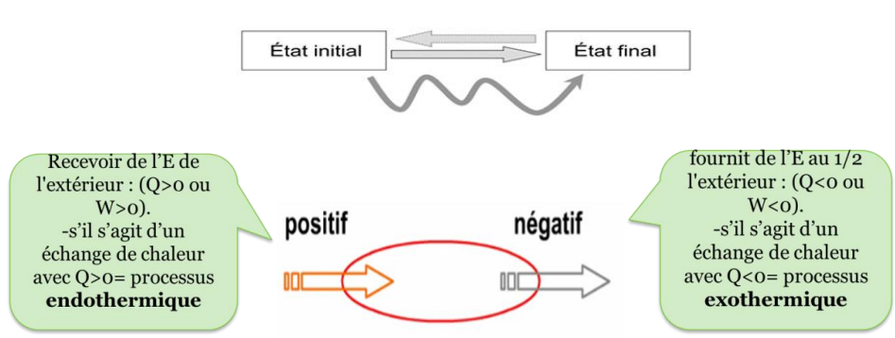
Concept of Internal Energy U and Enthalpy
Consider the extensive state function U "internal energy" in J.mol-1, which is independent of the path taken from state 1 to state 2. Variations of U are associated with energy exchanges of entropy/force S/F, work w, and/or heat transfer Q.

Slide 14
ΔU = change in internal energy, it is the variation in energy between the final and initial state of our system
ΔU = U final - U initial = Q + W
U: the total energy contained in a system; for a given molecule, it is the energy of bonds, vibrations, or rotations.
Q: is the quantity of heat exchanged with the system.
W: is the work done by the system on the external environment or vice versa.
w=vx∆p, P: pressure, V: volume. In the cell, pressure is constant ∆p=0 therefore w=0.

Slide 15
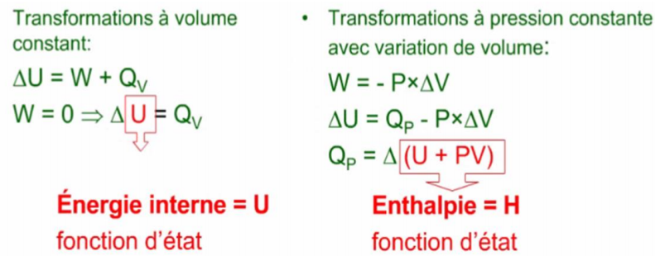
The most common, in biology, the variation of internal energy is summed up in the heat of the reaction Qp, that is to say: ΔU = Qp = ΔH.
This quantity of heat is called ENTHALPY (or H).
Enthalpy is also a function of the state of the system whose unit is: J/mol.

Slide 16
Enthalpy = the quantity of heat exchanged by the system during a transformation carried out at constant P:
▪ If ∆H>0 the reaction absorbs heat = endothermic reaction
▪ If ∆H<0 the reaction produces heat = exothermic reaction
Note: The unit of measurement for all these energies and energy variations is joules/mole or calories/mole. 1 calorie = 4.184 joules.

Slide 17
Relationship between enthalpy H and Gibbs free energy:
Enthalpy is the total energy, Gibbs free energy is the portion of energy capable of providing work. The difference is entropic energy or disorder energy defined by:
TxS
H=G+TS T: temperature
G=H-TS
∆G=∆H-T∆S
Major significance of ∆G:
Allows prediction of the direction of a chemical reaction
∆G<0: The reaction is exergonic or spontaneous, it occurs spontaneously from A to B.
∆G>0: The reaction is called endergonic, it only occurs if there is an external energy input.
∆G=0: The reaction occurs without energy consumption, it tends toward equilibrium.

Slide 18
2. Gibbs Free Energy and Equilibrium Constant:
Consider the following equilibrium: A+B -----> C+D .... (1)
Definition of standard state or standard chemical and biochemical conditions:
In chemistry:
Pressure of 1 atmosphere
Temperature of 25°C or 298 K
Concentration of each reactant at 1M (1mole/L)
pH=0 Under these conditions, the standard Gibbs free energy is denoted as Gº.
In biochemistry:
pH = 7 (cellular pH) Under these conditions, the standard Gibbs free energy is denoted as Gº'.

Slide 19
For biochemical reaction 1:
-The free energy of a molecule (A, B, C, D) at its concentration in the medium is related to the standard free energy Gº,
Example for A: GA = GºA + RT Ln [A] .... (2)
▪ Gº`A: Gibbs free energy at biochemical standard state
▪ R: ideal gas constant: 8.31 J/mol/K
▪ T: absolute temperature in Kelvin
▪ [A]: concentration of molecule A
The change in Gibbs free energy for reaction (1):
∆G = (GC+GD)-(GA+GB)

Slide 20
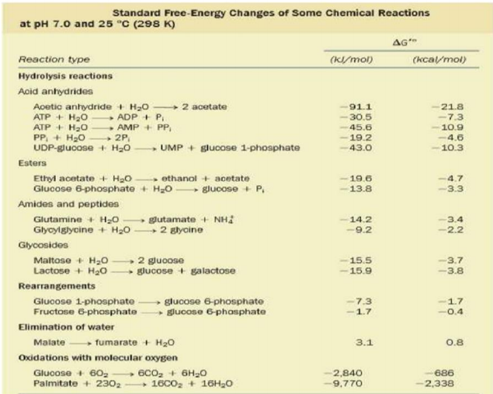
Examples de ∆G°` de certaines réactions :

Slide 21
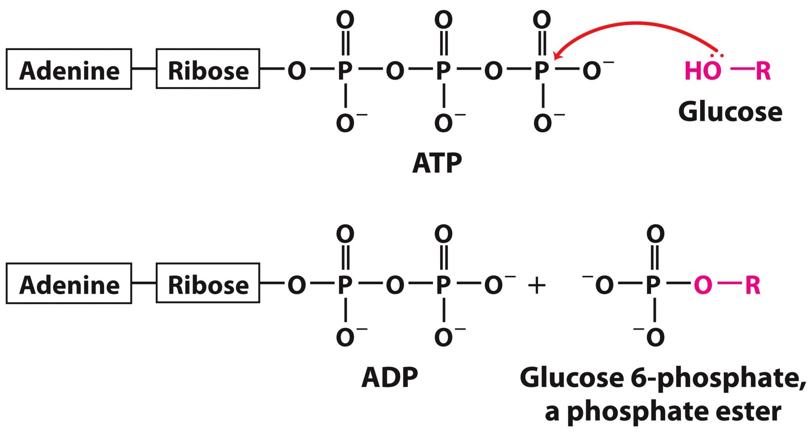
Phosphoryl Transfer from ATP

Slide 22
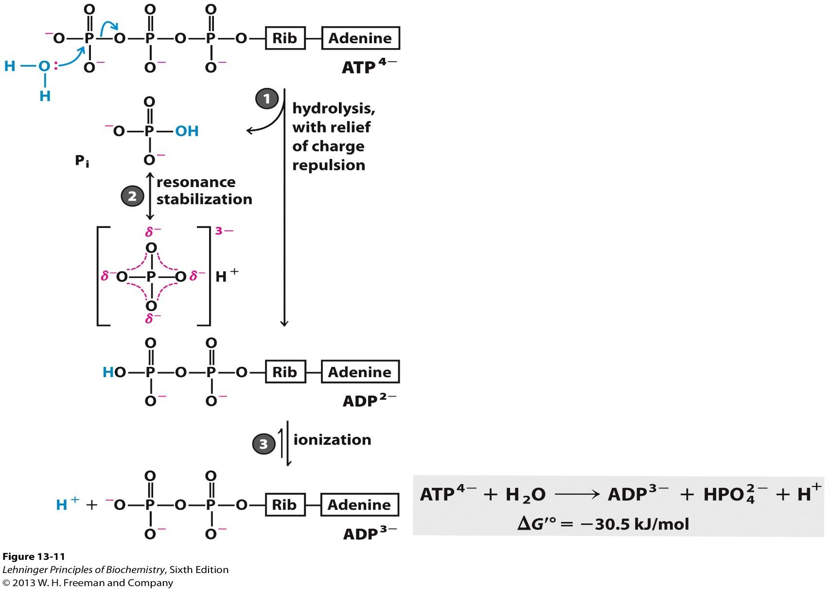
Free energy change for ATP hydrolysis is large and negative
Hydrolysis of ATP is highly favorable
under standard conditions
The reason why ATP is high energy compound?

Slide 23
High-energy molecules
These are molecules that have bonds that release a lot of energy upon hydrolysis.
Adenosine triphosphate (ATP)

Slide 24
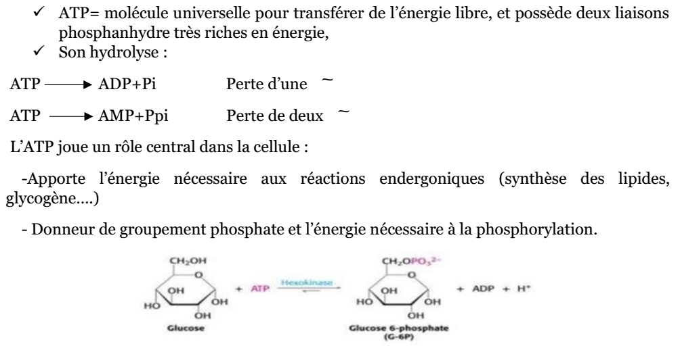

Slide 25
Actual ΔG of ATP hydrolysis differs from ΔG’
The actual free-energy change in a process depends on:
– The standard free energy
– The actual concentrations of reactants and products
▶ The free-energy change is more favorable if the reactant’s concentration exceeds its equilibrium concentration
▶ True reactant and the product are Mg-ATP and Mg-ADP, respectively
– ΔG° is also Mg++ dependent
−
Mg2+ in cytosol binds to ATP and ADP: true substrate is MgATP2-
ΔGp (posphorylation potential):
Actual free energy of hydrolysis of ATP under intracellular condition
Δ G for ATP hydrolysis (ΔGp = - 51.8 kJ/mol)
much more negative than Δ G’o (= -35.5 kJ/mol)
Mg2+ in cytosol binds to ATP and ADP: true substrate is MgATP2-
[MgADP ][P ]
ΔG = ΔGRT ln 2
[MgATP⁻²]

Slide 26
2. Other high-energy phospho-derivatives
The table shows the ΔG°' (Gibbs free energy change) and potential for transfer values for various phospho-derivatives.
3. Thioester linkages
Example of Coenzyme A: Composed of high free energy involved in the transfer of the acyl group.
CH3-CO~S-CoA -----> Acetyl CoA (ΔG°' = -9 kcal/mol)

Slide 27
Variation of free energy and redox potential
Chemical energy can be conserved in the form of high-energy electrons contained in energetic molecules.
1. Oxidation-reduction reactions
Electron transfer from an electron donor to an electron acceptor
Oxidation: loss of electron(s) or hydrogen(s).
Reduction: gain of electron(s) or hydrogen(s).
An oxidant (ox) is the electron acceptor.
A reductant (red) is the electron donor.
Redox couple: the oxidant (red/ox) represents a reductant and its oxidant counterpart.

Slide 28
An oxidation is always coupled to a reduction with two redox couples.
Red1 → Ox1 + n e- (1st half-reaction: oxidation)
Ox2 + n e- → Red2 (2nd half-reaction: reduction)
Red1 + Ox2 → Ox1 + Red2 .........(3)
The electrons are spontaneously transferred from the strongest reductant (red1) to the strongest oxidant (ox2), where the strongest reductant will be oxidized and the strongest oxidant will be reduced.
This reductive force is evaluated by the standard redox potential of the couple Eo' compared to that of the hydrogen considered as reference potential -0.42V at pH=7

Slide 29
When the E°' of a couple is lower than that of hydrogen, the couple is a reducing agent.
-When the E°' of a couple is higher than that of hydrogen, the couple is an oxidizing agent.
Table: Some redox couples and their E°' values

