Slide 1
2. Structure and Physicochemical Properties of Carbohydrates

Slide 2
2. Structure and Physicochemical Properties of
Carbohydrates
2.1. Simple Monosaccharides
2.2. Oligosaccharides
2.3. Polysaccharides, Glycosides

Slide 3
I. General characteristics of carbohydrates
I.1. Definition
Carbohydrates are organic compounds composed of carbon (C), hydrogen (H), and oxygen (O), with a general chemical formula of Cn(H2O)n.
They are a primary source of energy for living organisms and are found in a wide variety of foods, from sugars and starches to fibers.
Carbohydrates = Polyhydroxyaldehydes or Polyhydroxyketones and all their derivatives.

Slide 4
I.2 Biological Roles
1.Energy role
• 40 to 50% of the calories provided by human food are carbohydrates during cellular respiration, in the mitochondria.
• ​​They have a role of energy reserve in the liver and muscles (glycogen).
2. Structural role: Carbohydrates intervene as:
• Support elements (cellulose), protection and recognition in the cell.
• Reserve elements of plants and animals (glycogen, starch).
• Constituents of fundamental molecules: nucleic acids, coenzymes, vitamins, etc.
• They represent a high percentage of biomass because most of the organic matter on Earth is carbohydrate.
3. Economic role: Sugar processing industry is a very important sector.

Slide 5
I.3.Classification of carbohydrates

Slide 6
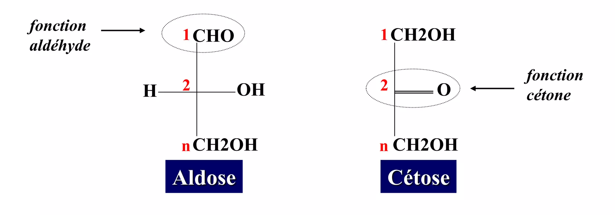
II. Monosaccharides
II.1. Definition: Also called simple oses. Oses are molecules containing both several alcohol functions and a reducing function (aldehyde or ketone).

Slide 7
Characterized by:
- the general formula (CH2O)n with n≥3
- an unbranched carbon chain
- substitution of all carbon atoms except one by a hydroxyl group (OH). The remaining carbon is substituted by a carbonyl group which can be aldehyde or ketonic.
H
O
1
C
1
CH₂OH
2
CHOH
2
C=O
3
CHOH
3
CHOH
4
CHOH
4
CHOH
5
CH₂OH
5
CH₂OH
Aldopentose
Cétopentose
Notes:
Dans la numérotation, le carbone le plus oxydé portera l’indice le plus faible

Slide 8
II.2. Classification et Nomenclatur des oses
II.2. Classification and Nomenclature of oses
Two (2) criteria:
=> The number of carbon atoms
- 3 carbons = Triose
- 4 carbons = Tetrose
- 5 carbons = Pentose
- 6 carbons = Hexose…
=> The nature of the carbonyl group
- Aldehydic function = Aldose
- Ketone function = Ketose.
Deux (2) critères :
=> Le nombre d’atomes de carbones
- 3 carbones = Triose
- 4 carbones = Tétrose
- 5 carbones = Pentose
- 6 carbones = Hexose…
=> La nature du groupement carbonylé
- Fonction aldéhydique = Aldose
- Fonction cétonique = Cétose.

Slide 9
=> Combination of the two criteria
- 3 carbons
- Ketone function
- 3 carbons
- Aldehydic function
- 6 carbons
- Aldehydic function
ketotriose
Aldotriose
Aldohexose
NB: the carbon carrying the carbonyl group always has the smallest number, namely:
N°1: for aldoses
N°2: for ketoses

Slide 10
II.3. Linear structure of oses
3.1. Fischer representation
the carbon chain is drawn vertically; the carbon atom with the smallest index (carrier of the carbonyl function) is placed at the top; the groups on the horizontal point towards the front of the sheet of paper.

Slide 11
II.3.2. Concept of stereoisomerism
Two compounds are stereoisomers if they deflect the
plane of polarized light by an angle equal in absolute value
but in opposite directions.
The compound that deflects this plane to the right is
dextrorotatory and is assigned the (+) sign
The one that deflects it to the left is said to be levorotatory and is assigned the (-) sign.
An equimolecular mixture of the two enantiomers of the same molecule is called: racemic mixture (optically inactive).

Slide 12
Optical rotation or activity:
The notion of rotatory power is linked to the existence in the molecule of 1 or more asymmetric carbons.
Example: glyceraldehyde
CHO
CHOH
CH₂OH
CHO
Glyceraldéhyde
CHO
H
C
HO
HO
C
H
CH₂OH
CH₂OH
D-Glyceraldéhyde
L-Glyceraldéhyde

Slide 13
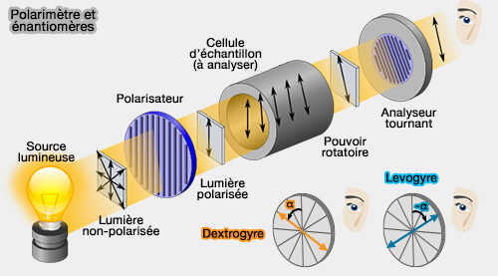
Enantiomeric forms of a molecule possess optical activity (if they don't have a plane of symmetry): each of them specifically rotates the plane of polarization of a polarized monochromatic wave.
The plane of polarization is rotated by an angle that is equal in absolute value but in opposite directions. This property is characterized by the specific rotatory power.

Slide 14
The specific rotatory power (SRP or [α]_{D}²⁰°) of a substance in solution is expressed by Biot's relation:
[α]_{D}²⁰°ᴰ = α / (c × l)
Where:
α: Angle of deviation of polarized light (in degrees).
c: Concentration of the solution (in g/ml)
l: Length of the tube containing the solution (in dm)
Or:
[α]_{D}²⁰°ᴰ = (α × 100) / (c × l) where: (c in g/100ml)
Example:
Glucose is dextrorotatory D-Glucose: [α]_{D}²⁰°ᴰ = +52°7
Fructose is levorotatory D-Fructose: [α]_{D}²⁰°ᴰ = -92°

Slide 15
Remarks
If n is the number of carbons, the number of asymmetric centers N is:
N=n-2 for aldoses
N=n-3 for ketoses
The number of stereoisomers is 2N.
If a sugar has (N) asymmetric carbons, it will have 2n-2 possible stereoisomers for aldoses / 2n-3 for ketoses.
Example: An aldohexose with 4 asymmetric carbons will have 24 stereoisomers, or 16 stereoisomers.
A sugar in the D series can be dextrorotary or levorotary; the same applies to sugars in the L series.
In general, natural sugars are from the D series.
Sugars having a plane of symmetry do not rotate polarized light, even if they have one or several asymmetric carbons.

Slide 16
Example: Mucic acid (derived from galactose)
H
O
C
H
C
HO
HO
C
H
Plane of symmetry
HO
C
H
H
C
HO
C
O
H

Slide 17
Sugars of the D series and L series are 'mirror images' of each other (enantiomers).
In general, for n asymmetric carbons, we will have 2n stereoisomers and 2n-1 pairs of enantiomers.
MIROIR
CHO
CHO
H C OH
HO C H
HO C H
H C OH
H
C OH
HO C
H
H
C
OH
OH
C
H
CH₂OH
CH₂OH
D-Glucose
L-Glucose

Slide 18
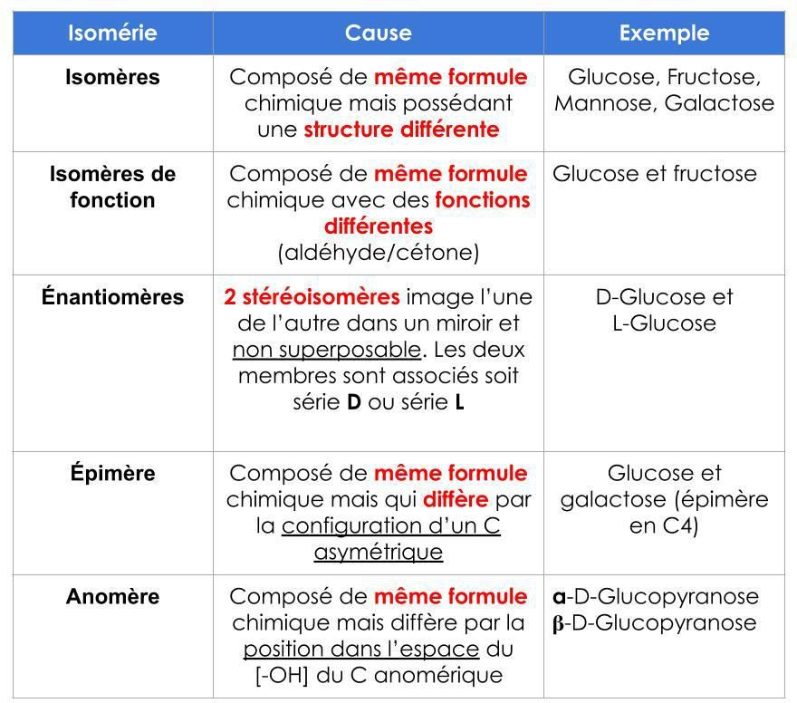

Slide 19
II.3.2. Aldose filiation (Kiliani-Fischer synthesis)
According to Kiliani and Fischer, carbon additions occur above carbon number 1; This leads to a pair of epimers.
CHO
+ 2H₂O
CΞN
COOH
+ 2H
CHO
+ HCN
H
C
OH
CHOH
NH3
CHOH
H₂O
CHOH
CH₂OH
C
H
C
OH
H
C
OH
H
OH
D-Glycer
aldéhyde
CHO
CH₂OH
CH₂OH
CHO
CH₂OH
H
C OH
HO
C H
H
C
OH
H
C
OH
D-Erythrose
CH₂OH
CH₂OH
D-Thréose

Slide 20
Chemical lineage of D-aldoses

Slide 21
Epimers
Epimerization occurs through chemical or enzymatic means (epimerase).
Erythrose and threose are epimers at C2
Glucose and mannose are epimers at C2
Galactose is an epimer of Glucose at C4. The absence of epimerase prevents the transformation of Galactose to Glucose and leads to one form of congenital galactosemia in newborns.

Slide 22
II.3.3. Ketose filiation
Ketoses are named by adding the suffix 'UL' to the name of the corresponding aldose
Example: Ribose => Ribulose
The conversion from aldoses to ketoses occurs through isomerases.

Slide 23
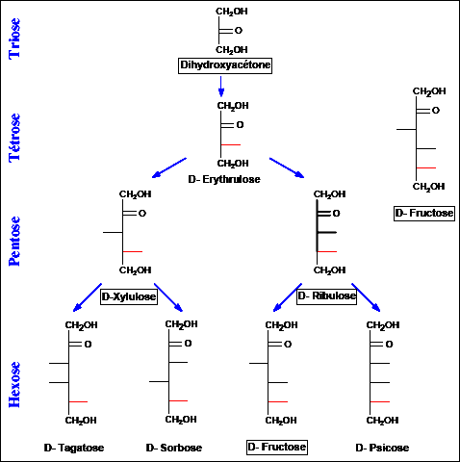
II.3.3 Lineage of D-series ketoses

Slide 24
II.4. Cyclic structure of oses
4.1.Oxidic Bridge and Tollens Formula 1883
Example of Glucose
OH
OH
CHO
H
C HO
H
C
H C OH
+H₂O
H C OH
H C OH
HO C H
HO C H
H₂O
HO C H
O
H
C OH
H
C OH
H
C OH
H
C
OH
H
C
OH
H
C
CH₂OH
CH₂OH
CH₂OH
D-Glucose
Oxidic Bridge C1- C5
D-Glucopyranose

Slide 25
Example of fructose (ketohexose)
CH₂OH
CH₂OH
CH₂OH
C O
HO C OH
+H₂O
HO C
HO C H
HO C H
H₂O
HO C H
H
C OH
O
H
C OH
H
C OH
H
C
OH
H
C
OH
H
C
CH₂OH
CH₂OH
CH₂OH
D-Fructose
Oxidic bridge C2-C5
D-Fructofuranose

Slide 26
The existence of the oxidic bridge allows us to understand:
The formation of the hemiacetal
The result of methylation
The higher optical rotation

Slide 27
4.2. Haworth Formula 1930
The 5 carbons and the oxygen are in the same plane.
L
CH₂OH
H
OH
C
CH₂OH
D
H C OH
O
α
OH
H
H
H
OH C H
O
OH
H C OH
O
OH
β
OH
H
C
H
OH
CH₂OH
Fisher Formula
Haworth Formula

Slide 28
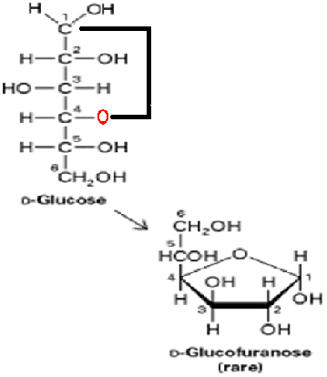
The stability of the ring depends on the sugar:
Aldohexoses are more stable in pyranose form
Ketohexoses are more stable in furanose form
TOLLENS
(1883)
Liaison en 1- 4
HAWORTH 1930
Forme
FURANE
D-Glucofuranose
Rare
In solution, these furanose and pyranose forms are in equilibrium with each other and with the linear form

Slide 29
In the D series, if the terminal carbon is outside the ring, it is oriented upwards. In the L series, it is the opposite.
In the α form, the anomeric hydroxyl group is always in the trans position relative to the last carbon outside the ring. This position is cis in the β form.
α-D-Glucopyranose
β-D-Fructofuranose

Slide 30
4.3. REEVES formula
The chair form : Equatorial plane containing carbons 2, 3, 5 and the oxygen atom. C4 is above the plane and C1 is below. This is the stable form of natural oses.
The boat form : a cyclic conformation where two opposite atoms of the ring (typically C1 and C4 in pyranoses) are elevated relative to the other atoms.
Notes:
Substituants axiaux (parallèles à l’axe), moins réactifs. Substituants équatoriaux (perpendiculaires à l’axe), plus réactifs.

Slide 31
II.5. Properties of monosaccharides
II.5.1. Physical properties
White, crystalline solids, sweet
Highly soluble in water
Insoluble in non-polar solvents
Possess optical activity in solution
Absorption spectrum:
- Absorb little in the visible and ultraviolet range -Characteristic Infrared spectrum

Slide 32
II.5.2. Chemical properties of monosaccharides
Properties of the carbonyl function
Formation of hemiacetals
Oxidation reactions
Oxydation douce par l’iode en milieu alcalin
Spécifique des aldoses
Donne des acides aldoniques

Slide 33
Example of glucose
CHO
COOH
C
C
+ H₂O + I₂
C
C
+ 2 H I
C
C
C
C
CH₂OH
CH₂OH
D-Glucose
Acide gluconique
Notes:
Les acides aldoniques sont instables et se transforment rapidement en lactone par estérification interne.

Slide 34
Energy oxidation
With nitric acid
Gives a diacid called aldaric or saccharic acid
CHO
COOH
C
C
Nitric acid
C
C
C
C
C
C
CH₂OH
COOH
D-Glucose
Glucaric acid

Slide 35
Energy oxidation with carbonyl protection
Primary alcohol function only oxidized
Formation of uronic acids (biological role)
CHO
CHO
C
C
Nitric acid
C
C
Protection CHO
C
C
C
C
CH₂OH
COOH
D-Glucose
Glucuronic acid

Slide 36
Oxidation by Periodic Acid (HIO₄)
Oxidative cleavage of the ring.
Cleavage between carbons carrying free OH groups.
Allows determination of the nature of the ring.
Furanose → simple dialdehyde
Pyranose → dialdehyde + formic acid (HCOOH)

Slide 37
Example of pyranic cycle
H
OH
H
O-CH₃
H
O-CH₃
C
C
C
+ CH₃OH
Periodic
acid
C
C
CHO
+ HCOOH
C
O
C
O
O
C
C
CHO
C
C
C
CH₂OH
CH₂OH
CH₂OH
Pyranose
Dialdéhyd
+ Formiacide

Slide 38
Example of furanic cycle
H
OH
H
OCH₃
H
OCH₃
C
C
C
+ CH₃OH
Periodic
acid
CHO
C
C
O
O
O
C
C
CHO
C
C
C
CH₂OH
CH₂OH
CH₂OH
Furanose
Dialdéhyde

Slide 39
Reduction reactions:
Through action of an alkaline borohydride
Transformation of aldehydes and ketones into alcohols called polyols or itols
From an aldose → one type of polyol
From a ketose → 2 epimeric polyols at C2

Slide 40
Example of D-Mannose (aldose)
H
O
C
CH₂OH
C
+ NaBH4
C
C
C
C
C
C
C
CH₂OH
CH₂OH
D-Mannose
D-Mannitol
The names of alditols are obtained by replacing the suffix -ose
with the suffix -itol. For example, D-mannose gives D-mannitol
and D-glucose gives D-glucitol (D-sorbitol) etc....

Slide 41
Example of fructose (Ketose)
CH₂OH
C
O
C
C
CH₂OH
C
CH₂OH
HO
H
H
C
C
OH
CH₂OH
C
C
+
NaBH4
C
C
C
C
CH₂OH
CH₂OH
D-Sorbitol
D-Mannitol

Slide 42
Addition and substitution reactions: Formation of glycosides through glycosidic bonds
Exp : Action of méthanol
HOH₂C
O
HOH₂C
O
CH₂OH
CH₂OH
+ CH₃OH
OH
O-CH₃
α-D-Fructofuranose
Méthyl-α-D-Fructofuranoside
Formation of O-hétérosides
NB: Glucose β-méthyle-O-D-glucopyranoside
An O-glycoside has no reducing power (it does not reduce metal oxides). It is not capable of mutarotation.

Slide 43
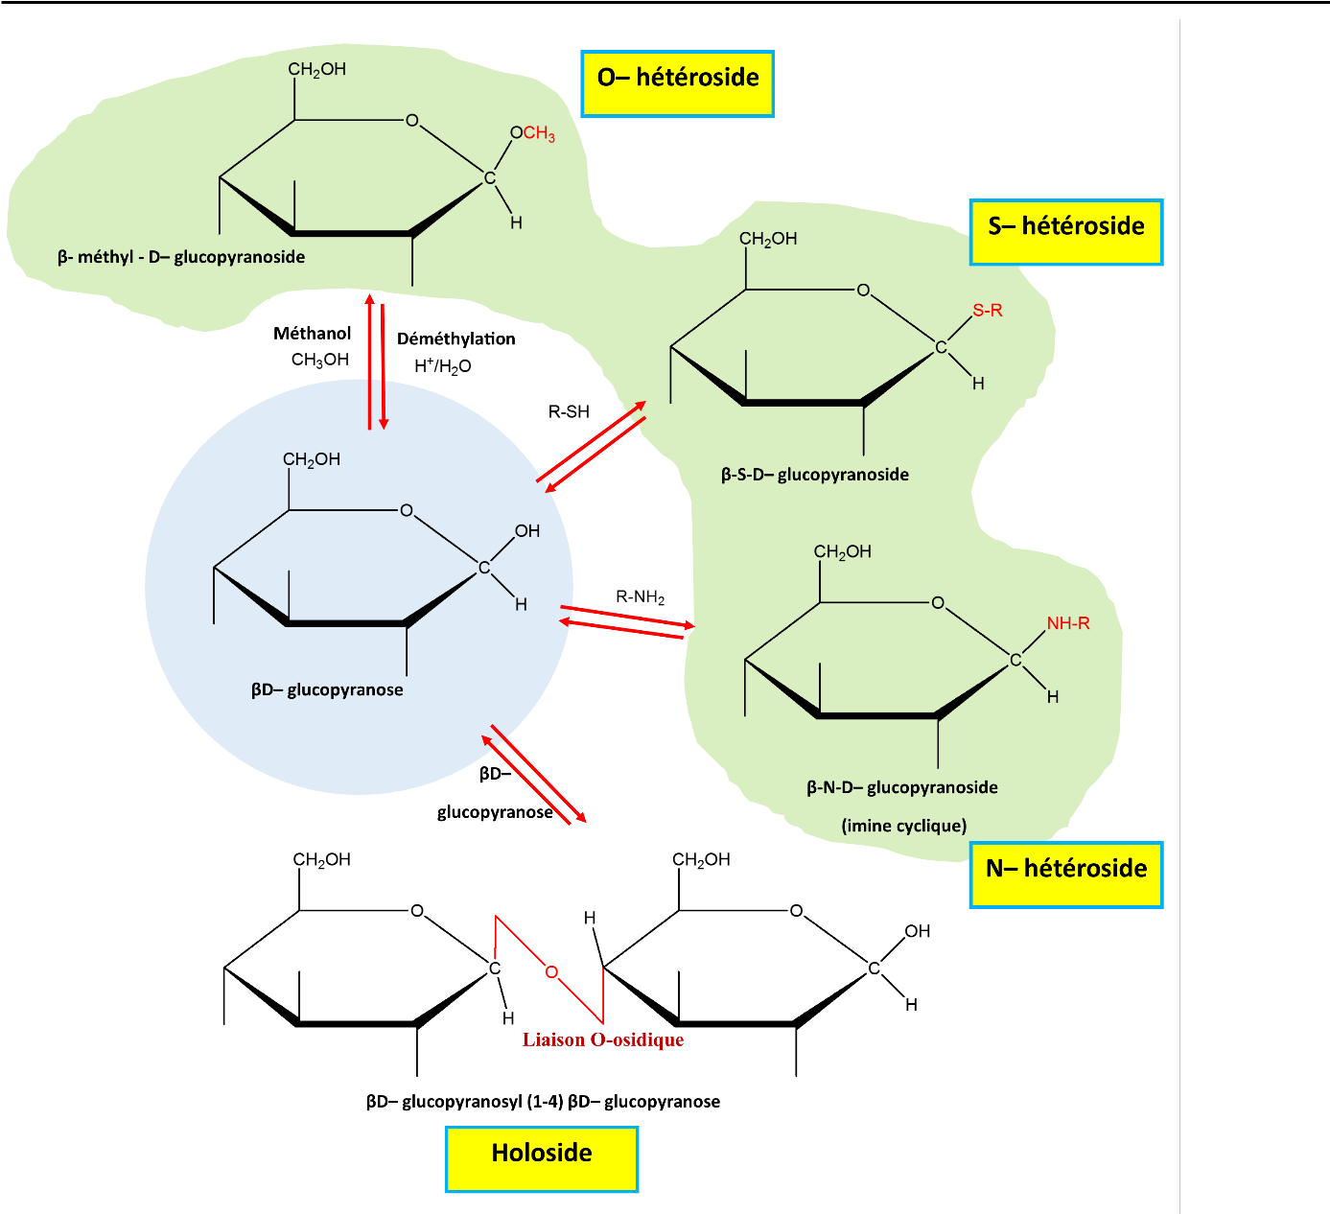
Addition and substitution reactions
Depending on the group substituting the OH of the anomeric carbon, a type of heteroglycoside is distinguished.
When the aglycone molecule is H0-R, the type of heteroside is an O-heteroside.
When the aglycone molecule is S-R, the type of heteroside is an S-heteroside.
When the aglycone molecule is NH-R, the type of heteroside is an N-heteroside.
Note: The names of O-glycosides are directly derived from the names of the original sugars. Thus, D-glucopyranose gives D-glucopyranosides..
A sugar can bond to another sugar forming a holoside or also called a disaccharide.
The holoside is reducing if there is a free anomeric carbon.

Slide 44
Properties related to the presence of alcohols
Formation of ethers (see methylation)
Formation d’esters : Par condensation avec des acides. Importance des esters phosphoriques
O
P-OH₂C
O
CH₂O-P
HOH₂C
CH₂OH
+ 2 H₃PO4
OH
OH
Fructose
Fructose 1- 6 bisphosphate
P
= - H₂PO₃

Slide 45
Formation of deoxy sugars: Sugars obtained by reduction of one or more hydroxyl groups (dehydroxylation)
HOH₂C
O
O
HOH₂C
1
1
Reduction of
OH de C₂
OH
OH
2
2
OH
OH
OH
H
α-D-ribose
α-2-désoxy- D-ribose
Note: There are other examples of dehydroxylation found in nature such as: Fucose or 6-deoxy-L-galactose, present in polysaccharides of insect cells, mammals, and plants.
Rhamnose or 6-deoxy-L-mannose, present in plants as heterosides and in the outer membranes of certain bacteria.
Quinovose is 6-deoxy-D-glucose, present in plants and certain bacteria.
Notes:
Importance dans la synthèse du DNA

Slide 46
They are present in:
The skeleton of arthropods (chitin)
The cell wall of bacteria
Formation d’osamines
Radical OH de C₂, remplacé par radical NH₂
Radical aminé en général acétylé (CH₃-COOH)
NH₃
CH₃-COOH
α-D-glucose
NH₂
α-D-glucosamine
NH-CO-CH₃
N-acétyl-α-D-glucosamine

Slide 47
There are two important derivatives of osamines
N-acetyl-muramic acid
Condensation N-acetyl-glucosamine + lactate
Responsible for bacterial wall rigidity
O
COOH
CH
CH3
NH-CO-CH₃

Slide 48
Neuraminic acid = Sialic acid
Condensation D-mannosamine + pyruvate
C
H
O
H
2
HO C H
HO C H
H₂N
OH
O
COOH
LAcetylated neuraminic acid leads to N-acetyl-neuraminic acid (Neu5Ac or NANA).
They are most commonly found as constituents of cellular glycoproteins and glycolipids.

Slide 49
Epimerization
In weak basic medium and cold conditions, oses undergo epimerization, which is an inversion of the configuration of substituents of a single asymmetric carbon.
CHO
CHO
Epimerization
H
C
OH
HO
C
H
CH₂OH
CH₂OH
D-Glyceraldéhyde
L-Glyceraldéhyde

Slide 50
Contiguity of alcohol and carbonyl function
Formation of osazones after nitrogenous base action
Phenylhydrazine action on D-glucose
A froid
CHO
HC=
N-NH-H₅C₆
+ H₂N-NH-H₅C₆
H C OH
H C OH
Milieu acétique
+ H₂O
HO C H
HO C H
H
C OH
H
C OH
H
C
OH
H
C
OH
CH₂OH
CH₂OH
D-Glucose
D-Glucose phénylhydrazone

Slide 51
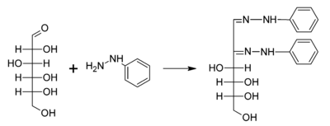
A chaud
Formation osazones par fixation de deux molécules de phénylhydrazine
CHO
HC=
N-NH-H₅C₆
HC=
N-NH-H₅C₆
+ H₂N-NH-H₅C₆
+ 2 x H₂N-NH-H₅C₆
OH
H C OH
C
C
=N-NH-H₅C₆
Milieu acétique
Milieu acétique
+ Acide
phénylacétique
HO C H
HO C H
HO C H
H
C OH
H
C OH
H
C OH
H
C
OH
H
C
OH
H
C
OH
CH₂OH
CH₂OH
CH₂OH
D-Glucose
Phénylhydrazone de D-Glucose
D-Glucosazone

Slide 52
Remarks
Two epimeric aldoses in C2 and their corresponding ketose give the same osazone.
Thus glucose, mannose and fructose give glucosazone.
Application: Identification of oses in biological fluids.
When heated, the ose solutions mixed with phenylhydrazine precipitate. Observing the shape of the crystals under a microscope allows for the identification of these oses in solution.
Glucosazone (x 250) Maltosazone (x 250) Lactosazone (x 250)

Slide 53
Etherification
The formation of an ether at the level of oses can be done by the addition of a carbon or a carbon chain at the level of a hydroxyl of an ose.
Methylation of oses is an etherification reaction leading to the addition of a methyl to a hydroxyl using methyl iodide ICH3 and silver oxide. Permethylation is a reaction that allows the methylation of all the hydroxyls of a ose. This type of reaction can affect the anomeric carbon by forming an acetal whose properties are different from those of ethers.
One of the properties that differs from them is that acetals can be hydrolyzed in acidic medium which leads to the release of methyl.

Slide 54
H₃C-OH₂C
O
CH₂O-CH₃
HOH₂C
O
CH₂OH
+ Sulfate de méthyle
(CH₃)₂SO₄
H₃C-O
O-CH₃
OH
O-CH₃
α-D-Fructofuranose
Pentaméthyl-1,2,3,4,6
O-méthyl α-D-Fructofuranoside

Slide 55
Analytical Reactions
Action of concentrated acids when heated
Rupture stability of ose
Cyclic structure through internal dehydration
Case of pentoses
CHO
HO CH CH OH
H CH C H
OH OH
CH CH
CH C
O
H C OH
H₂SO₄
H
C OH
H
C
OH
CHO
CHO
CH₂OH
Furfural

Slide 56
Case of hexoses
CH CH
C C
O
HO CH CH OH
H C C H
OH OH
H₂SO₄
HO₂HC
CHO
HO₂HC
CHO
Hydroxyméthyl furfural
Condensation of furfurals with phenols and other cyclic compounds => Colored compounds => Identification/quantification of sugars

Slide 57
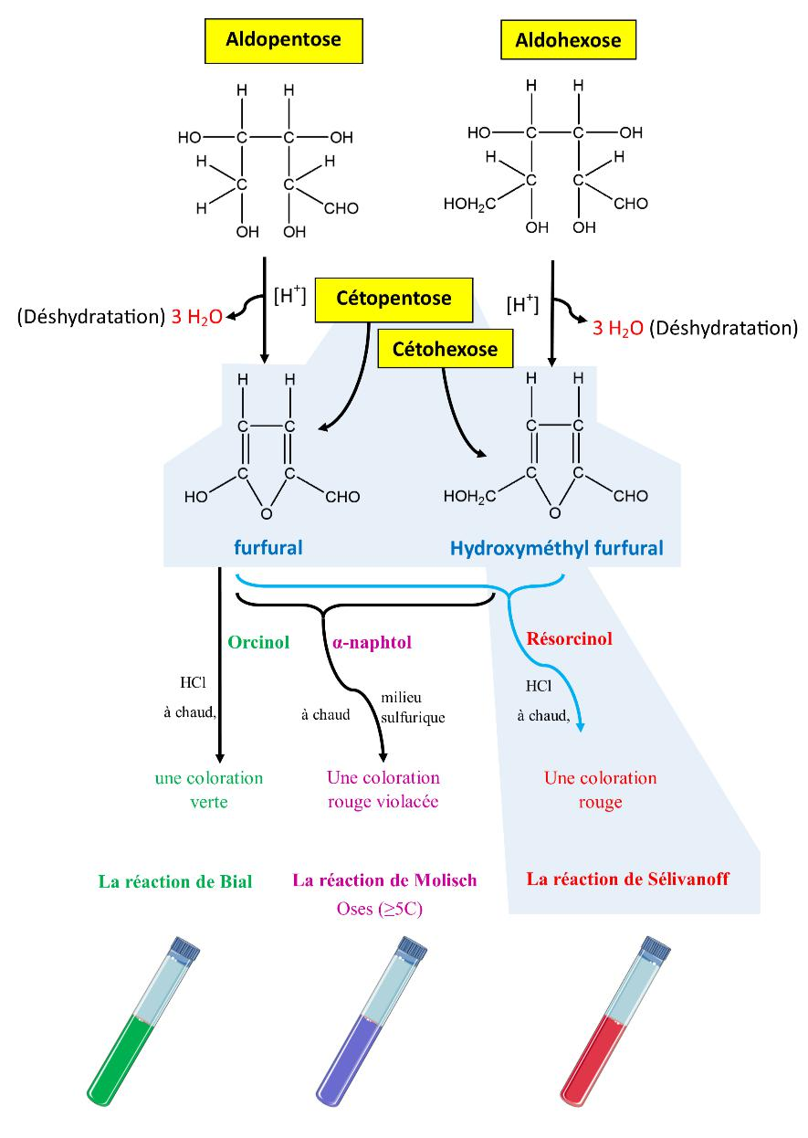
Dehydration
The Molisch reaction: Characterization of sugars with 5 or more carbon atoms using α-naphthol in a sulfuric acid medium and under heat. The product of the reaction is colored violet-red.
The Bial reaction: Characterization of pentoses using orcinol in the presence of hydrochloric acid and under heat. The product of the reaction is colored green-red.
The Seliwanoff reaction: Characterization of ketoses (dehydrate quickly compared to aldoses) using resorcinol in the presence of hydrochloric acid under heat. The product of the reaction is colored red.

Slide 58
Action of dilute bases in cold conditions
Rearrangements of anomeric carbon and neighboring carbon
Epimerization via ene-diol intermediates
CHO
HO CH
CH₂OH
HO CH
CHO
C OH
C=O
HO C
Trans
Ène-diol
D-fructose
Cis
Ène-diol
D-glucose
D-mannose

Slide 59
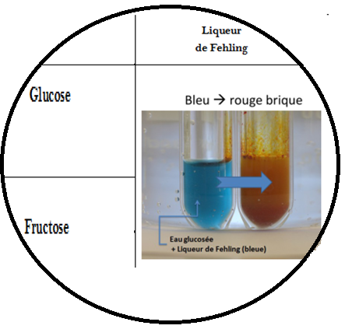
Addition of heavy metal salts
Demonstration of the reducing power of sugars
Fehling's solution + urine containing sugar gives a brick-red precipitate (cupric oxide in Fehling's solution is reduced by the sugar to cuprous oxide)
OTHERS
Tollens' reagent
Schiff's reagent
DNPH test
Iodine solution

Slide 60
Chromatography
Allows identification of a sugar in solution.
Uses slight differences in solubility of sugars in organic solvents
Ribose
Glucose
Dépl.Tâche
Rf =
Mélange X
Dépl.Solvant
Front of the solvent
Line deposit

Slide 61
III. Osides
III.1. Definition
Substances resulting from the association of oses, or ose derivatives, with each other; or from the association of oses and a non-sugar molecule.
Holosides : oses only
Heterosides : ose + aglycone
III.2. Holosides
Oligosaccharides ≤ 10 ose units
Polysaccharides > 10 ose units

Slide 62
III.2.1. Oligosides:
Diholosides (Disaccharides)
Condensation of 2 ose units joined by a glycosidic bond
The glycosidic bond involves at least one carbonyl function
The oligoside can have a name linked to the
number of oses constituting it, Examples:
Oligoside formed of two oses = diholoside = disaccharide.
Oligoside formed of five oses = pentaholoside = pentasaccharide.

Slide 63
Descriptive study of some diholosides
Maltose: Association of 2 glucose molecules united in a (1→4)
6
C
H
O
H
6’
2
C
H
2
O
H
O
O
4
5
1
4’
5’
1’
2
O
2’
3
3’
α-D-glucopyranosyl (1→4’) β-D-glucopyranose
β-Maltose
Notes:
Remarque : réducteur

Slide 64
Lactose: Milk sugar. Association of a galactose and a glucose united in b (1→4)
6
C
H
O
H
6’
2
C
H
2
O
H
O
O
5
4’
5’
4
O
1’
2
1
2’
3
3’
β-D-galactopyranosyl (1→4’) α-D-glucopyranose
α-Lactose

Slide 65
Sucrose: Ordinary sugar (cane, beet). Association of a glucose and a fructose united by their reducing group.
6’
C
H
2
O
H
O
4’
5’
1’
α-D-glucopyranoside
2’
3’
O
HOH₂C
O
β-D-fructofuranoside
CH₂OH
α-D-glucopyranosyl (1→2’) β-D-fructofuranoside
Sucrose

Slide 66
Remarks
Sucrose is dextrorotatory
Its hydrolysis (invertase or saccharase) produces a levorotatory solution of glucose and fructose
Sugar inverted.

Slide 67
Determination of disaccharide structure
Nature of constituent oses: acid hydrolysis followed by chromatography
Mode of binding of oses: Search for the reducing power.
If reducing disaccharide => Oside-ose bond
If non-reducing => Oside-oside bond
Position of the hydroxyls involved: Permethylation followed by hydrolysis, obtaining methylated oses identifiable by chromatography.
Conformation of the anomeric OH involved: By specific enzymatic hydrolysis
If α-glycosidase => conformation α
If β-glycosidase => conformation β

Slide 68
Example: Structure of a disaccharide X?
Hydrolysis of a disaccharide, followed by chromatography reveals the presence of a molecule of galactose and one of glucose.
The disaccharide heated in the presence of Fehling's solution gives a brick red color.
Permethylation followed by gentle hydrolysis and chromatography gives:
Tetra o-methyl 2,3,4,6-galactopyranose
Tri o-methyl 2,3,6-glucopyranose
Enzymatic hydrolysis is carried out using β-glycosidases, specifically β-galactosidase

Slide 69
Example of lactose
C
H
O
H
C
H
O
H
2
2
O
O
O

Slide 70
III.1.2. polyosides, Polysaccharides,
Starch:
Plant carbohydrate reserve polysaccharide
Food (cereals, tubers, etc.)
High polymer of α-D-glucoses
Linear starch or amylose :
Bonds in α (1→4)
Spiral spatial conformation
Amylopectin or isoamylose
Branches α (1→6)
Branching every 10 to 12 residues

Slide 71
α-amylase (saliva, pancreatic juice): Hydrolysis of α(1→4) bonds to release glucose and maltose
β-amylase: In plants, hydrolysis of α(1→4) bonds from the non-reducing ends.
α and β-amylase are stopped at the branching, with formation of boundary dextrins
α(1→6) bonds cut by α(1→6) glycosidase

Slide 72
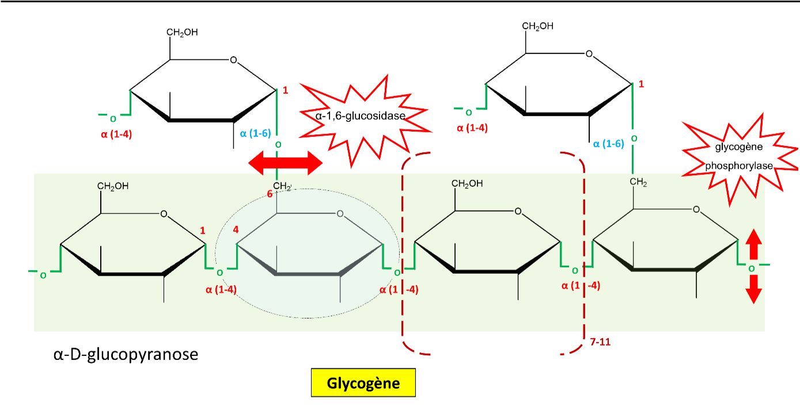
Le glycogène :
Polyoside de réserve du monde animal. Stocké au niveau du foie et du muscle
Structure identique à celle de l’amidon, mais ramifications tous les 8 à 10 résidus
Dégradation grâce aux phosphorylases et aux enzymes débranchantes.

Slide 73
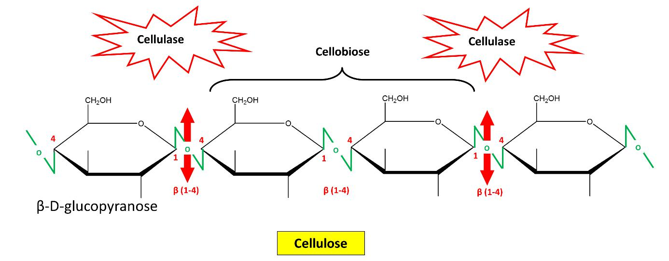
La cellulose :
Polyoside de structure du monde végétal
Enchaînement de D-glucoses en β (1→4)
L’organisme humain ne peut les dégrader
Liaisons coupées par les cellulases de certaines bactéries de l’appareil digestif des ruminants avec libération de β-D-glucose
Confère aux parois des cellules végétales leur rigidité.
50 % du bois
100 % du coton

Slide 74
III.3. Heterosides
Resulting from the association of the carbonyl of a ose with a non-carbohydrate fraction
Their classification is done according to the nature of the functional group of the aglycone involved in the ose bond
O-heteroside: sugar + alcoholic or phenolic hydroxyl (OH)
S-heteroside: ose + thiol group (SH)
N-heteroside: ose + NH2 group

Slide 75
III.4. Mucopolysaccharides (MPS)
Heterogeneous polyosides, polymerization of elementary disaccharide subunits
A molecule of hexuronic acid
A molecule of hexosamine carrying or not several sulfate groups
They have a very marked acidic character
They are always united with proteins

Slide 76
Structural MPS: Present in connective tissues.
Hyaluronic acid: present in all the connective ground substance. Sensitive to hyaluronidase which is a diffusion factor (therapeutic applications), facilitates the penetration of the spermatozoon into the egg during fertilization, penetration of pathogenic bacteria into the body.

Slide 77
Chondroitin: Structure and properties similar to those of hyaluronic acid.
C
OO-
O
C
H
2
O
H
H
O
O
O
H
4
OH
H
1
β
H
1
O
3
OH
H
OH
H
NH-CO-CH₃
Acide glucuronique
N-acétyl-glucosamine
Hyaluronic acid

Slide 78
Secretory MPS: Represented by heparin, its derivatives and mucoitin sulfates
Heparin and derivatives: Secreted by mast cells and endowed with anticoagulant properties
Mucins: In the mucus secreted by the glands of the digestive tract, the genital tract and the respiratory system

Slide 79
III.5. Glycoproteins (GCP)
Covalent union of a carbohydrate moiety (glycan) with a protein moiety
Biological importance
Constituents of plasma membranes
Support for recognition signals
Monosaccharide constituents
Neutral oses (D-galactose, D-xylose, etc.)
Osamines (D-glucosamine, D-galactosamine, etc.)
Uronic acids (D-glucuronic acid)
Sialic acids (N-acetylneuraminic acid)

Slide 80
III.6.Glycolipids (GCL)
Covalent union of a carbohydrate fraction with a lipid fraction
Existence of two poles
A hydrophilic pole: the larger it is, the more soluble the glycolipid is
A hydrophobic pole due to the lipid part
Notes:
Existence de cérébroglucosides

