Slide 1
Six sigma (basics and models) Course 14
محاضرات موجهة لطلبة السنة ثانية ماستر اقتصاد وتسيير المؤسسات
قسم العلوم الإقتصادية- جامعة بسكرة

Slide 2
Six sigma definitions
The six Sigma, is simply a TQM process that uses the process capability analysis as a way of measuring progress, where Sigma is the standard deviation.
The statistical aspects of six sigma of six sigma confirms, that we should reduce the process variability, and keep the process average centered on the targret. These concepts have been established by Shewhart, Deming and Taguchi earlier.
The Six Sigma represents a statistical measure and a management philosophy… it combines people power with process power…
The five phases of six sigma are: define the (process) problem, measure where you stand, analyse where the problem starts, improve the situation and control the new process to confirm that it is fixed- DMAIC (Dumb Managers Always Ignore Customers ) (Define, Measure, Analyze, Improve, Control )
the main thrust of six sigma, is to reduce errors and wastage, in every kind of business endeavor, to please the customers and widen the bottom line.

Slide 3
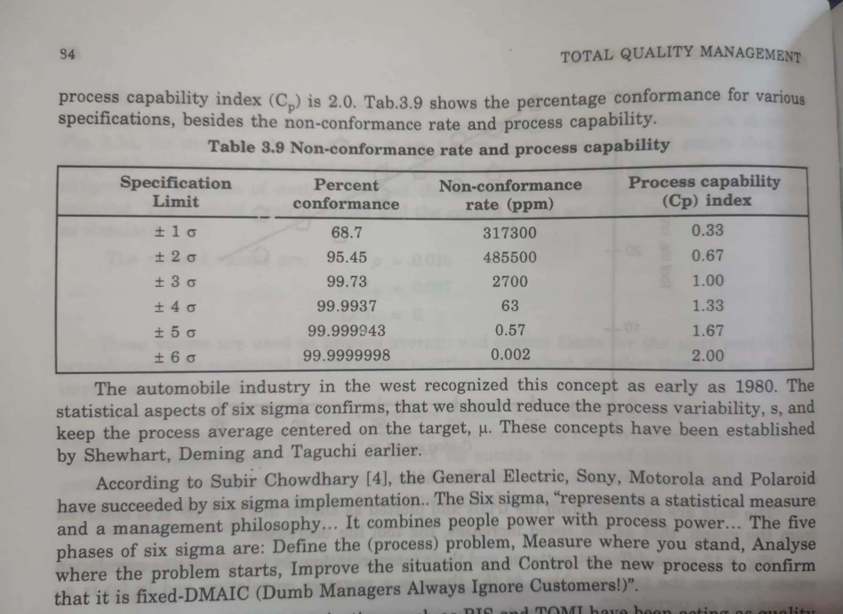

Slide 4
Six Sigma:
Six Sigma is a data-driven methodology that seeks to improve process efficiency and eliminate defects by identifying and removing the causes of variability. Therefore, it is based on the concept of reducing process variation to achieve higher levels of performance and customer satisfaction.
Key Elements:
Define, Measure, Analyze, Improve, Control (DMAIC): A structured problem-solving approach.
Statistical Tools: Using statistical methods to analyze and improve processes.
Belt System: Classifying individuals involved in Six Sigma projects into different “belts” (e.g., Black Belt, Green Belt) based on their level of expertise.
Example:
For instance, General Electric (GE) is a notable example of a company that has embraced Six Sigma. Under the leadership of Jack Welch, GE extensively applied Six Sigma methodologies to improve processes and achieve substantial cost savings.

Slide 5
Six Sigma
A business process for improving quality, reduce cost and increasing customer satisfaction.
Statistically
Having no more than 3.4 defects per million
Conceptually
Program designed to reduce defects
Requires the use of certain tools and techniques
EX: Motorola, GE, TI, Kodak

Slide 6
Six Sigma Programs
Six Sigma programs
Improve quality
Save time
Cut costs
Employed in
Design
Production
Service
Inventory management
Delivery

Slide 7
Six Sigma Management components:
Providing strong leadership
Defining performance merits
Selecting projects likely to succeed
Selecting and training appropriate people
Six Sigma Technical components:
Improving process performance
Reducing variation
Utilizing statistical models
Designing a structured improvement strategy

Slide 8
Six Sigma Team
Top management: essential
Program champions
Master “black belts”: tools
“Black belts”: pivotal role
implement process improvement projects, facility change convey knowledge to Green belts
“Green belts”
Six Sigma Process
Define Measure Analyze Improve Control

Slide 9
Basic Steps in Problem Solving
Define the problem and establish an improvement goal
Collect data
Analyze the problem
Generate potential solutions
Choose a solution
Implement the solution
Monitor the solution to see if it accomplishes the goal

Slide 10
Benefits:
Reduces defects and waste.
Improves customer satisfaction.
Enhances efficiency and productivity.
Lowers operational costs.
Fosters a culture of continuous improvement.
Application Areas:
Six Sigma is widely used in manufacturing, healthcare, finance, IT, and supply chain management to streamline operations and improve quality.

