Slide 1
Lecture starting soon

Slide 2
STATISTICS Quantitative Data Analysis in Applied Linguistics
LECTURE 8:
Correlation
Moustafa Amrate
Department of English, University of Biskra
moustafa.amrate@univ-biskra.dz

Slide 3
Types of advanced tests
Types of advanced tests
Difference
Relationship

Slide 4
Typical quantitative/ experimental design
Independent samples testing
Pretest
Pretest
Control group
Experimental group
Paired (related) sample testing
Paired sample testing
Independent samples testing
Posttest
Posttest

Slide 5
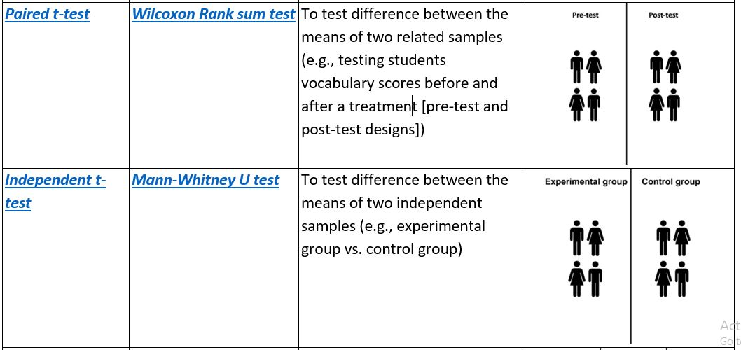
Classification of inferential statistical tests

Slide 6
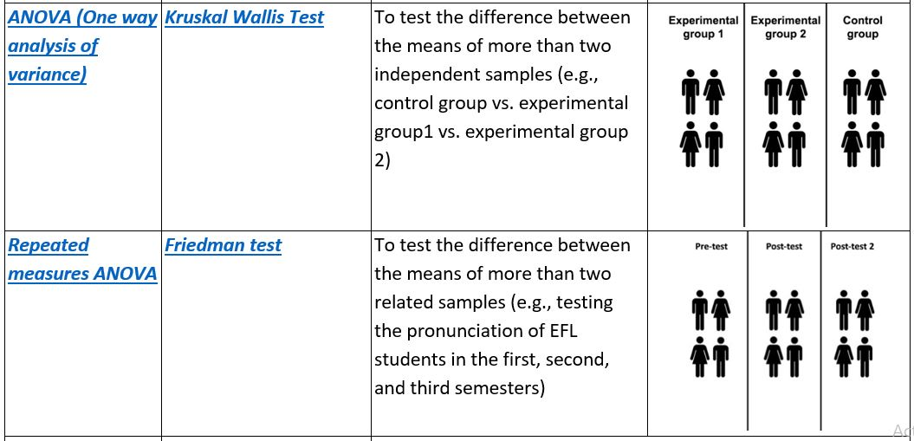
Classification of inferential statistical tests

Slide 7
Correlational research
A correlational research design investigates relationships between variables without the researcher controlling or manipulating any of them.

Slide 8
The concept of correlation
Correlation refers to statistical tests that investigate the degree to which two or more variables are linked (related) to each other.

Slide 9
The concept of correlation
Correlation refers to statistical tests that investigate the degree to which two or more variables are linked to each other.
For example, a correlational study in Applied Linguistics would look at the relationship between the number of years living in the uk and ESL/ EFL learners’ pronunciation accuracy.

Slide 10
Correlation ≠ causation
“Correlation research attempts to determine the relationship between or among variables; it does not determine causation”
(Mackey & Gass, 2015, p. 284)

Slide 11
Correlation ≠ causation
In other words, the fact that two variables are linearly linked to each other does not mean that one is causing the other.
Correlation does not always mean causation
For example, just because British people spend more money in shops during the winter, it does not mean that the cold temperature is causing people in the UK to spend more money. It just happened that the winter season coincides with the British holiday season, a period that is known for increased spending.

Slide 12
Example

Slide 13
Example

Slide 14
Detecting a correlation in descriptive statistics
Generally, correlations can be detected or noticed when summarizing and describing data. For example, the table below reports the percentage of public library members in relation to their social class.
Percentage of public library members by their social class origin
PUBLIC LIBRARY MEMBERSHIP | SOCIAL CLASS STATUS
 | Middle class | Working class
Member | 86% | 37%
Non-member | 14% | 63%
Total | 100% | 100%
(Adapted from Cohen, Manion, & Morrison, 2007, p. 529)
Cohen, L., Manion, L., & Morrison, K. (2002). Research methods in education. Routledge.

Slide 15
Detecting a correlation in descriptive statistics
Generally, correlations can be detected or noticed when summarizing and describing data. For example, the table below reports the percentage of public library members in relation to their social class.
Percentage of public library members by their social class origin
PUBLIC LIBRARY MEMBERSHIP | SOCIAL CLASS STATUS
 | Middle class | Working class
Member | 86% | 37%
Non-member | 14% | 63%
Total | 100% | 100%
(Adapted from Cohen, Manion, & Morrison, 2007, p. 529)
Cohen, L., Manion, L., & Morrison, K. (2002). Research methods in education. Routledge.

Slide 16
Detecting a correlation in descriptive statistics
Generally, correlations can be detected or noticed when summarizing and describing data. For example, the table below reports the percentage of public library members in relation to their social class.
Percentage of public library members by their social class origin
PUBLIC LIBRARY MEMBERSHIP | SOCIAL CLASS STATUS
 | Middle class | Working class
Member | 86% | 37%
Non-member | 14% | 63%
Total | 100% | 100%
(Adapted from Cohen, Manion, & Morrison, 2007, p. 529)
Cohen, L., Manion, L., & Morrison, K. (2002). Research methods in education. Routledge.

Slide 17
Classification of inferential statistical tests

Slide 18
Detecting a correlation in inferential statistics
Parametric correlation test
PEARSON CORRELATION
Numerical data
Non-parametric correlation test
SPEARMAN'S CORRELATION
Categorical data
Random sampling
Normal distribution of data
Homogeneous (similar) variances
Non-random sampling
Non-normal distribution of data
Heterogeneous (non similar) variances

Slide 19
Correlational tests are designed to answer the following questions:
1) Is there a relationship between two (or more) variables?
2) What is the direction of the relationship?
3) What is the strength of the relationship?

Slide 20
Interpreting correlation test results
1. The direction of a correlation
A correlation can either be positive or negative.
Positive correlations are prefaced with a plus sign (+) to indicate the positive nature of the relationship.
On the other hand, a negative correlation (-) is to be found when an increase in one variable is accompanied by a decrease in the other variable.

Slide 21
Interpreting correlation test results
2. The strength of a correlation
Correlation tests can give us:
No correlation,
Low correlation,
Medium correlation,
Strong correlation,
Perfect correction.
However, “perfect correlations of +1.00 or -1.00 [or even 0.00] are rarely found and most coefficients of correlation in social research are around +0.50 or less”.
(Cohen, Manion, & Morrison, 2007, p. 530)

Slide 22
2. The strength of a correlation

Slide 23
Classification of inferential statistical tests

Slide 24
Pearson correlation (r)
“Pearson product-moment correlation is the standard type, computed between two continuous (numerical) variables. When we talk about ‘correlation’ in general, this is what we usually mean. The Pearson product-moment correlation coefficient is symbolized by the lower-case letter ‘r’”
(Dornyei, 2007, p.224)

Slide 25
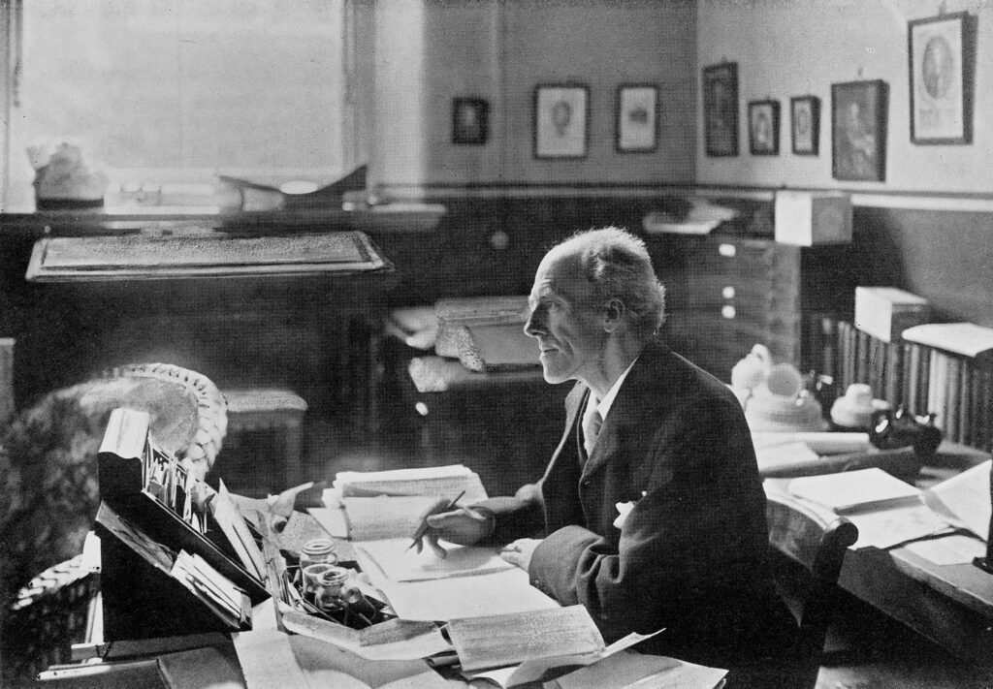
Karl Pearson (1857 - 1936)

Slide 26
Pearson correlation

Slide 27
Pearson correlation
Participants | Language learning experience | (xi - x̄) | (xi - x̄)^2 | Gramatical errors | (yi - ȳ) | (yi - ȳ)^2 | (xi - x̄) (yi - ȳ)
student 1 | 9 years |  |  | 37 errors
student 2 | 12 |  |  | 8
student 3 | 7 |  |  | 56
student 4 | 10 |  |  | 22
student 5 | 8 |  |  | 35
student 6 | 11 |  |  | 24
student 7 | 9 |  |  | 32
student 8 | 8 |  |  | 41

Slide 28
Pearson correlation
عدد سنوات تعلم لغة أجنبية
الأخطاء اللغوية
Participants | Language learning experience (x) | (xi - x̄) | (xi - x̄)^2 | Gramatical errors (y) | (yi - ȳ) | (yi - ȳ)^2 | (xi - x̄) (yi - ȳ)
student 1 | 9 |  |  | 37
student 2 | 12 |  |  | 8
student 3 | 7 |  |  | 56
student 4 | 10 |  |  | 22
student 5 | 8 |  |  | 35
student 6 | 11 |  |  | 24
student 7 | 9 |  |  | 32
student 8 | 8 |  |  | 41
مجموع قيم x
مجموع قيم y
معدل قيم x
معدل قيم y

Slide 29
Pearson correlation
عدد سنوات تعلم لغة أجنبية
الأخطاء اللغوية
Participants | Language learning experience | (xi - x̄) | (xi - x̄)^2 | Gramatical errors | (yi - ȳ) | (yi - ȳ)^2 | (xi - x̄) (yi - ȳ)
student 1 | 9 (xi) |  |  | 37
student 2 | 12 |  |  | 8
student 3 | 7 |  |  | 56
student 4 | 10 |  |  | 22
student 5 | 8 |  |  | 35
student 6 | 11 |  |  | 24
student 7 | 9 |  |  | 32
student 8 | 8 |  |  | 41
مجموع قيم x
74
مجموع قيم y
255
معدل قيم x
9.25
معدل قيم y
31.88

Slide 30
Pearson correlation
عدد سنوات تعلم لغة أجنبية
الأخطاء اللغوية
Participants | Language learning experience | (xi - x̄) | (xi - x̄)^2 | Gramatical errors | (yi - ȳ) | (yi - ȳ)^2 | (xi - x̄) (yi - ȳ)
student 1 | 9 | -0.25 |  | 37 | 5.12
student 2 | 12 | 2.75 |  | 8 | -23.88
student 3 | 7 | -2.25 |  | 56 | 24.12
student 4 | 10 | 0.75 |  | 22 | -9.88
student 5 | 8 | -1.25 |  | 35 | 3.12
student 6 | 11 | 1.75 |  | 24 | -7.88
student 7 | 9 | -0.25 |  | 32 | 0.12
student 8 | 8 | -1.25 |  | 41 | 9.12
مجموع قيم x
74
مجموع قيم y
255
معدل قيم x
9.25
معدل قيم y
31.88

Slide 31
Pearson correlation
عدد سنوات تعلم لغة أجنبية
الأخطاء اللغوية
Participants | Language learning experience | (xi - x̄) | (xi - x̄)^2 | Gramatical errors | (yi - ȳ) | (yi - ȳ)^2 | (xi - x̄) (yi - ȳ)
student 1 | 9 | -0.25 |  | 37 | 5.12 |  | -1.28
student 2 | 12 | 2.75 |  | 8 | -23.88 |  | -65.67
student 3 | 7 | -2.25 |  | 56 | 24.12 |  | -54.27
student 4 | 10 | 0.75 |  | 22 | -9.88 |  | -7.41
student 5 | 8 | -1.25 |  | 35 | 3.12 |  | -3.90
student 6 | 11 | 1.75 |  | 24 | -7.88 |  | -13.79
student 7 | 9 | -0.25 |  | 32 | 0.12 |  | -0.03
student 8 | 8 | -1.25 |  | 41 | 9.12 |  | -11.40
مجموع قيم x
74
مجموع قيم y
255
-157.75
معدل قيم x
9.25
معدل قيم y
31.88

Slide 32
Step 4
………
-157.75
Step 1
--------
×
-----------
………….
Step 2
…………..
………….
Step 3
…………

Slide 33
Pearson correlation
عدد سنوات تعلم لغة أجنبية
الأخطاء اللغوية
Participants | Language learning experience | (xi - x̄) | (xi - x̄)^2 | Gramatical errors | (yi - ȳ) | (yi - ȳ)^2 | (xi - x̄) (yi - ȳ)
student 1 | 9 | -0.25 | 0.06 | 37 | 5.12 | 26.21 | -1.28
student 2 | 12 | 2.75 | 7.56 | 8 | -23.88 | 570.25 | -65.67
student 3 | 7 | -2.25 | 5.06 | 56 | 24.12 | 581.77 | -54.27
student 4 | 10 | 0.75 | 0.56 | 22 | -9.88 | 97.61 | -7.41
student 5 | 8 | -1.25 | 1.56 | 35 | 3.12 | 9.73 | -3.90
student 6 | 11 | 1.75 | 3.06 | 24 | -7.88 | 62.09 | -13.79
student 7 | 9 | -0.25 | 0.06 | 32 | 0.12 | 0.01 | -0.03
student 8 | 8 | -1.25 | 1.56 | 41 | 9.12 | 83.17 | -11.40
مجموع قيم x
74
19.50
مجموع قيم y
255
1430.88
-157.75
معدل قيم x
9.25
معدل قيم y
31.88

Slide 34
Step 4
………
-157.75
Step 1
19.50
×
1430.88
………….
Step 2
…………..
………….
Step 3
…………

Slide 35
Step 4
-0.94
-157.75
-----------------------------------------
Step 1
19.50
×
1430.88
-157.75
Step 2
27902.16
-157.75
Step 3
167.04

Slide 36
Interpretation of Pearson correlation

Slide 37
Step 4
-0.94
-157.75
Very high negative correlation
Step 1
19.50
×
1430.88
-157.75
Step 2
27902.16
-157.75
Step 3
167.04

Slide 39
The Spearman (rank) correlation (P)
The Spearman correlation is the non-parametric equivalent for the Pearson correlation. “As the name suggests, the correlation is based on the ranks of the data (in a rank order) rather than the actual [numerical] values”
(Dornyei, 2007, p. 230)
In other words, this test is used when the data of the variables being correlated do not meet the conditions for parametric tests

Slide 40
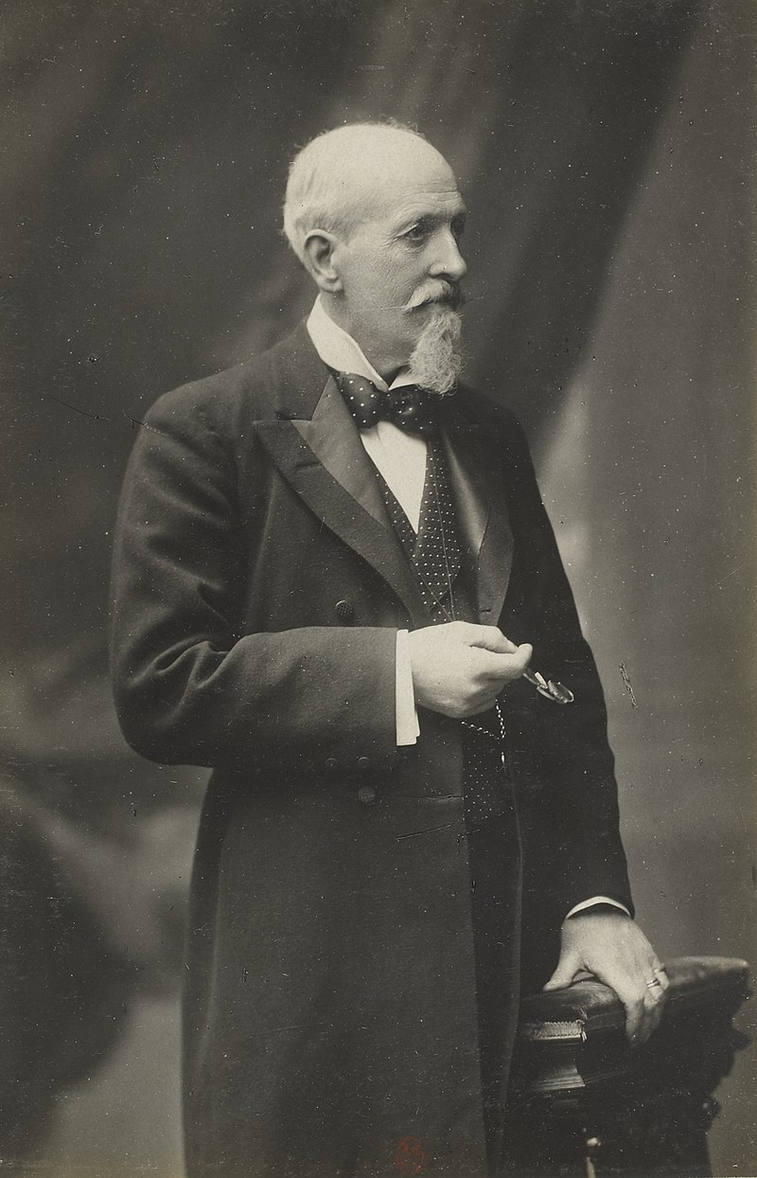
Charles Edward Spearman (1863 -1945)

Slide 41
The Spearman correlation

Slide 42
The Spearman correlation 1 = Never ………5 = Always
Participants | Library use frequency | Rank | Grammatical errors | Rank | d
student 1 | 1 |  | 37
student 2 | 2 |  | 8
student 3 | 2 |  | 56 | 1
student 4 | 4 | 2 | 22
student 5 | 3 |  | 35
student 6 | 3 |  | 24
student 7 | 5 | 1 | 32
student 8 | 3 |  | 41

Slide 43
The Spearman correlation
Participants | Library use frequency | Rank | Grammatical errors | Rank | d
student 1 | 1 | 8 | 37 | 3
student 2 | 2 | (6) 6.5 | 8 | 8
student 3 | 2 | (7) 6.5 | 56 | 1
student 4 | 4 | 2 | 22 | 7
student 5 | 3 | (3) 4 | 35 | 4
student 6 | 3 | (4) 4 | 24 | 6
student 7 | 5 | 1 | 32 | 5
student 8 | 3 | (5) 4 | 41 | 2

Slide 44
The Spearman correlation
Participants | Library use frequency | Rank | Grammatical errors | Rank | d
student 1 | 1 | 8 | 37 | 3 | 5 | 25
student 2 | 2 | 6 (6.5) | 8 | 8 | .. | ..
student 3 | 2 | 7 (6.5) | 56 | 1 | .. | ..
student 4 | 4 | 2 | 22 | 7
student 5 | 3 | 3 (4) | 35 | 4
student 6 | 3 | 4 (4) | 24 | 6
student 7 | 5 | 1 | 32 | 5
student 8 | 3 | 5 (4) | 41 | 2

Slide 45
The Spearman correlation
Participants | Library use | Rank | Gramatical errors | Rank | d
student 1 | 1 | 8 | 37 | 3 | 5 | 25
student 2 | 2 | 6.5 | 8 | 8 | .. | ..
student 3 | 2 | 6.5 | 56 | 1 | .. | ..
student 4 | 4 | 2 | 22 | 7 | .. | ..
student 5 | 3 | 4 | 35 | 4 | .. | ..
student 6 | 3 | 4 | 24 | 6 | .. | ..
student 7 | 5 | 1 | 32 | 5 | .. | ..
student 8 | 3 | 4 | 41 | 2 | .. | ..

Slide 46
The Spearman correlation
Participants | Library use | Rank | Gramatical errors | Rank | d
student 1 | 1 | 8 | 37 | 3 | 5 | 25
student 2 | 2 | 6.5 | 8 | 8 | -1.5 | 2.25
student 3 | 2 | 6.5 | 56 | 1 | 5.5 | 30.25
student 4 | 4 | 2 | 22 | 7 | -5 | 25
student 5 | 3 | 4 | 35 | 4 | 0 | 0
student 6 | 3 | 4 | 24 | 6 | -2 | 4
student 7 | 5 | 1 | 32 | 5 | -4 | 16
student 8 | 3 | 4 | 41 | 2 | 2 | 4
106.50

Slide 47
………
Step 4
6 × 106.50
Step 1
8 (8² – 1)
……….
Step 2
…….
………
Step 3

Slide 48
- 0.27
Step 4
---------------------------------------
6 × 106.50
Step 1
8 (8² – 1)
639
Step 2
504
1.27
Step 3

Slide 49
Spearman correlation interpretation

Slide 50
- 0.27
Step 4
Weak negative relationship
6 × 106.50
Step 1
8 (8² – 1)
639
Step 2
504
1.27
Step 3

Slide 52
Thank you for attending!
Q& A

