Slide 1
Chapter IV: Sampling in cultivated fields

Slide 2
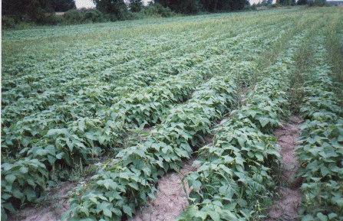

Slide 3
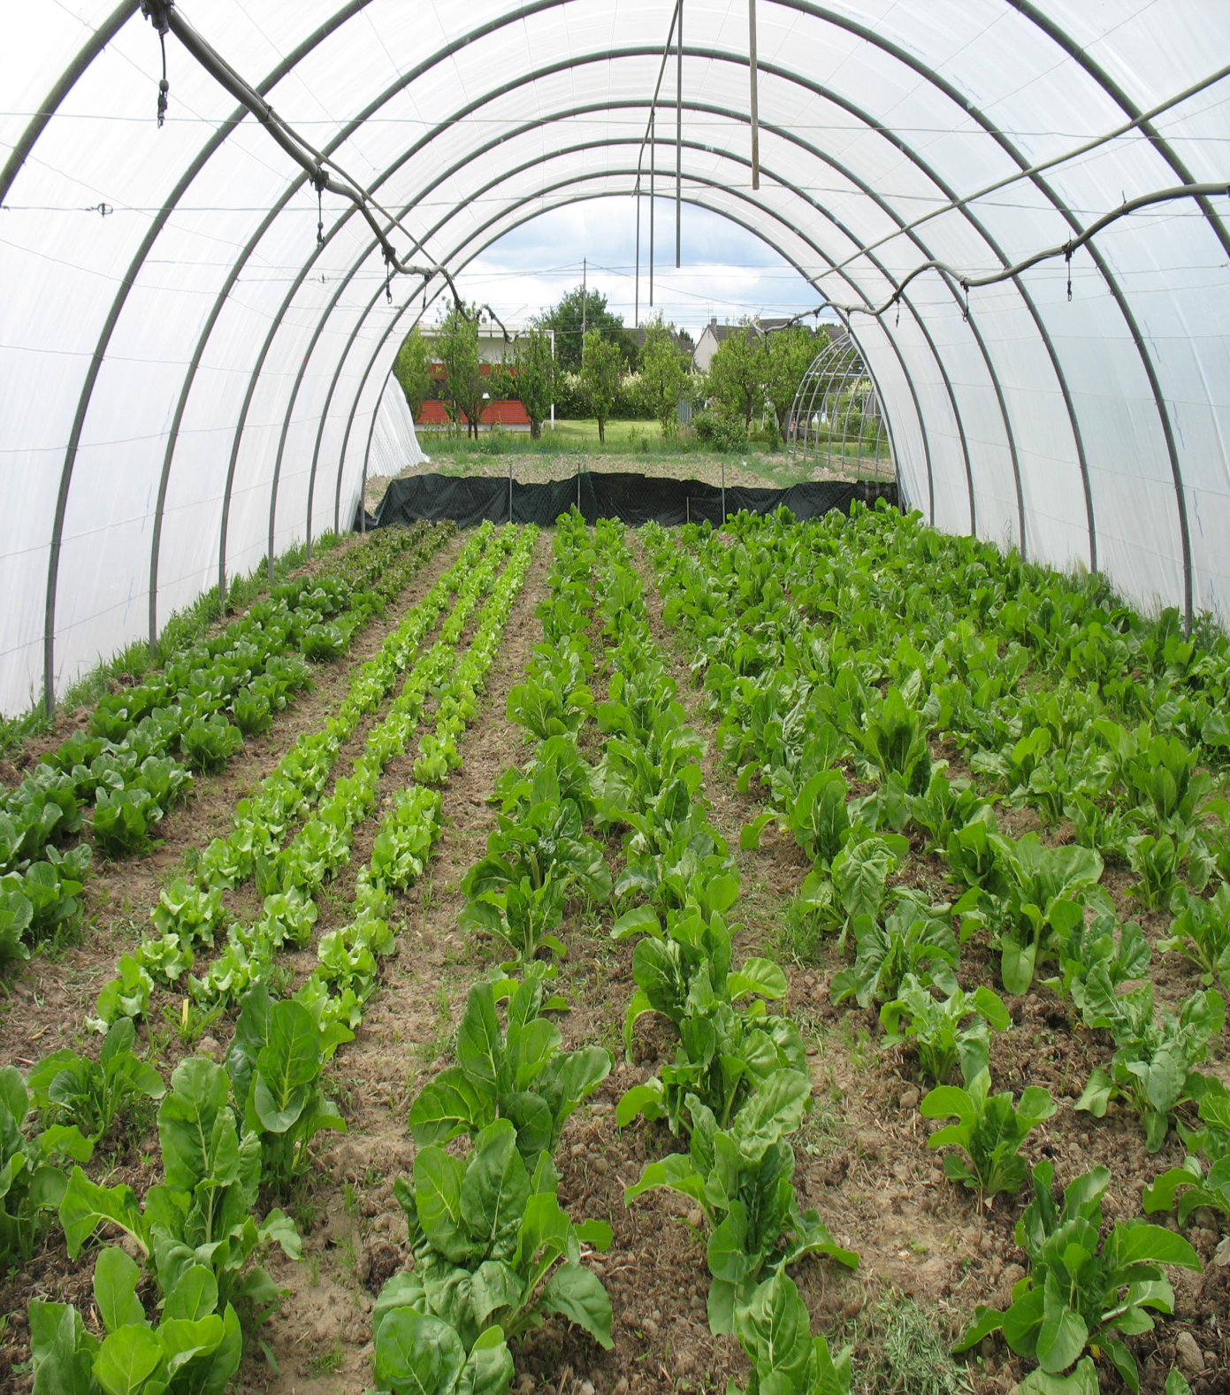

Slide 4
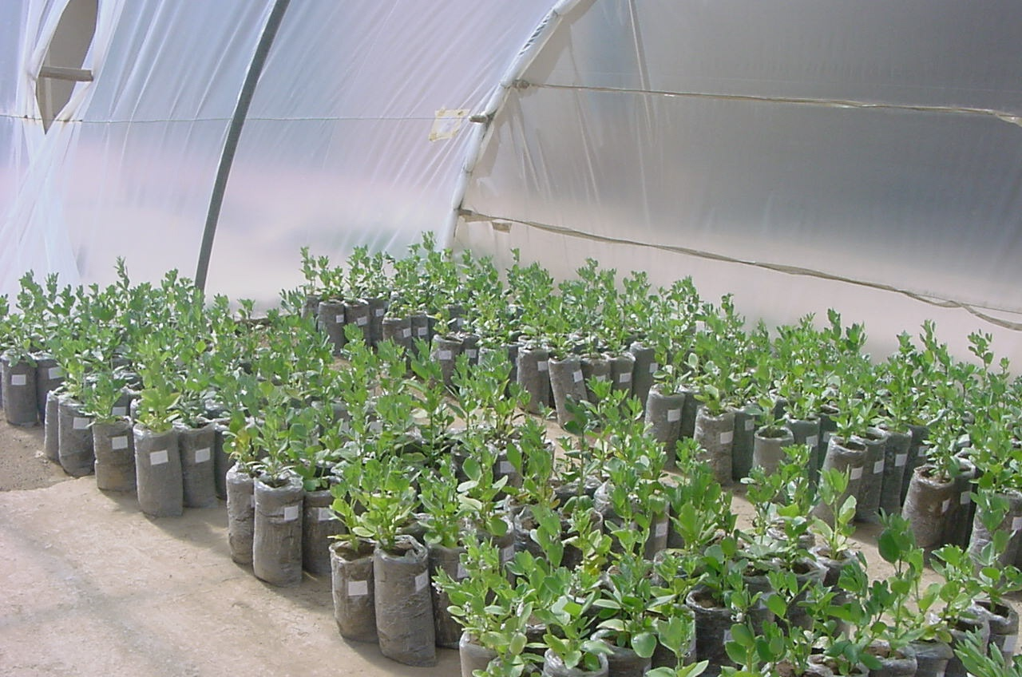

Slide 5
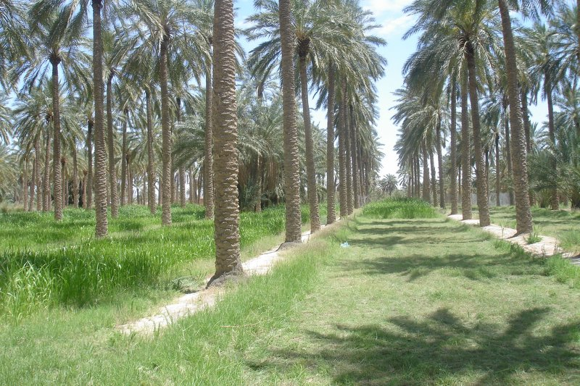

Slide 6
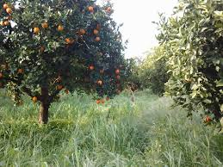

Slide 7
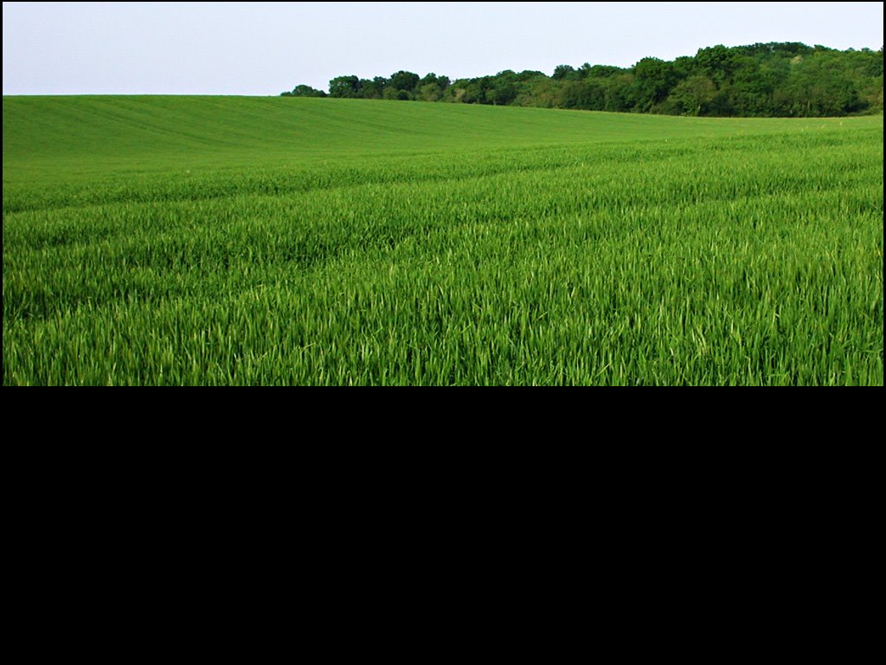

Slide 8
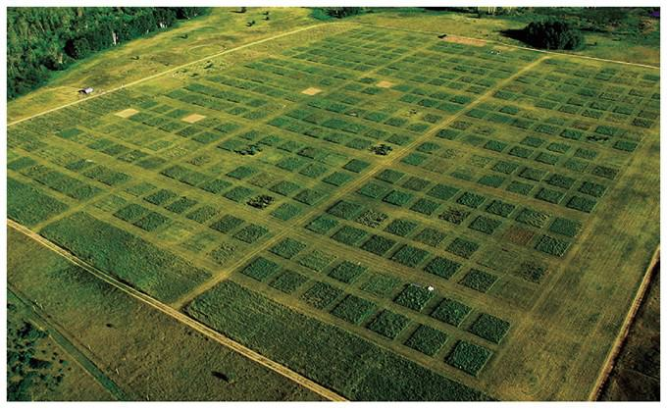

Slide 9
In the biotic part: Biocoenosis (living beings)

Slide 10
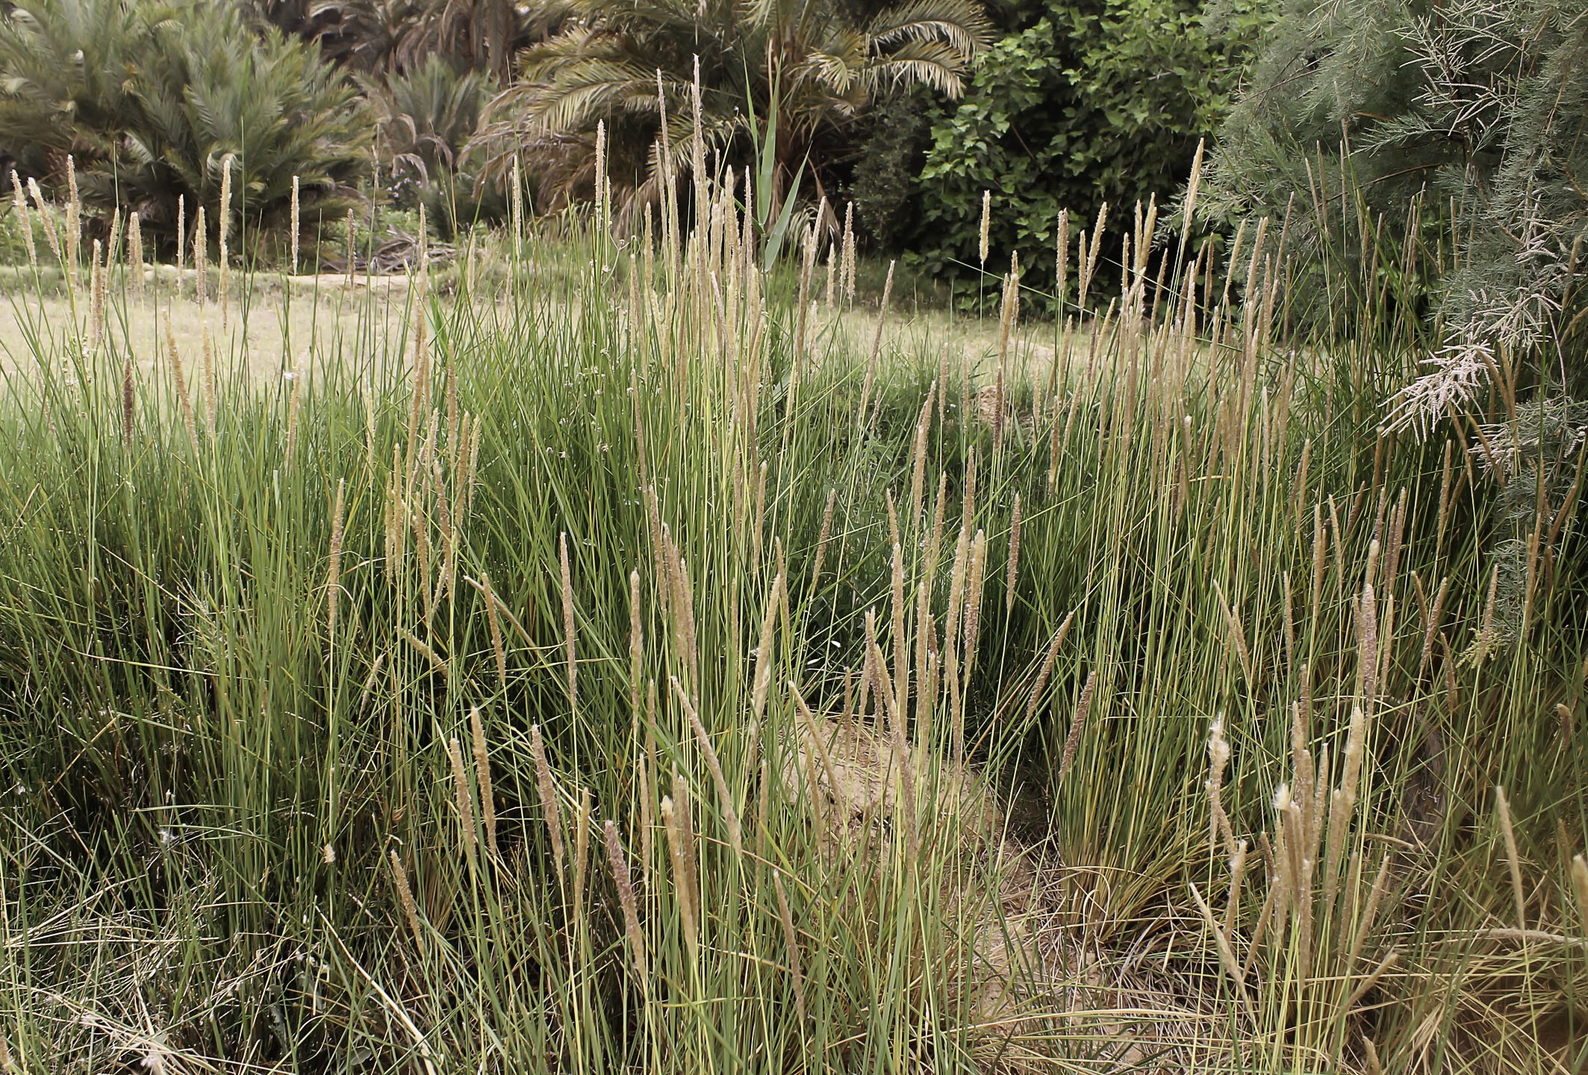
Species: Imperata cylindrica L. Family: Poaceae

Slide 11
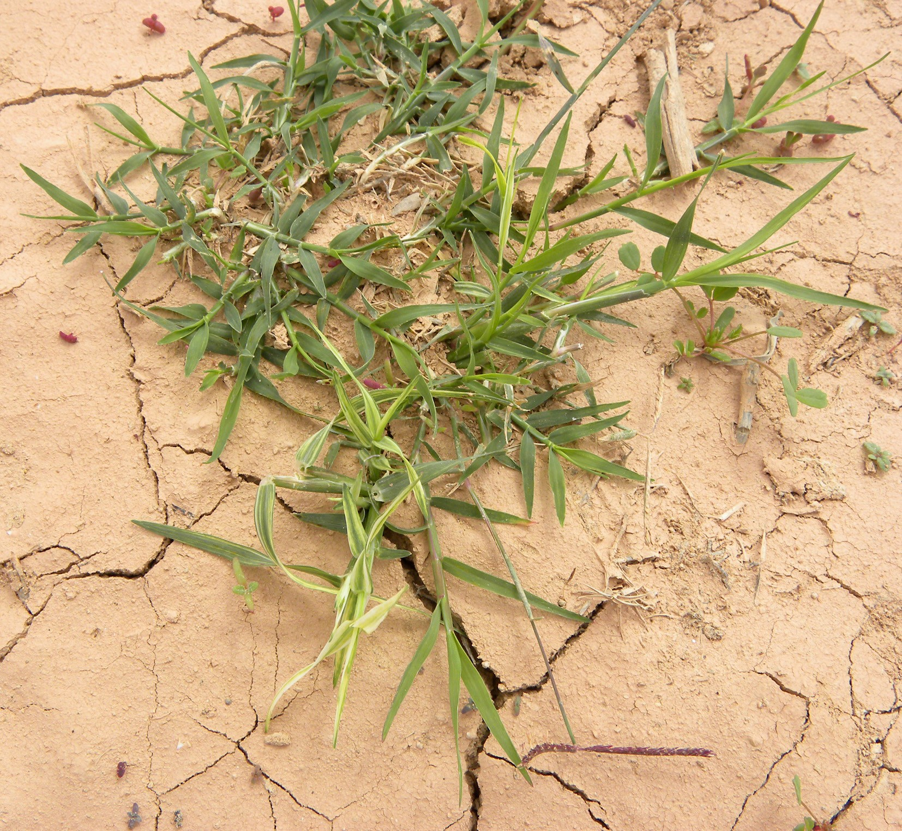
Species: Cynodon dactylon L. Family: Poaceae

Slide 12
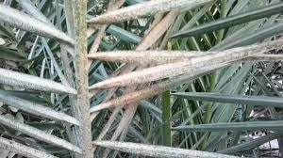
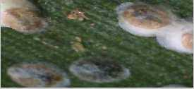
Species: Parlatoria blanchardi L. Family: Poaceae

Slide 13
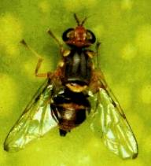
Species: Bactrocera oleae G. Family: Tephritidae.

Slide 14
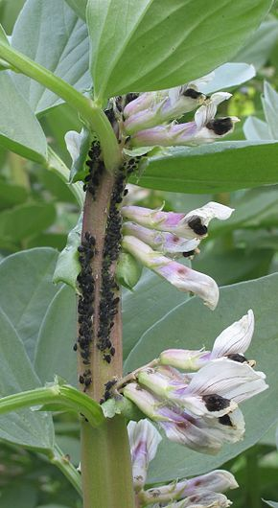
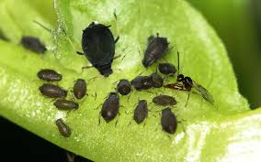
Species: Aphis fabae Scop. Family: Aphididae.

Slide 15
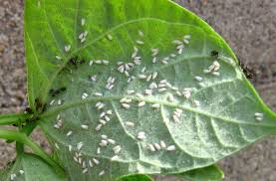
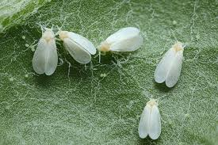
Species: Trialeurodes vaporariorum. Family: Aleyrodidae.

Slide 16
How to do that ???

Slide 17
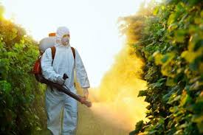

Slide 18
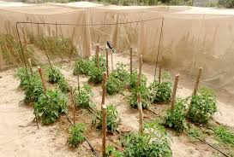
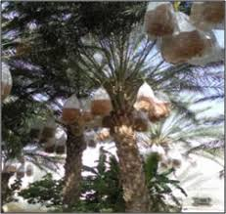
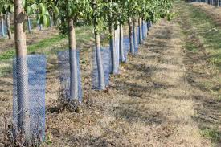
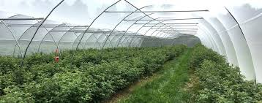

Slide 19
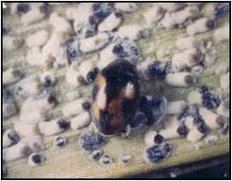
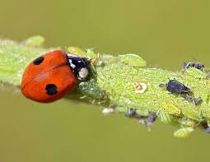
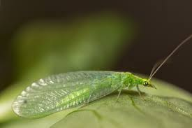
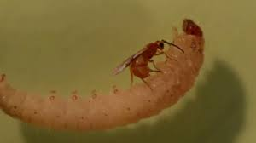

Slide 20
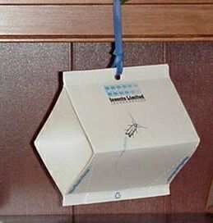
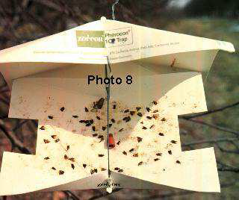
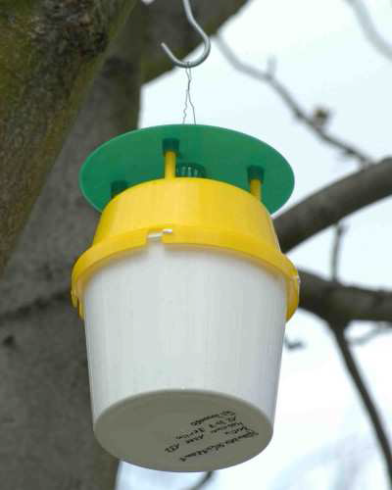
Pheromone traps
Use sex pheromones to attract certain species (usually males). Disadvantage: high cost
Phéromone = substance sécrétée par un individu et qui agit, par son odeur distinguée, sur le comportement d’un autre individu

Slide 21
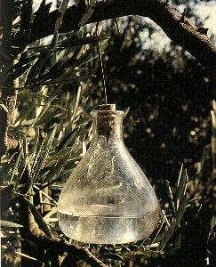
Different types of traps

Slide 22
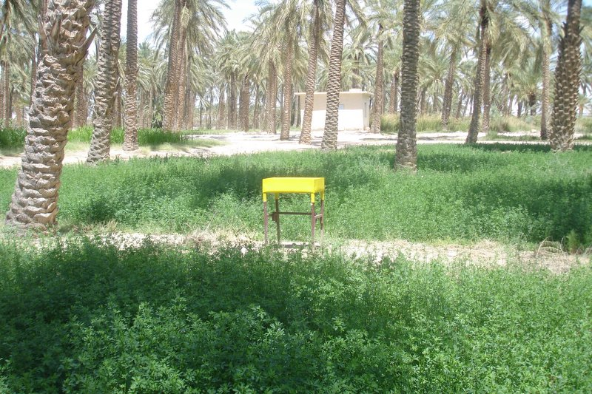
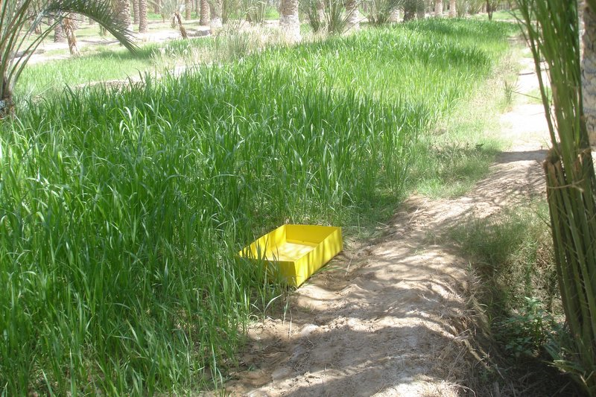
1. Yellow bins

Slide 23
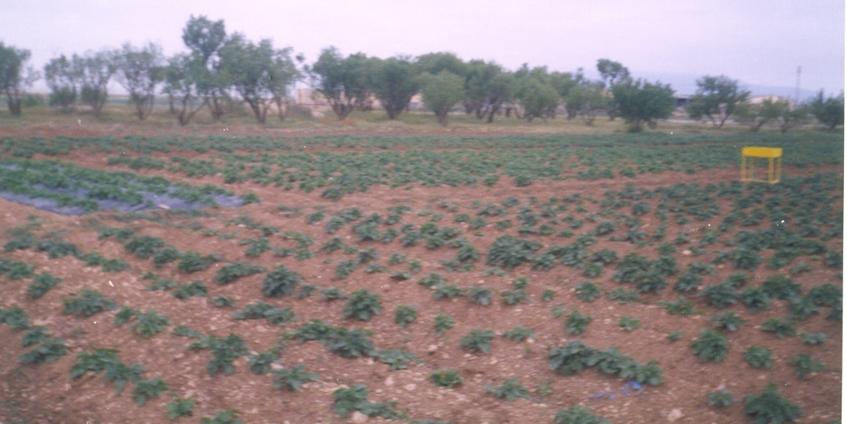
Placed on the floor
Placed 0.7 m above the ground
0,4 m
0,15 m
0,6 m
6 rectangular traps 3 placed on the ground and 3 at 0.7 m above the ground

Slide 24
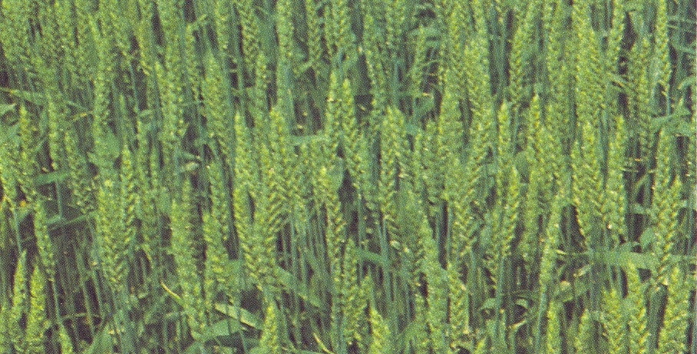
Methodology - Insect trapping - Sampling of cereal tillers (ANGLADE et al., 1977)
4 small plots of 100 m²
25 tillers taken per plot
4 m
25 m

Slide 25
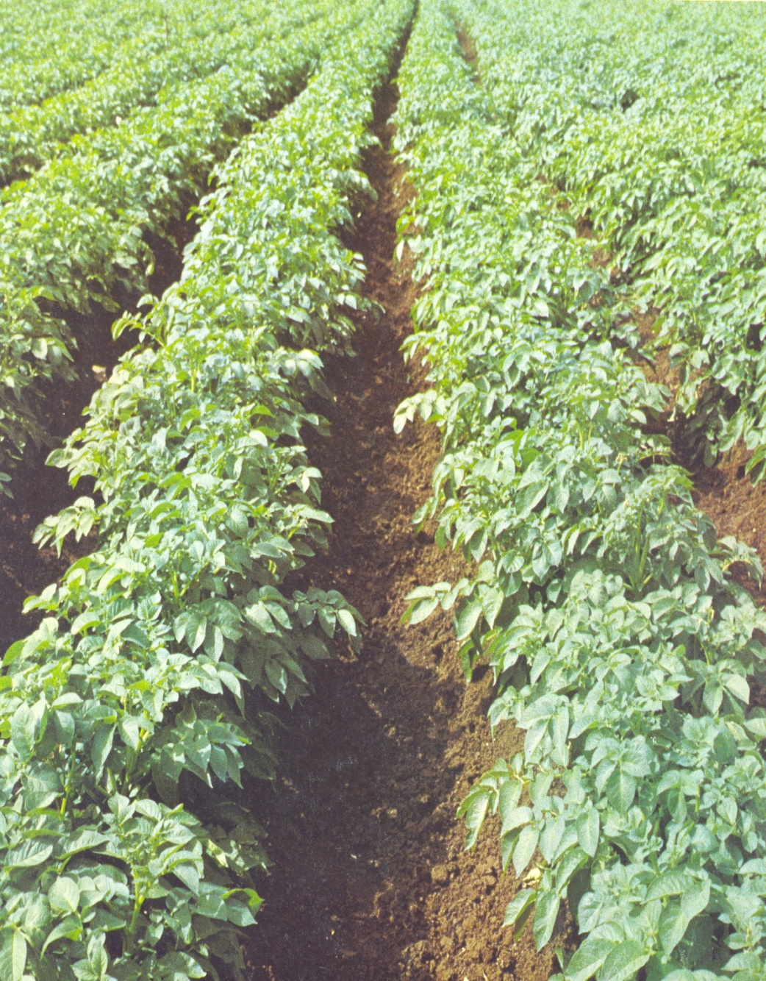
a. Tenth Plant Method Average number of aphids per plant = ∑ y x 10 N y: number of aphids on the leaf examined. N: Number of plants examined
Top Counting
2. Leaf sampling
20th plant
10th plant
Low Counting
Top Counting
1er plans

Slide 26
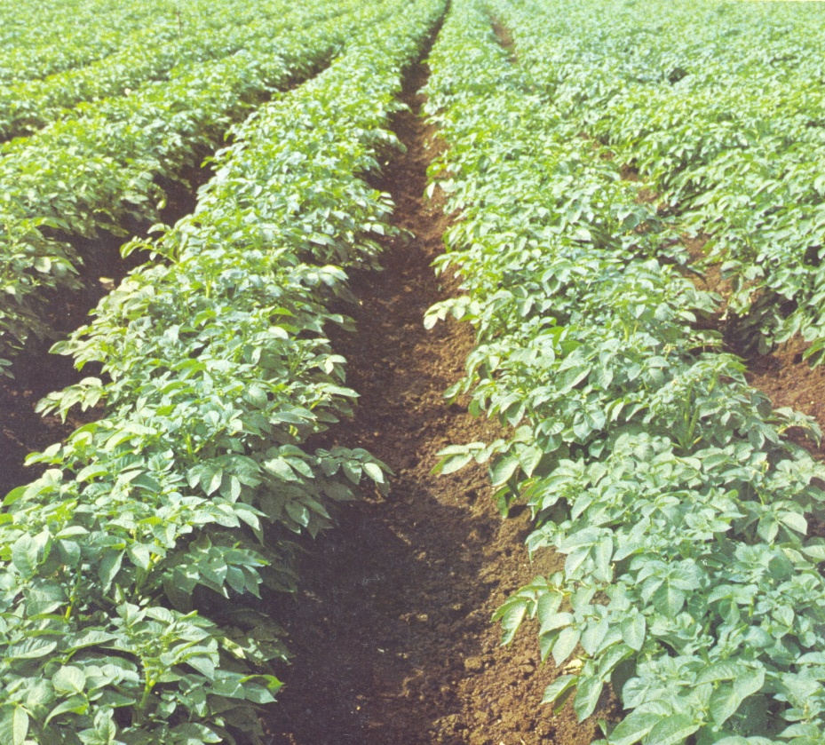
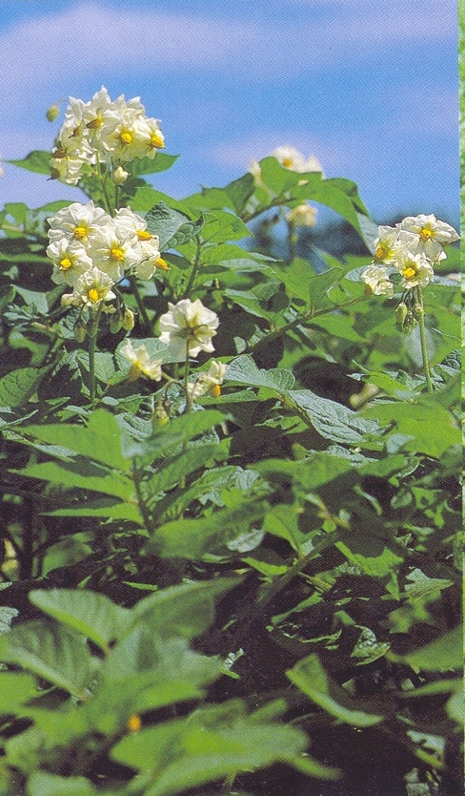
b. 100-sheet method
20th plant
Upper floor (1 sheet)
10th plant
Middle floor (1 sheet)
1st plant
Lower Floor (1 sheet)
Total of 100 leaves per leaf stage

Slide 27
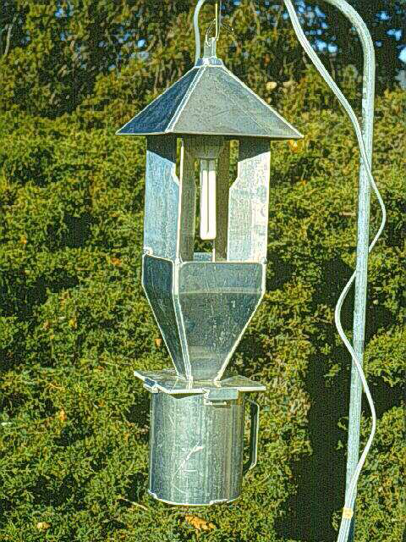
3. Light traps
Highly selective: only for species that are attracted to light. Allows you to compare different strata of the same environment (herbaceous, shrubby and tree). Allows you to compare population variations during the night or season. n individuals for a period of time t at a given time during the night.

Slide 28
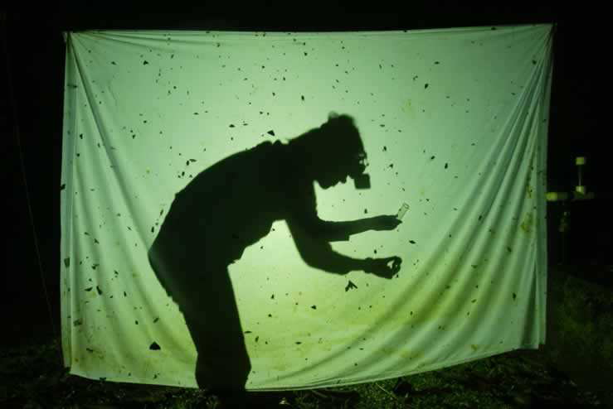
Light trap made easy Only allows manual and selective collection (no real usable numerical results)

Slide 29
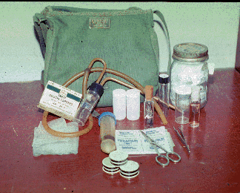
4. Vacuum cleaner

Slide 30
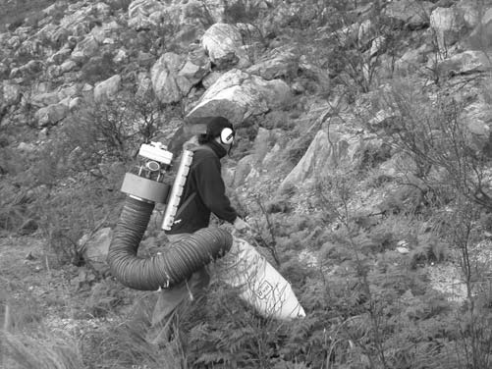
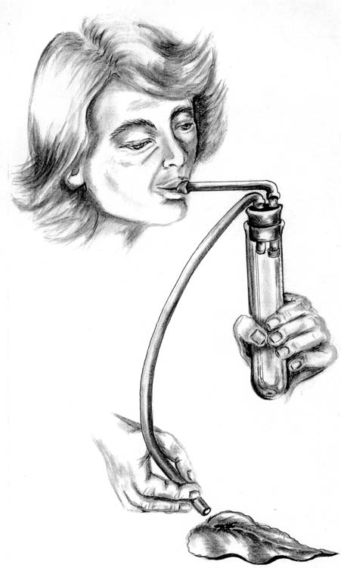

Slide 31
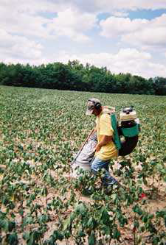
Gives much more accurate results than the mower net.
Effective for insects living on low plants (cultivated fields, grasses).

Slide 32
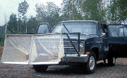
Zoom-Zoom Method!!! Astonishing, but not so stupid... Interesting results can be obtained on "aerial plankton".

Slide 33
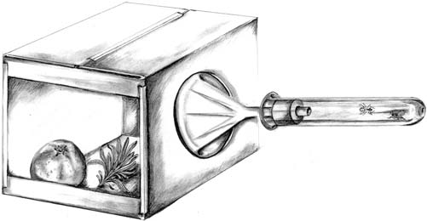
Other techniques

Slide 34
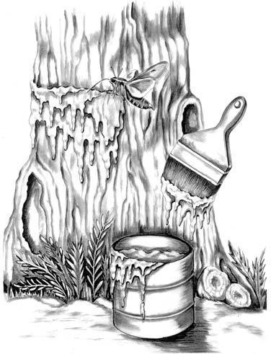
Other techniques
Is the smearing of a tree trunk with a mixture of molasses or molasses with a little alcohol. It can be very effective in attracting certain species of insects, especially moths, with different species attracted to different recipes and different tree trunk heights.

Slide 35
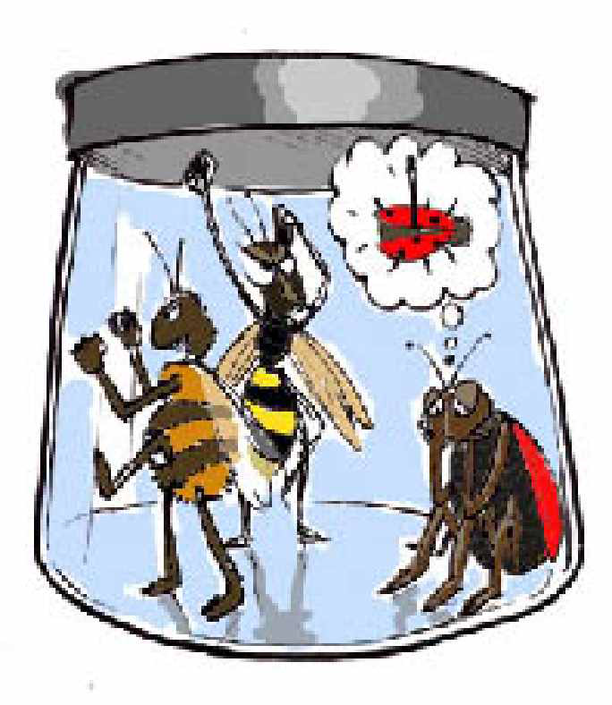

Slide 36
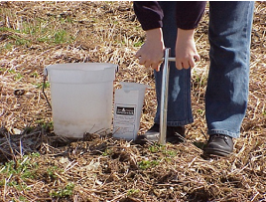
In the abiotic part:
Biotope (Water, Area, and Soil)

Slide 37
The temporal distribution (is based on specific periods that can influence the phenomena studied)
Spatial distribution (can be made in different geometric arrangements)
The purpose of the sampling protocol in the abiotic part of cultivated fields is to collect the essential abiotic parameters for assessing the quality of the agricultural environment (soil, water, climate). These data help to diagnose production constraints and guide cultural practices. Sampling is planned according to a logical spatial (grid or W) and temporal (by stage of the crop cycle) distribution.
Grid Sampling:
Sampling follows a regular grid pattern, often square or rectangular, where the points are evenly spaced. This method is particularly useful when it is necessary to ensure uniform coverage of the study area.
W (W Sampling): Sampling follows a specific "W" shaped distribution, where the points are placed according to a logic of steps or curves. It is sometimes used to capture specific variations or to examine more complex geographic patterns.
The seasons: Sampling is done at different times of the year, to capture seasonal variations. This is commonly used in agricultural, ecological, or climate studies where seasonal changes can affect the results. Each season (spring, summer, autumn, winter) can be used to observe temporal variations on the variables of interest.
The stages of the cultural cycle: In agricultural studies, the stages of the crop cycle (sowing, growing, maturing, harvesting) are often used as reference points for sampling. This makes it possible to monitor the evolution of the crop throughout its life cycle and to observe how external factors (weather, environmental, etc.) influence yield at different stages.

Slide 38
1- Materials needed
Manual auger or corer Plastic bags or sterile boxes, Probe thermometer and soil hygrometer Portable Conductivity Meter Portable pH meter or strips Sample vials (water) Labels, field notebook, collection sheets Weather station or handheld sensors Portable GPS or smartphone with geolocation app

Slide 39
2- Objective of abiotic sampling
Collect reliable data on non-living physicochemical parameters affecting crop development (soil, water, local climate).
2.1. Soil samples:
Depth: 0–20 cm (surface horizon); possibly 20–40 cm. Number of Samples: Minimum 5 points mixed for a composite sample. Measured parameters: pH, electrical conductivity, organic matter content, texture (sand, silt, clay), nutrient content (N, P, K), moisture content.
2.3. Climate measurements (station or manual): Ambient Temperature (morning and afternoon), Relative humidity, Wind speed and direction (if possible), Rainfall (historical), Solar radiation (if available).
2.2. Water samples (if irrigation or groundwater): Source: wells, canals, drip irrigation, water table. Measured parameters: pH, electrical conductivity, nitrates, phosphates, temperature, turbidity

Slide 40
2.4. Field forms to be completed:
Floor sheet
Date | Code | GPS | Depth | Color | Texture | Humidity | pH | EC | Remarks
Water sheet
Date | Code | Source | Temperature | pH | EC | NO₃⁻ | PO₄⁻ | Turbidity | Observations
Climate sheet
Date | Hour | Temperature | HR | Wind | Rain | Remarks

Slide 41
EX: Soil Sampling Protocol
Soil sampling can be done at any time of the year, as long as the results are available in time to develop fertilizer and manure application recommendations. The preferred sampling period is fall. Early fall sampling allows lime to be applied as needed, but post-harvest sampling in late fall allows samples to be analyzed and results available in time to plan for the next growing season.

Slide 42
1- Operational approach
1.4. Field Measurements
Soil temperature: measured with a probe for 2 minutes. Humidity: measured with a sensor or by the gravimetric method. pH: measured directly or in aqueous suspension. Electrical conductivity: measured in a soil-water suspension (1:2). 1.5. Climatic conditions Note the ambient temperature, sunshine, wind, and sky conditions.
1.1. Site definition:
Identify the plot: contact details, type of crop, management method (irrigation, fertilization).
1.2. Terrain networking:
Divide the land into homogeneous areas. Choose representative sampling points according to a defined grid.
1.3. Soil sampling:
Sample at different depths (0–20 cm, 20–40 cm). Homogenize multiple samples for a composite sample. Avoid the edges of the plot.

Slide 43
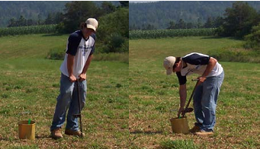
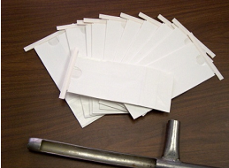
2- Tools needed
To obtain representative samples, you can use an auger or a probe. Some farmers drill a hole in a flat plastic container and use a cordless drill to take a sample through the hole.
Sampling buckets should be made of stainless steel or plastic. Sample bags should be free of contaminants and samples should be kept in a cool, dry place.

Slide 44
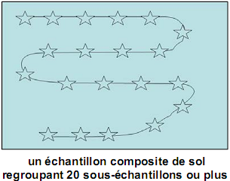
3- Sample Collection Methods
The following is a description of three soil sampling methods that are commonly used in the province depending on the degree of variability within the field.
3. 1. Composite Sample: The most common method of sample collection is to take a random sample from the field without regard to the topography or other characteristics of the field. This method works well in fields that have a consistent track record of soil type, production and management.

Slide 45
3.2. Laminated composite sample: A field may be subdivided into areas with similar topography and management history or similar crop performance. Each area is then sampled separately.

Slide 46
3.3. Systematic (grid) sampling: Sampling points are established in advance at fixed intervals in a field, such as one point per hectare. Four or five sub-samples are then taken near each point, and there is now a soil sample and a specific result for each point. With this information, a fertility map can be developed for the field that shows areas with similar fertility.
This method can be advantageous for high-value crops or crops that are sensitive to certain nutrients or pH. When a soil has a high nutrient content, this sampling method is probably less advantageous. It requires the use of a GPS device.

Slide 47
4- Preparation of a composite soil sample
After collecting 20 to 30 sub-samples from the field in a bucket, remove any crop debris or stones, grind the clods and mix well. After mixing samples, place 500 mL (2 cups) of soil in a sample bag with the field identification number, date of collection and grower's name.
Verify with the selected laboratory that the sample will be analyzed using methods generally used for the region.

